Slide 1
MPCA LAB MINI PROJECT
PROJECT TITLE: Arduino NiMh controlled battery charger with text display
SECTION: D
STUDENTS NAME: NIKHIL M A
NIKHIL VR
NISHANTH M
NISHANTH JC
SRN’s: PES2UG19CS257
PES2UG19CS258
PES2UG19CS264
PES2UG19CS263

Slide 2
PROBLEM STATEMENT
Create an Arduino Controlled Battery Charger
An Arduino and attached charging circuit is used to monitor and control the charging of NiMH rechargeable batteries

Slide 3
INTRODUCTION
Rechargeable batteries are a great way to power your portable electronics. They can save you a lot of money and when properly recycled, they are much better for the environment. In order to get the most out of your rechargeable batteries, they need to be properly charged. That means that you need a good charger. One could spend a lot of money on a commercial charger, but it's much more fun to build one by ourselves. So here is how we build an Arduino controlled battery charger that shuts down if any safety hazards are present.

Slide 4
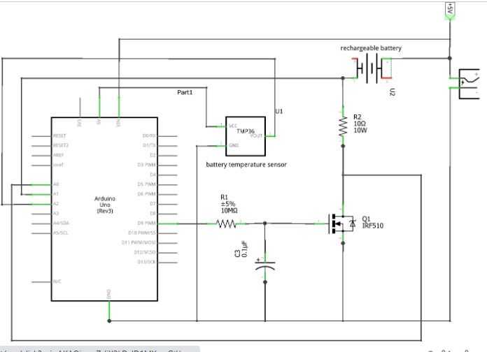
BLOCK DIAGRAM

Slide 5
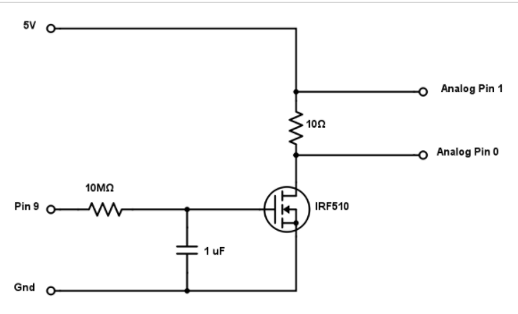
THE CHARGING CIRCUIT

Slide 6
REQUIRED COMPONENTS
Arduino Microcontroller
NiMH AA Battery
10 ohm Power Resistor (rated for at least 5 watts)
1 Mohm resistor
1 µF Capacitor
IRF510 MOSFET
TMP36 Temperature Sensor
5V Regulated Power Supply
Prototyping Breadboard
Wires

Slide 7
PROJECT DESCRIPTION
The circuit design for this charger is a basic Arduino controlled power supply. The circuit is powered by a 5-volt regulated voltage source such as an AC adapter or an ATX computer power supply. Most USB ports would not appropriate for this project because of the current limitations. The 5V source charges the battery through a 10 ohm power resistor and a power MOSFET. The MOSFET sets how much current is allowed to flow into the battery. The resistor is included as an easy way to monitor the current. This is done by connecting each terminal to analog input pins on the Arduino and measuring the voltage on each side. The MOSFET is controlled by a PWM Output pin on the Arduino. The pulses of the pulse width modulation signal are smoothed out into a steady voltage signal by a 1M resistor and a 1 µF capacitor. This circuit allows the Arduino to monitor and control the current flowing into the battery.

Slide 8
PROJECT DESCRIPTION
As an extra precaution, we included a TMP36 temperature sensor to monitor the temperature of a battery. This sensor outputs a signal voltage that directly corresponds to the temperature. So it doesn’t require calibration or balancing like a thermistor does. The sensor is placed as close to the battery as possible to get the correct temperature reading. The pins of the sensor are then connected 5V, GND, and an analog input pin on the Arduino.
The safety parameters of the battery is set to 1.5V ,maximum allowable temperature is set to 35 degrees celsius and the charging time is set to 13 hours. If any of the safety parameters exceed the threshold or if the battery charger finishes its charging time, then the LED will start flickering and an appropriate message is displayed on the LCD screen.

Slide 9
APPLICATIONS
Many battery chargers do not provide efficient and reliable charging cycles. This means the charger may leave the battery improperly charged, which can reduce the battery’s life and possibly damage the battery. Hence and Arduino controlled battery charger is used to charge NiMh batteries.
As an extra precaution, we included a TMP36 temperature sensor to monitor the temperature of a battery. This sensor outputs a signal voltage that directly corresponds to the temperature. If the temperature exceeds a certain value, the voltage supply is cut off and the red LED glows.
This NiMh or AA battery charger can be further taken into the field of electric vehicles where the Lithium-Ion (Li-IOn) batteries of vehicles can be monitored and if the safety parameters or threshold is exceeded the batteries stop charging.

Slide 10
REFERENCES(Website links, Books etc.
Study of Rechargeable batteries and application of batteries in the field of electric vehicles/motors from google.
Our Project is made public on tinkercad and this is the link where one can access it.
Link->
https://www.tinkercad.com/things/imSwDhu70jK-mpca-project-nimh-controlled-battery-charger-with-text-display
(MPCA PROJECT-NiMh controlled battery charger with text display)

Slide 11
THANK YOU

