Slide 1

Statistics for Data Science-Project
Topic: Predicting the Survival Rate of Titanic Passengers

Slide 2

Data Analysis:
The data we’ve selected is the passenger list who survived after the titanic disaster. The data set contains the details of total 891 passengers.
Few columns:
Survived- If the traveller lived or died
Pclass- passenger division
SibSp- no.of siblings/ spouse of a person onboard
Parch- no. of parents/children each passenger was touring with
Fare- Ticket fare
Embarked-Implies where the traveller mounted from
S-Southampton
C-Cherbourg
Q-Queenstown

Slide 3
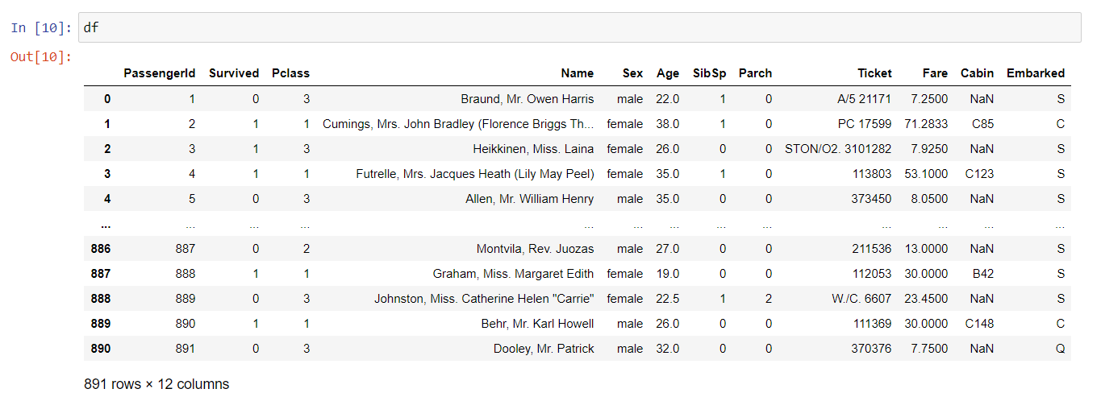
Sample of the data set:

Slide 4
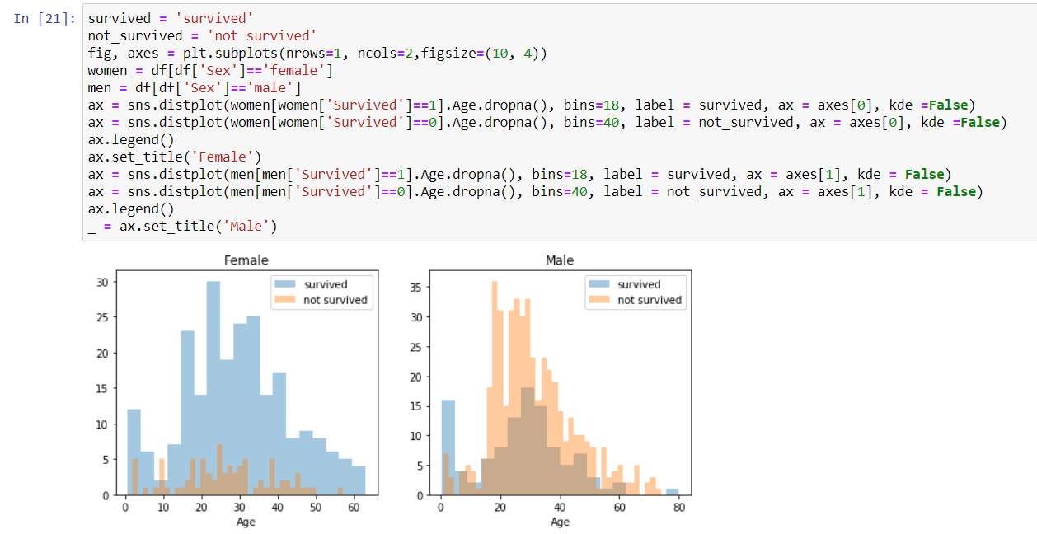
Graph Visualization:

Slide 5
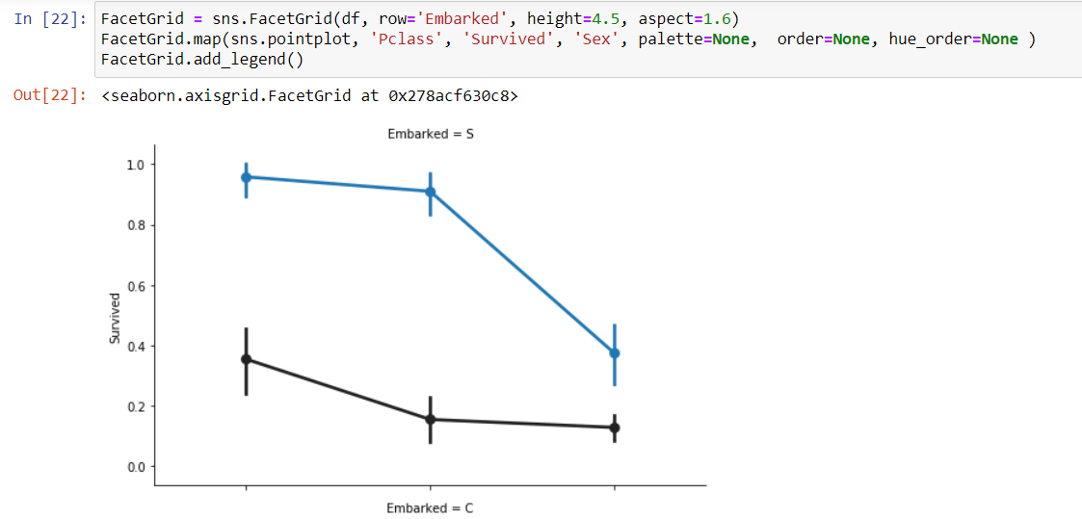

Slide 6
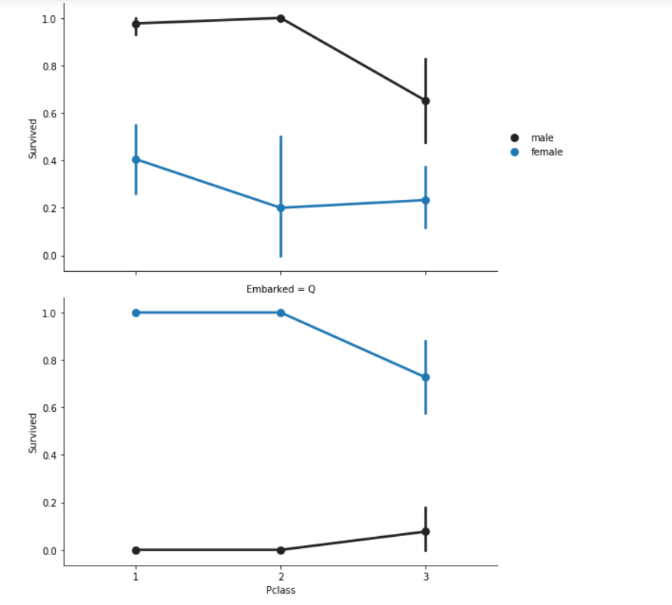

Slide 7
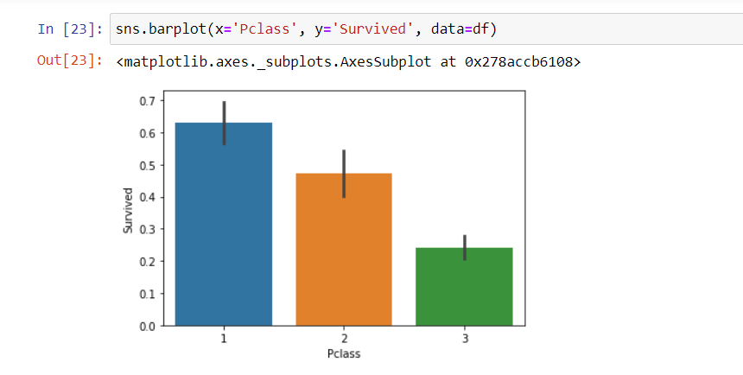

Slide 8
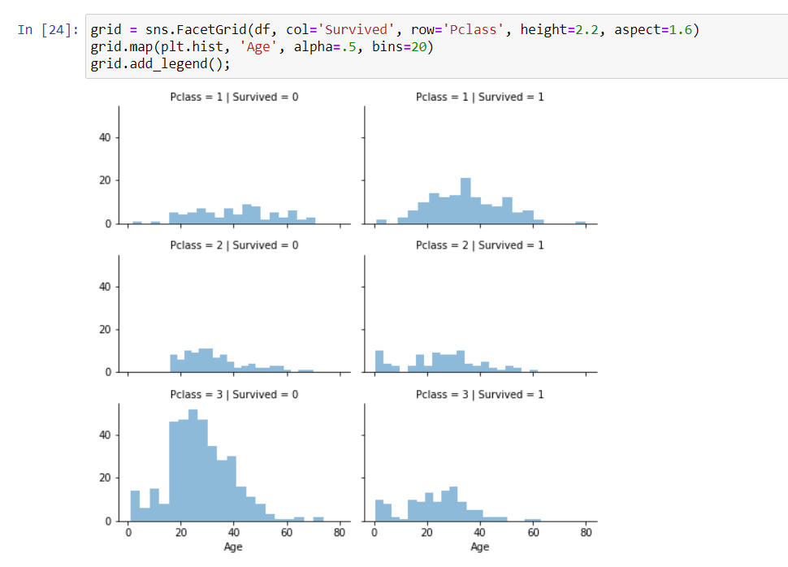

Slide 9
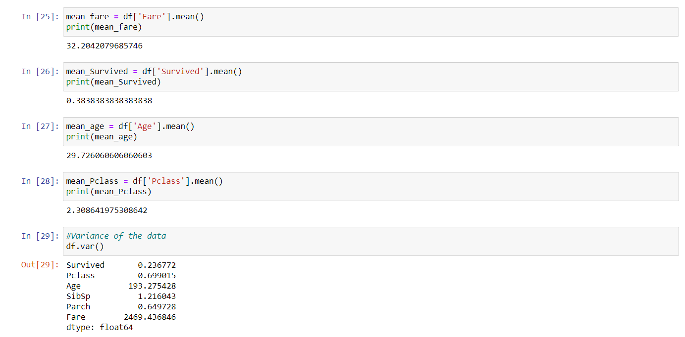
Normalization and Standardization

Slide 10
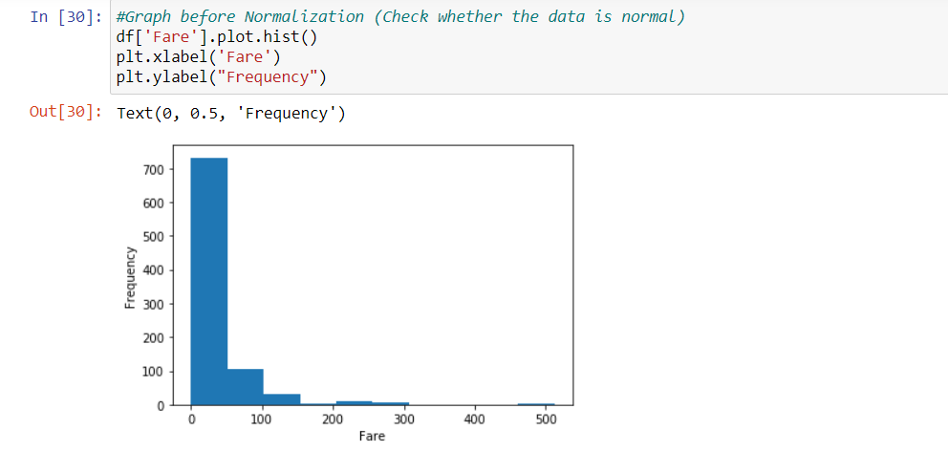
Graph of Fare before normalization:

Slide 11
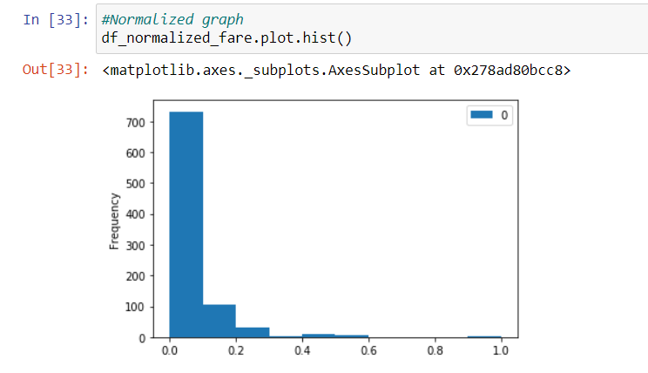
After Normalization:

Slide 12
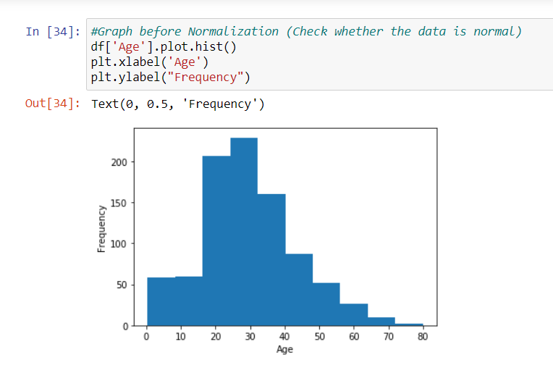
Graph of Age before Normalization:

Slide 13
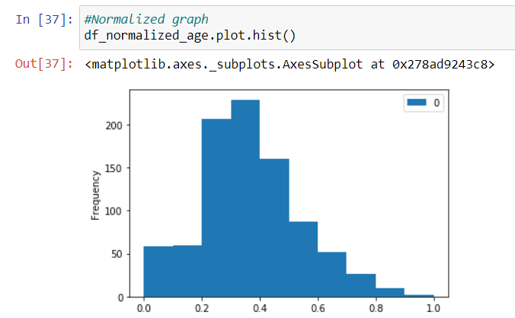
After Normalization:

Slide 14
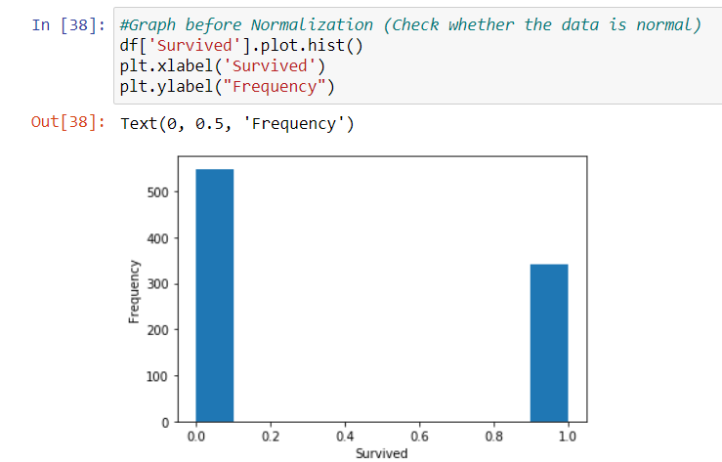
Graph of Survived before Normalization:

Slide 15
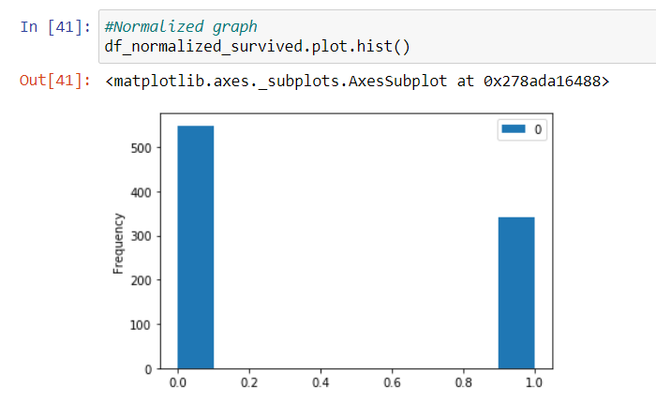
After Normalization:

Slide 16
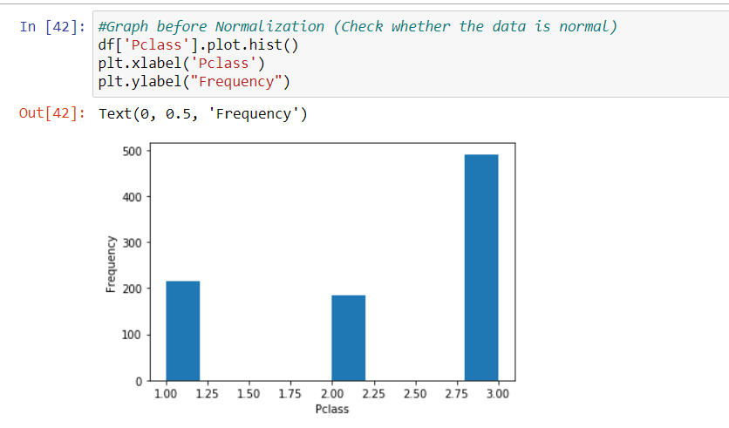
Graph of Pclass before Normalization:

Slide 17
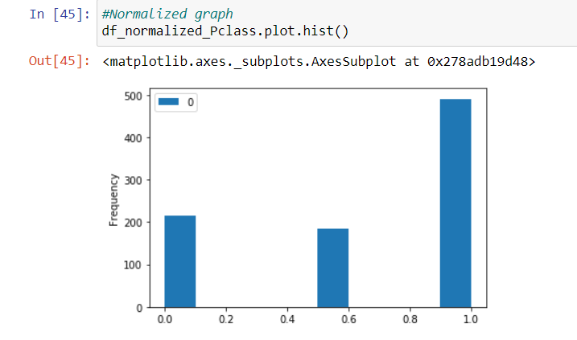
After Normalization:

Slide 18
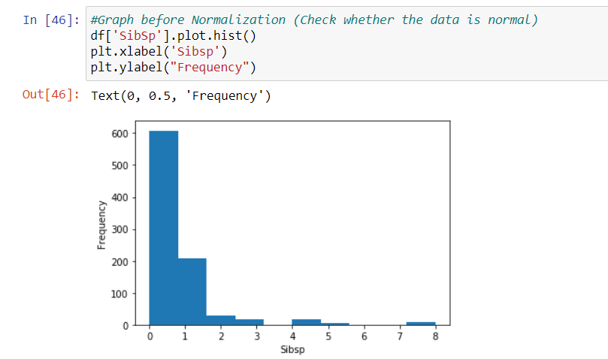
Graph of SibSp before Normalization:

Slide 19
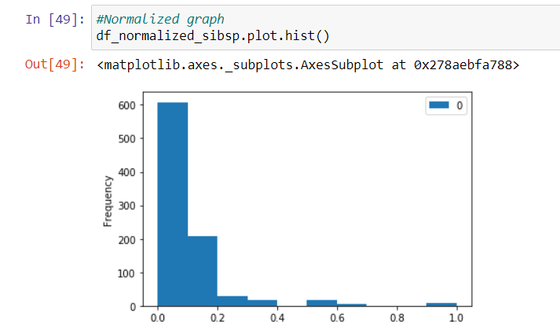
After Normalization:

Slide 20
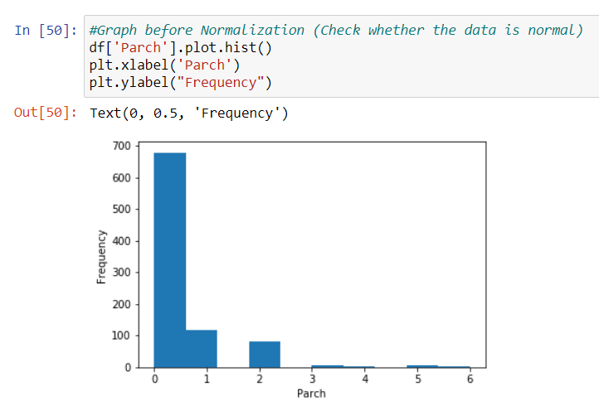
Graph of Parch before Normalization:

Slide 21
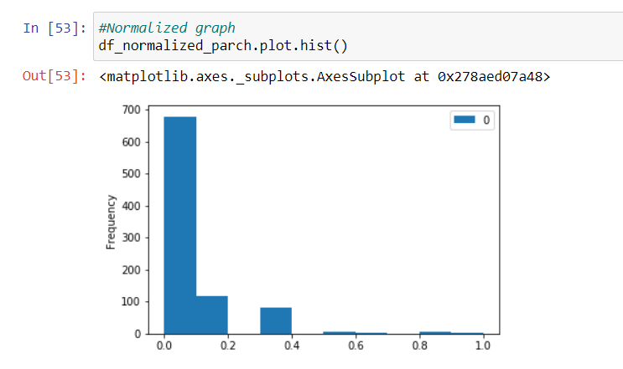
After Normalization:

Slide 22
Hypothesis Testing
The two main variables we are concenred with are "Survived", "Pclass". "Survived" is a binary variable that refers to whether that person survivied "Pclass": is a categorical variable that refers to the class of the person in the ship (first, second, or third) It seems safe to assume that rich people were on the first class while poor were on the third but let's check that using the "Fare" variable which refers to how much people paid.

Slide 23
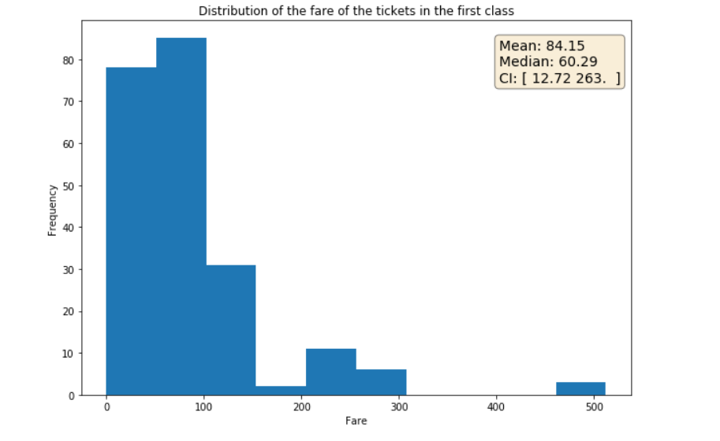
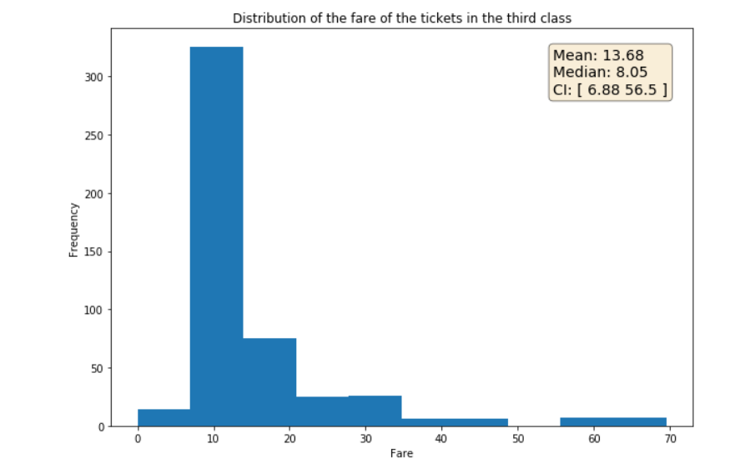

Slide 24
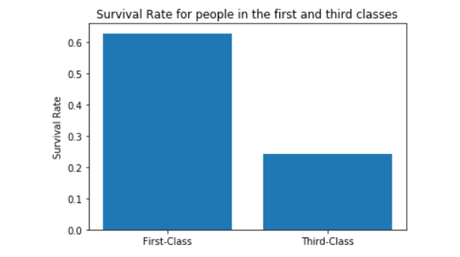
Our assumption seems fair.First class had rich people who paid more and third class had people who paid less

Slide 25
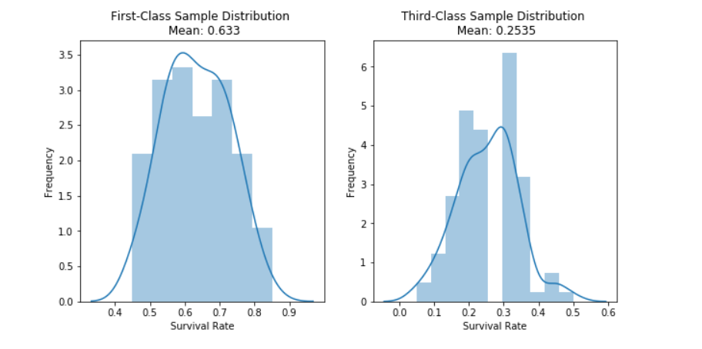
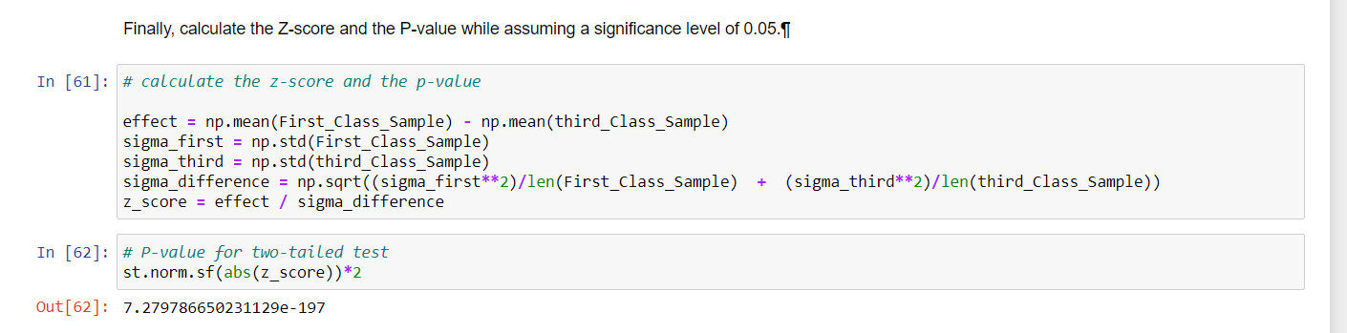

Slide 26
Conclusion:
The P-value is very low and it's safe to reject the null hypothesis.
Conclusion The conclusion is that the provided sample proves a significant correlation between the socioeconomic class and the survival rate. Note that we still can’t establish causation between these two features as we discussed above but we can just make a generalized induction that richer people had a better chance of survival at the ship.

Slide 27
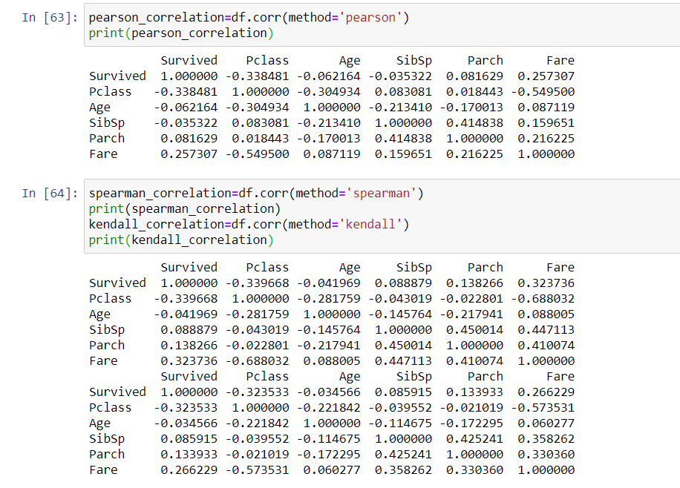
Correlation:

Slide 28
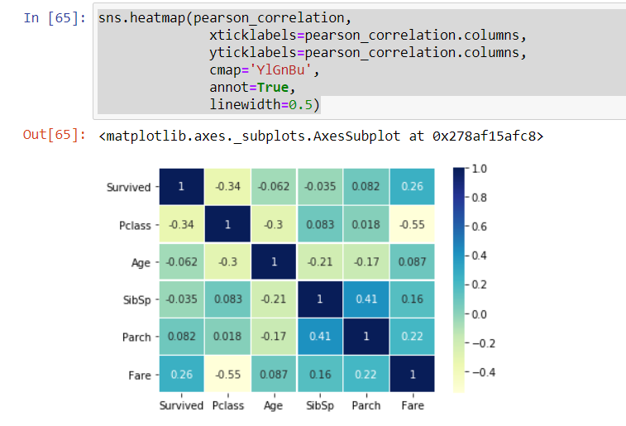

Slide 29
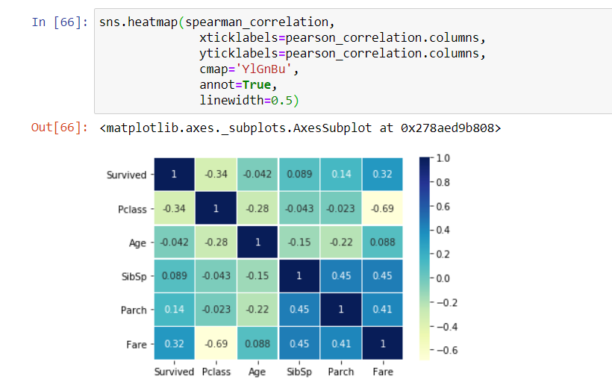

Slide 30
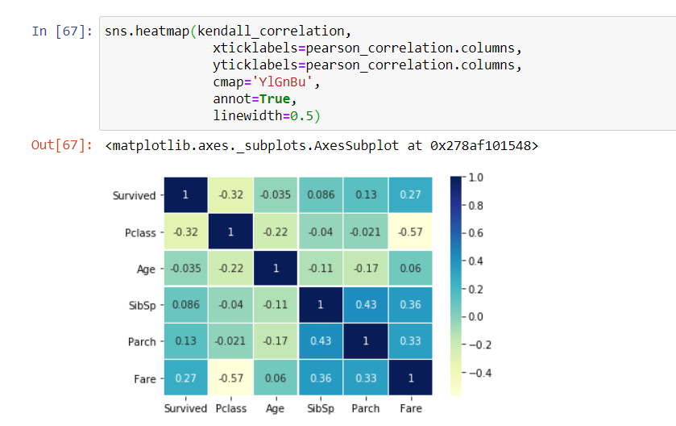

Slide 31
Conclusions:
More than 60% of the passengers had died
The survival chances of a class-1 traveler were higher than a class-2 and class-3 traveler.
More than 80% of male commuters died,as compared to around 70% female commuters.
A larger fraction of children under 10 survived than died.
More than 90% of people travelled alone or with one of their of their sibling or spouse.The chances of survival dropped drastically if someone travelled with more than 2 siblings or spouse.
The chances of survival skyrocketed when a traveller travelled alone.
Th higher a tourist paid, the higher would be his chances to survive.
People who boarded from Cherbourg had a higher chance of survival than people who boarded from Southampton or Queenstown.

Slide 32
BY:
Nikhil M Adyapak-PES2UG19CS257
Minal HR-PES2UG19CS234
Manoj Kumar-PES2UG19CS222
M Satvika-PES2UG19CS207

