Slide 1

UE19CS204 – Web Technologies Mini Project
Project Title - E-Review Website
Section D
Team Members-
1.Minal H R PES2UG19CS234
2.Nikila S PES2UG19CS260
3.Nikhil Adyapak PES2UG19CS257
GITHUB Link https://github.com/NikhilAdyapak/Web-technology-project.git

Slide 2
Abstract
The user can click on a particular product name of the electronic products or the image and will get the product details like the brand,model,price,rating and the features which is enlisted under the description. The aim of this project is to create a website where a user can find honest features and can review the products before he buys them.
GOAL:
Effective product page designs are essential to the success of your e-commerce business.
Product page designs will have a huge impact on your conversion
rates.So, let’s make them as effective as possible

Slide 3
Technologies Used
We used Visual Studio code as our code editor and google chrome as the browser
We installed npm that is node package manager and ran npm install on the command prompt
For node application,we ran the command npm init in the main folder
We installed express,mongodb and mongoose by running npm install express,npm install mongodb and npm install mongoose on the command prompt
Since the java script follows es5 version and we had to convert it to es6 version, we ran the command
npm install @babel/cli @babel/core @babel/node @babel/preset -env nodemon --save-dev
This is to make it so that we can run the backend server on
the terminal itself

Slide 4
Technologies Installed but not used
We were trying the sign up and the login and could not successfully do the coding for the login and removed the frontend part of it which was the loginScreen.js but left the backed part of the code as it is.
The unused packages for the backend part were installed and we tried to implement the sign in page.
We installed jsonwebtoken by running the command
npm install jwt
We installed dotenv by running the command
npm install dotenv
We also installed a Java Scipt library called redux to manage the state of the application by running the command npm install redux.

Slide 5
Member Contributions
Nikhil finalised the project topic. As a group we had a lot more ideas and this idea seemed to be more appealing to us.
Minal and Nikila contributed to finding sources ,information and contributed to backend part of coding
Nikhil contributed to the major part of the code . i.e; frontend and backend
And finally , We together prepared the project report presentation.

Slide 6
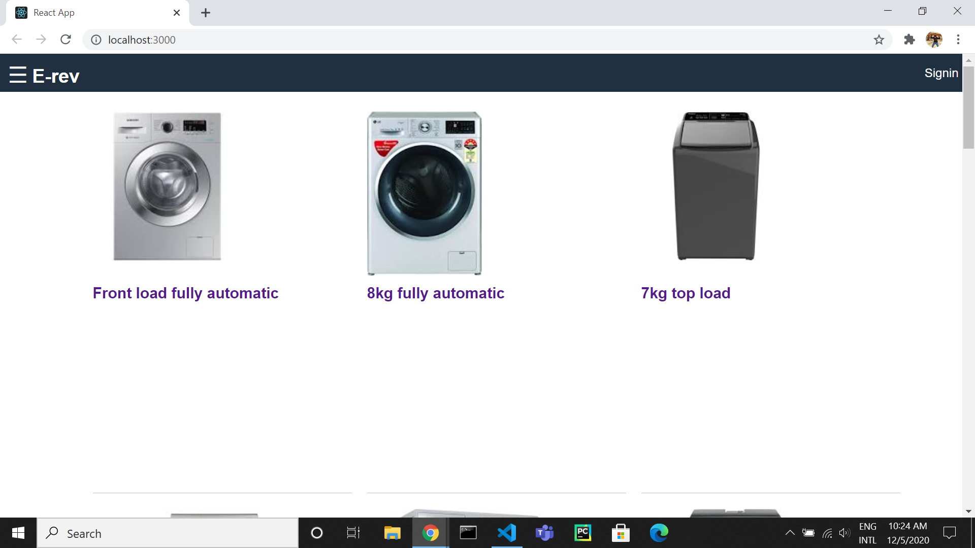
Screenshots of the website

Slide 7
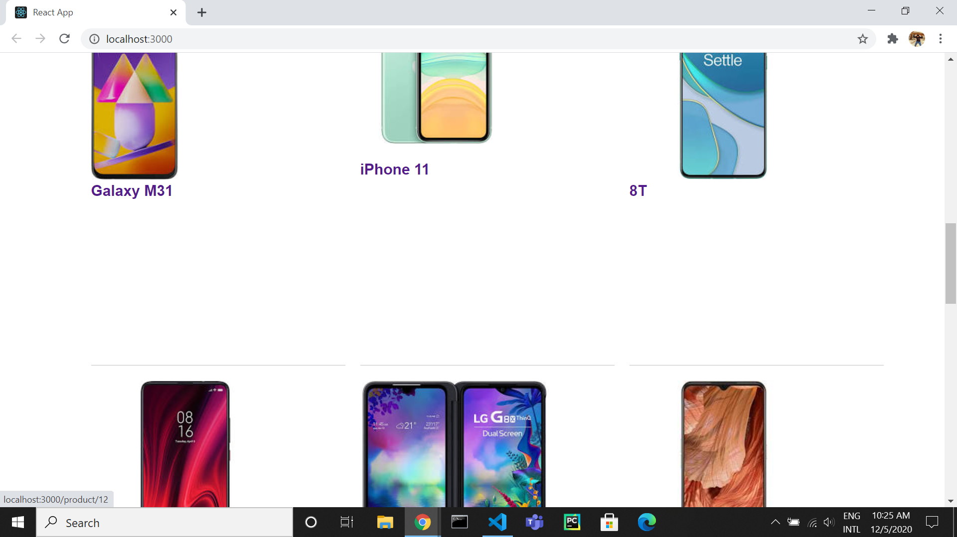

Slide 8
