Slide 1
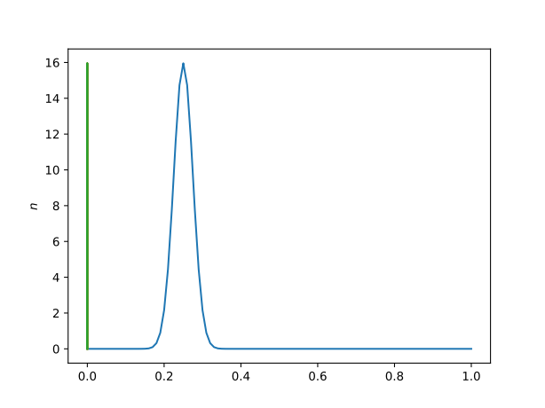
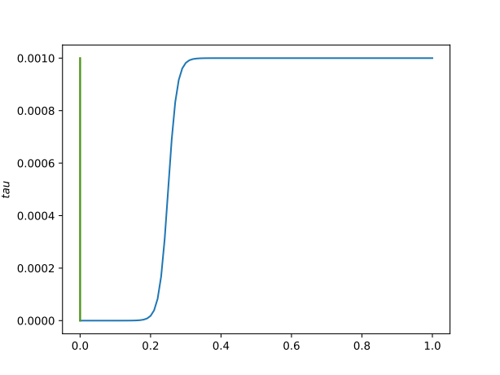
Dirichlet
Dirichlet
1
1m
2
For n = 1 and tau = 0.001;
Eigenfrequency -> 200.047+0.142j
Everything kept same except n and tau;
For left plot, integration from 0 to 1 is 1. Please ignore the left peaks.
Now, the frequency and growth rate are increased;
Eigenfrequency -> 201.545+1.125j

Slide 2
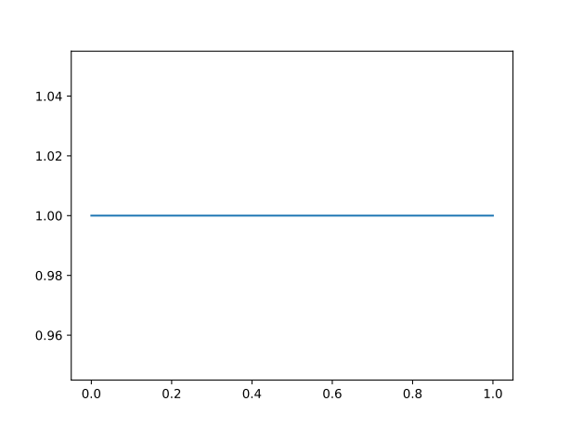
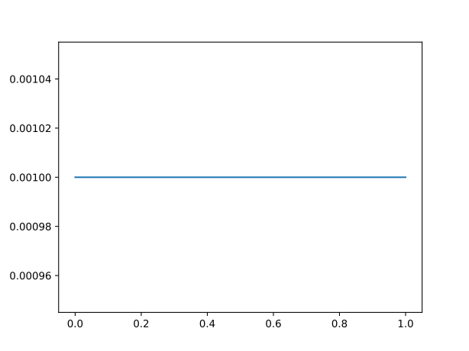
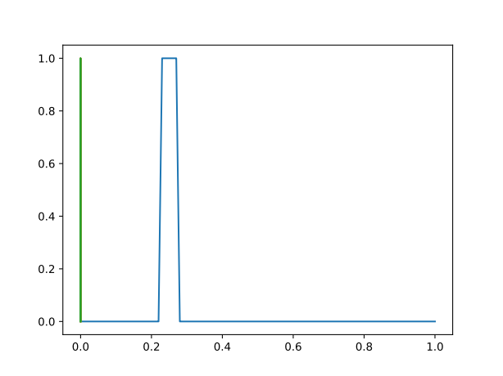
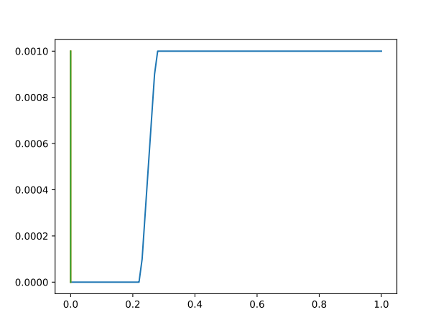
Dirichlet
Dirichlet
1
1m
2
n
tau
frequency
200.042+0.128j
200.047+0.142j
200.112+0.085j

