Slide 1

Code Refactoring and Bug Fixing

Slide 2
About me
AKULA NIKHIL
B.TECH (CSE) - 2023
Why you want to learn Data Science
Data science is a field that involves scientific methods, processes, algorithms, and systems. It's a common platform for the unification of statistics, data analysis, and machine learning.
It powers everything from innovation and the customer experience to the future of health care. Data science has the potential to improve the way we live and work, and it can empower others to make better decisions, solve problems, discover new advancements, and address some of the world's most pressing issues.
linkedin.com/in/akula-nikhil-214974214/
github.com/NikhilAkula4511

Slide 3
INTRODUCTION
A team of enthusiastic data scientists embarked on a mission to develop a Note Taking Application using Python, Flask, and HTML. However, their lack of experience in backend development has led to challenges in making the application fully functional.Recognizing your proficiency in backend development, you have been tasked with fixing the broken code and ensuring the application works seamlessly.
Task:
Refactor the existing codebase and ensure the proper functioning of the Note Taking Application. Document all identified bugs during the debugging process. Remember, the task is not about recreating the app from scratch. Your goal is to fix the already existing codebase and make the application work as intended.

Slide 4
TECHNOLOGIES USED
PYTHON
FLASK
HTML

Slide 5
BUGS IDENTIFIED
List and briefly describe the bugs encountered during the debugging process
Bug 1: Unable to save notes
Bug 2: Notes not displaying correctly
Bug 3: Issues with routing

Slide 6
Bugs Identified in Python
While mentioning route to app it has only post method , fix this issue by adding get method to retrieve the data
While taking the input or notes, html file contains form type but here we mentioned it args so fix it by form in place of args

Slide 7
Bugs Identified in HTML file
While Taking the input from HTML form it has no method mentioned so fix it with method=“post”.
Not mentioned the type of Button i,.e. input type=“button”.

Slide 8
Conclusion
Summarize key takeaways from the refactoring and debugging process
Reflection on overall improvement in functionality

Slide 9
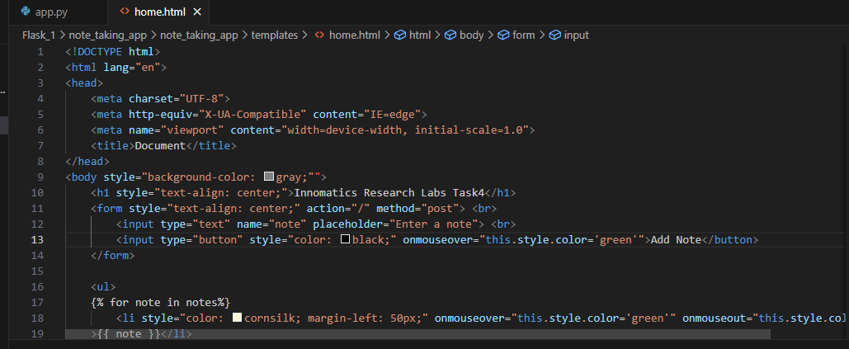
Snapshots after Fixing Errors

Slide 10
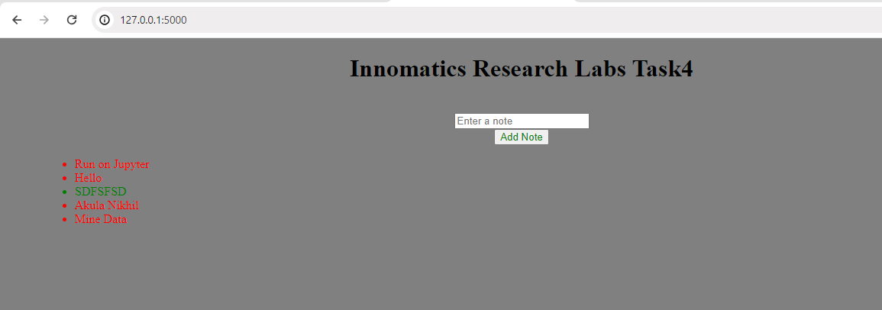

Slide 11

THANK YOU

