Slide 1

DATA ANALYSIS ON ASPIRING MIND EMPLOYMENT OUTCOME DATASET

Slide 2
About me
AKULA NIKHIL
B.TECH (CSE) - 2023
Why you want to learn Data Science
Data science is a field that involves scientific methods, processes, algorithms, and systems. It's a common platform for the unification of statistics, data analysis, and machine learning.
It powers everything from innovation and the customer experience to the future of health care. Data science has the potential to improve the way we live and work, and it can empower others to make better decisions, solve problems, discover new advancements, and address some of the world's most pressing issues.
linkedin.com/in/akula-nikhil-214974214/
github.com/NikhilAkula4511

Slide 3
Agenda
INTRODUCTION
OBJECTIVE
TOOLS USED
Exploratory Data Analysis:
Data Cleaning ans Manipulation
Univariate Analysis
Bivariate Analysis
Multivariate Analysis
Key Business Question
Conclusion
Challenges

Slide 4
INTRODUCTION
The dataset was released by Aspiring Minds from the Aspiring Mind Employment Outcome 2015 (AMEO). The study is primarily limited only to students with engineering disciplines. The dataset contains the employment outcomes of engineering graduates as dependent variables (Salary, Job Titles, and Job Locations) along with the standardized scores from three different areas – cognitive skills, technical skills and personality skills.
The dataset also contains demographic features.
The dataset contains around 40 independent variables and 4000 data points. The independent variables are both continuous and categorical in nature. The dataset contains a unique identifier for each candidate. Below mentioned table contains the details for the original dataset.

Slide 5
OBJECTIVE
Finding the insights which are helpful to understand about data.
Target column highly correlated with?
Find the outliers .

Slide 6
TOOLS USED
Python
Matplotlib
Seaborn
Numpy

Slide 7
Data Cleaning and Manipulation
Manipulation on Job City column to proper order
Proper order on Designation column
Replace the values on “10Board” column based on board with much understanding way
Replace “0” with ‘NOT Mentioned’ in ‘Job City,Designation,10board’ columns
After this Data as follows:

Slide 8
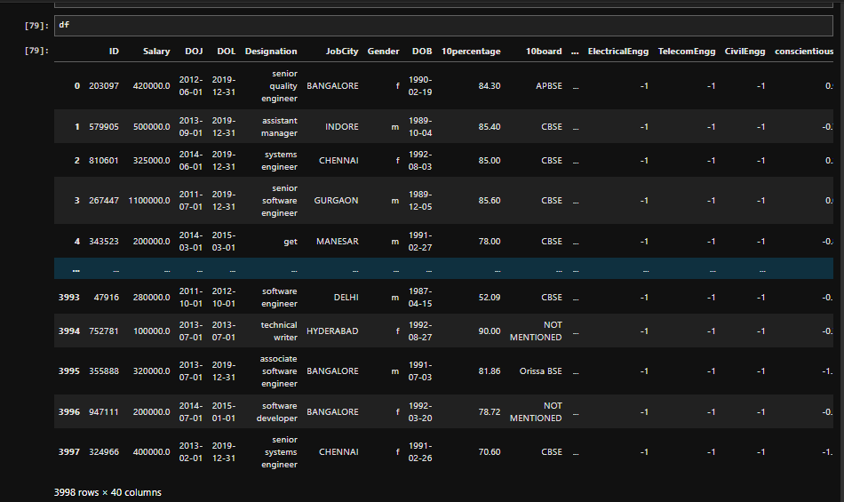

Slide 9
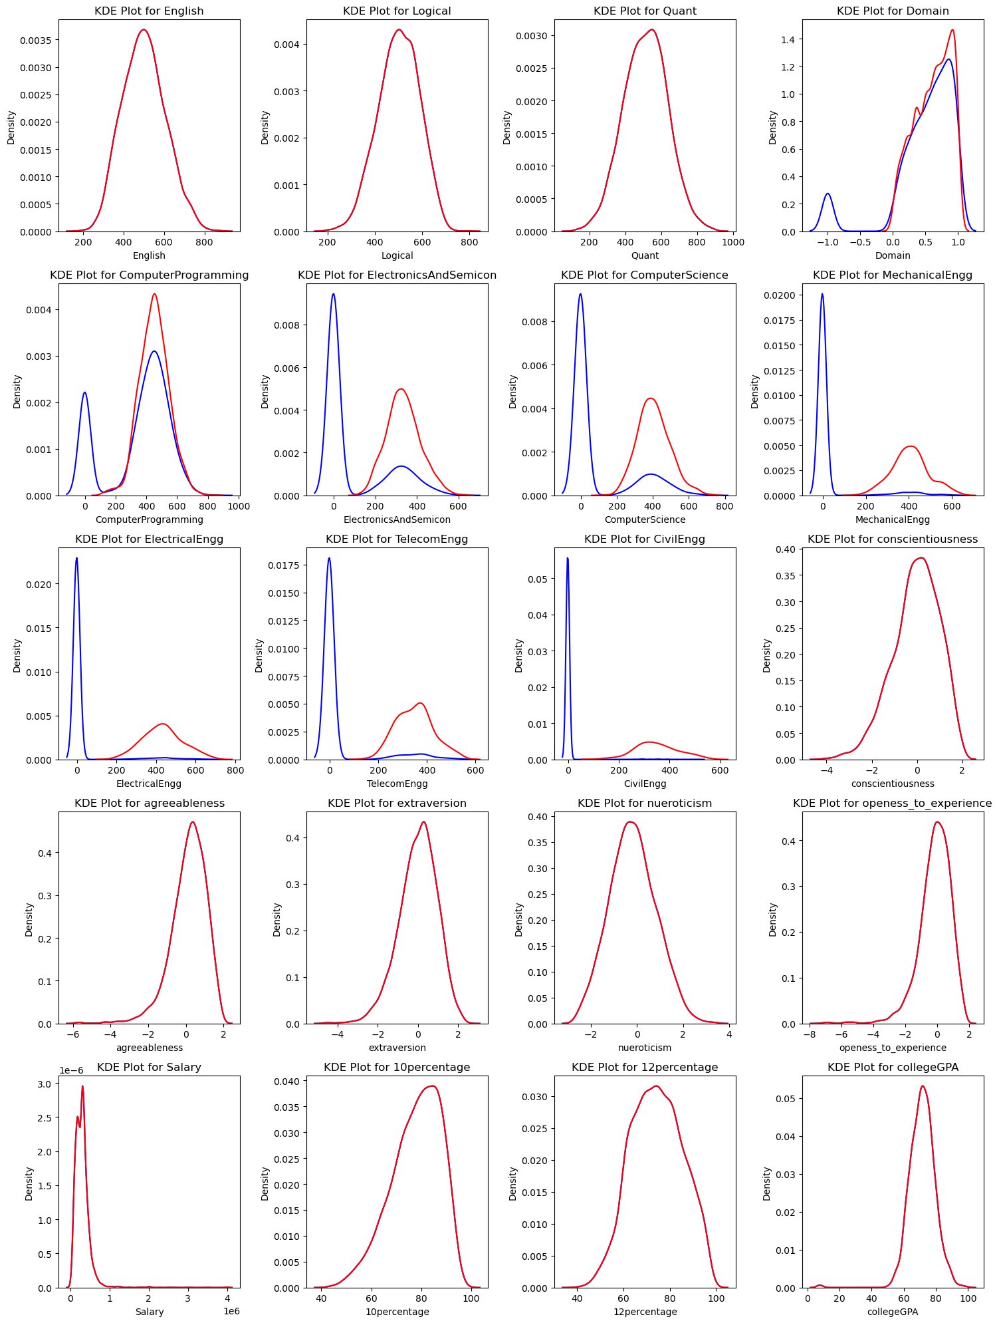
Univariate Analysis
Here KDE plot indicates:
Blue line before -1 remove
Red line after -1 remove
It clearly indicates all numerical
Columns are follow normal distribution

Slide 10
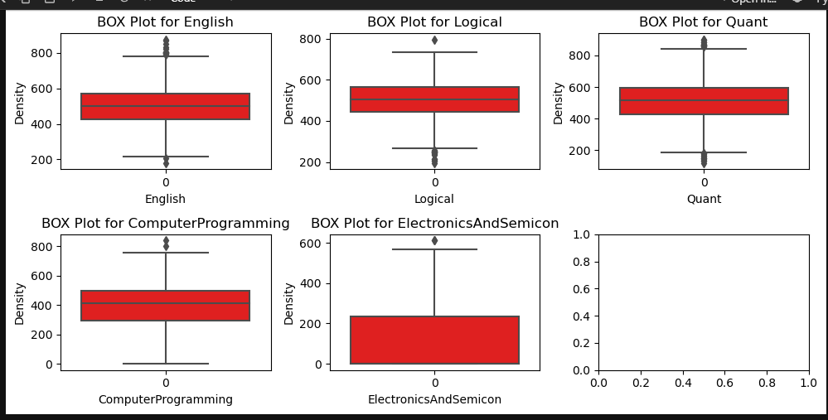
Box Plot
This Box indicates all the columns i.e English,Logical Quant and computer Programming has equal in avg of marks except Electronics and semicon column
Very few outliers in the data which not affect the data

Slide 11
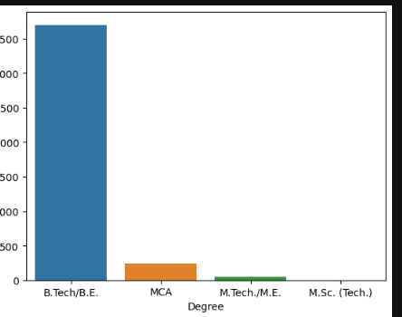
Countplot
On adjacent column Which clearly indicates that Out of four specified degrees such as BE, MCA, ME, M.Sc most of the employees from BE

Slide 12
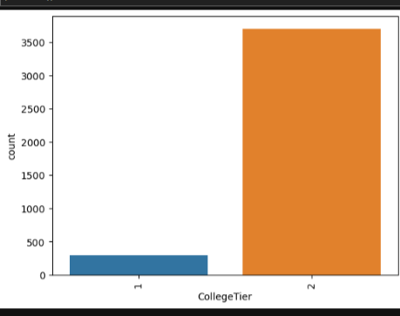
Countplot
From adjacent graph it indicates Most of the Employees from College Tier was 2

Slide 13
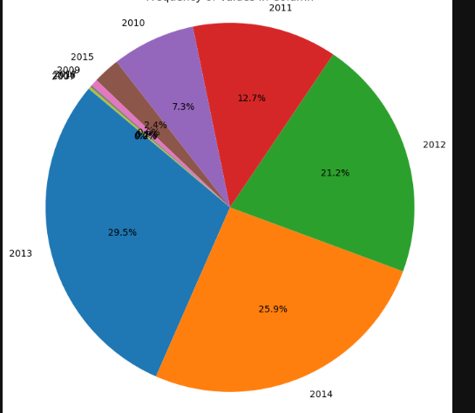
PieChart
Pie Chart indicates that From 2013 and 2014 most of the employees are graduated. It looks like almost 50% (55.2) of the people are from these two years

Slide 14
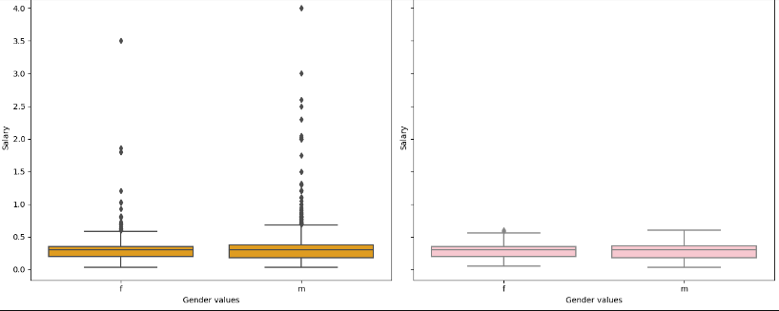
Bivariate Analysis
As this boxplot describes
that almost Male and Female
Are equal amount of payable.

Slide 15
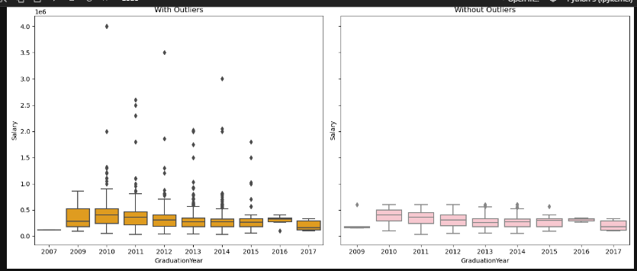
Box Plot
From adjacent graph which describes that avg salary based on years.
Which indicates As Experience increases in Job avg salary increases

Slide 16
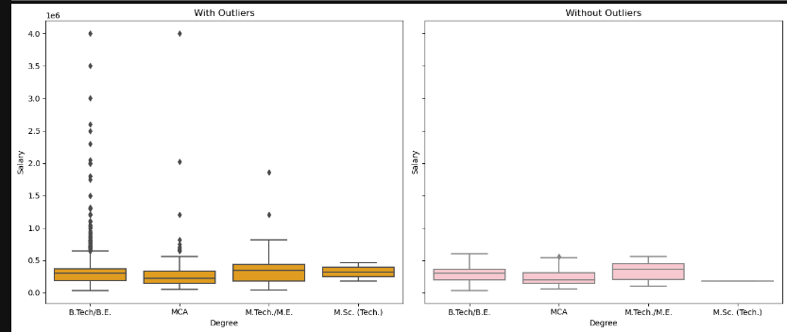
Box Plot
From this graph which describes , Employees who are did ME then their salary might be high

Slide 17
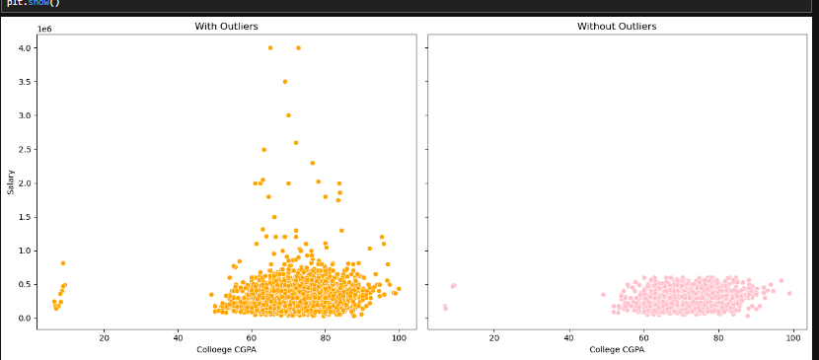
Scatter Plot
Which describes as CGPA increases Salary may increase

Slide 18
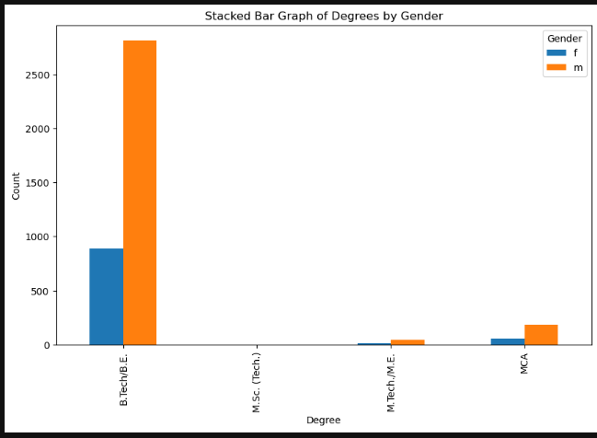
Stacked Bar Graph
Which describes As orange color indicates Male and Blue color indicates Female,
It clear indicates Based on degree no.of employees

Slide 19
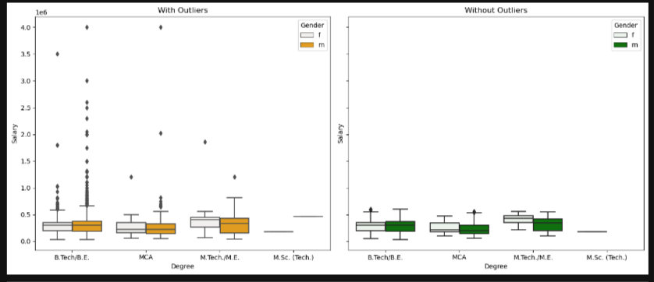
Multivariate Analysis
Adjacent graph indicates
Almost doing BE and MCA
Avg salary might be same but
Doing ME who are Female which
Might avg salary might be high

Slide 20
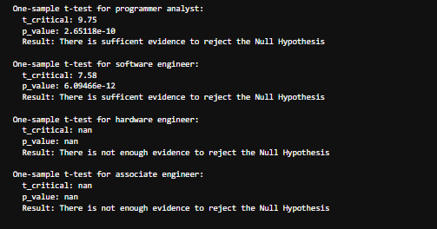
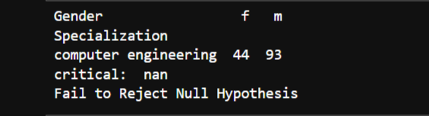
Key Business Question
On research Question:
Observed that: Who did CSE on their graduation
Programmer analyst and S/W engineer might get avg salary above 3LPA
H/W and Associate engineer there is no much evidence to get avg salary
There is a relationship among the Gender and Specialization on given
data

Slide 21
Conclusion
As Experience of the employee increases his/her salary might be high
Most of the Employees background BE/Btech
Salaries Might be high employee who did ME as their Post graduation
Salaries on Tier 1 colleges might high
When compare to Male with Female Who are did their ME, Female Salary high

Slide 22

THANK YOU

