Slide 1
Compiler and Virtual Machine
for a
Programming Language :
DANS
Aaditya Maheshwari 1207856165
Dhanya Mary Jacob 1207643992
Nikhil Aravind 1207456168
Suhas Xavier 1207389153

Slide 2
Overview
Why did we choose ANTLR over YACC/Bison?
Description of the grammar
How our lexer identifies tokens
How our parser parses the tokens to generate an AST
How our intermediate code is generated and handled
What happens at runtime
A few sample programs

Slide 3
Why ANTLR?
ANTLR generates an LL(*) parser, YACC and Bison generate LALR parsers
Although LALR grammars are a lot easier to construct and debug, you will need to take care of errors like shift-reduce and reduce-reduce
ANTLR generates recursive descent parsers, "processing logic" is contained in the parser's code, each production rule of the grammar is represented by a function in the parser's code.
Grammar writing more difficult, but the generated code is readable
Graphical IDE tool, called ANTLRworks. Visualises your grammar rules as you type them, identifies and depicts conflicts graphically.

Slide 4
Grammar
parse
: block EOF #block of text followed by End of File
;
block
: (statement | functionDecl)* (Return expression ';')? #statement or function followed by return exp
;
statement
: assignment ';' #assignmentStatement
| functionCall ';' #functionCallStatement
| ifStatement #ifStatement
| whileStatement #whileStatement
;

Slide 5
Grammar
assignment
: Identifier '=' expression #assign expression to an identifier
;
functionCall
: Identifier '(' exprList? ')' #identifierFunctionCall
| Println '(' expression? ')' #printlnFunctionCall
| Size '(' expression ')' #sizeFunctionCall
;
ifStatement
: ifStat elseIfStat* elseStat? End #if, followed by any number of elseIf branches, then else
;

Slide 6
Grammar
ifStat
: If expression Do block #IfStatement
;
elseIfStat
: Else If expression Do block #ElseIfStatement
;
elseStat
: Else Do block #ElseStatement
;
functionDecl
: Def Identifier '(' idList? ')' block End #FunctionDeclaration
;

Slide 7
Grammar
idList #IdentifierList
: Identifier (',' Identifier)*
;
exprList #ExpressionList
: expression (',' expression)*
;

Slide 8
Grammar
expression
: '-' expression #unaryMinusExpression
| expression '*' expression #multiplyExpression
| expression '>=' expression #gtEqExpression
| expression '==' expression #eqExpression
| expression '?' expression ':' expression #ternaryExpression
| Number #numberExpression
| Null #nullExpression
| functionCall #functionCallExpression
| Identifier #identifierExpression
| String #stringExpression
| '(' expression ')' #expressionExpression
;

Slide 9
Grammar
Println : 'println';
Input : 'input';
Size : 'size';
Def : 'def';
If : 'if';
Else : 'else';
GTEquals : '>=';
Subtract : '-';
Multiply : '*';
Divide : '/';
OBrace : '{';
OBracket : '[';

Slide 10
Grammar
Bool #BooleanValues
: 'true'
| 'false'
;
Number #Number
: Int ('.' Digit*)?
;
Identifier #Identifier
: [a-zA-Z_] [a-zA-Z_0-9]*
;
String
: ["] (~["\r\n)* ["] #DoubleQuoteString
| ['] (~['\r\n)* ['] #SingleQuoteString
;

Slide 11
Grammar
Comment
: ('//' ~[\r\n]* | '/*' .*? '*/') -> skip #CommentLine
;
Space
: [ \t\r\n\u000C] -> skip #WhiteSpace
;
Int #Integer
: [1-9] Digit*
| '0'
;
Digit #SingleDigit
: [0-9]
;

Slide 12
The Lexer
The Lexer is responsible for the task of breaking lexioms in the input program into tokens.
Tokens are single elements of the language such as an identifier, expressions, keywords and expressions.
The input program can also contain white spaces and comment lines.
The Lexer can be trained to ignore these white spaces and comment lines by calling the skip() which is defined in the Lexer class.
Comment : ('//' ~[\r\n]* | '/*' .*? '*/') -> skip;
Space : [ \t\r\n\u000C] -> skip

Slide 13
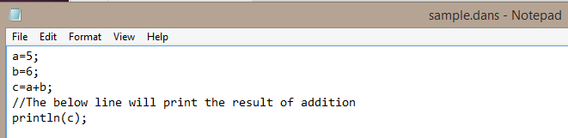
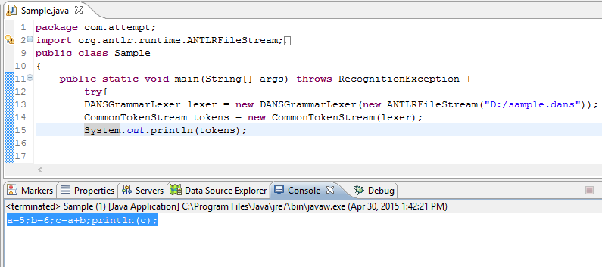
The Lexer
Input program including comment lines
Stream of tokens with comment lines removed

Slide 14
The Parser
The Parser is responsible for performing syntax analysis of the tokens generated by the Lexer.
The Parser analyzes the input tokens against the rules defined in the grammar and generates a parse tree as output.
It generates an error if it encounters an incorrect syntax but continues parsing the rest of the tokens till it reaches the end of the file.
The intermediate code generated by the Parser can then be used to perform semantic analysis and evaluation.

Slide 15
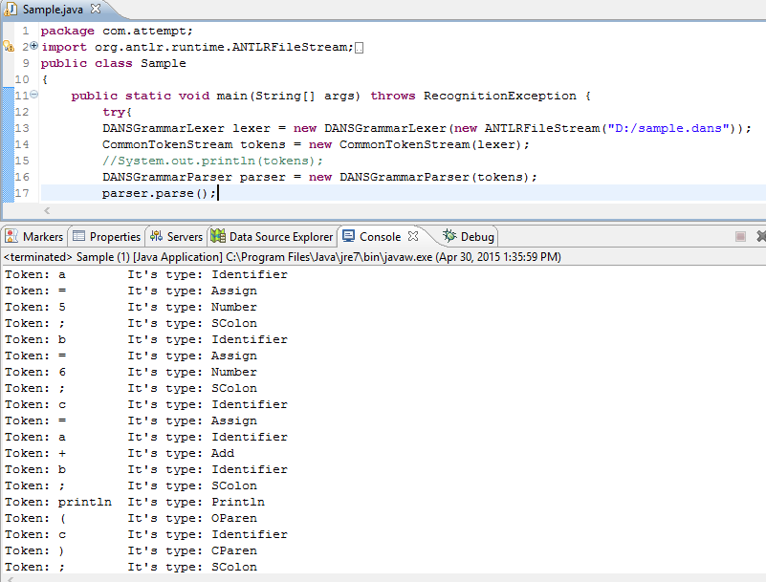
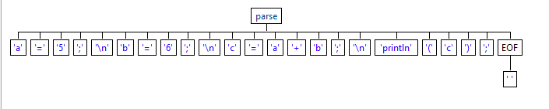
The Parser
The Parse Tree
The parser matches each token to its
corresponding type in the input
Grammar.

Slide 16
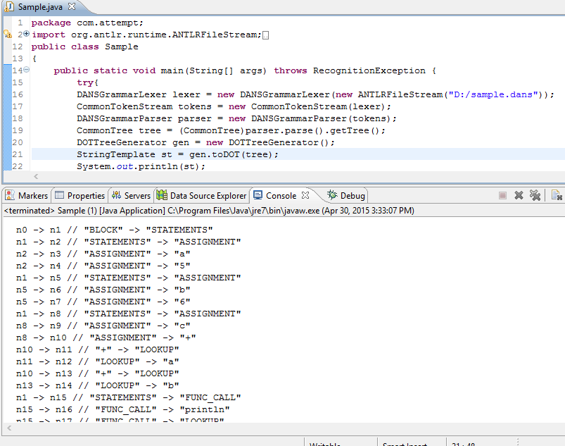
Intermediate Code

Slide 17
Intermediate Code
n0 [label="BLOCK"]; n8 [label="ASSIGNMENT"];
n1 [label="STATEMENTS"]; n9 [label="c"];
n10 [label="+"];
n2 [label="ASSIGNMENT"]; n13 [label="LOOKUP"]
n3 [label="a"]; n12 [label="a"];
n4 [label="5"]; n13 [label="LOOKUP"]
n14 [label="b"];
n5 [label="ASSIGNMENT"];
n6 [label="b"]; n16 [label="println"];
n7 [label="6"]; n17 [label="LOOKUP"];
n18 [label="c"];

Slide 18
Semantic Analysis
The generated parse tree needs to be traversed in order to ensure semantic accuracy since the parse tree can contain syntactically correct but semantically incorrect expressions.
Eg: if a+b > true do
A Tree Visitor interface is created that walks the entire tree to check for semantic correctness and outputs an error if it encounters any.
The visitor class creates an entry for every expression in the grammar and assigns a context which can be referenced later.

Slide 19
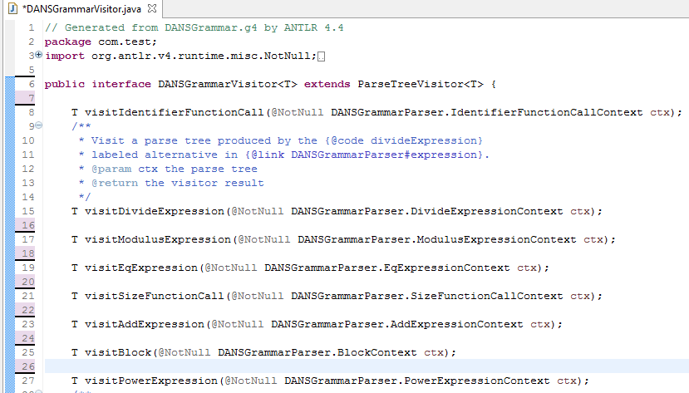
Semantic Analysis

Slide 20
Runtime
Similar to the Visitor interface, a Listener interface is also created for every entry in the input grammar file.
The Listener defines a function and a context for every entry in the grammar.
These methods and its respective context is then used during evaluation of a particular expression.

Slide 21
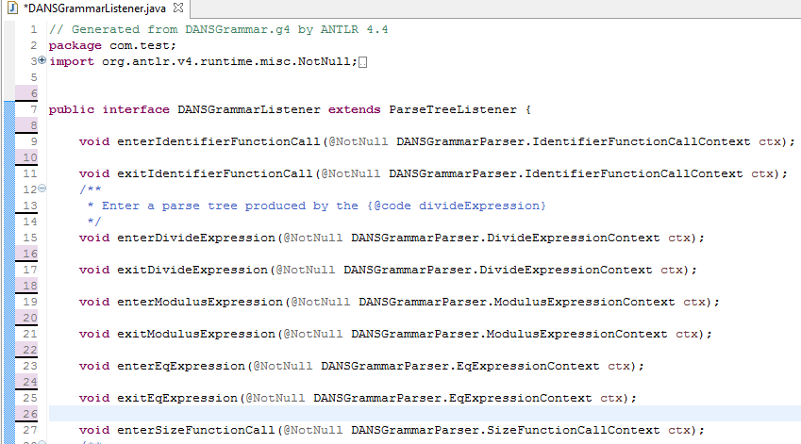
Runtime

Slide 22
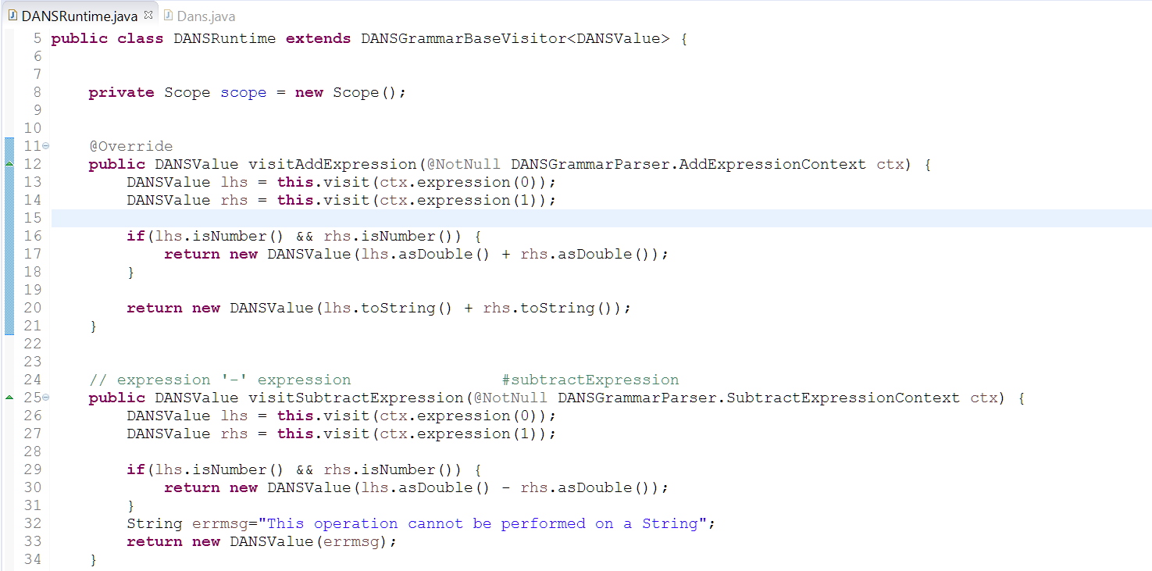
DANS Runtime

Slide 23
HelloWorld
Program:
println(“Hello, World!”);
Output:
Hello, World!

Slide 24
Integer Arithmetic
Program:
a = 2;
b = 7;
sum = a + b;
product = a * b;
println(“The sum is: ”+sum); println(“The product is: ”+product);
Output:
The sum is: 9
The product is: 14

Slide 25
Conditionals
Program:
a = 4;
b = 8;
if a > b do
println("A is greater");
else
println("B is greater");
end
Output:
B is greater

Slide 26
Conditional Loops – Factorial.dans
Program:
factorial = 1;
number = 5;
i = 1;
while i <= number do
factorial = factorial * i;
i = i + 1;
end
println("Factorial of number " + number + " is " + factorial);
Output: Factorial of number 5 is 120

Slide 27
System.exit();
<conclusion>
Thank you for DANSing with us.
</conclusion>

