Slide 1
Superstore
E-commerce

Slide 2
Statement:
Gaining various Insights on sales of a superstore in different countries.

Slide 3
Project by-
Sarang Sonawane
Prajwal Bambulkar
Nikhil Bhor
Ankit Dahate

Slide 4
Content
Comparisons of Libraries
Importing Libraries
Data Reading
Data Manipulation
Data visualization
Bar graph
Area Plot
Pie Chart
Heat map
Pair Plot
Conclusion

Slide 5
NUMPY VS PANDAS NUMPY PANDAS
When we have to work on Numerical data, we prefer the NumPy module.
Whereas the powerful tool of NumPy is Arrays.
NumPy is memory efficient.
NumPy has a better performance when number of rows is 50K or less.
NumPy is capable of providing multi-dimensional arrays.
Indexing of NumPy Arrays is very fast.
When we have to work on Tabular data, we prefer the pandas module.
The powerful tools of pandas are Data frame and Series.
Pandas consume more memory.
Pandas has a better performance when a number of rows is 500K or more.
Pandas offer a have2d table object called DataFrame.
Indexing of the pandas series is very slow as compared to NumPy arrays.

Slide 6
MATPLOTLIB VS SEABORN Matplotlib Seaborn
Matplotlib is utilized for making basic graphs. Datasets are visualized with the help of bar graphs, histograms, lines and so on.
Matplotlib uses comparatively complex and lengthy syntax.
Matplotlib is well connected with Numpy and Pandas and acts as a graphics package for data visualization in python.
Matplotlib is a highly customized and robust
Matplotlib plots various graphs using Pandas and Numpy
Seaborn contains a number of patterns and plots for data visualization. It uses fascinating themes.
Seaborn uses comparatively simple syntax which is easier to learn and understand.
Seaborn is more comfortable in handling Pandas data frames. It uses basic sets of methods to provide beautiful graphics in python.
Seaborn avoids overlapping of plots with the help of its default themes.
Seaborn is extended version of Matplotlib.

Slide 7
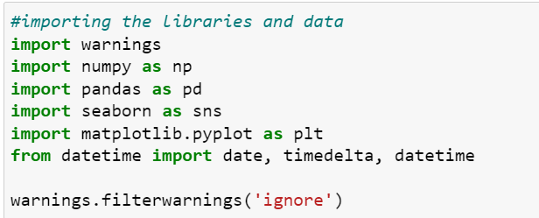
Importing Libraries

Slide 8
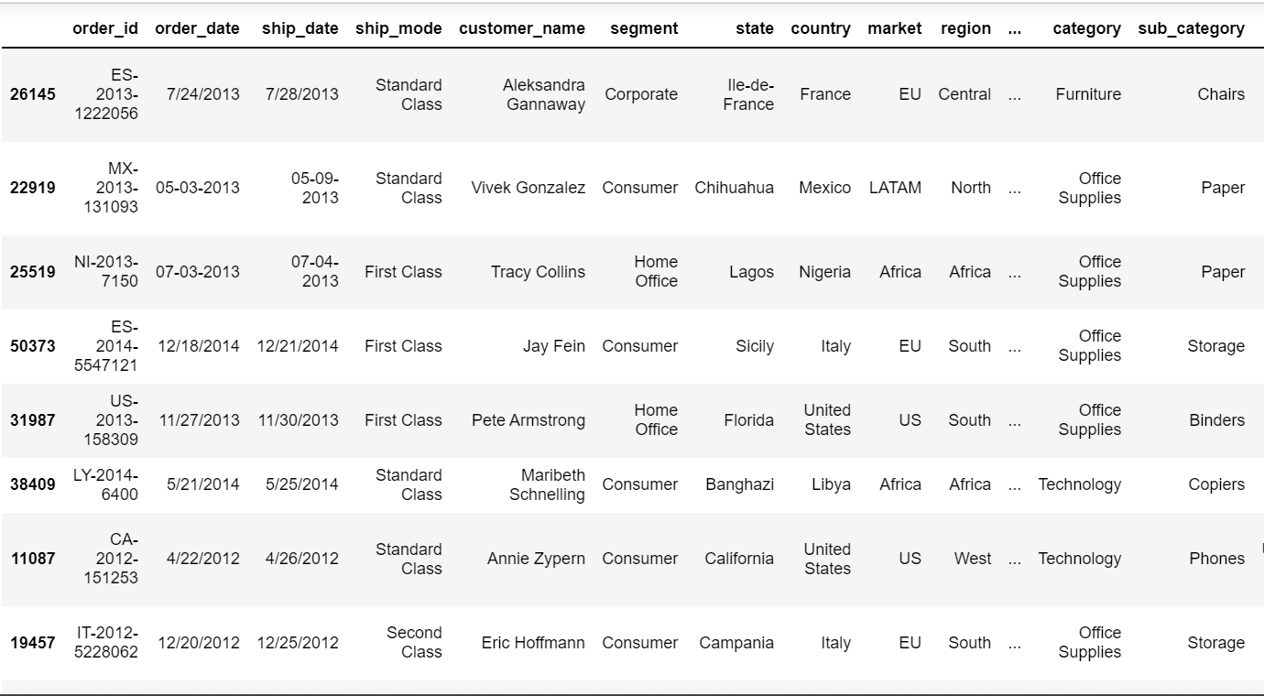
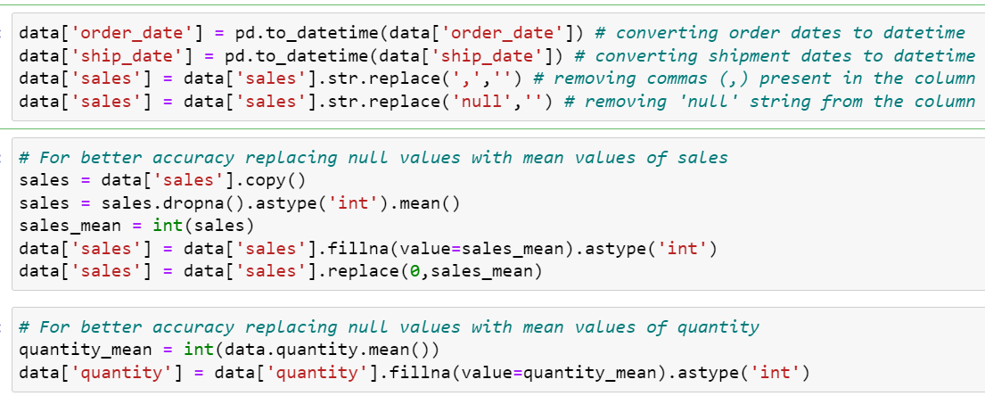
Data Reading
Data is imported and showed at an random.
All the date are converted into standard date format and also replacing of null with mean values.

Slide 9
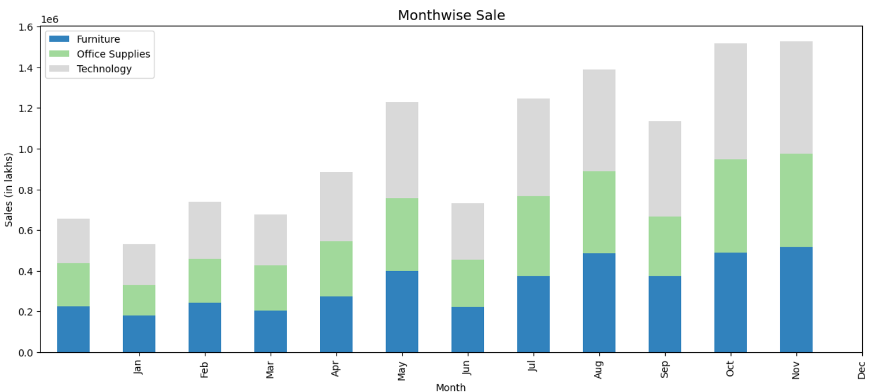
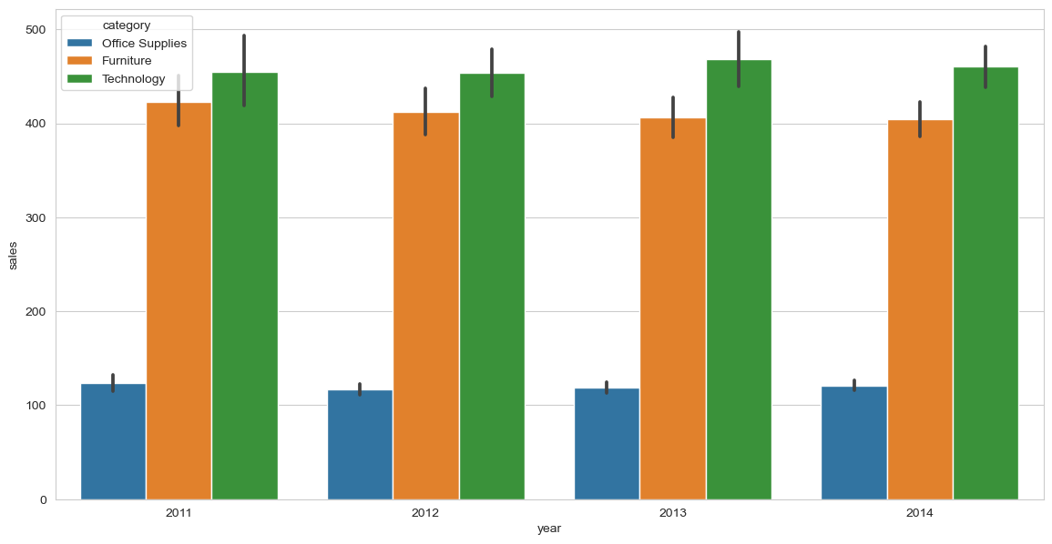
Data Visualization (Sales)
Which are the most selling products?
1. Staples
2. Cardinal Index Tab, Clear
3. Eldon File Cart, Single Width
4. Rogers File Cart, Single Width
5. Stockwell Paper Clips, Assorted Sizes
Which are the Top 10 products by sales?
1. Apple Smart Phone, Full Size
2. Cisco Smart Phone, Full Size
3. Motorola Smart Phone, Full Size
4 .Nokia Smart Phone, Full Size
5. Canon image CLASS 2200 Advanced Copier
6. Hon Executive Leather Armchair, Adjustable
7. Office Star Executive Leather Armchair
8. Harbour Creations Executive Leather Armchair
9. Samsung Smart Phone, Cordless
10. Samsung Smart Phone, VoIP

Slide 10
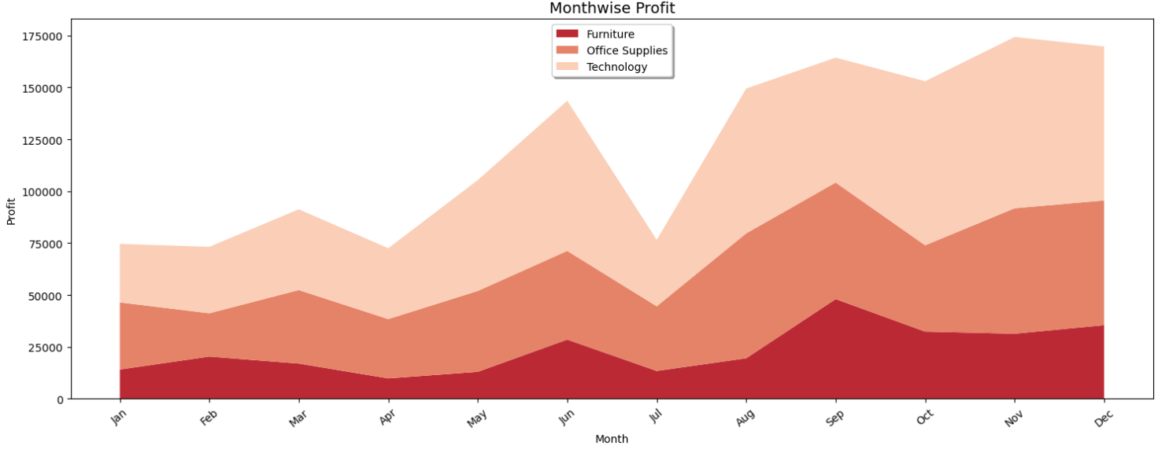
Data Visualization (Profit)
Which are the most profitable Category?
1. Technology
2. Furniture
3. Office supplies
Which customer segments are the most profitable?
1. Consumer
2. Corporate
3. Home Office
What market sold the most products?
1. APAC
2. EU
3. US
4. LATAM
5. EMEA
6. Africa
7. Canada
What are the top 10 state profit wise?
1. Paysand£
2. Shizuoka
3. Mie
4. Rajshahi
5. Qinghai
6. Zagrebacka
7. Podgorica
8. Sulawesi
9. Tengah
10.Sikasso Maysan

Slide 11
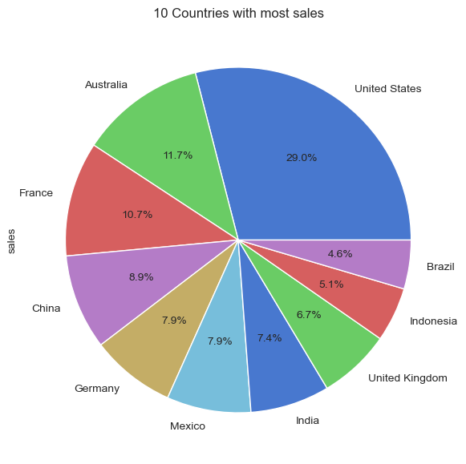
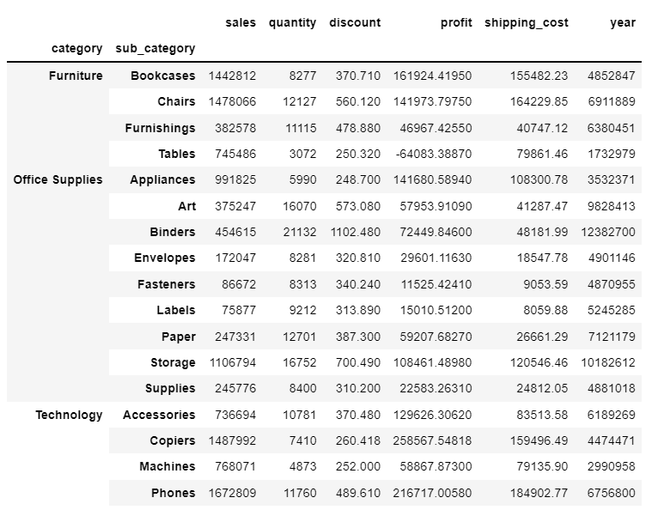
Total sales values by category and subcategory
Top 10 Countries With Sales

Slide 12
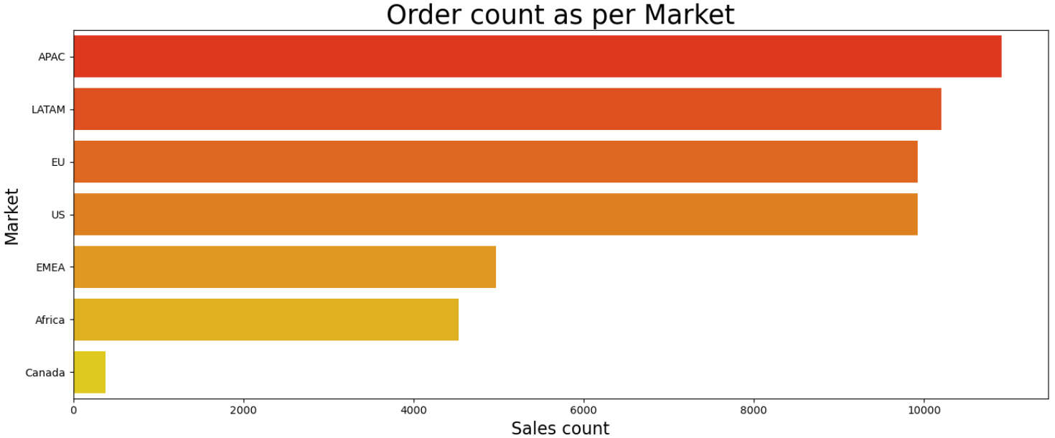
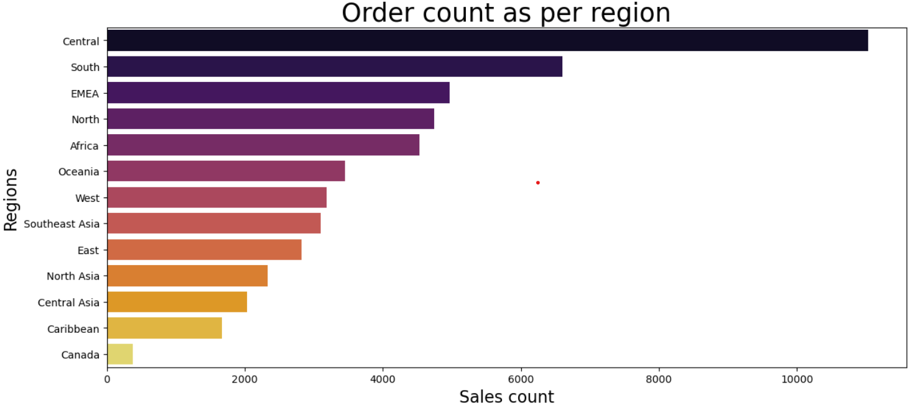
Data Visualization (Order Count)

Slide 13
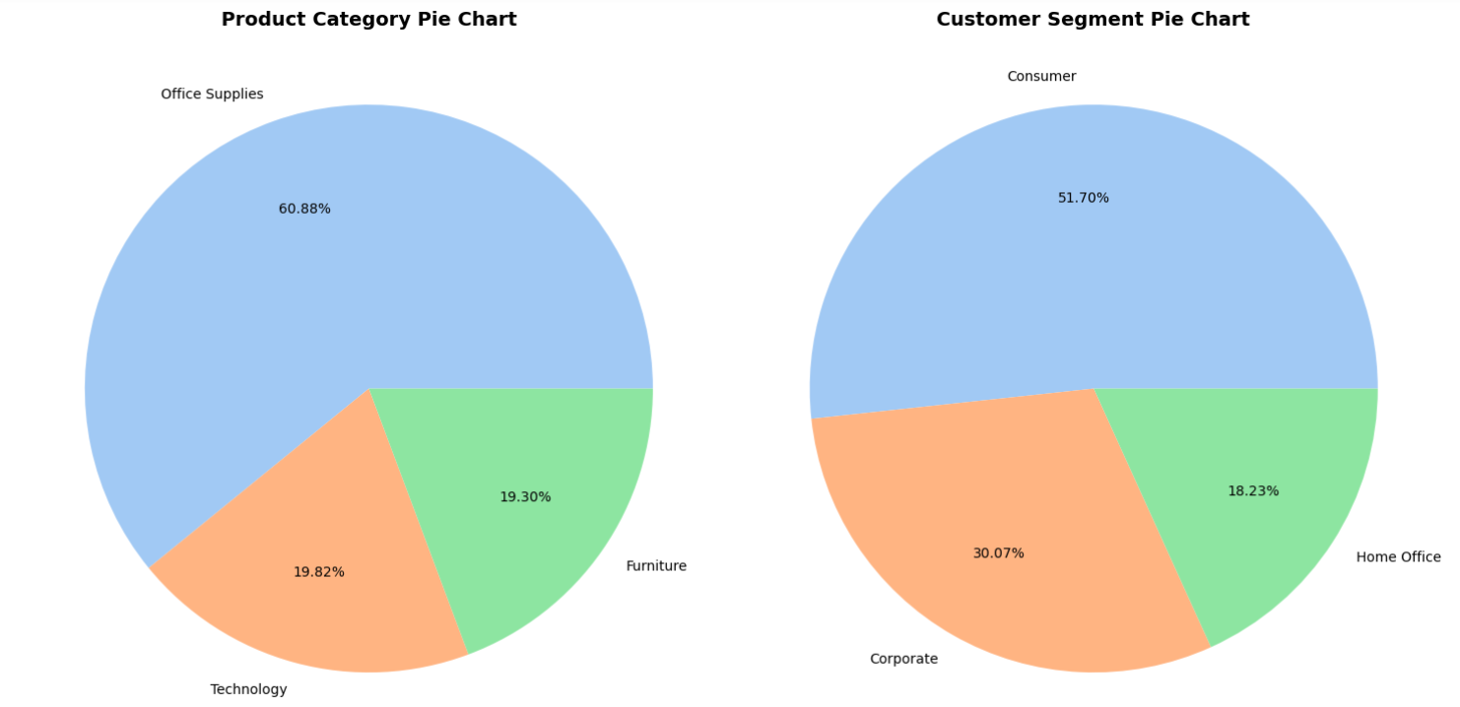
Data Visualization(Product and Customer)

Slide 14
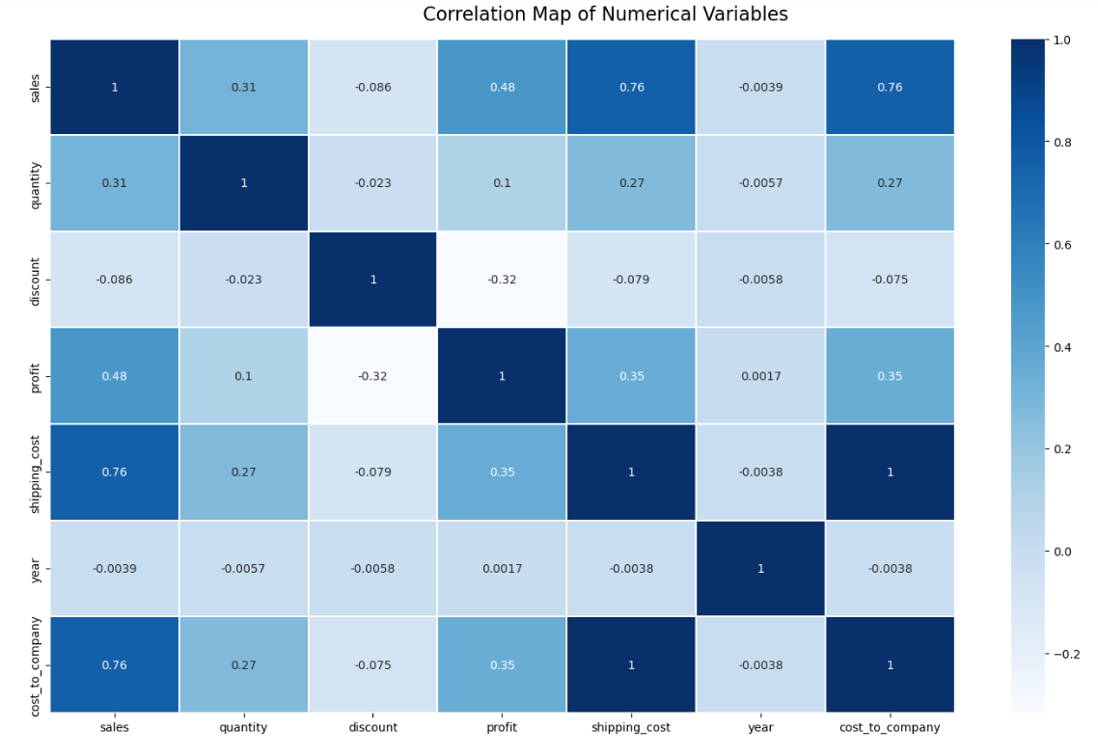
Data Visualization(Correlation)

Slide 15
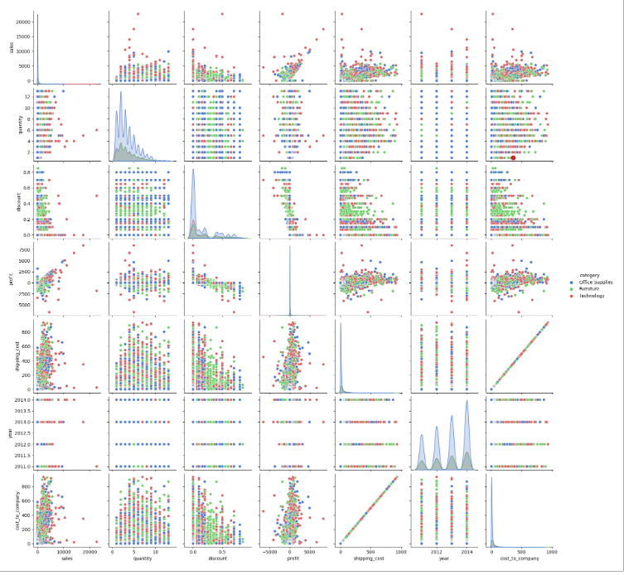
In [ ]:
Data Visualization (Pair Plot)

Slide 16
Conclusion
This is to state that we have learnt various insights of a commercial superstores from different region wise stating its profit, sales and quantity of products.

Slide 17
THANK YOU

