Slide 1


ScamShield
  Team name: pulse
  Team leader name: Nikhil Kumar
  Problem Statement: Invoice bank-detail changes can redirect a payment.

Slide 2
ScamShield invoice intelligence
Invoice fraud hides in ordinary payment work: a familiar invoice can carry a changed bank account or a request to bypass checks.
ScamShield is an invoice-first fraud intervention that combines Gemini’s semantic reading of payment instructions with deterministic transaction checks. The same pattern can extend to other payment rails.
LIVE PROTOTYPE Two synthetic invoice paths ran on the public service. People confirm extracted fields; policy returns Continue, Verify or Review. No payment is executed.

Slide 3
Invoice fraud in numbers
£41.3m UK invoice and mandate fraud losses · 2025
2,305 reported UK cases · 2025
68% of loss value on business and other non-personal accounts
Semantic context plus transaction checks can surface risky invoice instructions before payment.
Source: UK Finance, Fraud Report 2026, p. 41.
Notes:
Source: UK Finance Fraud Report 2026, p. 41. For 2025 UK invoice and mandate fraud: £41.3m gross losses across 2,305 cases; 68% of lost value was on business and other non-personal accounts. Reported totals include value later recovered. https://www.ukfinance.org.uk/system/files/2026-06/UK%20Finance%20Fraud%20Report%202026.pdf

Slide 4
Solution features
MODEL-READ SEMANTIC SIGNALS
Gemini classifies impersonation, safe-account claims, urgency, secrecy, upfront fees and verification bypass. For invoices, it also extracts candidate fields for a person to confirm.
DETERMINISTIC TRANSACTION CHECKS
Rules compare amount, payment history, vendor identity and destination account with available case and vendor records.
POLICY OUTCOMES
A deterministic policy maps the combined evidence to Continue, Verify or Review. Evidence and missing checks are saved with the case.

Slide 5
Invoice review flow
Invoice upload
Gemini field extraction
Human review and confirmation
Rules + Gemini context
Policy decision
Continue · Verify · Review
Firestore case record
On request: Gemini ranks saved evidence
Deterministic templates render the explanation
Synthetic demo only. The recommendation is simulated; no payment is executed.

Slide 6
Hybrid risk decision
Gemini semantic context
6 signals from payment language
Deterministic policy
Combine available evidence
Continue · Verify · Review
Transaction facts
Amount · history · vendor · destination
Policy example: impersonation + secrecy scores each ≥ 0.8 → Review
Scores describe language signals, not fraud probability.

Slide 7
Live Google Cloud architecture
Firebase anonymous auth
Browser client
React
Cloud Run
FastAPI
Vertex AI
Gemini 2.5 Flash-Lite
Firestore
Owner-scoped cases + quotas
Cloud Run owns deterministic policy and Firestore writes. Gemini classifies context and orders recorded evidence on request; templates render explanations. No payment executes.

Slide 8
Technology stack
LIVE PROTOTYPE
React and TypeScript · Python FastAPI · deterministic policy
Firebase anonymous authentication · Firestore · Cloud Run
Vertex AI Gemini 2.5 Flash-Lite for invoice extraction and semantic classification
NEXT CLASSIFIER: JEV
Jev is a candidate structured decision model for a low-latency classification path. Its adapter passes fixture tests but is disabled on live GCP. Latency and quality remain unmeasured.
Notes:
TypeSafe describes Jev as a structured probabilistic decision model intended to emit actionable structured decisions. ScamShield’s adapter passes fixture tests but is disabled on live GCP. Jev has no measured latency or quality result in this project. https://typesafe.ai/blog/introducing-system-one-models-and-jev

Slide 9
Cost and data safeguards
CLOUD COST STATUS
Cloud Run, Firestore and Vertex AI calls may incur charges. Credit coverage is unconfirmed.
MODEL REQUEST LIMITS
9 attempts per visitor per day · 50 globally per day · 200 total. These restrict model calls and are not a billing cap.
Use synthetic invoice data only.
Notes:
ScamShield uses Vertex AI Gemini 2.5 Flash-Lite, Firebase Authentication, Firestore and Cloud Run. 59 backend tests passed. Live synthetic invoice checks covered extraction, classification, requested explanation, Firestore reads, idempotency, restart durability and visitor isolation. Use synthetic data only.

Slide 10
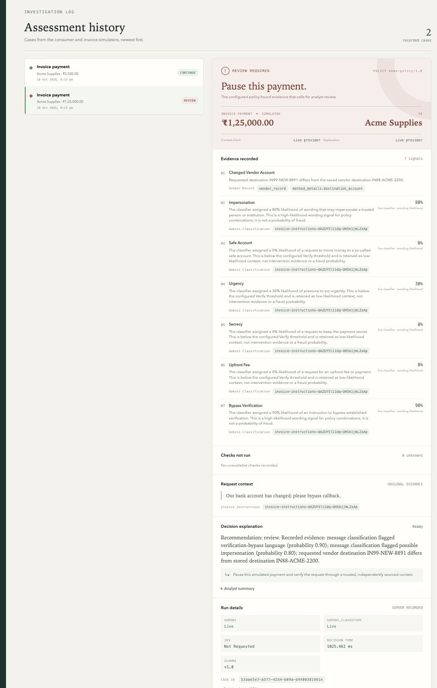
Live synthetic case evidence
LIVE SYNTHETIC INVOICE CASE
The public app used Vertex Gemini to extract fields and classify request context. The person confirmed the vendor destination before assessment. The deterministic policy then assessed recorded evidence.
One invoice matched the saved account and returned Continue. The changed destination case returned Review. A requested explanation used Gemini-ranked saved evidence with deterministic templates. Firestore retained both cases across a deployment revision. No payment moved.

Slide 11
Prototype verification
SOFTWARE CHECKS
59 backend tests pass in the release check.
LIVE INTEGRATION CHECK
Two synthetic invoice paths completed with live Vertex Gemini extraction and classification. A requested explanation used Gemini-ranked evidence with deterministic templates. Firestore readback, retry idempotency, restart durability and visitor isolation were verified.
EVIDENCE LIMIT
These checks establish integration behavior, not fraud-detection accuracy or model latency. No accuracy or latency benchmark is claimed.

Slide 12
Future development
NEXT STEPS
01 Benchmark Jev against Gemini on a reviewed case set: p50/p95 latency, precision, recall, false-positive rate and calibration.
02 Keep Jev disabled until quality and operational checks are complete.
03 Add verified vendor feeds and extend beyond invoices to more payment rails.
04 Preserve human review and deterministic policy control; the app never initiates a payment.

Slide 13
Submission links
Public repository
https://github.com/NikhilBudaniya/scamshield
Live Cloud Run app
https://scamshield-304420617883.us-central1.run.app
Demo video
Watch recorded demo
Use synthetic examples only. No payment is executed.

Slide 14


