Slide 1
Chat-Bot : Author

Slide 2
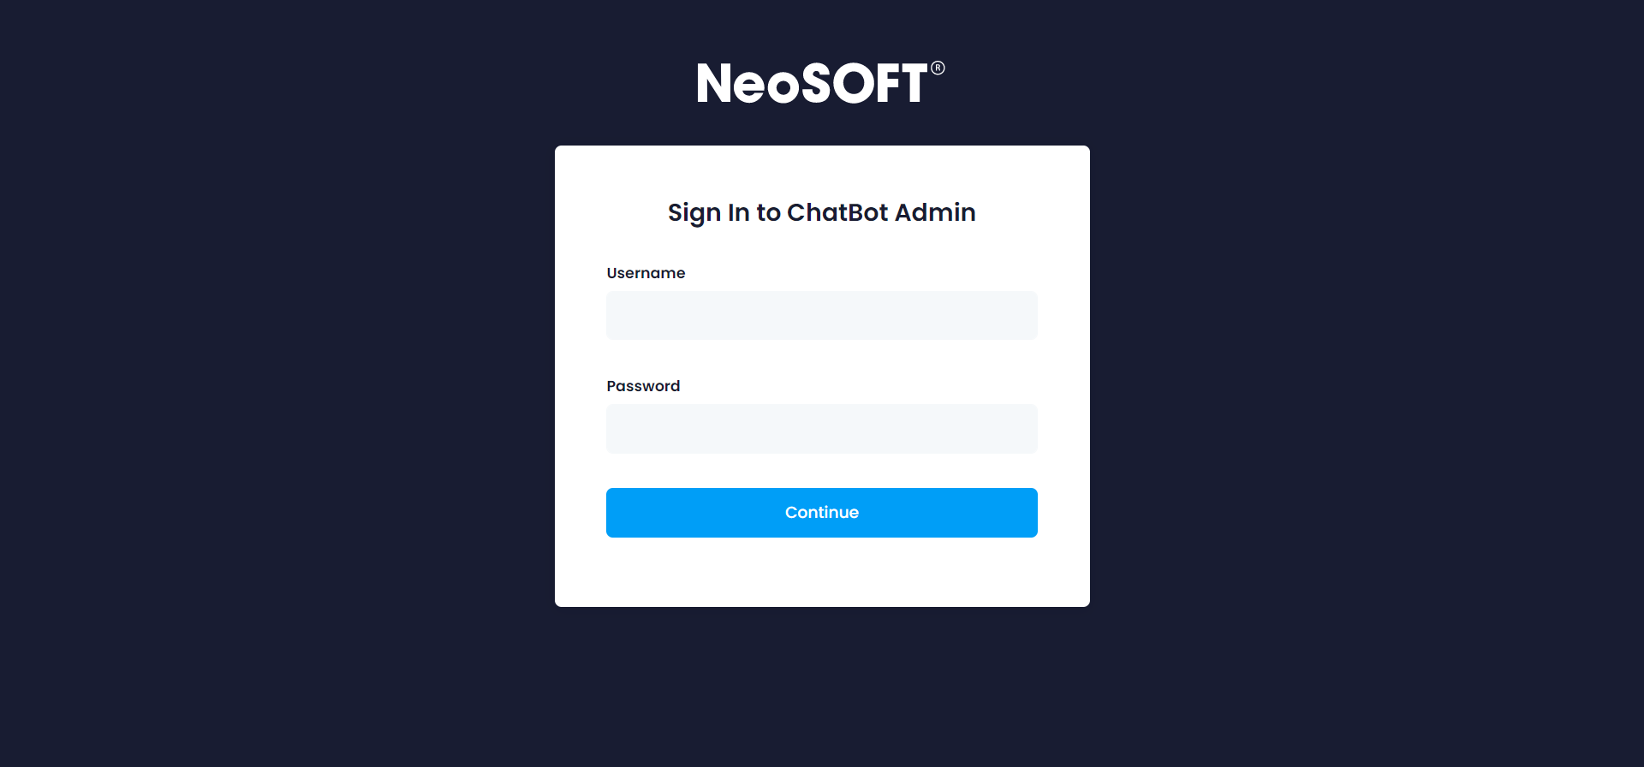
Login

Slide 3
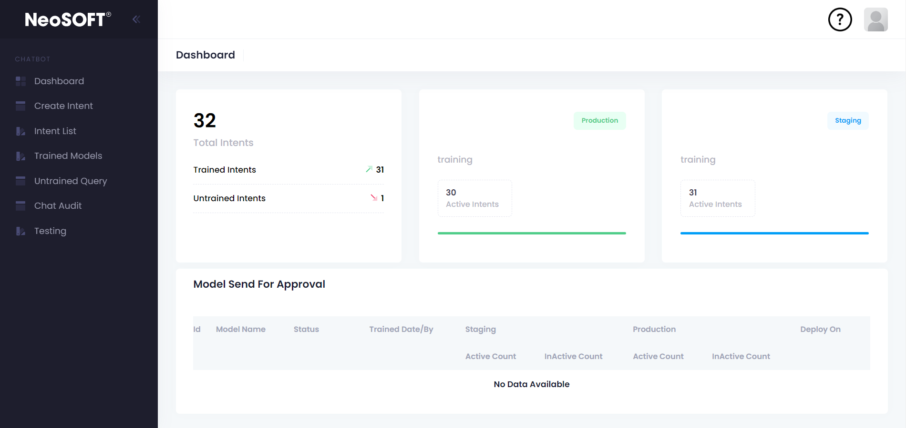
Author Dashboard
Total Intent Details
Current Production Model
Current Staging Model
Pending for Approval model List

Slide 4
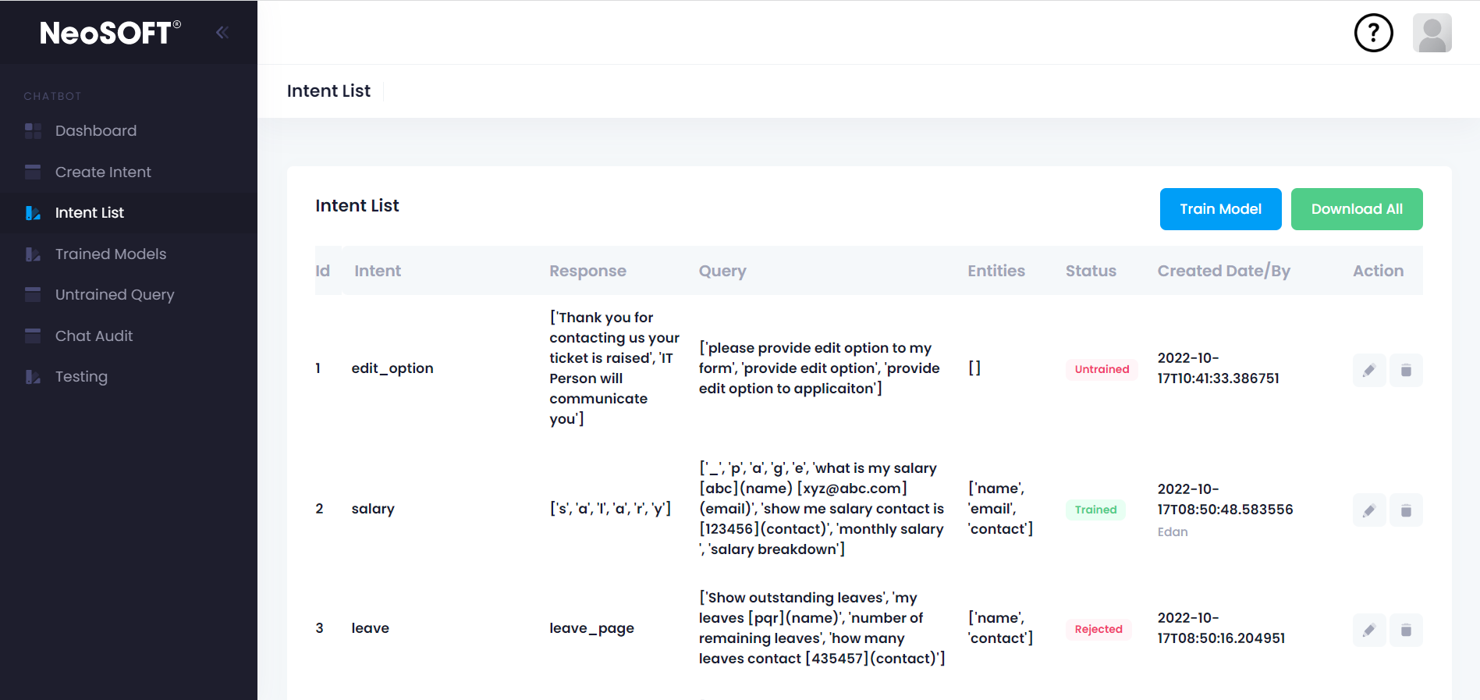
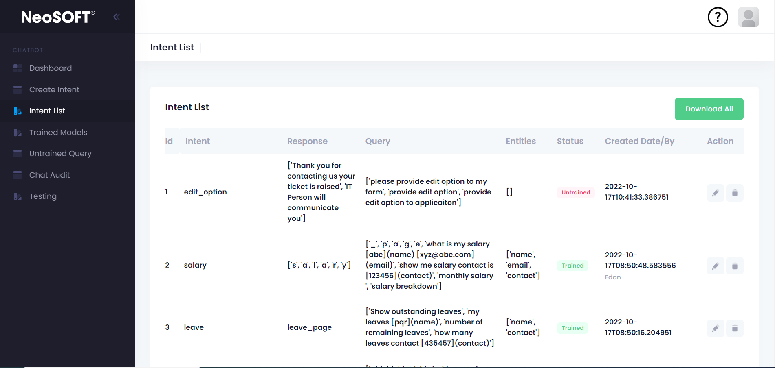
Intent List
Edit / Delete
Edit/Delete
Train Model – We can train our all intents only when 1) At least Single Intent is untrained 2) Latest Model Status need Approved or Rejected

Slide 5
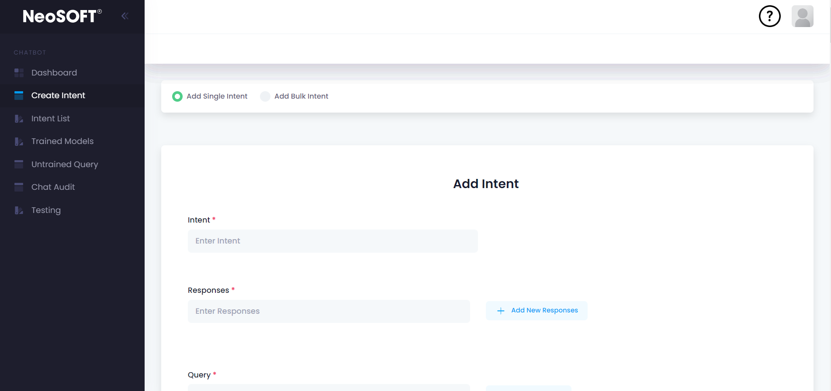
Add New Intent

Slide 6
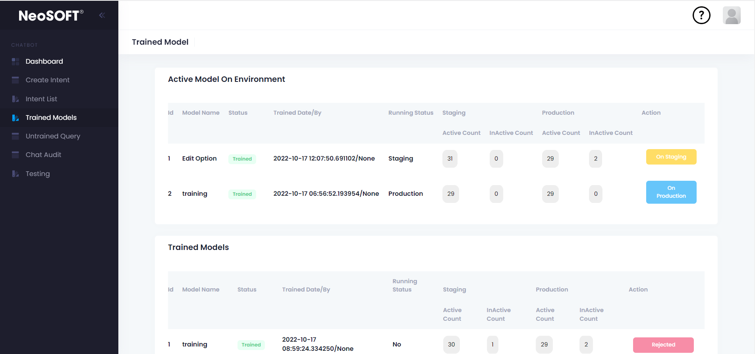
Trained Model List

Slide 7
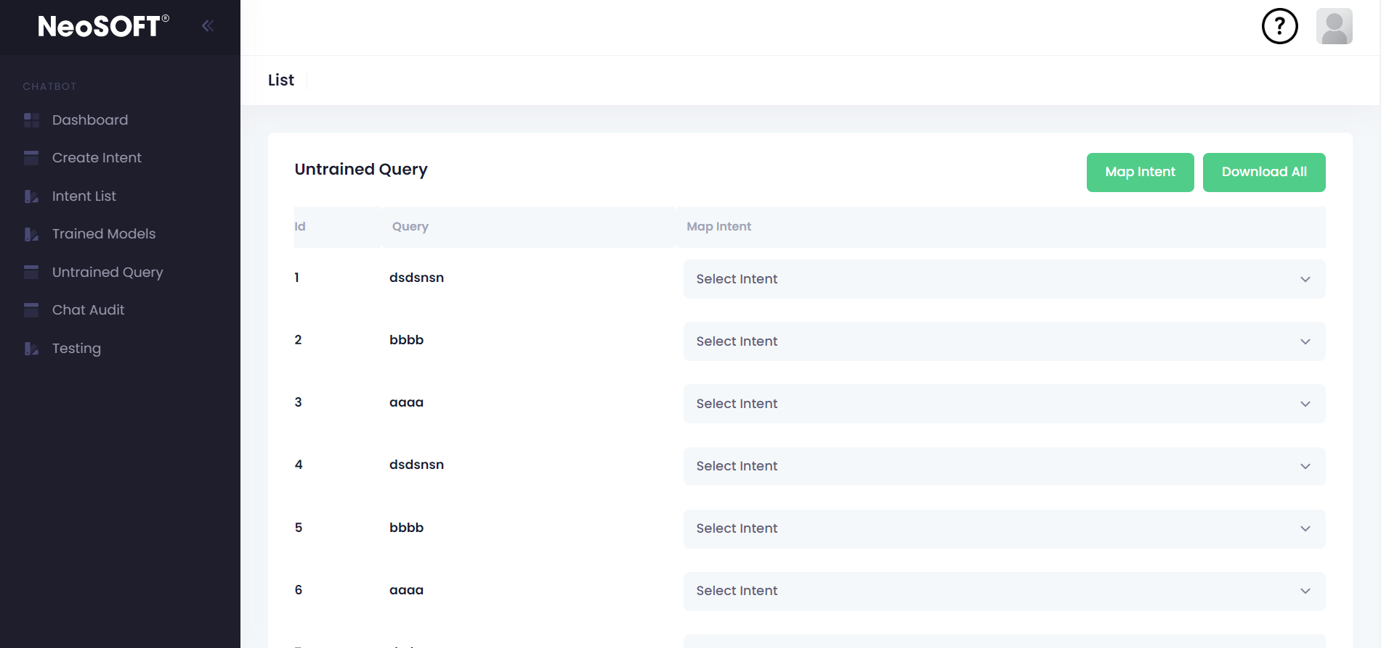
Untrained Query
Here we can Map Untrained Query with proper Intent

Slide 8
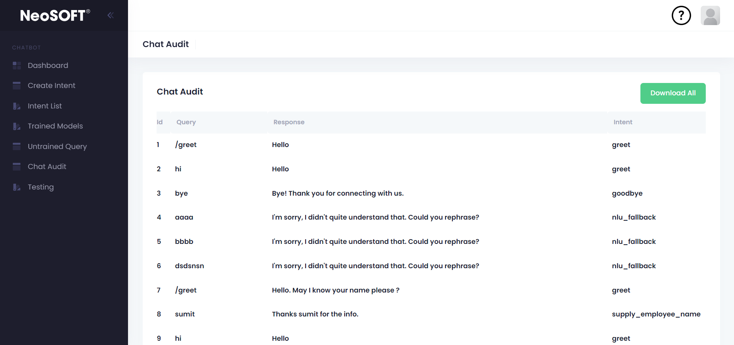
Chat Audit
List of all chats and their responses happened on our chatbot

Slide 9
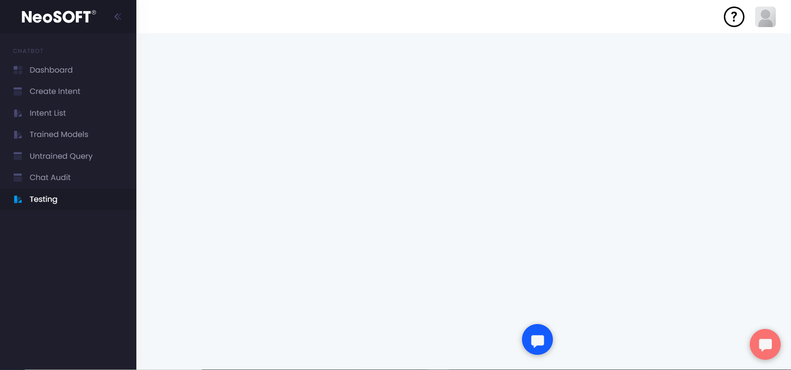
Chat-Bot Testing

Slide 10
Author Access
Add Intent
Add Single Intent
Add Bulk Intent
Edit Intent / Delete Intent
Train Model with new Intents
After Training author can test particular model on Staging Environment
Can reject model after testing
Can Approve Authors Models

Slide 11
Thank You

