Slide 1
Chat-Bot

Slide 2
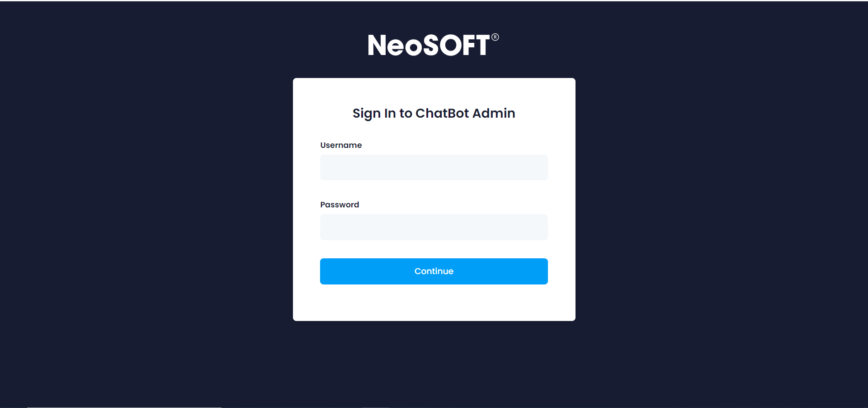
Login Page

Slide 3
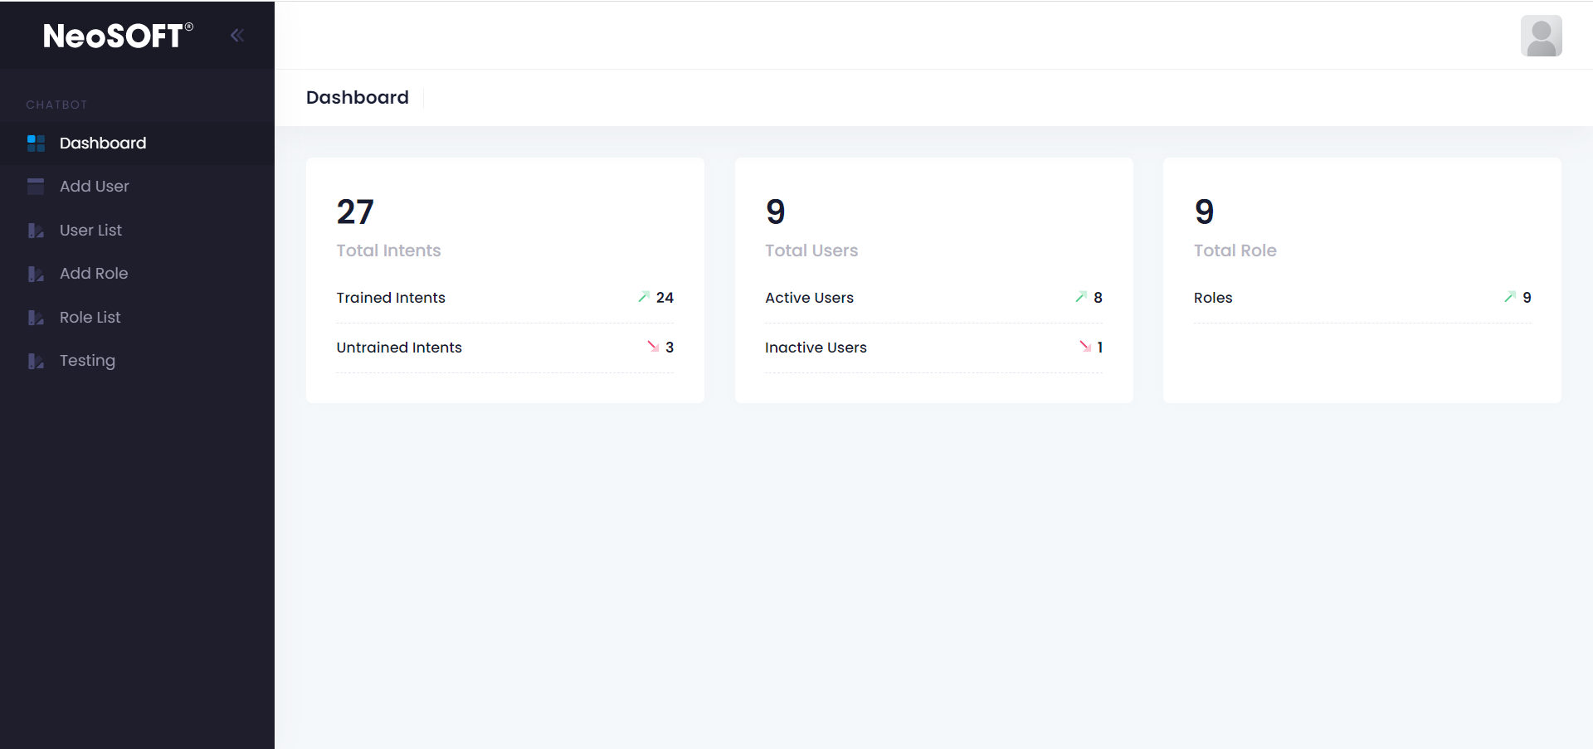
Super Admin Dashboard

Slide 4
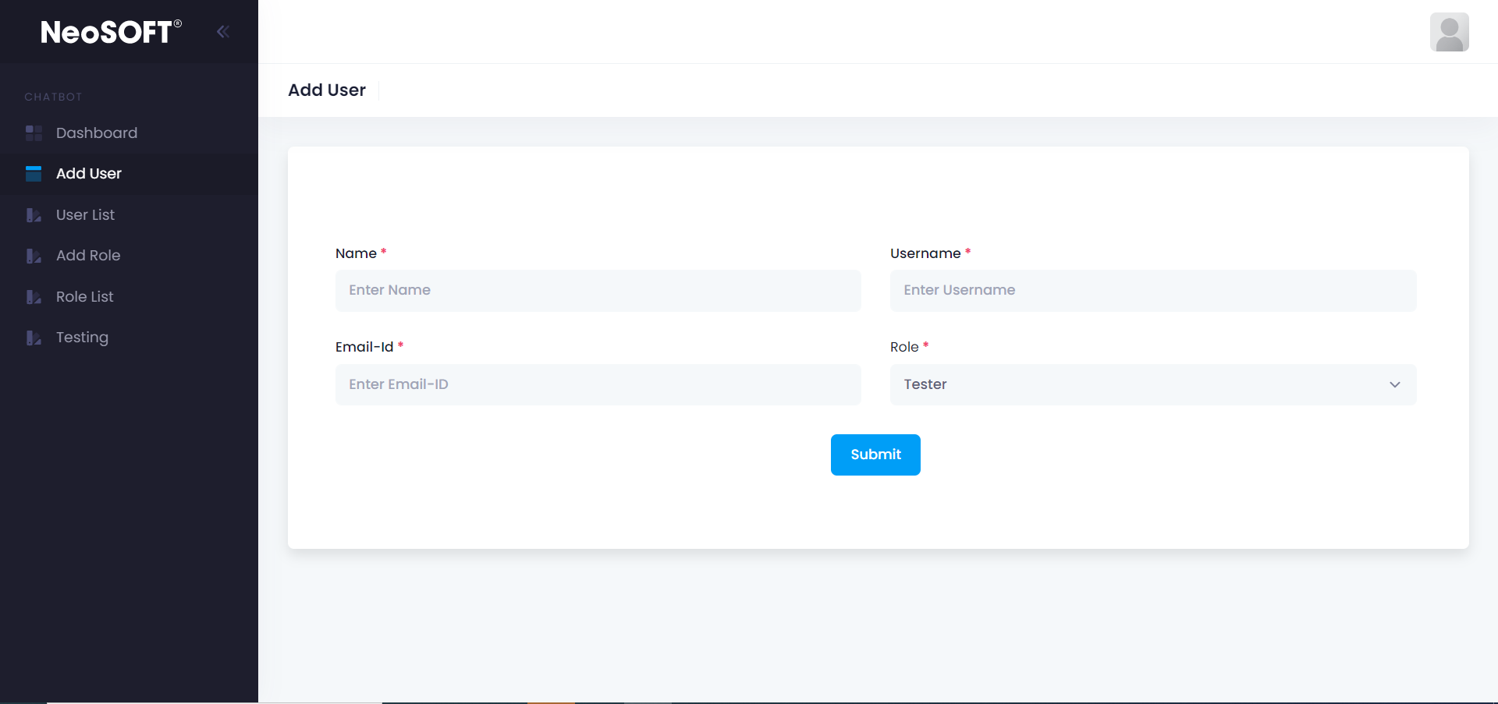
ADD User
Add new admin with appropriate role(access)

Slide 5
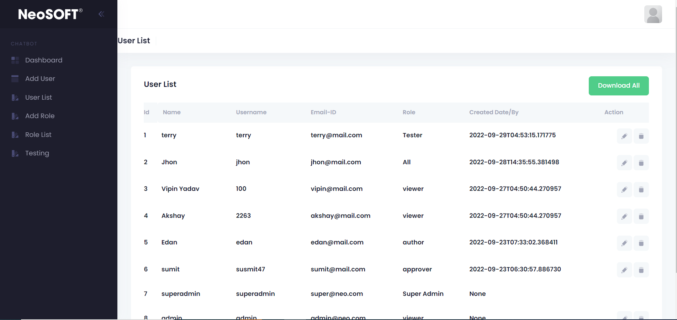
All Users List
List of all users with there role. We cant remove Super Admin

Slide 6
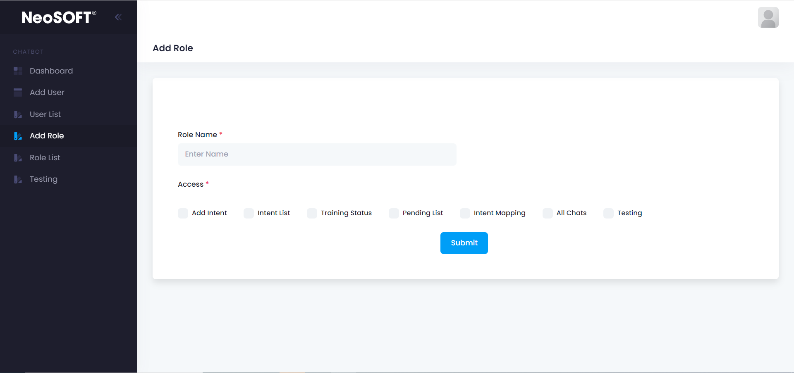
Add Role
Super Admin can - Add New Role with selected Access

Slide 7
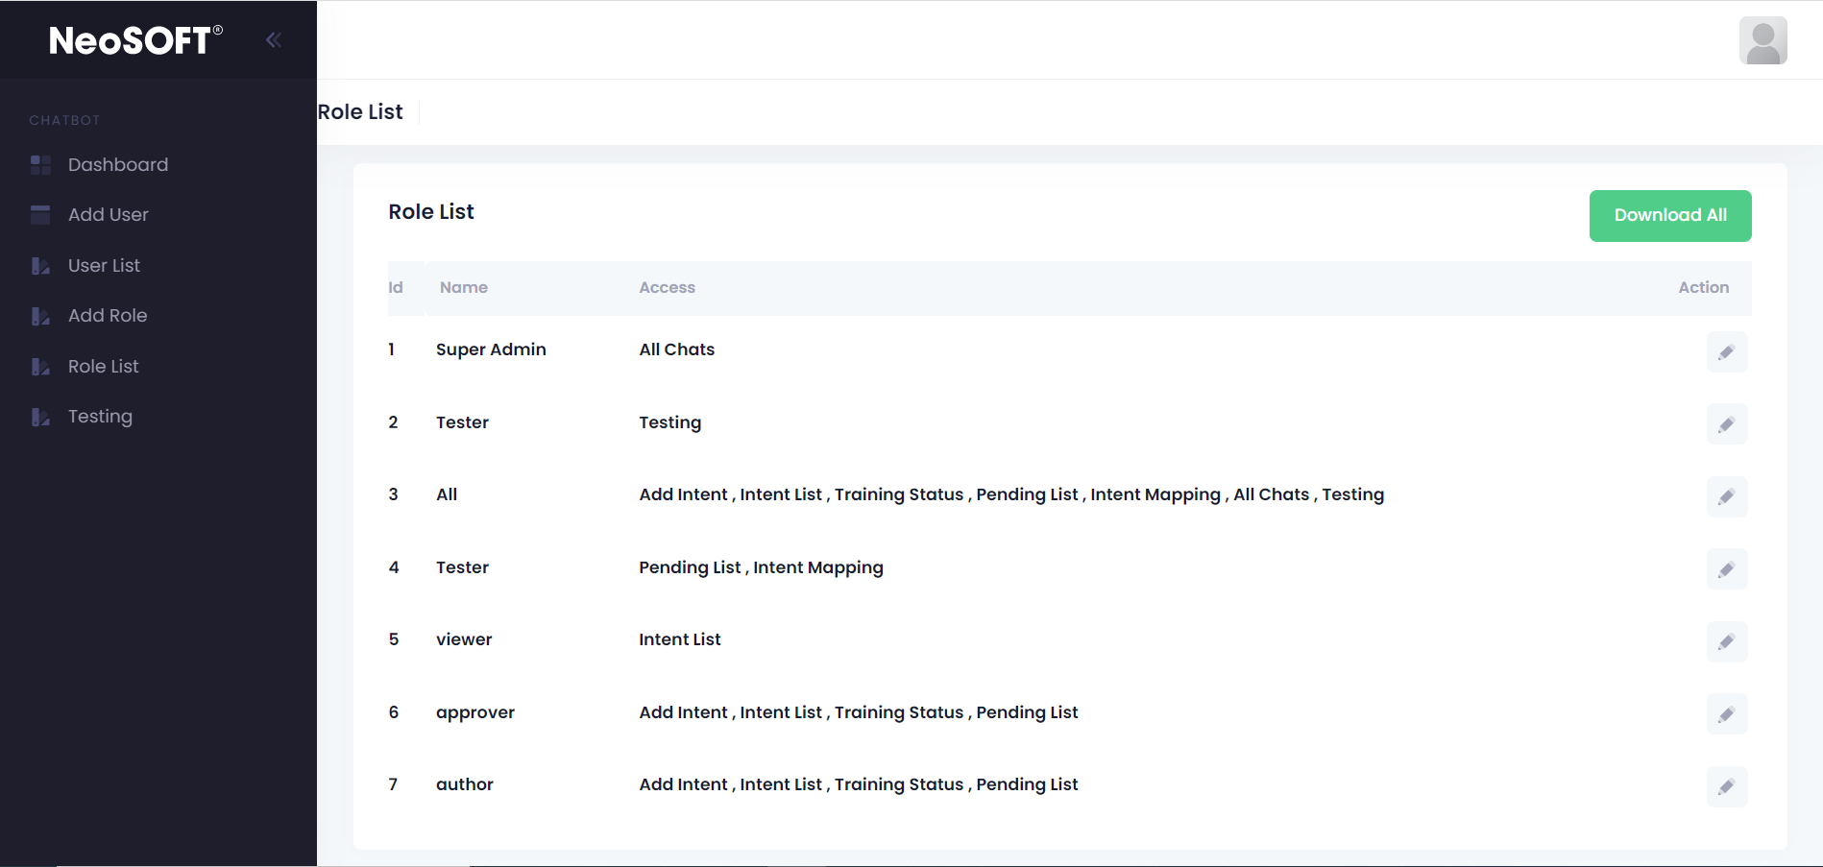
Role List
All Role List. Super Admin can - Edit role with selected Access

Slide 8
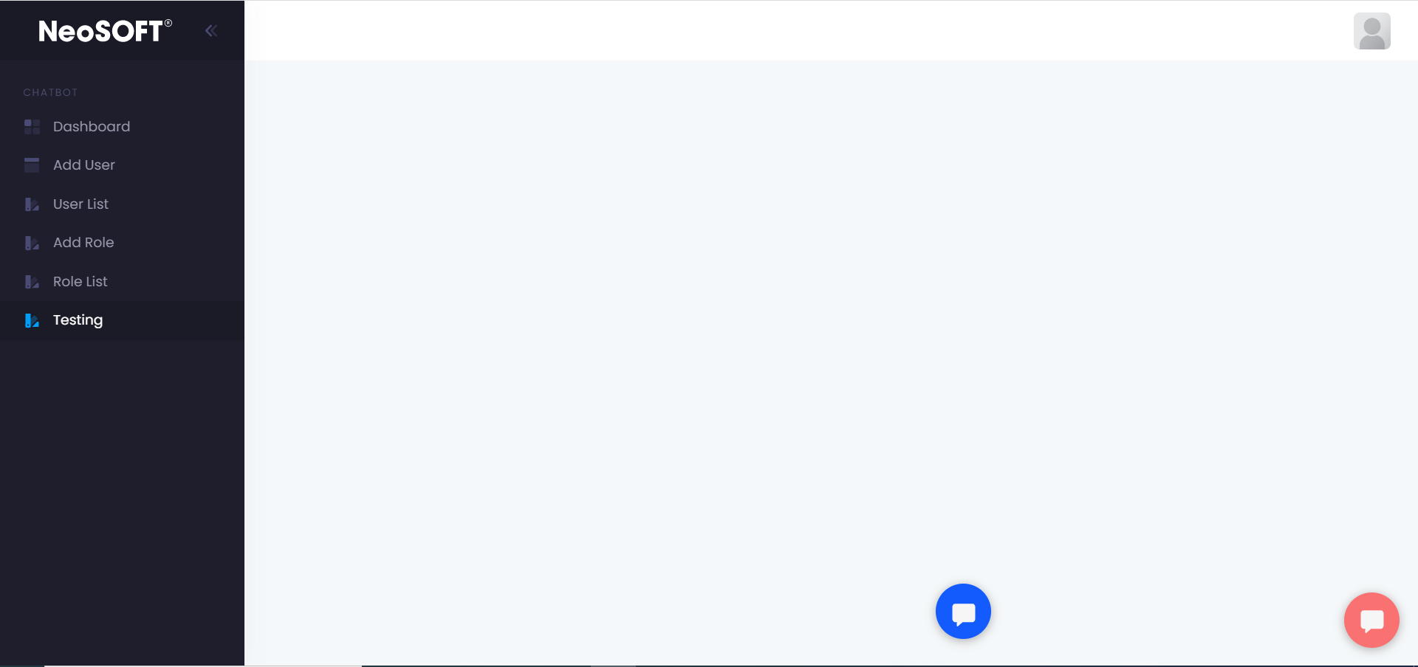
Test Chat-Bot working

Slide 9
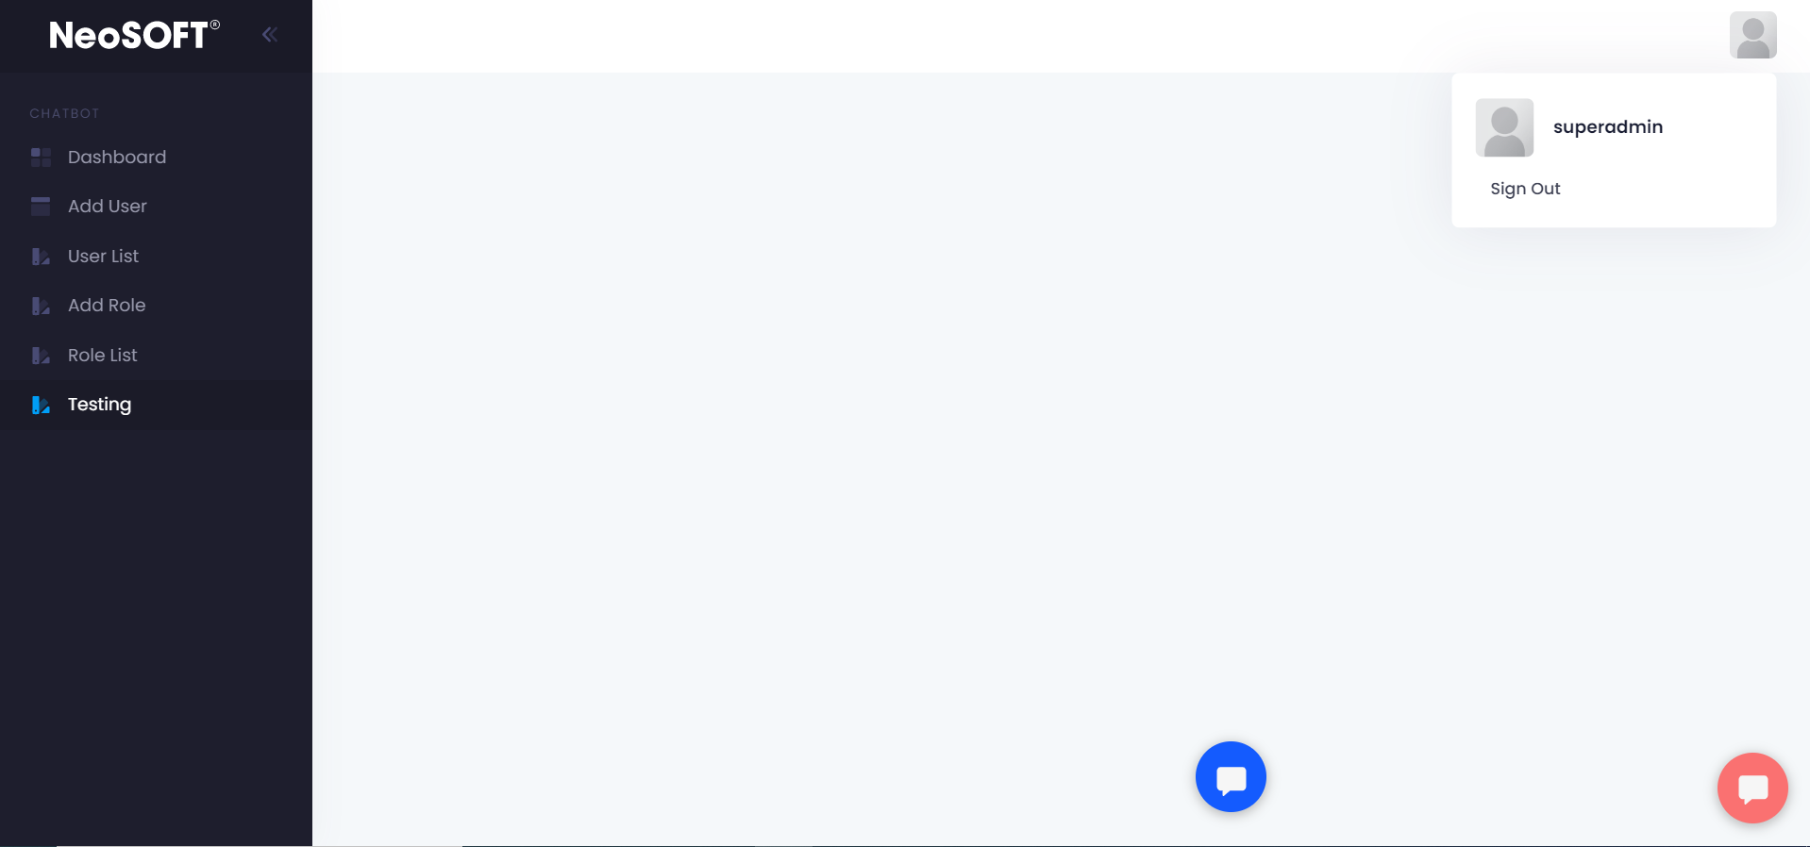
Logout

Slide 10
Thank You

