Slide 1
Hi :)

Slide 2
What do you do when you’re hungry...
And, you don’t feel like cooking...
And, your friends said that they cannot hang out...

Slide 3
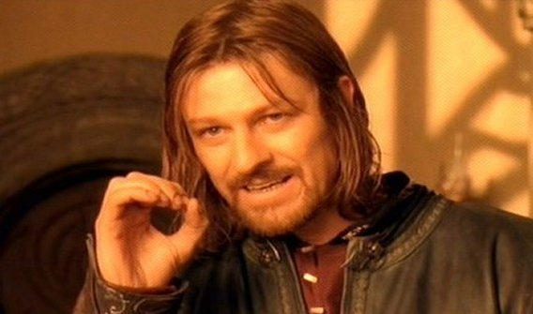
YOU ARE A SOFTWARE ENGINEER!!
You write a script that orders a pizza for you...

Slide 4

Couldn’t you just order the pizza ONLINE via phone or the INTERNET?

Slide 5
In computer programming, an Application Programming Interface (API) is a set of subroutine definitions, communication protocols, and tools for building softwares.
In general terms, it is a set of clearly defined methods of communication among various components.
What’s an API?

Slide 6
LET’S ORDER PIZZA PROGRAMMATICALLY!!

Slide 7
INSTRUCTIONS: Know the delivery address Know the nearest dominos Give them our order Pay for our order

Slide 8
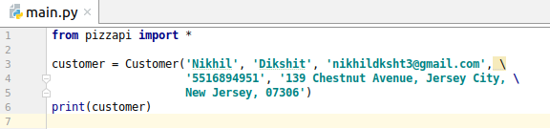

WHO AM I?

Slide 9

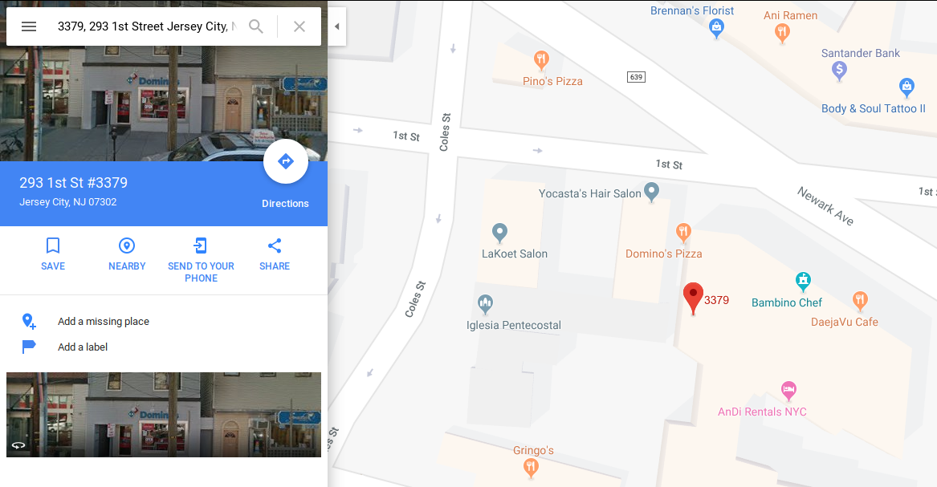

LET’S GET OUR STORE!

Slide 10

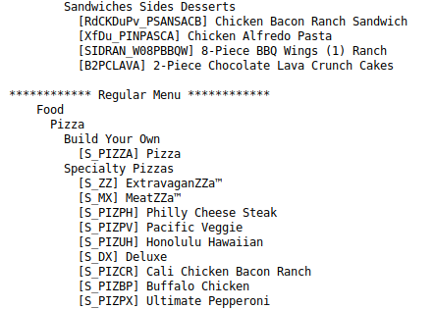
OKAY, LET’S SEE THE MENU?

Slide 11
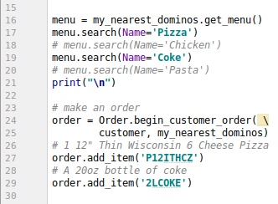
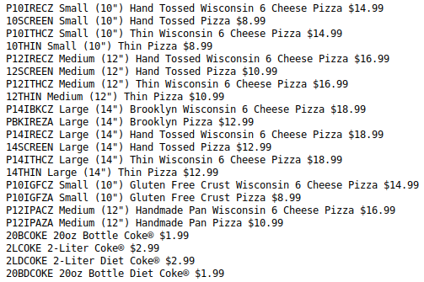
WHAT DO I WANT TO TREAT MYSELF?

Slide 12
WE’RE ALMOST THERE!!!

Slide 13

GUYS!?!?

Slide 14
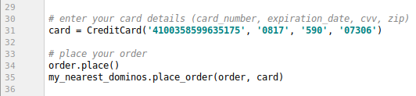
PAY AND WE’RE DONE!

Slide 15
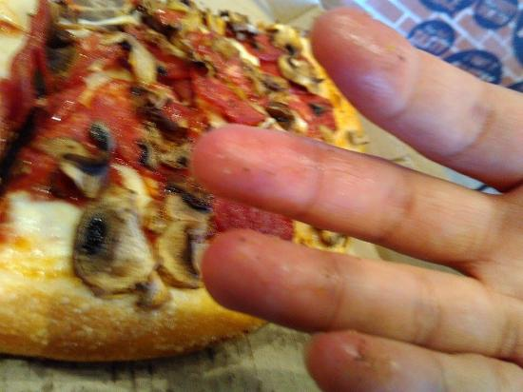

Slide 16
If you order something using this, let me under my thread on Blackboard.
THANKS!

