Slide 1
Design & Analysis of Algorithms
Vertex k – Labelling of Non-Homogeneous Caterpillar Graph
Nikhil Gande, Rishab Macherla, Sravan Kumar Sankalamaddi, Vamshidhar Reddy Erigela, Sai Kumar Kothuru, Manoj Reddy Yasa, Gowthami Annem, Manisha Sankalamaddi, Vinithanjani Kolli, Gayathri Sarapu.

Slide 2
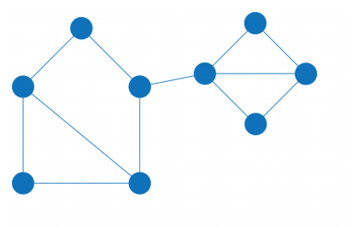
What is Graph?
A Graph in Data Structure is a non-linear data structure that consists of nodes and edges which connects them.
A Graph in Data Structure is a collection of nodes that consists of data and are connected to other nodes of the graph.

Slide 3
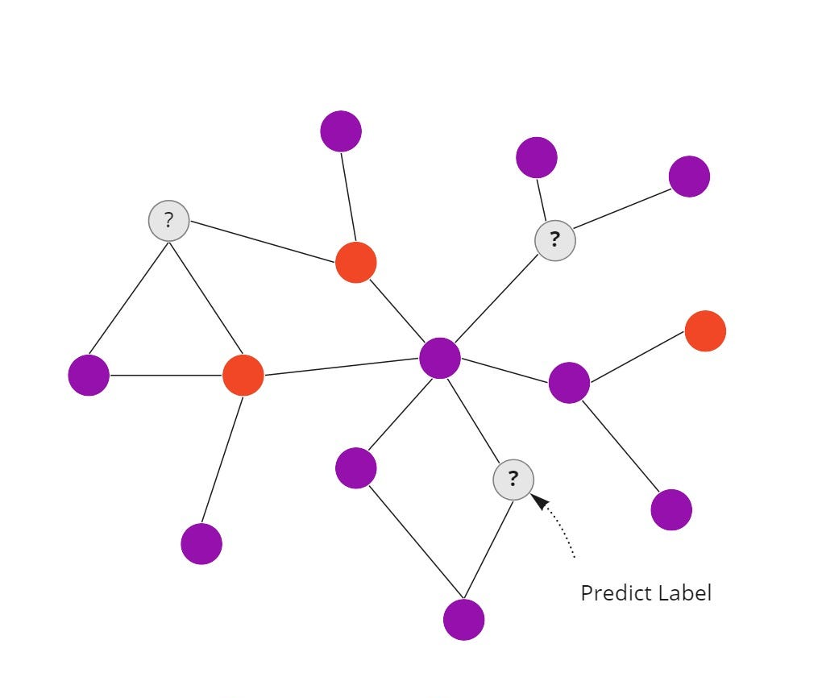
What is Graph Labelling
An assignment of integers to vertices or edges, or both, under certain conditions. There are different labeling in Graphs
Vertex labeling: Assigning labels to the vertices of a graph. This is used in various fields, such as computer science, chemistry, and social network analysis.
Edge labeling: Assigning labels to the edges of a graph.
Graph coloring: Assigning colors to the vertices or edges of a graph.
Distance labeling: Assigning labels to the vertices of a graph based on their distance from a particular vertex or set of vertices.

Slide 4
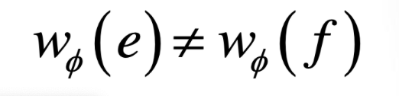
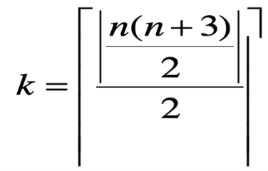
What is Vertex – K Labelling
In 2014 Ahmad introduced vertex k-labeling.
For every two different edges e and f
i.e., this means that, no two edges should have same weights i.e., edge weights should be unique.
What is the difference between Graph Vertex Labelling &
Vertex K – Labelling???
In Vertex Labelling, we label the vertex with some condition depending on the type of graph we are labeling but, incase of Vertex K – Labelling, the maximum weight the vertex can be ‘k’.

Slide 5
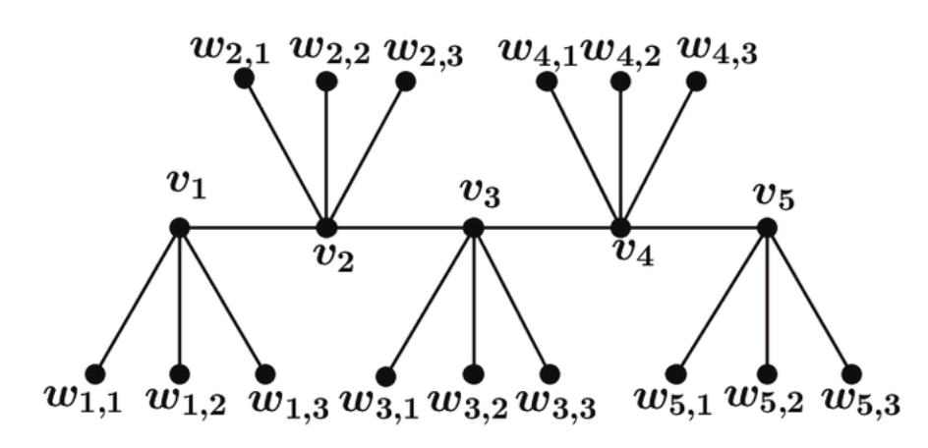
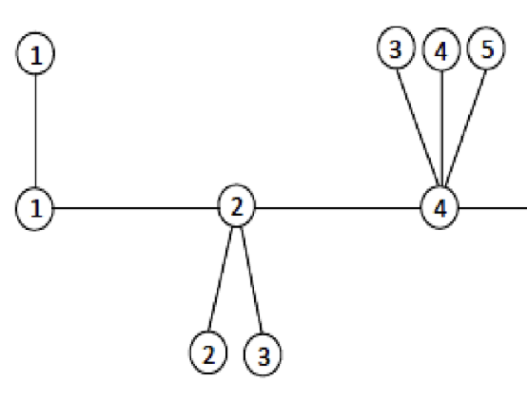
Homogeneous Caterpillar Graph vs Non - Homogeneous Caterpillar Graph??
A Homogeneous Caterpillar Graph is a Graph in which the number of pendant vertices in for a star is not unique
Ex:
A Non-Homogeneous Caterpillar Graph is a Graph, in which, the number of Children for each star will be unique.
Ex:
 | In this graph, the first star v1, has 3 children (pendant vertices). The second star v2, also has 3 children(pendant vertices). “So, in a Homogeneous Caterpillar Graph, the number of children will not be unique.”
 | In this graph, the first star v1, has 1 children (pendant vertices). The second star v2, also has 2 children(pendant vertices). “So, in a Non-Homogeneous Caterpillar Graph, the number of children will be unique.”

Slide 6
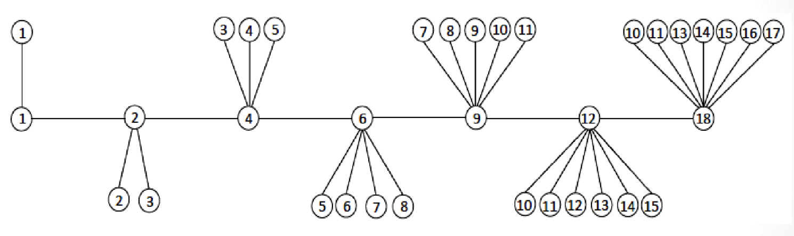
Also, in a Non – Homogeneous Caterpillar Graph,
Ex:
So, from this, graph, if, we consider, star 1, it has 1 child.
Similarly, Star2, it has 2 children, ….Star 7 it has 7 Children, so that, the number of children for each star is unique satisfying the property of Non-Homogeneous Caterpillar Graph.

Slide 7
Conditions to follow when performing Vertex K-Labelling for a Non-Homogeneous Caterpillar Graph:
Therefore, here, in our case, we have to achieve Vertex K-Labelling for Non – Homogeneous Caterpillar, i.e.,
When labelling, we have to keep in mind the following conditions
No 2 edges in the graph should have same weights.
The maximum label for the vertex should not be more than k.

Slide 8
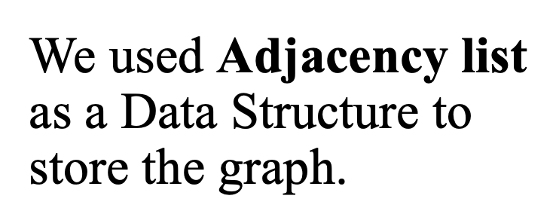
Algorithm
class node{
constructor(sn) {
this.star_number=sn;
this.label=1;
this.neighbour_nodes=[];
this.next_node=null;
}
}
star_number: represents the star number of a particular star in the given graph.
label : represents the main label of a particular star
next_node: connects the other star by storing the address of immediate star in the graph.

Slide 9
let edge_weight=[]; function generate_caterpillar(n){ let initial_node=new node(1); initial_node.label=1; initial_node.neighbour_nodes.push(1); edge_weight.push(2); if(n==1) return initial_node; let present_star=initial_node; for(let i=2;i<=n;i++){ presentstar=generateStar(present_star,initial_node,n,i); present_star=presentstar; } return initial_node; } | function generateStar(presentStar,initial_node,n,i){ let newstarnum=presentStar.star_number+1; let new_node=new node(newstarnum); presentStar.next_node=new_node; if(i==n){ new_node.label=Math.ceil(n*(n+3)/4); edge_weight.push(new_node.label+ presentStar.label); } else { generateMainlabel(presentStar,new_node); for(i=1;i<=new_node.star_number;i++) { generateChildrenforStar(new_node); } return new_node; }
Content
Content

Slide 10
function generateChildrenforStar(nn){ let parent_label=nn.label; assigned_label=2; let check=true; while(1){ let total=parent_label+assigned_label; check=edge_weight.includes(total); if(!check){ edge_weight.push(total); nn.neighbour_nodes.push(assigned_label); break; } assigned_label=assigned_label+1; } } | function generateMainlabel(ps,nn){ node_l=2; previous_l=ps.label; let check=true; while(1){ total=node_l+previous_l; // used for checking weight check=edge_weight.includes(total); # check whether weight is in weight[] if(!check){ nn.label=node_l; edge_weight.push(total); break; } node_l=node_l+1; } }
Content
Content

Slide 11
let start_node=generate_caterpillar(3);
console.log(edge_weight)
/*for(let i=0;i<edge_weight.length;i++){
console.log(edge_weight[i]);
}*/
// Travesing the graph
for(i=1;i<=12;i++){
console.log(start_node.label);
let num=start_node.star_number;
let s=start_node.neighbour_nodes;
console.log(s);
start_node=start_node.next_node;
}
Content

Slide 12
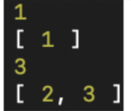
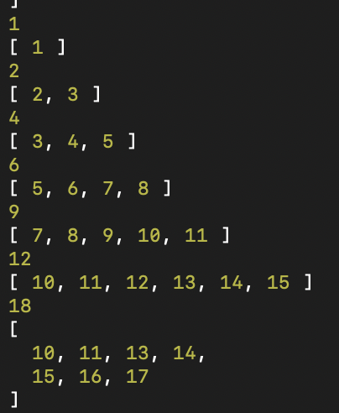
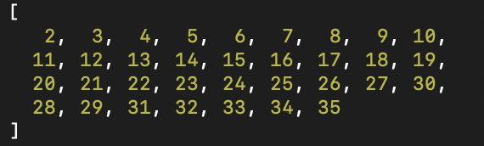
Sample Outputs for different number of Stars
n - value | V(G) ( Vertex Labels of Graph G) | E(G) – Edges weights of the Graph (G)
2
7
[ 2, 4, 5, 6 ]

Slide 13
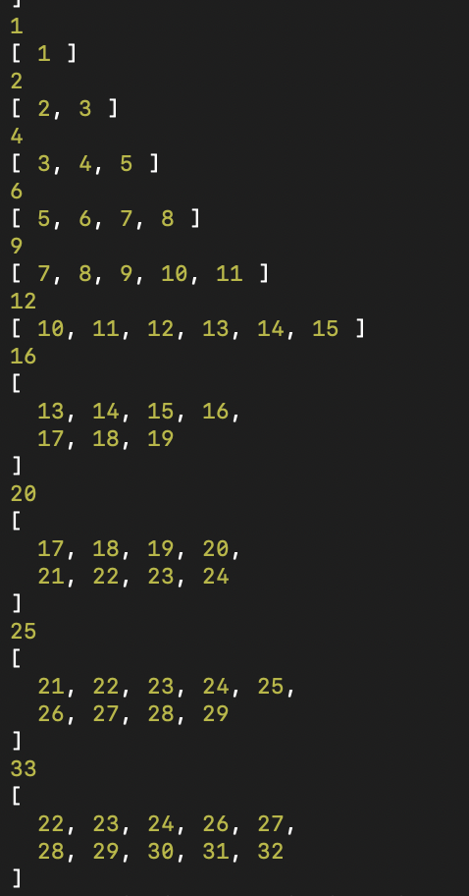
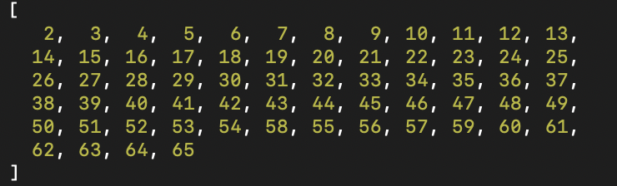
Contd..
n - value | V(G) ( Vertex Labels of Graph G) | E(G) – Edges weights of the Graph (G)
10

Slide 14
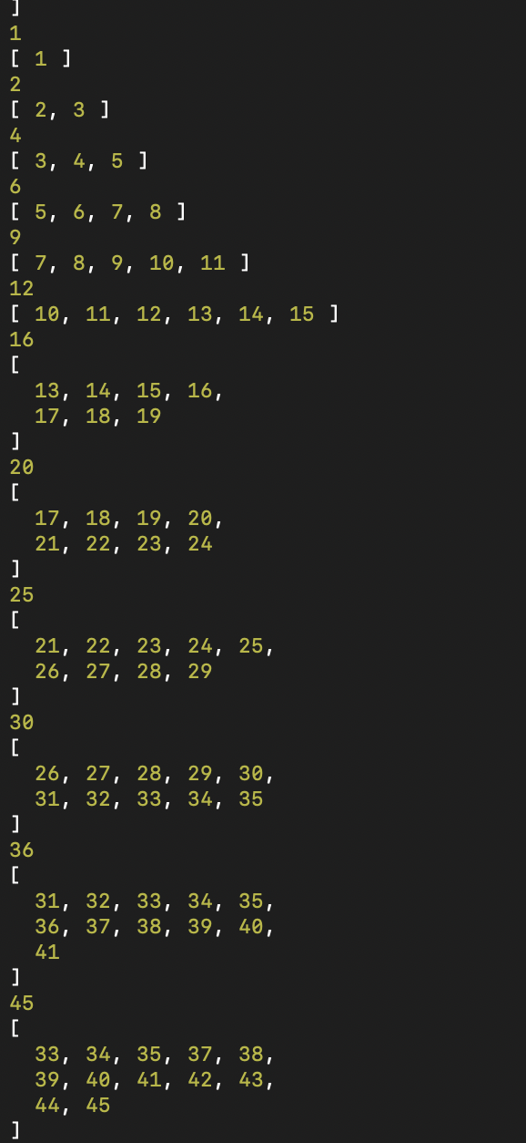
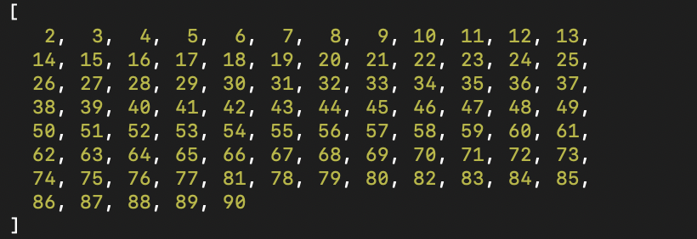
Contd..
n - value | V(G) ( Vertex Labels of Graph G) | E(G) – Edges weights of the Graph (G)
12

Slide 15
Analyzing Time Complexity
For our Algorithm, we have used Bootstrap Approach.
In the given graph, for each node the number of sub nodes is increasing as given below
1+2+3+4+……=n(n+1)/2
Where n=number of vertices in the given graph
So, the overall time complexity is O(n²)

Slide 16


Slide 17


