Slide 1
SAMSUNG PRISM - MONTHLY PROGRESS REVIEW
PRISM
A consent management and data-rights (DSAR) platform
built for India's DPDP Act, 2023
Reporting period: 19 July 2026 - 19 August 2026
Progress | KPIs | Model choices | Challenges | Results | Observations | Next two weeks

Slide 2
CONTEXT
What PRISM does, in plain words
The problem
Samsung collects photographs, audio, video and written transcripts of real people. The law says a person may ask what is held about them, and may ask for it to be deleted.
THE FLOW, END TO END
1
Approve
The DPO approves the project and its consent notice
What we built
One platform that records consent before collection, hides anyone who did not consent, and can find and erase one person's data on request.
2
Consent
The person scans a QR code, reads the notice, signs consent
Who uses it
Five staff roles - DPO, Data Owner, Collection Agent, Data Admin, Platform Admin - and the person themselves, the Data Principal.
3
Collect
The agent captures images, audio or a written transcript
4
Protect
AI blurs faces, masks identity text, mutes unknown voices
Two apps
An admin portal for staff, and a mobile-first portal so a person can see their own data and raise a request without asking anyone.
5
Prove
Every action is written to a tamper-evident audit chain
6
Erase
A request finds the data, exports or deletes it, and signs a certificate
PRISM - Monthly Review - August 2026
2

Slide 3
1 - PROGRESS
Last month's progress at a glance
Dates
Milestone
What it means
19 - 28 Jul
Core platform (waves 0-6)
Projects, consent notices, capture sessions, face redaction, identity-text masking, audit chain, least-privilege database role
28 Jul - 1 Aug
DSAR system completed
All 9 planned phases: item index, import path, per-item search and actions, scoped purge, export packages, request timeline
1 - 16 Aug
Audio pipeline and hardening
Audio worker built; production-readiness Phase 0 (security blockers) and Phase 1 (role model) closed
16 - 17 Aug
Voice made first-class
Voice enrollment stored and erasable, gallery-based speaker matching, audio wired into retention and purge
18 - 19 Aug
Audio proved, text pipeline added
The audio pipeline run end to end on a real recording for the first time; a third capture type for written transcripts, redacted with Presidio and spaCy
18 - 19 Aug
Video capture started
New video tables, upload route, and a worker that tracks faces across frames and blurs them
Headline: the platform now runs end to end for images, audio and written text - approve, consent, collect, protect, prove, erase. Video is the leg currently being built.
PRISM - Monthly Review - August 2026
3

Slide 4
1 - PROGRESS
What we actually shipped
Bringing in a person's existing data
Before, a photo could only enter through a live session, so older material was invisible to a data request. Admins can now import it, and the missing consent is recorded honestly rather than hidden.
Audio, proved on a real recording
A 1 minute 49 second clip: two speakers separated, the consented speaker kept, the unknown speaker muted, and ten spoken-PII spans muted automatically.
Written text as a third capture type
A transcript can now be pasted or uploaded, quotes tagged to the person who said them, and names, emails and numbers masked with Presidio and spaCy.
Search and act on one item at a time
A paged, filterable list of everything held about a person, with redact, delete or mark-for-export on a single item or on a whole selection.
Voice prints are now erasable
Previously a voice print had no database row of its own, so an erasure had nothing to delete. It is now stored, encrypted and shredded like any other identifier.
Erasure that can be proved
Per-item deletes reuse the same purge engine as a full erasure, and the request closes with a signed deletion certificate.
PRISM - Monthly Review - August 2026
4

Slide 5
2 - KPIS
KPIs against the milestones in the worklet
KPI
Milestone target
Achieved as of 19 August 2026
DSAR plan phases delivered
9 of 9
9 of 9 - complete
Production-readiness phases
6 planned
3 done (0, 1, 2) - Phase 3 next
Capture types delivered
2 (image, audio)
3 live - image, audio, text - video in progress
Audio pipeline verified
Built
Verified on a real 1:49 recording
Automated tests passing
No regression
123 / 123 - 0 failures
Model stacks benchmarked
-
3 - faces, text in images, audio
REST endpoints live
-
109 across 17 route modules
Database model
-
39 tables - 19 migrations - row-level security on
AI workers built
4
4 - face, image-PII, audio, video
Admin screens delivered
22
22 screens - 5 roles - plus the person-facing portal
Access events recorded
100%
2,525 recorded - 0 break-glass reads
Frames released without redaction
0
0 - the fail-closed rule held
PRISM - Monthly Review - August 2026
5

Slide 6
The working system
Screenshots taken from the running platform on 19 August 2026 - real data, not mock-ups
PRISM - Monthly Review - August 2026
6

Slide 7
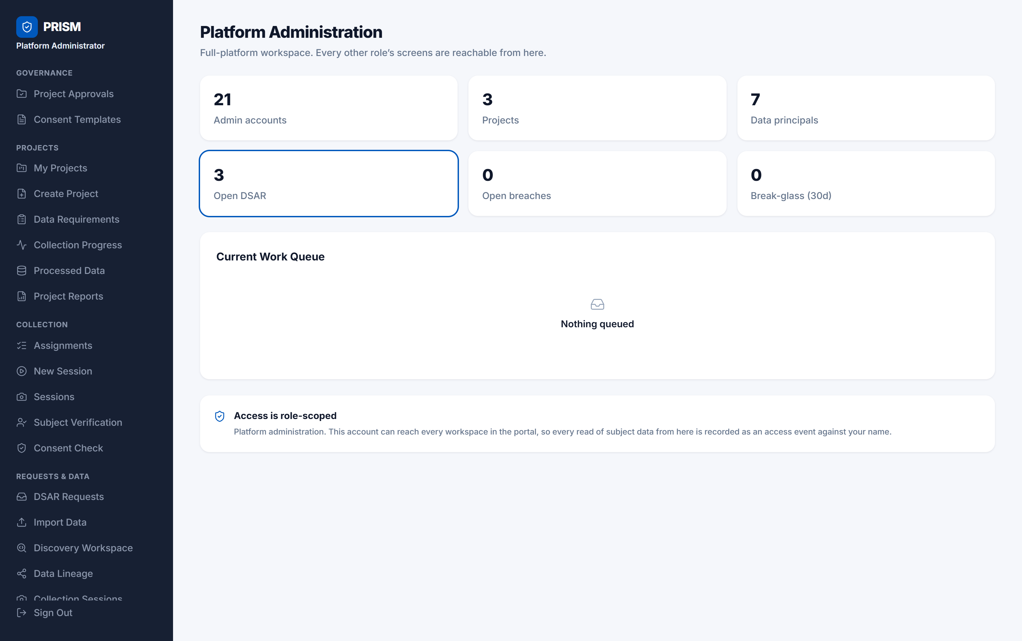
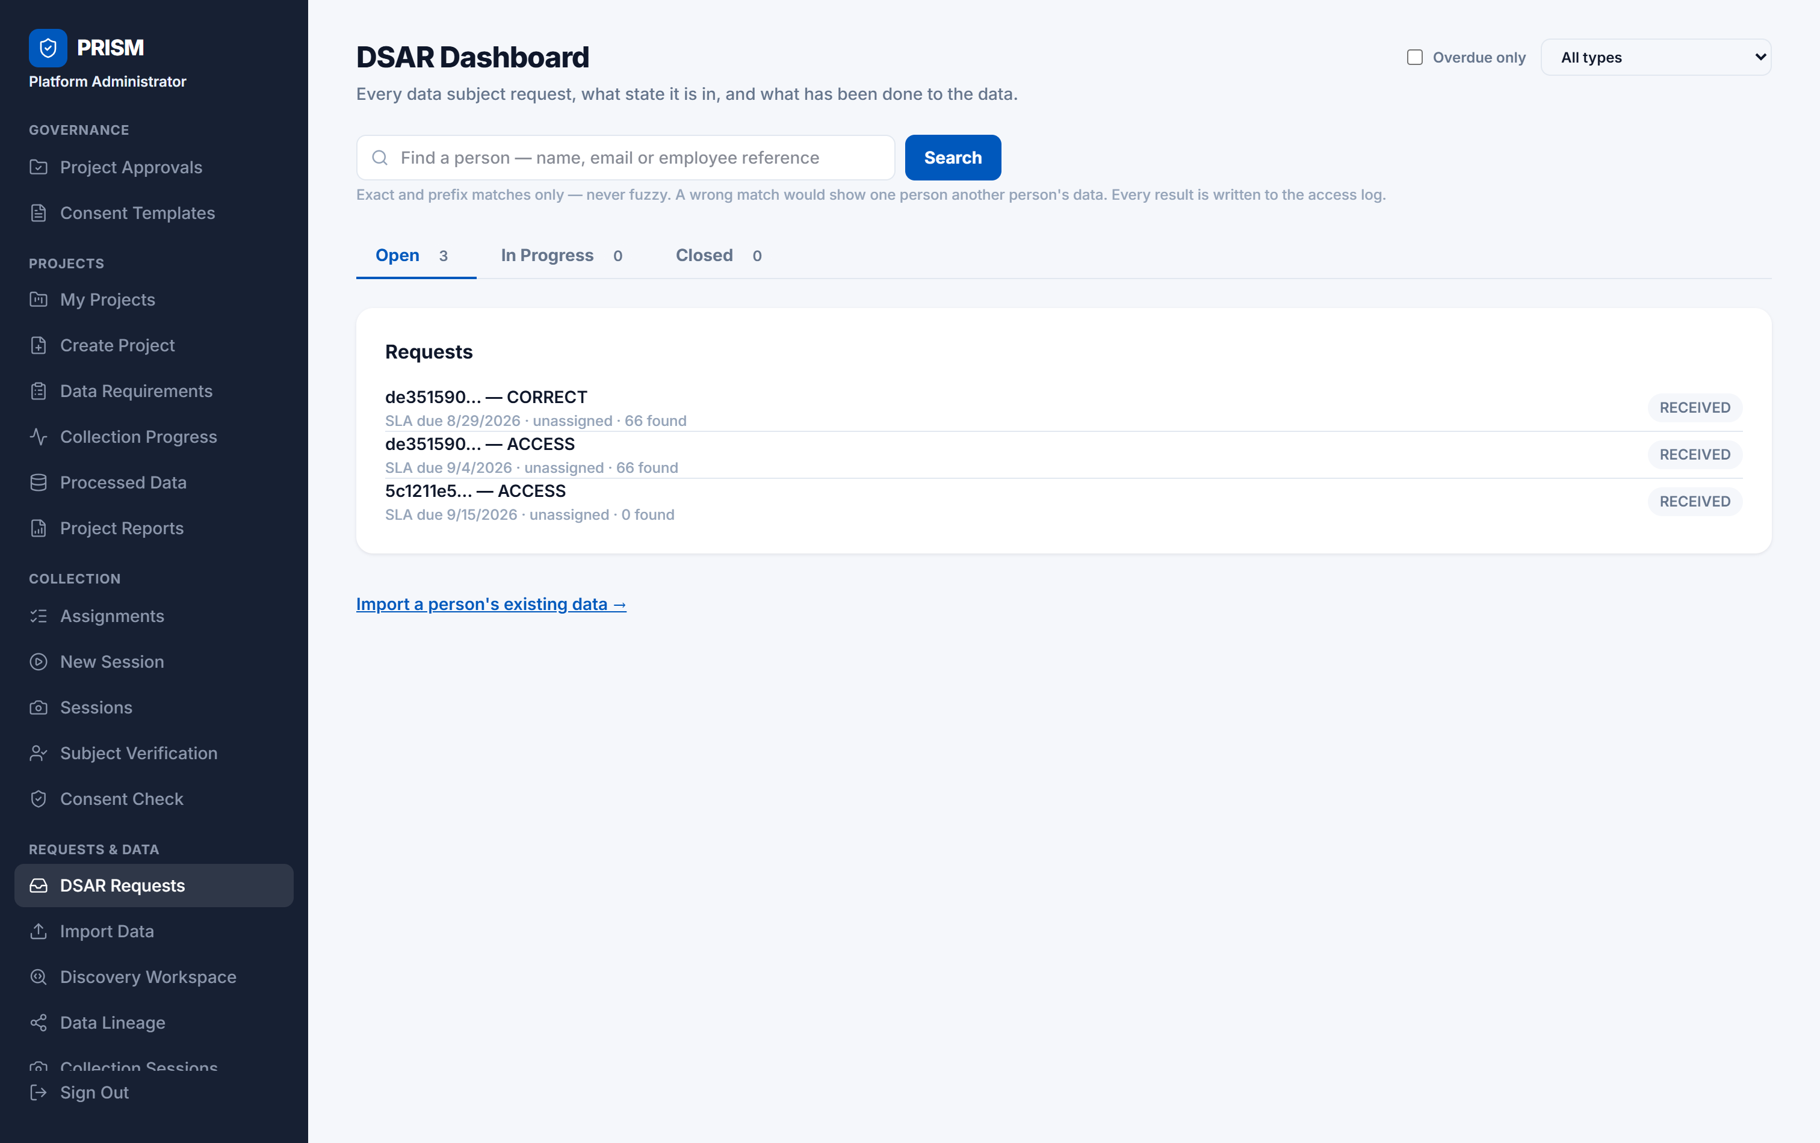
SCREENS - ADMIN PORTAL
Platform overview and the request queue
Platform Administration - live counts of accounts, projects, people and open requests
DSAR Dashboard - every request, the stage it is at, and its legal deadline
PRISM - Monthly Review - August 2026
7

Slide 8
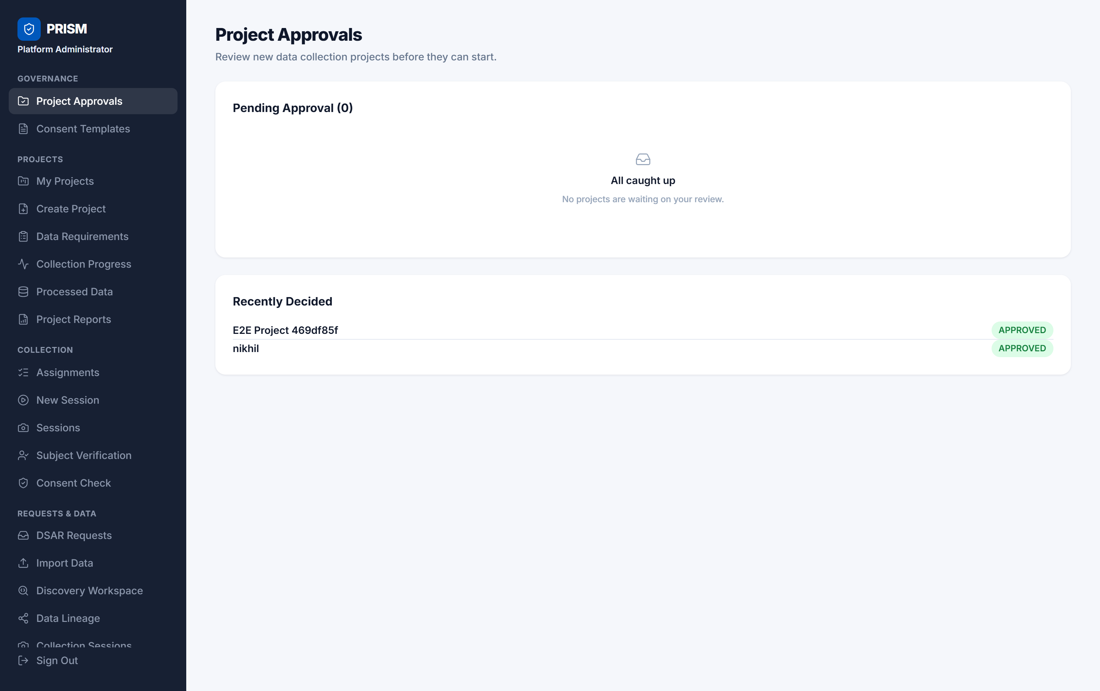
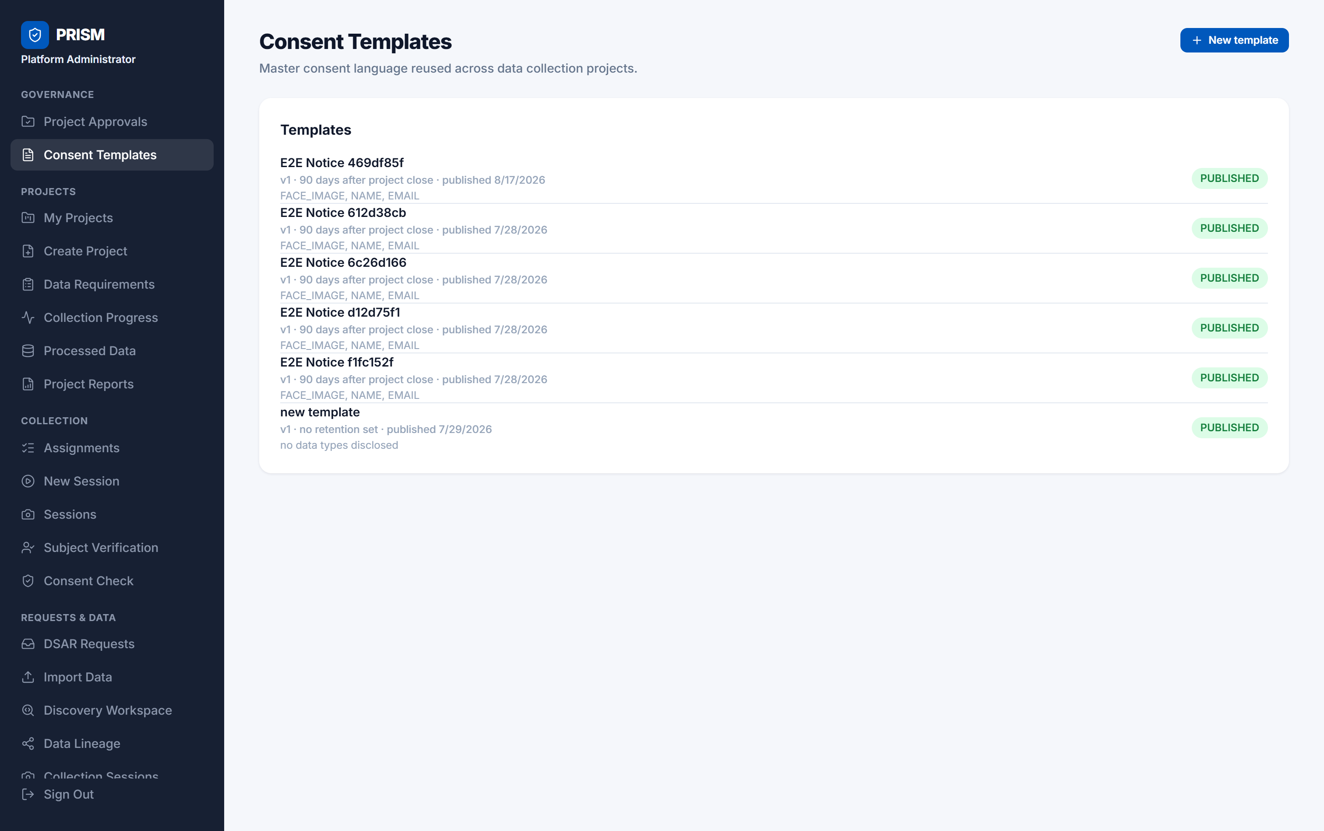
SCREENS - ADMIN PORTAL
Governance - nothing is collected before it is approved
Project Approvals - the DPO approves a project and its purpose before any collection can start
Consent Templates - the exact notice a person reads, versioned and frozen once published
PRISM - Monthly Review - August 2026
8

Slide 9
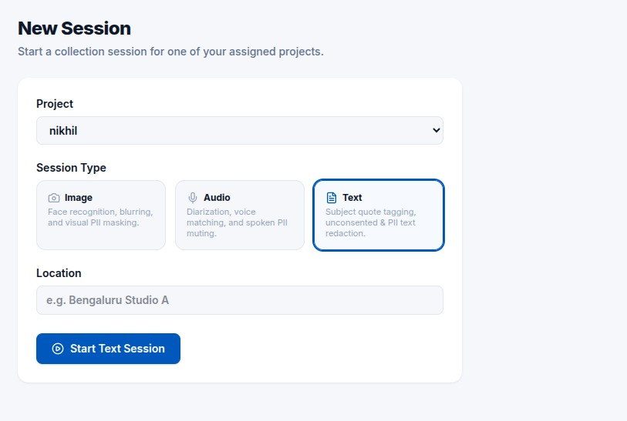
SCREENS - COLLECTION AGENT
Three kinds of data, one set of rules
ONE PLATFORM, THREE PIPELINES
Image
Faces detected, matched against the people who consented, and blurred if they did not. Identity text in the frame is masked separately.
Audio
The recording is split by speaker, each speaker is matched to a consented person, and unknown voices are muted. Spoken names, numbers and card details are muted too.
Text
Quotes are tagged to the person who said them. Anything not tagged to a consented person is redacted, and names, emails and phone numbers are masked automatically.
The same consent record, the same audit chain and the same erasure engine sit behind all three.
Starting a session - the agent picks the kind of data being collected
PRISM - Monthly Review - August 2026
9

Slide 10
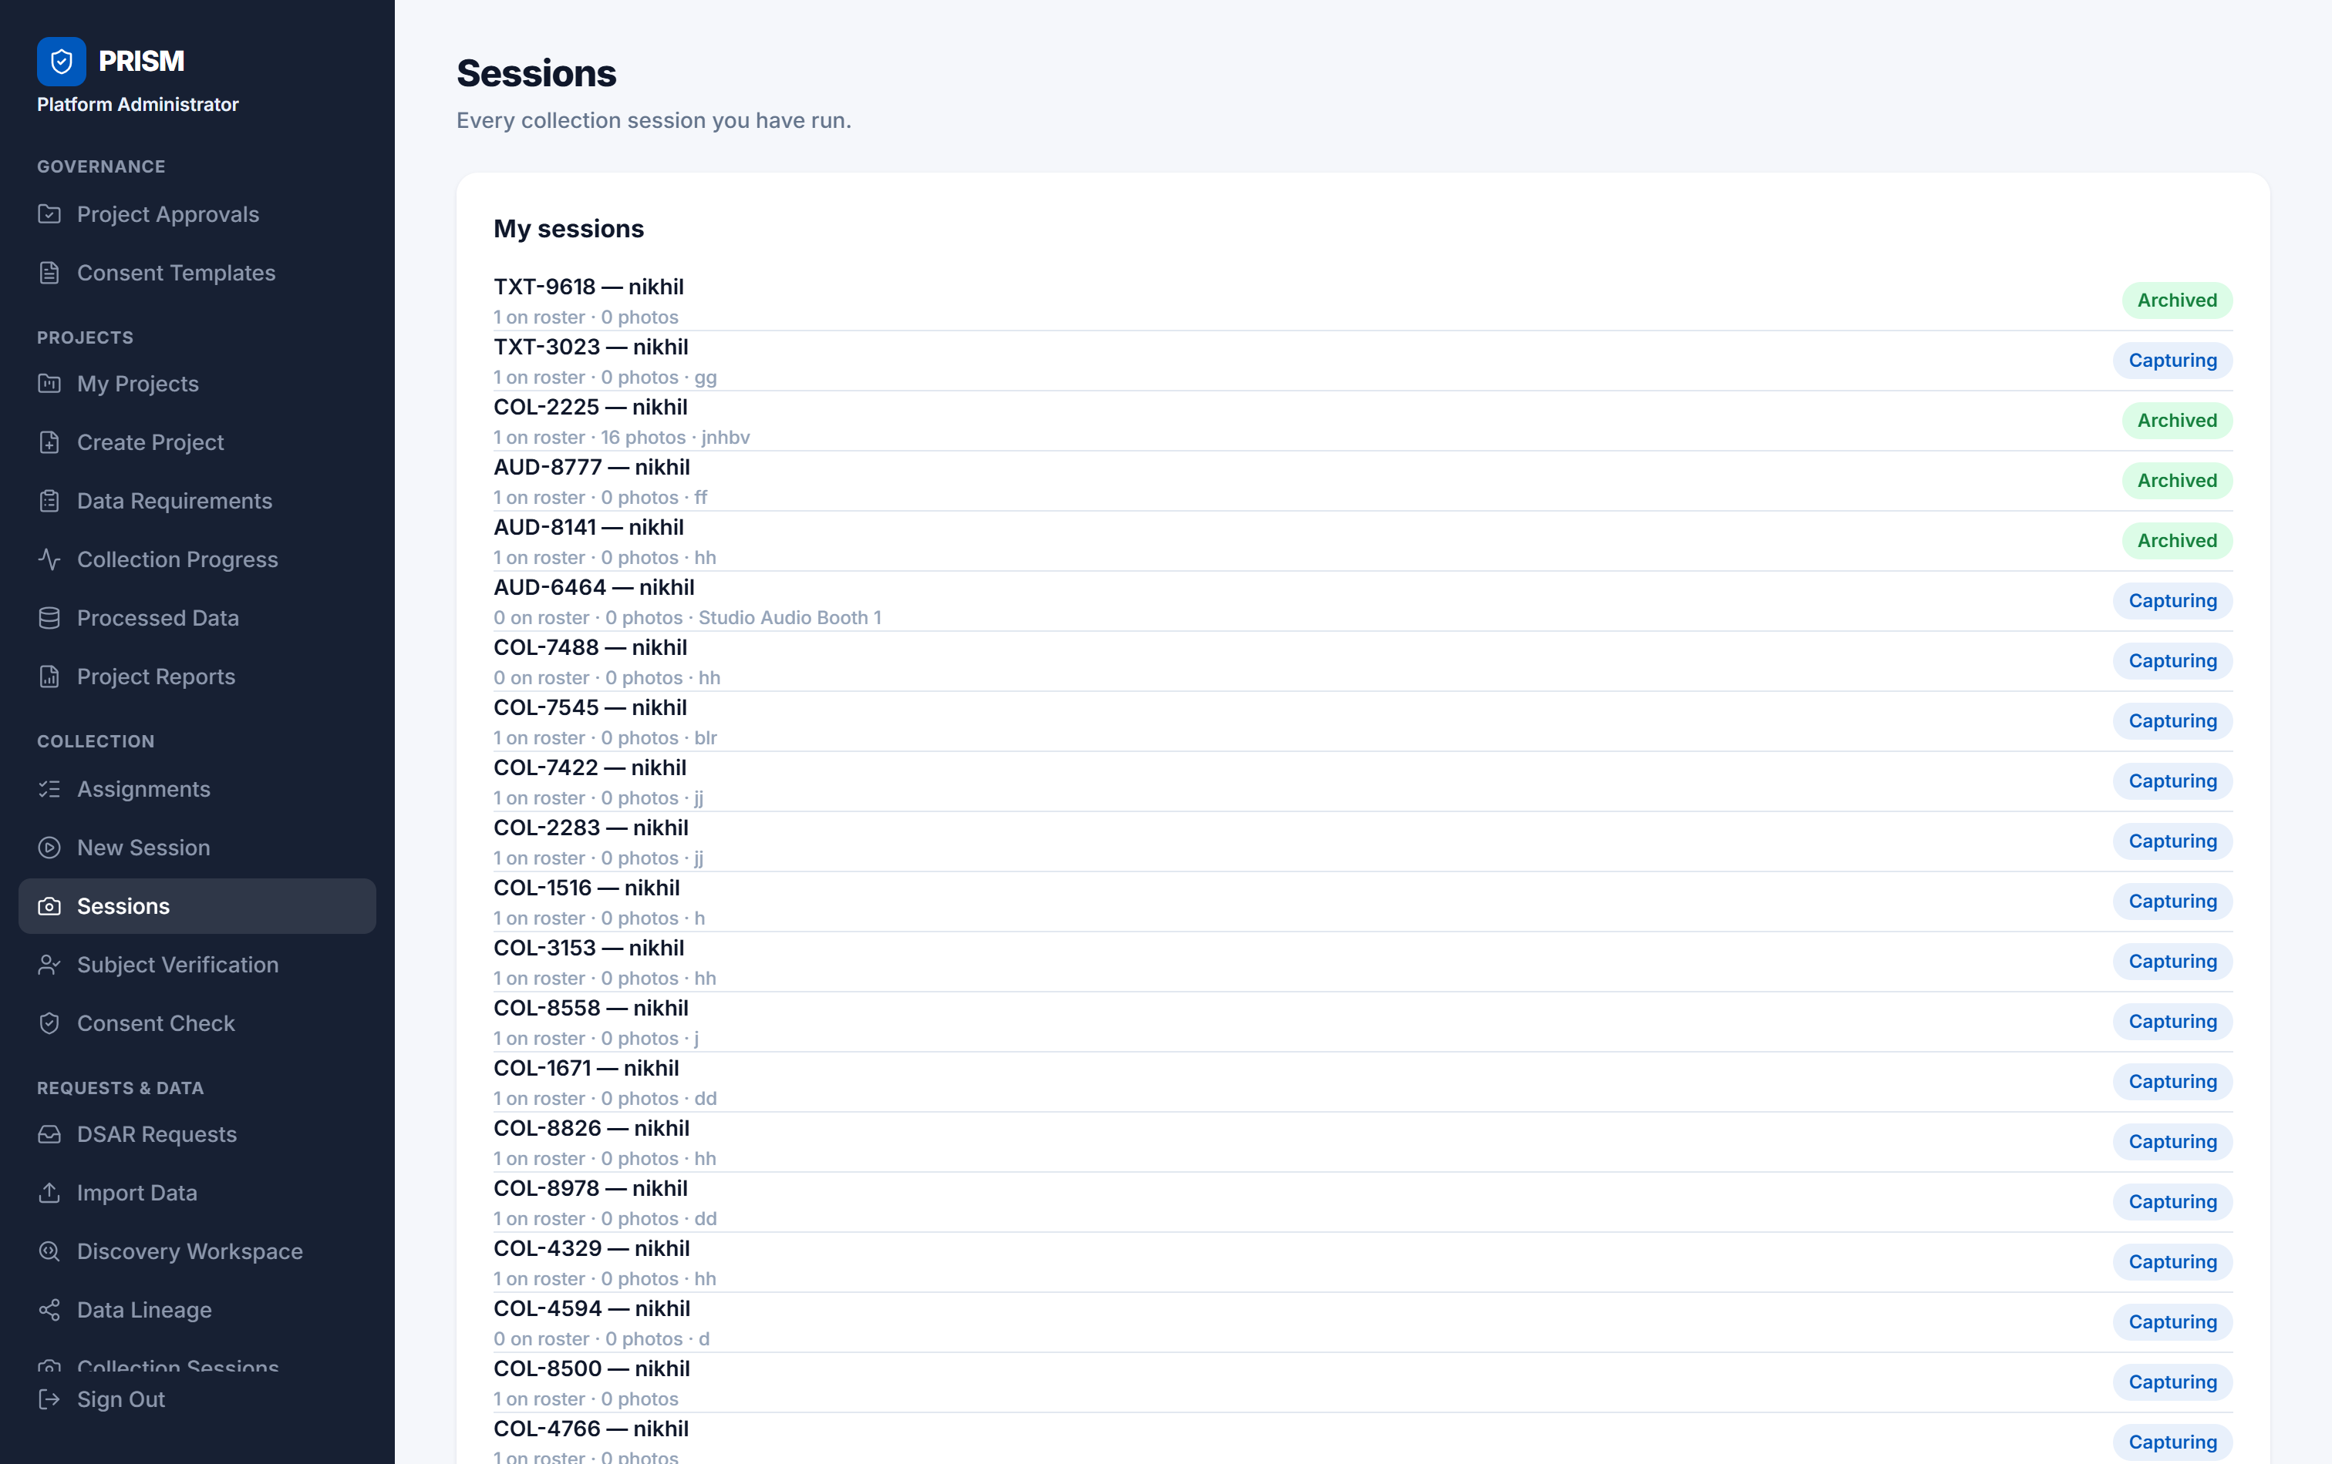
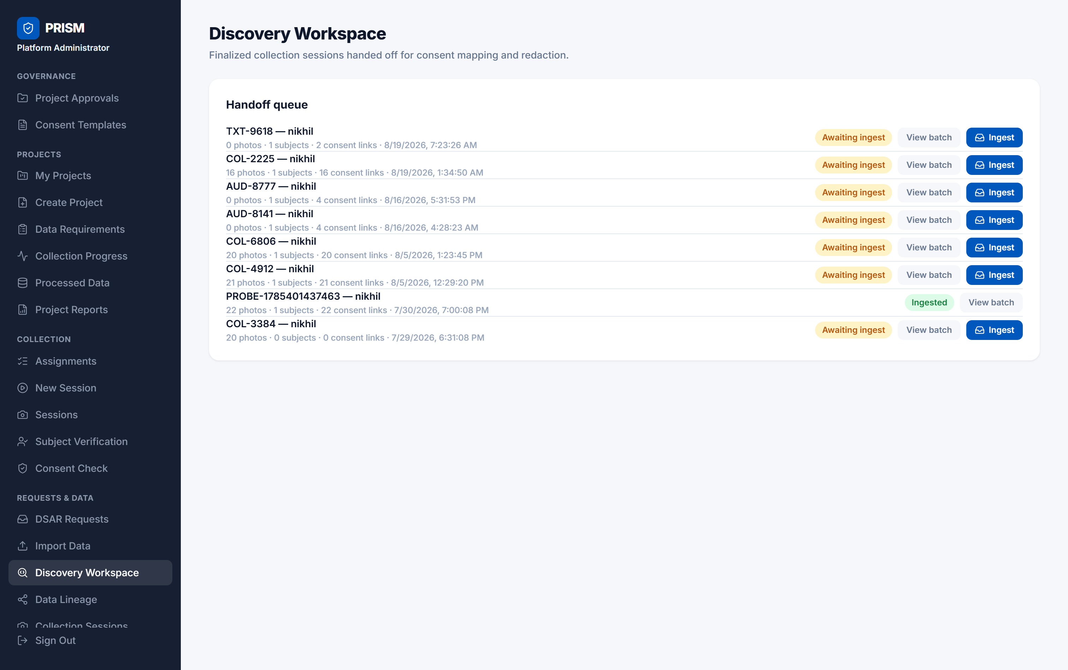
SCREENS - ADMIN PORTAL
Collection and hand-off
Sessions - every capture session an agent has run, and the stage it has reached
Hand-off queue - a session only moves on once its frames are redacted and linked to consent
PRISM - Monthly Review - August 2026
10

Slide 11
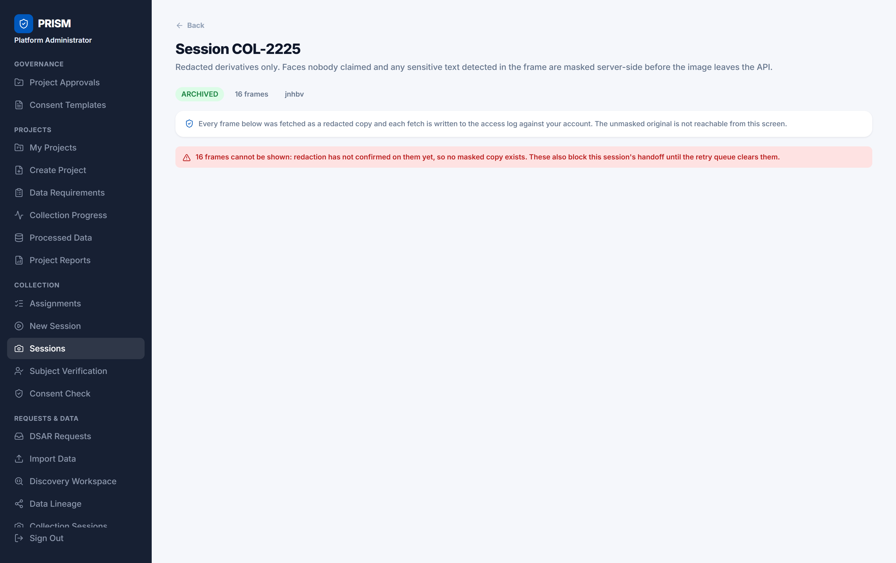
SCREENS - ADMIN PORTAL
Fail-closed, seen in the product
WHAT THIS SCREEN PROVES
The AI redaction workers were switched off when this screenshot was taken.
The platform did not fall back to showing the original photographs. It refused to show anything, and it blocked the session from moving forward.
"The worker is down" and "the worker found nothing" must never lead to the same outcome. That rule is enforced in the pipeline, in the queue, and here in the interface.
PRISM - Monthly Review - August 2026
11

Slide 12
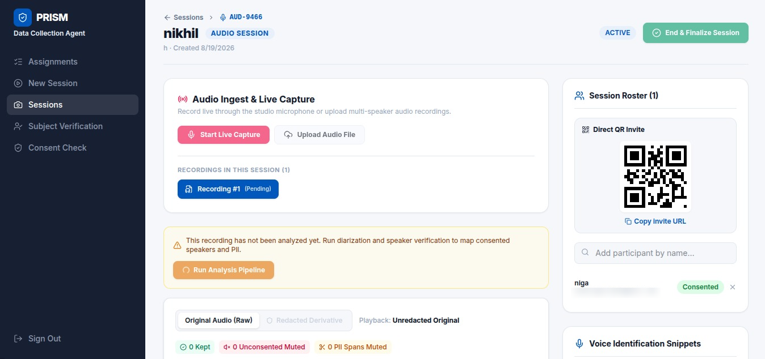
SCREENS - AUDIO PIPELINE
Audio - capture and analysis
WHAT HAPPENS HERE
The agent records live, or uploads a multi-speaker file.
Everyone in the room joins the session roster by scanning the QR code and giving consent on their own phone.
Nothing is analysed automatically. Until the pipeline is run, the recording is marked Pending and is playable only as the unredacted original, which is access-logged.
Audio session AUD-9466 - one recording pending analysis, one consented participant on the roster
PRISM - Monthly Review - August 2026
12

Slide 13
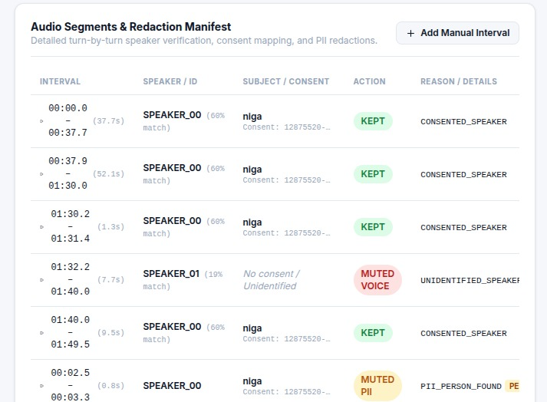
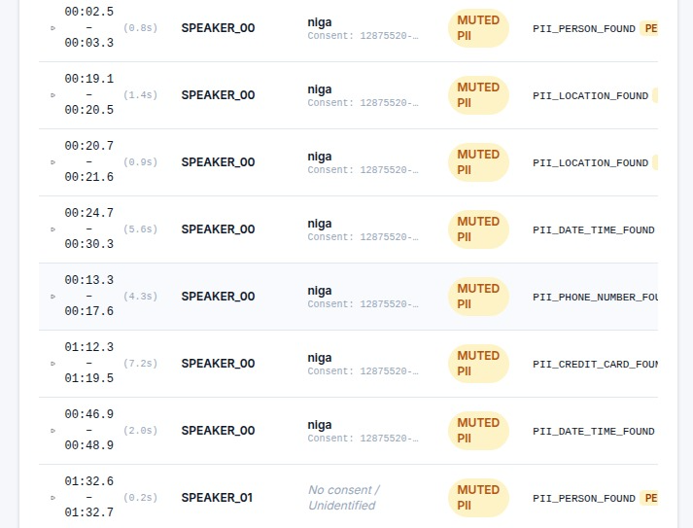
SCREENS - AUDIO PIPELINE
Audio - every turn is decided, and the reason is recorded
Speaker turns - SPEAKER_00 matched the consented person and was kept; SPEAKER_01 did not match anyone and was muted
Spoken PII - names, locations, dates, a phone number and a card number, each muted with the reason stored
PRISM - Monthly Review - August 2026
13

Slide 14
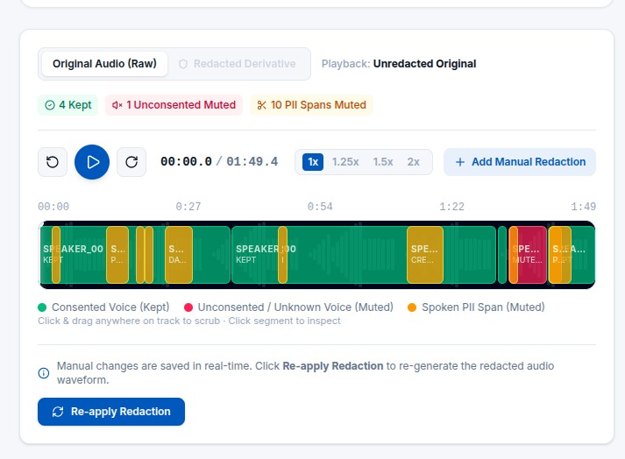
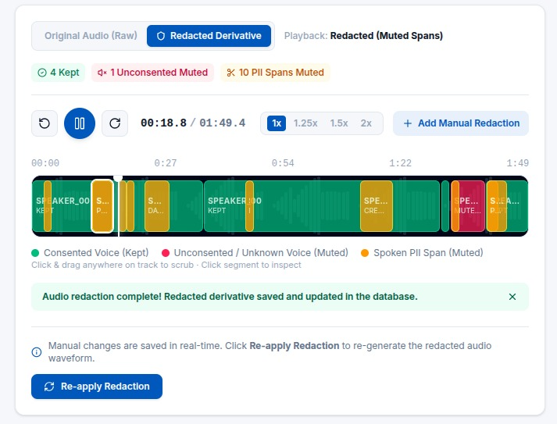
SCREENS - AUDIO PIPELINE
Audio - original and redacted, side by side
Before - the original recording, played only with an access log entry
After - the redacted copy: green is consented speech, red is an unknown voice, amber is spoken PII
4 turns kept · 1 unconsented speaker muted · 10 spoken-PII spans muted · redacted copy saved to the database as a separate object
PRISM - Monthly Review - August 2026
14

Slide 15
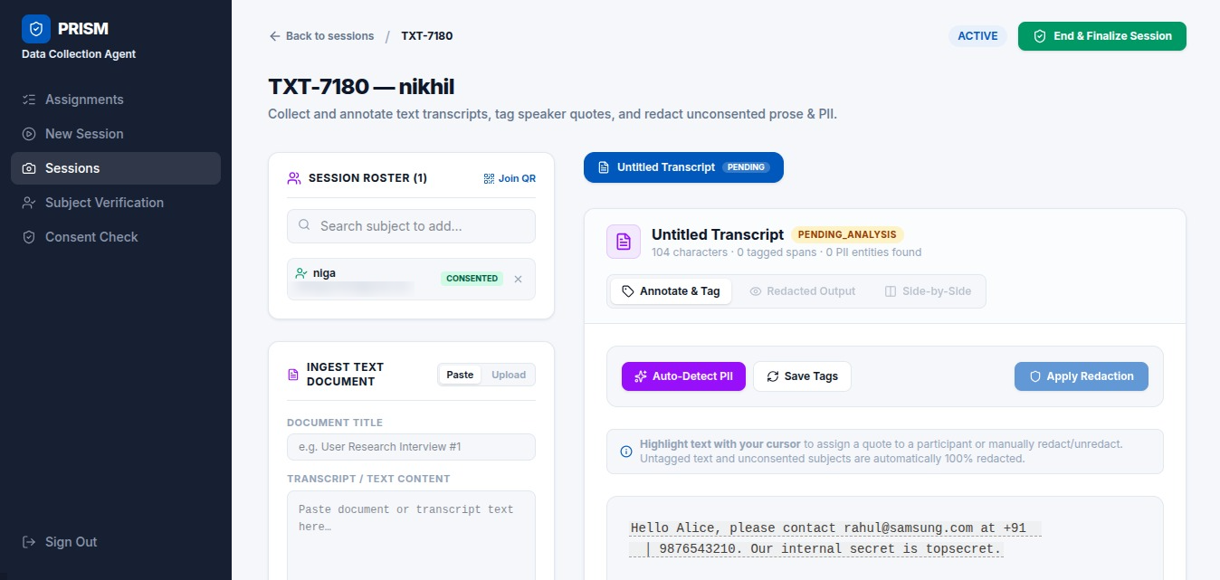
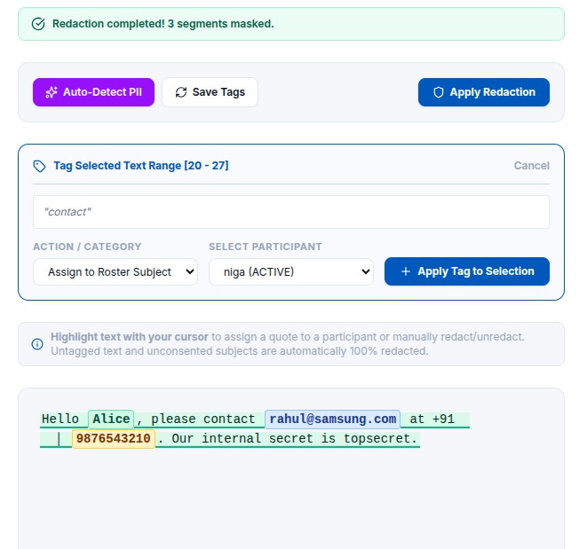
SCREENS - TEXT PIPELINE
Text - ingest, tag and detect
A text session: paste or upload a transcript, then tag each quote to the person who said it
Auto-detect finds the PII; a human assigns quotes to a consented participant
The default is redaction, not disclosure: any text not tagged to a person who consented is redacted in full, so forgetting to tag someone hides them rather than exposing them.
PRISM - Monthly Review - August 2026
15

Slide 16
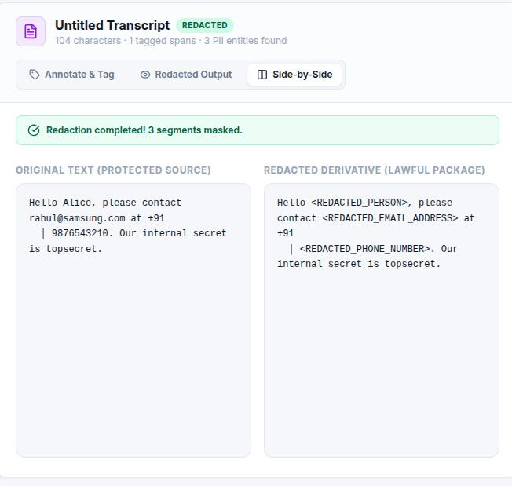
SCREENS - TEXT PIPELINE
Text - before and after
WHAT THE MODEL FOUND
Three entities were detected and masked in a 104-character transcript.
A person's name became <REDACTED_PERSON>, an email address became <REDACTED_EMAIL_ADDRESS>, and a phone number became <REDACTED_PHONE_NUMBER>.
The original is kept as the protected source and the masked version as the lawful package. Only the masked copy travels; the original stays sealed and every read of it is logged.
Note what was not redacted: "our internal secret is topsecret" is a company secret, not personal data. The model is deliberately scoped to identity, because over-redaction destroys the usefulness of the record without protecting anybody.
PRISM - Monthly Review - August 2026
16

Slide 17
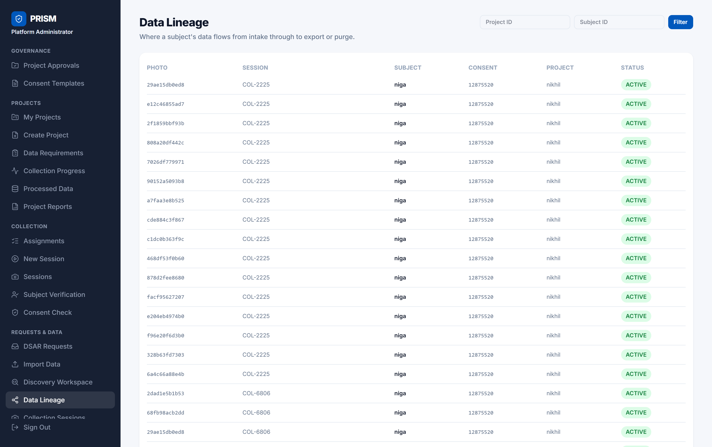
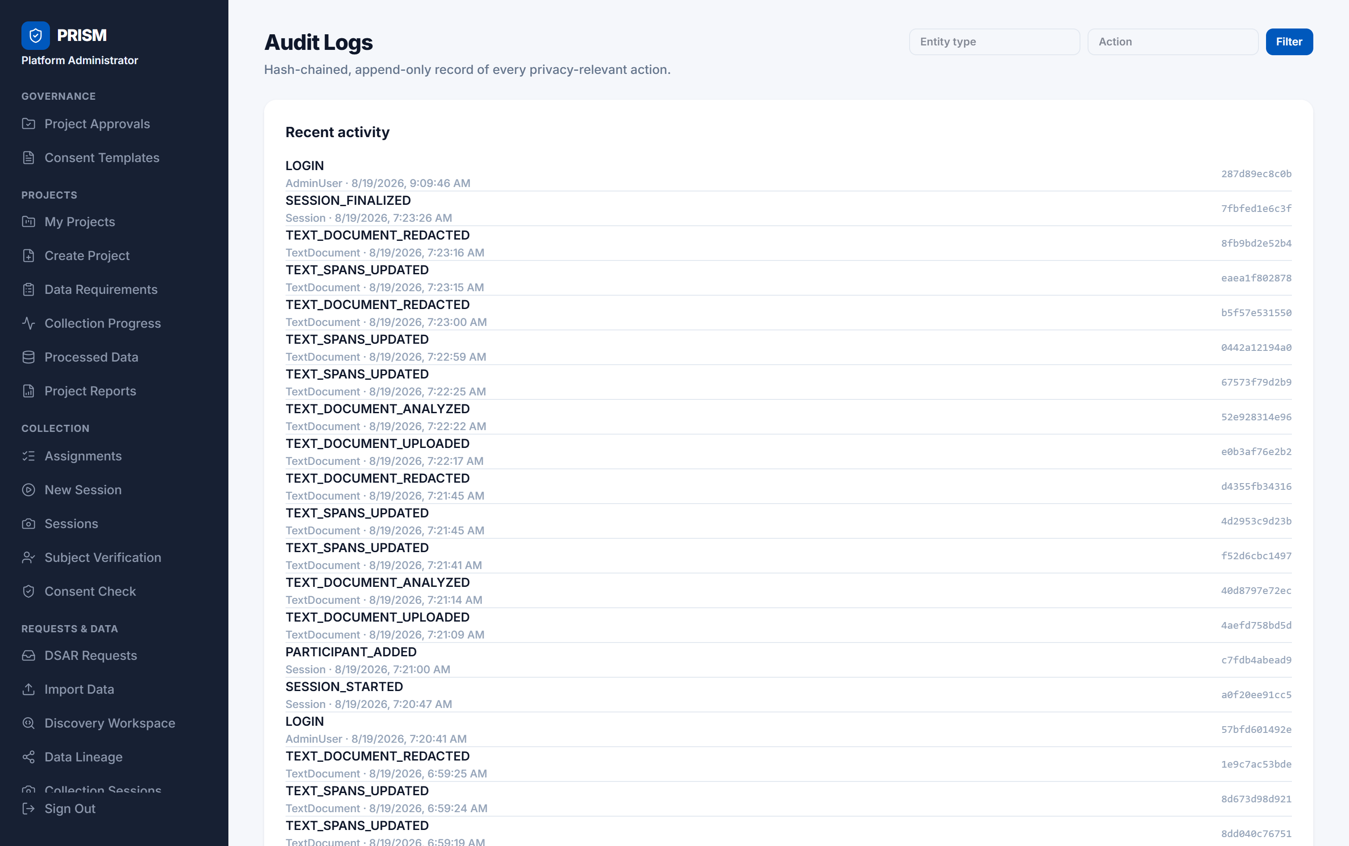
SCREENS - ADMIN PORTAL
Traceability - every photo and every read is accounted for
Data Lineage - each photo traced back to its session, person, consent record and project
Audit Logs - an append-only, hash-chained record of every privacy-relevant action
PRISM - Monthly Review - August 2026
17

Slide 18
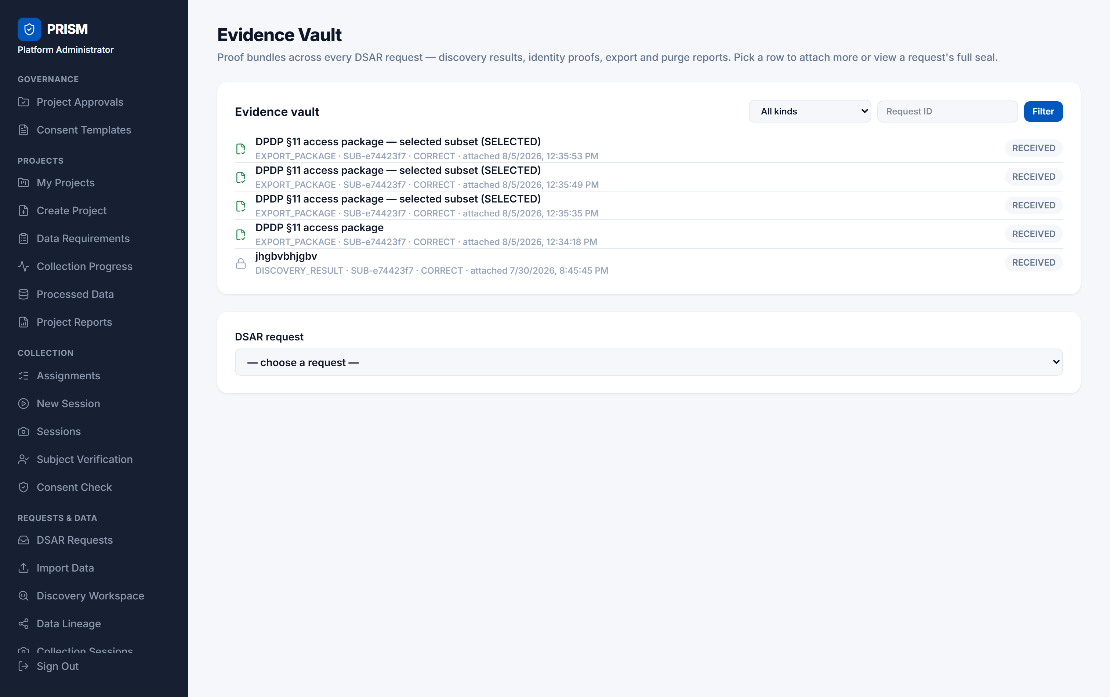
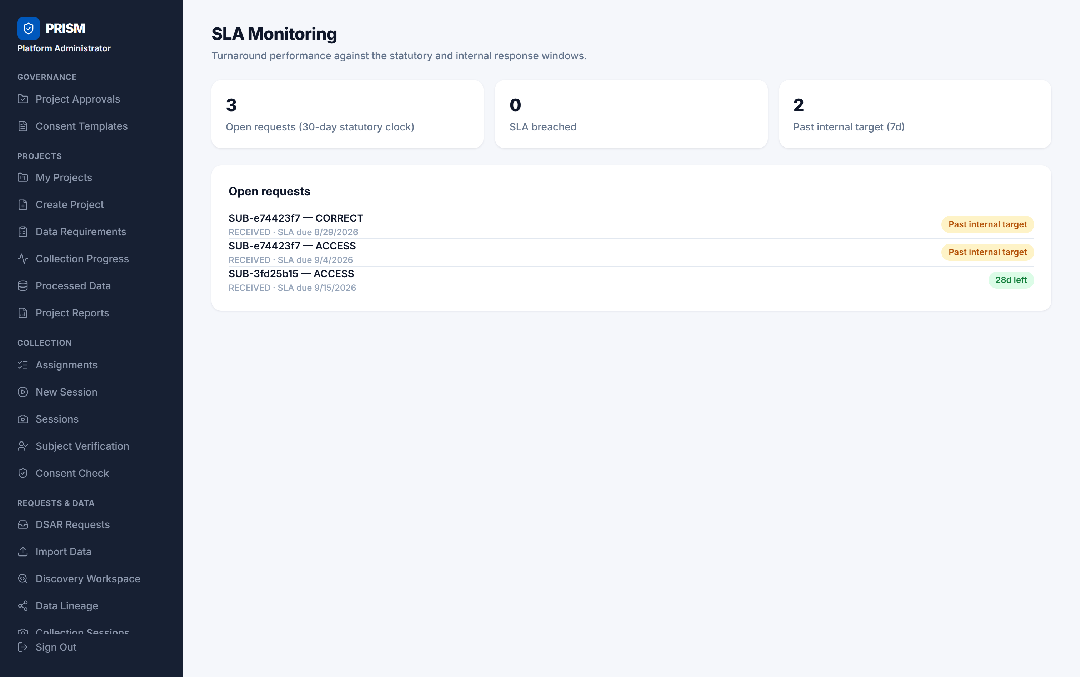
SCREENS - ADMIN PORTAL
Evidence and deadlines
Evidence Vault - the proof bundle for each request: discovery results, export packages, purge reports
SLA Monitoring - the legal clock on every open request, with an earlier internal target
PRISM - Monthly Review - August 2026
18

Slide 19
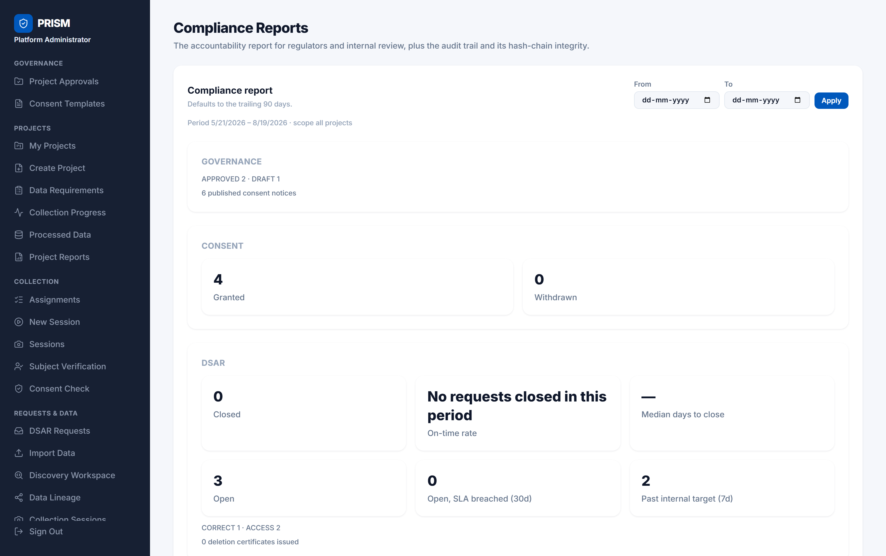
SCREENS - ADMIN PORTAL
The report a regulator would ask for
Compliance Reports - governance, consent, requests, access, data minimisation and breaches for a chosen period, plus a button that recomputes the audit hash chain and reports whether it still holds
PRISM - Monthly Review - August 2026
19

Slide 20
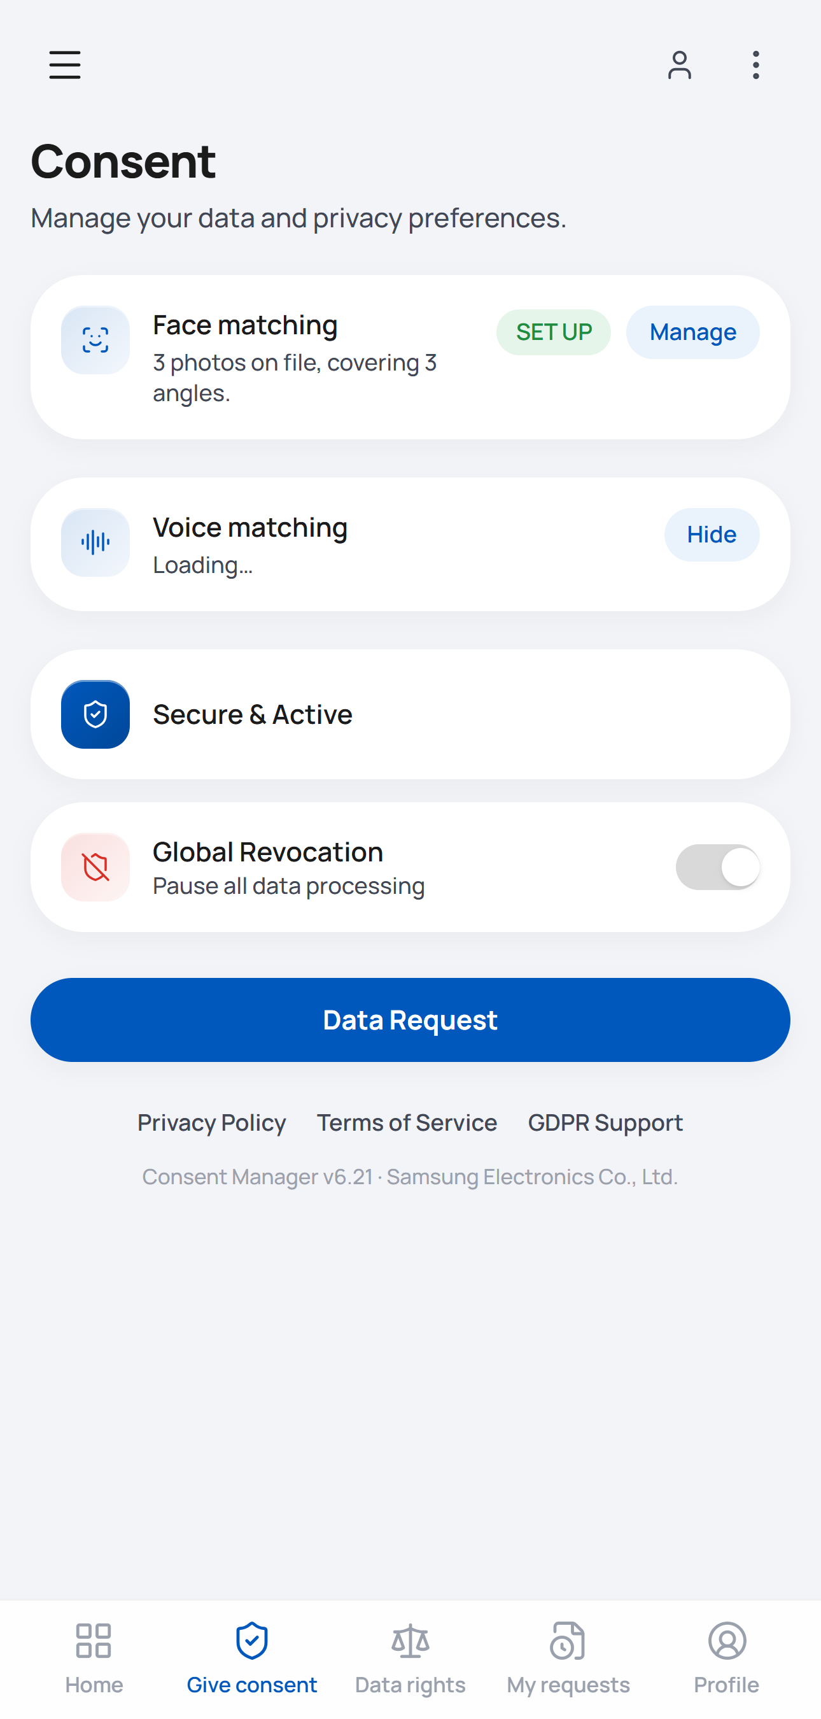
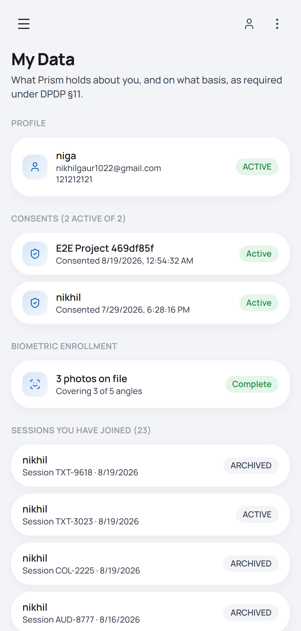
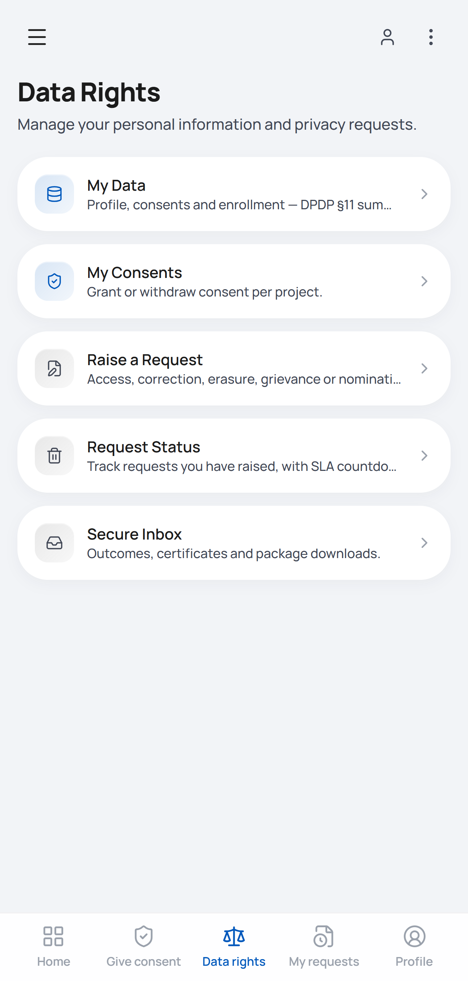
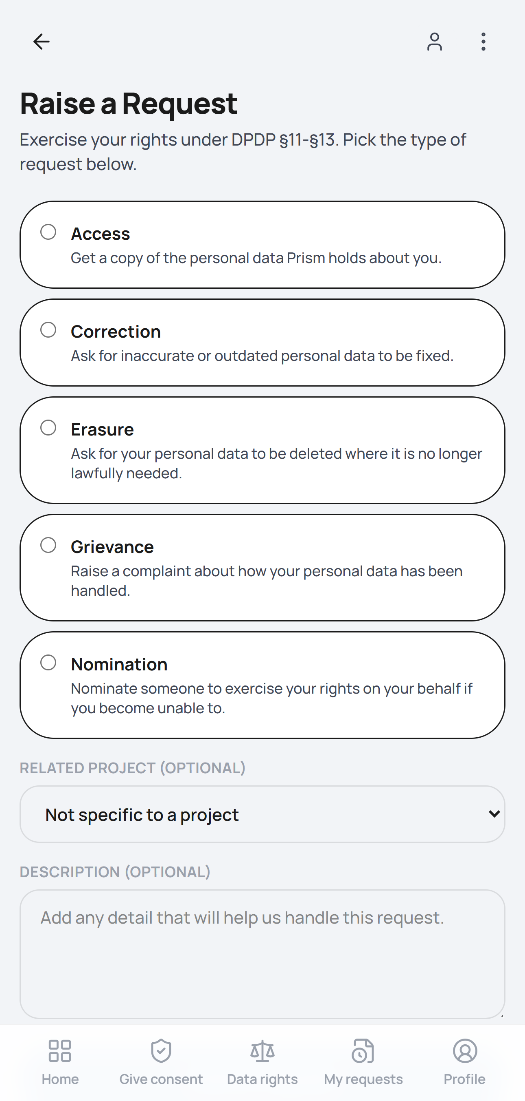
SCREENS - DATA PRINCIPAL
The person's own portal - built for a phone
Consent - face and voice matching,
and a switch to pause everything
My Data - exactly what is held,
and on what legal basis
Data Rights - access, correction,
erasure, grievance, nomination
Raise a Request - the person asks
for their rights themselves
PRISM - Monthly Review - August 2026
20

Slide 21
Why we chose these models
Every stack was picked to run accurately on a CPU, on our own machines, with nothing sent off-premise
PRISM - Monthly Review - August 2026
21

Slide 22
MODEL COMPARISON
Model choice - detecting and recognising faces
Used by the image pipeline and the video worker to find faces and tell people apart.
Model stack
Detection accuracy
Recognition accuracy
CPU execution speed
Packaging & portability
InsightFace (buffalo_l - SCRFD + ArcFace)
High
State-of-the-Art
Very Fast (ONNX)
Easy (ONNX wheel)
Dlib (ResNet-34) / OpenFace
Medium
Medium-Low
Slow
Complex OS dependencies
MTCNN + FaceNet
Low (struggles with pose / yaw)
Medium
Medium
Medium
RetinaFace (ResNet-50)
Extremely High
High
Very Slow on CPU
Heavy
Chosen because it is the only stack that is both accurate and fast enough to run on a CPU - there is no GPU in the collection environment. RetinaFace detects slightly better but is far too slow, and ONNX packaging means the same wheel installs on every machine.
PRISM - Monthly Review - August 2026
22

Slide 23
MODEL COMPARISON
Model choice - reading and masking text in images
Used to find identity documents, badges and screens inside a photograph and mask what they say.
Model / tool
Accuracy
CPU speed
Latency
Infrastructure & privacy footprint
RapidOCR + Presidio (spaCy)
High
Fast
Low (under 1.5s)
100% local / self-contained
Tesseract OCR
Medium (struggles with noise)
Fast
Low
Needs an OS-level binary (fragile Docker builds)
EasyOCR (PyTorch)
High
Slow on CPU
High (4-6s)
Heavy PyTorch engine dependency
Cloud OCR (GCP Vision / AWS Rekognition)
Extremely High
Fast
Medium-High
Breaks DPDP: sends raw PII off-premise
LLM-based extraction (local Llama-3-8B)
Extremely High
Extremely Slow
Very High
Heavy VRAM needs, non-deterministic
Chosen because it is the only accurate option that never leaves the machine. Cloud OCR is more accurate and would also ship raw identity documents to a third party - the exact thing the DPDP Act exists to prevent. The text pipeline reuses the Presidio and spaCy half of this stack on its own, with no OCR, because that text arrives already typed.
PRISM - Monthly Review - August 2026
23

Slide 24
MODEL COMPARISON
Model choice - separating speakers and reading speech
Used to split a recording by speaker, identify who is speaking, and find personal details said out loud.
Model / tool
Audio accuracy
CPU speed
Resource footprint
PyAnnote 3.1 + Faster-Whisper + SpeechBrain
High
Fast
Moderate (CTranslate2 optimised)
OpenAI Whisper (original PyTorch)
High
Slow on CPU
Heavy
PocketSphinx / Kaldi
Low
Extremely Fast
Very Low
WavLM / Wav2Vec2 (speaker ID)
High
Slow on CPU
High
Chosen because CTranslate2 makes Whisper fast enough on a CPU without giving up accuracy, PyAnnote 3.1 is the strongest open diarisation model available, and SpeechBrain produces the speaker fingerprints from the same pipeline. PocketSphinx is faster but far too inaccurate to base a redaction decision on.
PRISM - Monthly Review - August 2026
24

Slide 25
3 - CHALLENGES
Technical challenges, and how we solved them (1 of 3)
The app cannot create its own tables - and that failed silently
Problem: the application connects as a restricted database user that is not allowed to change the schema. An earlier hardening change also removed default rights on new tables, so a feature would deploy cleanly and then fail with "permission denied" the first time a real user touched it - at run time, not at deploy time.
Solution: every migration now ships its own grant block for the application user, and migrations are run under a separate administrative connection for the duration of that one command. This is written into the handoff as a standing rule for every future table.
A worker being down looked exactly like "nothing found"
Problem: if the identity-masking or audio service was unreachable, an empty result came back - and an empty result means "no sensitive content here". A photograph of an identity card could have been marked clean simply because a container had stopped.
Solution: an unreachable worker now raises its own distinct error, which parks the item as DEFERRED and requeues it. It is never treated as clean. The test suite exercises that branch directly.
PRISM - Monthly Review - August 2026
25

Slide 26
3 - CHALLENGES
Technical challenges, and how we solved them (2 of 3)
Erasing one person from a file that contains several people
Problem: a group photo, or a recording with three speakers, belongs to more than one person. Honouring one erasure by deleting the file would destroy everybody else's data - and their consent record with it.
Solution: when an item is shared, the server quietly downgrades DELETE to RE-REDACT and never lets the client decide otherwise. Recordings also stay sealed under the session key rather than a per-person key, so one person's erasure is carried out by removing specific locations instead of throwing the whole file away.
Voice is not face - copying the face design broke it twice
Problem: the face model produces a 512-number fingerprint; the speech model produces 192. The face gallery is also built once per session, but several recordings in one session are analysed at the same time, so a shared gallery meant one job tearing down what another was still reading.
Solution: a separate voice gallery with the correct 192 numbers, keyed per recording rather than per session. As a side effect it can no longer go stale - a voice enrolled halfway through a session is in the next recording's gallery automatically.
PRISM - Monthly Review - August 2026
26

Slide 27
3 - CHALLENGES
Technical challenges, and how we solved them (3 of 3)
Video is not "a lot of photos"
Problem: a two-minute clip at 30 frames per second is 3,600 frames. Storing them as photographs would have told a person we hold 3,600 photographs of them - and running face detection on every frame costs minutes of GPU time per clip.
Solution: video became its own kind of data with its own table. The worker detects faces on every Nth frame, links them with a tracker, and averages five good views into one fingerprint per person. It is far faster, and the averaged fingerprint matches better than any single frame.
Redacting text is a different problem from redacting a face
Problem: with a face, anything the model misses is still a face and can be blurred by a human. With text, the safe default is inverted - an untagged sentence might belong to anyone, so leaving it visible is the risky choice.
Solution: the text pipeline redacts by default. Any prose not tagged to a person who consented is masked in full, so forgetting to tag somebody hides them rather than exposing them.
Browser audio does not match what the model needs
Problem: Chrome records one format, Safari records another, and the speech model wants 16 kHz mono WAV.
Solution: convert in the browser before upload. A five-second clip now arrives under 200 KB and loads on any backend.
PRISM - Monthly Review - August 2026
27

Slide 28
4 - RESULTS
Results till now
123/123
3
2,525
0
Automated tests passing
0 failures, held across three phases
Capture types working
Image, audio and written text
Access events recorded
0 break-glass reads (0%)
Data released unredacted
The fail-closed rule held throughout
Area
Where it stands on 19 August 2026
End-to-end flow
Approve, consent, collect, protect, hand off, request, erase - working today for images, audio and written text
Audio, proved
A 1:49 recording: 2 speakers separated, 4 turns kept, 1 unconsented speaker muted, 10 spoken-PII spans muted, redacted copy saved
Text, proved
A pasted transcript: 3 identity entities found and masked, original and redacted copy held side by side
Governance
2 projects approved and 1 in draft - 6 consent notices published - 4 consents granted, 0 withdrawn
Collection
8 sessions handed off, 1 ingested into the golden store - 83 frames cleared, 25 still pending redaction
Requests
3 requests open and inside their deadline - 4 export packages produced with evidence - 0 breaches
PRISM - Monthly Review - August 2026
28

Slide 29
5 - OBSERVATIONS
Observations based on these results
Failing closed is correct, but it looks broken
An environment where a worker was simply never provisioned showed red errors and a spinner that never resolved. We now say "not offered in this deployment" and keep real errors for real faults.
Three pipelines, three machines, nothing merged yet
The image, audio and text pipelines were each built separately, and the text work and the updated audio screens are not yet on the main branch. The features exist; the integrated system does not. This is now the biggest risk to the 31 August deadline, and it is the first item in the plan.
Almost every bug was at a boundary
Database grants, route ordering, audio formats, fingerprint sizes. The business logic held; the joins between systems did not. Environment drift counts too - with the containers stopped, 33 of the 123 tests fail at once and it reads exactly like a code regression.
Speaker matching works - on one recording
The demo correctly kept the consented speaker and muted the unknown one. That is one recording with two speakers. The acceptance threshold has not been measured across a wider sample, and until it is, a stranger being accepted stays possible.
A green test suite is not proof the AI works
The suite passes partly because it tests the fail-closed branch. With the model containers switched off it still reports 123 of 123 - by design, and it must not be read as "the pipeline works".
An honest gap beats a tidy record
Imported data with no consent is labelled "lawful basis unverified" rather than given a manufactured consent row, so the gap shows up in every request response instead of disappearing.
PRISM - Monthly Review - August 2026
29

Slide 30
6 - PLAN TO THE DEADLINE
The next two weeks, day by day
13 days from today to the 31 August deadline. Integration comes first, because nothing the team built separately is merged yet.
Day
Workstream
What gets done
Wed 19 Aug
Integration
Merge the text pipeline and the updated audio screens into main; apply the pending voice-enrollment migration
Thu 20 Aug
Integration
Resolve the schema conflicts from the merge; get the full test suite green on merged main
Fri 21 Aug
Audio
Calibrate the speaker-match threshold on a wider set of recordings and lock the value
Sat 22 Aug
Video
Video capture, face tracking and blurring working end to end
Sun 23 Aug
Buffer
Catch up on anything that slipped; no new work planned
Mon 24 Aug
Video
Video wired into the request grid, so it can be found and deleted exactly like a photo
Tue 25 Aug
Cleanup
Phase 3 - remove the three unused AI directories and the comments pointing at them
Wed 26 Aug
Interface
Phase 4 - design tokens, and consistent loading, empty and error states
Thu 27 Aug
Interface
Phase 4 - mobile person-facing portal and the accessibility pass
Fri 28 Aug
Release
Phase 5 - CI pipeline and the front-end test harness
Sat 29 Aug
Release
Load test at 5,000 items; close the two open privacy-impact risks
Sun 30 Aug
Freeze
Full regression run, code freeze, demo dry run
Mon 31 Aug
Deadline
Final demo and submission
PRISM - Monthly Review - August 2026
30

Slide 31
Thank you
Questions and feedback welcome.
PRISM - DPDP 2023 consent management and data-rights platform - monthly review, August 2026

