Slide 1
SAMSUNG PRISM - PROJECT REVIEW
PRISM
Privacy-First AI Consent and Redaction Platform for Multimodal AI Data
Built for India's Digital Personal Data Protection Act, 2023 · Worklet 26TS12VITV · SRIB-PRISM Program
Review date: 3 September 2026
End-to-end video demo | Architecture: capture-to-storage and DSAR | AI models and services | Role flows | Tech stack | Glossary

Slide 2
AGENDA
What this review covers
1
End-to-end video demo
A live walk through one project: approval, consent, video upload, tracking, tagging, redaction, erasure.
2
Architecture - capture to storage
One diagram: a frame or clip from the shutter to its encrypted resting place, and every component it touches.
3
Architecture - DSAR
Kept separate on purpose: how a rights request is discovered, executed, signed and delivered.
4
AI models and services
The nine model families, the five stateless workers and the seven queue workers, and why each was chosen.
5
Role flows
Data principal, data owner, collection agent, DPO, data admin - the flowcharts from the repository.
6
Tech stack in one page
Frontends, backend, AI core, infrastructure, verification tooling.
7
Patentability
What in PRISM is candidate inventive matter, the closest prior art, and how a filing would proceed.
8
Glossary
Platform acronyms, DPDP Act vocabulary we use correctly, and the terms we use that are not DPDP terms.
PRISM · Project Review · 3 September 2026
2 / 19

Slide 3
1 - END-TO-END VIDEO DEMO
The demo script: one project, five roles, one clip, one erasure
Each step is a real screen in the running platform. The right column is what the reviewer should notice.
1
Create the project
Nothing can be collected before governance.
Data Owner
Purpose, retention, required data types (video + audio), consent template. Status stays DRAFT.
2
Approve the project
The DPO gate is a hard gate, not a checkbox.
DPO
Project Approvals: review purpose limitation and the bound notice, approve. Policy version is frozen.
3
Assign the agent
Agents only see projects they are assigned to.
Data Owner
My Projects > Assignments: the collection agent is scoped to this one project.
4
Open a session and share the invite
Every capture is tied to a session, an agent and a project.
Collection Agent
New Session > QR / invite link for the data principal.
5
Consent and enrol
Consent is per project and separately for biometrics.
Data Principal
Read the notice, accept consent, enrol face (5 poses, 512-d ArcFace) and voice (192-d ECAPA).
6
Upload the video
The video worker detects and tracks faces; the PII worker scans frames.
Collection Agent
Sessions > Upload: a short .mp4. The clip is sealed with AES-256-GCM before it touches disk.
7
Tag tracks and redact
Every untagged track is blurred for the whole clip. Fail-closed: DEFERRED if a worker is down.
Agent / Owner
Session Video Panel: tracks matched to the enrolled person are confirmed; press Redact.
8
Raise erasure, confirm, download certificate
Ed25519-signed certificate lists every location purged, including the video derivatives.
Data Principal
Data Rights > Erasure. The principal sees what will be destroyed and presses Erase. Data Admin executes; DPO closes.
PRISM · Project Review · 3 September 2026
3 / 19

Slide 4
1 - END-TO-END VIDEO DEMO
What happens inside while the demo runs
Video is not 'many photos': a 2-minute 30 fps clip is 3,600 frames. Detection is strided, embedding is sparse, and the decision is never made by the worker.
Upload
Detect
Track
Embed
Match
Tag
Decide
Redact
Store
Agent uploads .mp4. API hashes it (SHA-256), seals it under the subject-scoped key, writes a Video row: PENDING_ANALYSIS.
video-worker /analyze: every N-th frame through SCRFD (InsightFace buffalo_l). No decisions, no database, no memory.
IoU tracker with constant-velocity prediction links detections into tracks. Boxes coast for HOLD_SEC when a face is lost.
5 best frames per track through ArcFace, averaged into one 512-d vector. Same model as face-worker, so vectors are comparable.
Backend clusters tracks and searches the session's Qdrant gallery of enrolled faces. Only the backend reads consent.
Agent confirms auto-matches and tags unknown clusters. Status: ANALYZED. Unclaimed tracks stay unclaimed.
Backend builds the box schedule: every track not tied to an active ProjectConsent is a blur interval. PII frames go to image-pii-worker.
video-worker /redact re-encodes with dilated, held boxes. Partial encodes are deleted, never returned. Status: REDACTED.
Original stays sealed and untouched; redacted derivative and 'detected' derivative are written under the subject path. Vectors destroyed.
Fail closed, in space and in time
Anything not affirmatively tagged is blurred. Tracks coast past their last detection and boxes are dilated, so a head turn never un-blurs a face for a quarter second inside a file stamped 'redacted'. A worker outage sets DEFERRED and blocks ingest instead of publishing a clean-looking clip.
Detect / Decide / Redact separation
The worker reports what is in the frame and executes a rectangle list. Between those two calls a human tags, and the backend, the only component that reads the consent matrix, decides who may remain visible. A bug in an ML worker cannot expose an unconsented person.
One embedding space, enforced
video-worker loads the same buffalo_l pack as face-worker because the session gallery holds ArcFace vectors. A different model would compare by cosine similarity and produce confident nonsense. Averaging five views per track matches the gallery better than a single still does.
PRISM · Project Review · 3 September 2026
4 / 19

Slide 5
2 - ARCHITECTURE
Capture to storage: one path for every modality
Every filesystem write goes through one module (storage.js), which is where envelope encryption lives. Workers hold no database access and no consent logic.
CLIENTS
Data principal portal :5173
React 19 - registration, OTP, notice, consent, 5-pose face and voice enrolment (MediaPipe guidance), My Data, rights requests.
Admin portal :5180
Five roles: DPO, data owner, collection agent, data admin, platform admin. Sessions, upload, tagging, handoffs, DSAR queue.
Capture surfaces
Camera shutter or file input in a field session; admin batch import for a named person (tagged IMPORT_UNVERIFIED). TLS 1.3 in transit.
API
Node.js / Express API - the only place consent is evaluated
JWT + RBAC (five admin roles) · zod validation · helmet, rate limiting · pino audit and access logs with HMAC hash chain
Ingest: raw payload received in RAM > SHA-256 > AES-256-GCM envelope (MEDIA_KEK > HKDF per-subject DEK) > staged blob + metadata row > job queued. Consent matrix, tagging, box schedules, redaction decisions, handoff, retention clocks.
STATE
PostgreSQL 16 (Prisma 5)
~60 models: subjects, consents, sessions, photos / videos / recordings / text, item index, DSAR, audit, breach, retention.
Redis 7 + BullMQ 5
Queues: face-recognition, redaction-retry, dsar-purge, dsar-item-action, project-export. Plus retention and reaper sweeps.
Qdrant v1.12
Per-session, ephemeral face (512-d) and voice (192-d) galleries. Created at session start, destroyed at finalize - no biometric vector outlives its scope.
AI WORKERS
face-worker :8001
SCRFD + ArcFace; bystander blur
image-pii-worker :8002
RapidOCR + Presidio (Indian IDs); mask
audio-worker :8003
pyannote, faster-whisper, ECAPA; mute
text-worker :8004
Presidio + 15 Indian recognizers; span redact
video-worker :8005
strided detect, track, sparse embed; blur schedule
STORAGE
Staged blob (session scope)
Encrypted at write. Face crops and session vectors are destroyed at finalize. Raw originals swept after retention TTL.
Vault storage/media/subjects/<id>/...
Golden copy under the per-subject DEK after data-admin ingest. Destroying that key is the crypto-shred a certificate attests to.
Two files, always
Original master: sealed, never overwritten, break-glass only. Redacted derivative: the only thing exports, analytics, search and the principal's own portal ever see.
PRISM · Project Review · 3 September 2026
5 / 19

Slide 6
3 - ARCHITECTURE
DSAR: a rights request from receipt to signed certificate
Separate from capture on purpose. Six phases, two execution branches, one clock that the law sets (30 days) and one we set ourselves (7 days).
1 Initiation
2 Triage & SLA
3 Discovery
4 Execution
5 Audit & verify
6 Delivery
• Raised by the data principal in the portal, or by a data admin on their behalf (email, phone, internal).
• Types: ACCESS §11 · CORRECT §12(1) · ERASE §12(3) · WITHDRAWAL_ERASURE §6(4), auto-raised · GRIEVANCE §13 · NOMINATION §14.
• Tracking id, timestamps, audit event.
• Appears in the request queue (RECEIVED > TRIAGE).
• Statutory clock: 30 days. Internal target: 7 days. Both visible on the SLA board and in DPO reports.
• Identity proof attached to the evidence bundle.
• Walk the item index and its relationships: collection sessions, vault stores, admin imports, derived caches.
• Nullable session ids are walked too - a session-less import is a completeness hole, not a display bug.
• Output: discovery evidence manifest.
• ACCESS: build the §11 summary and a redacted-derivative package; principal mints a single-use download link.
• ERASE: principal is shown the material and must press Erase (the gate). Then: shred subject DEK, purge Qdrant points, tombstone item rows, status ERASED.
• CORRECT and GRIEVANCE are resolved by a human.
• Purge report per location, including the video 'detected' derivative and per-person caches.
• Audit hash-chain segment signed with the HMAC secret.
• Ed25519 deletion certificate enumerating every location purged.
• DPO review, request CLOSED.
• Certificate and any package delivered through the principal's secure inbox - nothing is emailed from the admin side.
• The principal's own portal is the check: what it says is held must match what is held.
Request lifecycle
RECEIVED > TRIAGE > DISCOVERY > EXECUTING > REVIEW > CLOSED (or REJECTED with a recorded reason)
Erasure cannot execute until the data principal has confirmed. Purge is a BullMQ job so a crash mid-way is retried, never half-done and silent.
Who does what
Data principal raises and confirms · DPO triages, sets SLA, approves closure · Data owner supplies project-scoped discovery evidence · Data admin executes export or purge · Platform admin holds break-glass only
Every read of an original along the way lands in the access log the principal can see.
PRISM · Project Review · 3 September 2026
6 / 19

Slide 7
4 - AI MODELS AND SERVICES
Model summary: nine model families, all running locally on CPU
No third-party inference in the production redaction path. Every model executes inside the project's own containers.
Modality / worker | Model | Task | Why this one
Image · face-worker :8001 | InsightFace buffalo_l (SCRFD detector + ArcFace, 512-d) | Face detection, embeddings for clustering, bystander blur | Best open accuracy/speed balance on CPU; batch pass after the session, so no GPU latency needed. Embeddings never persisted by the worker.
Image · image-pii-worker :8002 | RapidOCR (ONNX) | Text extraction from photos and video frames | Weights ship inside the wheel: no download at build or run time, fully offline and reproducible.
 | Presidio + spaCy en_core_web_sm + ~15 custom Indian recognizers | PII on OCR text: Aadhaar, PAN, GSTIN, Voter ID, passport, UPI, IFSC, plates | Stock Presidio has no Indian ID coverage. Fail-closed: any error returns 503, never 'no PII found'.
Video · video-worker :8005 | InsightFace buffalo_l + IoU / constant-velocity tracker (non-ML) | Strided detection, cross-frame tracking, sparse per-track embedding | Forced compatibility: the gallery holds ArcFace vectors, so the same model is a correctness requirement. On-screen text is delegated to :8002.
Audio · audio-worker :8003 | pyannote/speaker-diarization-3.1 | Who spoke when | State-of-the-art open diarization; gated licence handled via HF token; lazy-loaded so /ready never blocks.
 | faster-whisper (small, configurable) | Transcription with word timestamps | Size is a speed/accuracy dial. VAD filtering off so quiet bystander speech is never dropped before PII scan.
 | SpeechBrain ECAPA-TDNN (spkrec-ecapa-voxceleb, 192-d) | Voice enrolment and speaker identity | ~80 MB, open, accurate enough for consent matching; small cold start.
 | Presidio (stock recognizers) | PII in transcripts | Spoken text does not need the document-ID recognizers; stock entity set suffices.
Text · text-worker :8004 | Presidio + ~15 checksum-aware regex recognizers | PII spans with character offsets, consent-aware span redaction | Deliberately rule-based: deterministic and auditable. No model non-determinism in a compliance decision.
Browser · user portal | MediaPipe tasks-vision | Live guidance during 5-pose face capture | Runs in the browser; nothing leaves the device until the principal confirms the capture.
Demo-only, excluded from production: spaCy NER inside the Streamlit tool, and an OpenAI model for name disambiguation gated behind an API key. Reference-only code: ai-core/prism-visual-pipeline and ai-core/audio-services.
PRISM · Project Review · 3 September 2026
7 / 19

Slide 8
4 - AI MODELS AND SERVICES
Services summary: how the AI side was built and how it is wired
Twelve workers in total: five Python FastAPI microservices and seven Node.js queue or timer workers, all behind one Express API.
One contract for every modality
CAPTURE > DETECT (AI worker: finds faces, PII, speech spans; makes no decision) > DECIDE (backend: consent + policy) > REDACT (AI worker executes an irreversible blur, mute or mask).
Every worker is stateless: no database, no consent logic, no memory between calls. Pydantic v2 + pydantic-settings, uvicorn, Python 3.10-3.12, uv for the audio services.
Image pipeline is queue-mediated (BullMQ). Audio, video and text redaction are synchronous HTTP calls from the backend.
AI microservice | Port | Status | Role
face-worker | 8001 | core | Face detection, ArcFace embeddings, bystander blur
image-pii-worker | 8002 | core, not optional | OCR + Presidio masking; the image pipeline fails closed without it
audio-worker | 8003 | opt-in | Diarization, transcription, speaker ID, PII flags, mute redaction, voice embeddings
text-worker | 8004 | core | PII spans with offsets, consent-aware span redaction
video-worker | 8005 | opt-in | Detect, track, sparse embed; executes the blur box schedule
Backend worker (Node.js) | Trigger | Role
recognition.worker.js | queue: face-recognition | Face matching for a session against the Qdrant gallery once it ends
redaction.worker.js | queue: redaction-retry | Retries photos whose synchronous PII/face redaction failed
purge.worker.js | queue: dsar-purge | Executes erasure jobs and issues deletion certificates
itemAction.worker.js | queue: dsar-item-action | Per-item DSAR redact, delete or export-mark actions
export.worker.js | queue: project-export | Builds signed project export and DSAR access-package archives
retention.worker.js | interval sweep | Sweeps raw originals past TTL; expires download packages
reaper.worker.js | interval sweep | Requeues stalled photo/video jobs; times out stuck recognition
Design principles observed across the code
No third-party inference in production. Detect / Decide / Redact separation. Fail closed: an outage is an explicit 503 or DEFERRED, never a clean scan.
Irreversible redaction: wide-kernel Gaussian and mosaic-then-blur, mute intervals, character masking, tuned to destroy signal rather than obscure it.
Shared embedding spaces enforced where two workers compare vectors. Data minimisation: session galleries and face crops are destroyed at finalize.
PRISM · Project Review · 3 September 2026
8 / 19

Slide 9
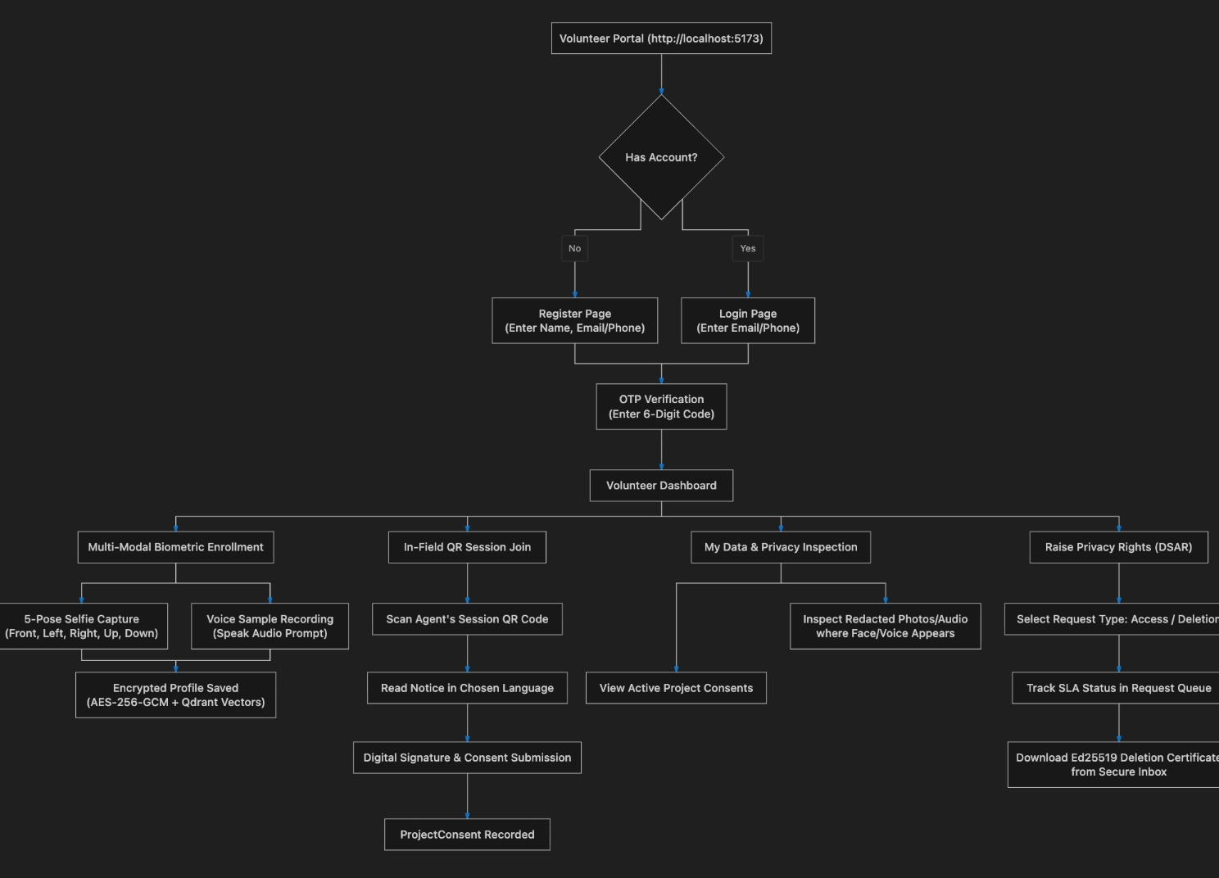
5 - ROLE FLOWS
Data principal: register, consent, enrol, inspect, exercise rights
The person's own portal, built for a phone. Flow from the repository's flow folder.
Consent before anything
OTP sign-in, notice in the chosen language, digital signature. A ProjectConsent row is the key every later decision, and every erasure, hangs off.
Biometric enrolment is separate consent
Five poses and a voice sample, encrypted AES-256-GCM at rest, vectors in Qdrant. Withdrawal auto-raises an erasure request.
My Data is the §11 surface
Redacted photos and audio where the face or voice appears, active consents, and every access to an original.
Rights requests
Access, correction, erasure, grievance, nomination. SLA status is visible, and the deletion certificate lands in the secure inbox.
PRISM · Project Review · 3 September 2026
9 / 19

Slide 10
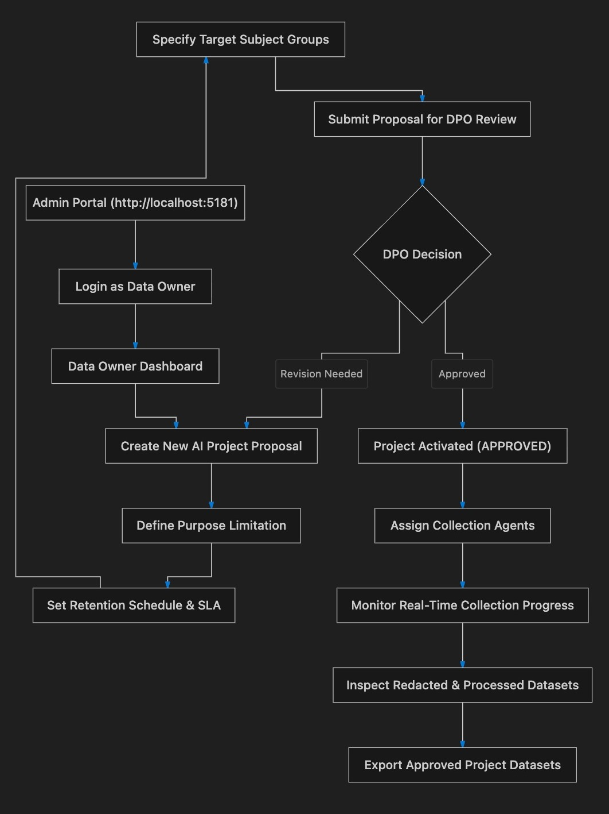
5 - ROLE FLOWS
Data owner: propose a purpose, get it approved, run the project
The business owner of a purpose. Cannot collect, only define, assign and inspect.
Purpose limitation is written down
Target groups, purpose, retention schedule and SLA are part of the proposal the DPO reviews. Rejection returns it with feedback.
Approval freezes policy
On APPROVED the policy version is frozen, so consent captured later is provably against the text that was approved.
Assign, then watch
Collection agents are assigned per project. Progress, processed datasets and redacted output are inspected here; originals are not.
Export
Approved datasets export as redacted derivatives with a signed manifest and EXIF/XMP provenance stamps on every image.
PRISM · Project Review · 3 September 2026
10 / 19

Slide 11
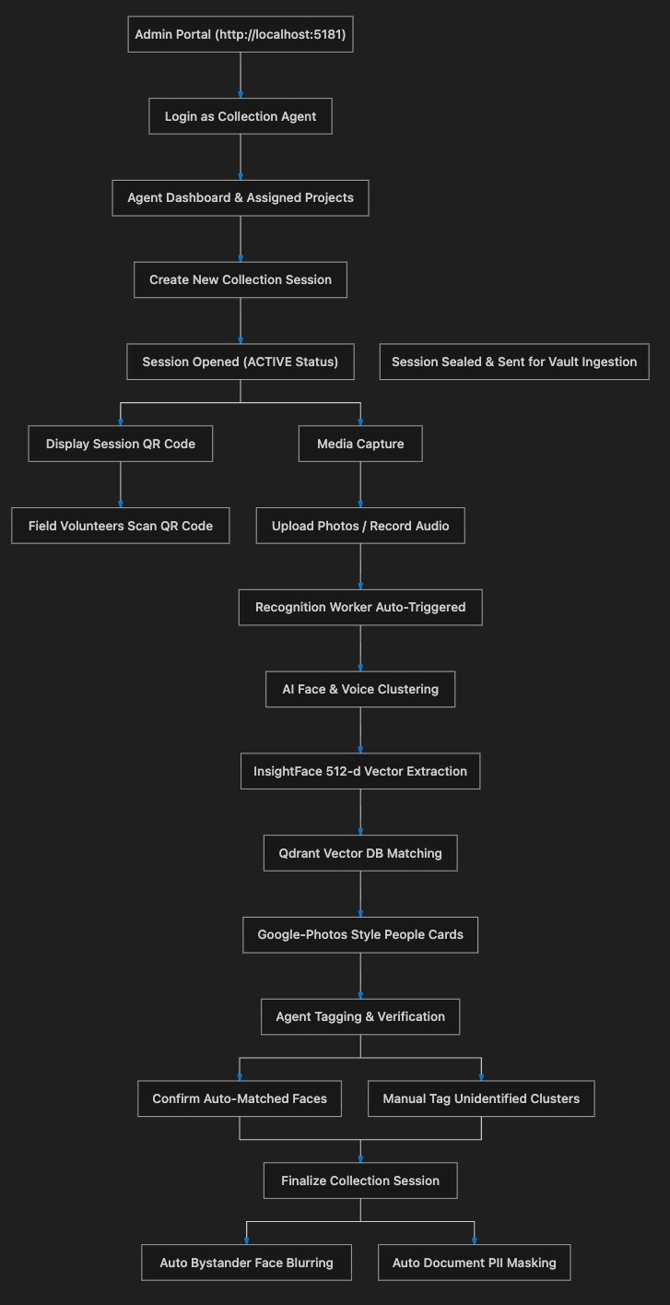
5 - ROLE FLOWS
Collection agent: sessions, tagging, sealed handoff
The only human who sees raw frames, and only before archive. Everything is tied to a project, a session and consent.
Session QR joins consented people
The roster search shows everyone but offers Add on nobody who has not consented to this project.
Recognition is automatic, tagging is human
InsightFace vectors, Qdrant matching, people cards. The agent confirms matches and tags unidentified clusters.
Finalize re-checks consent
Revoked consents are dropped, bystander faces are blurred, document PII is masked, session vectors are destroyed.
Sealed handoff
The session is archived and sent for vault ingestion; the agent loses access to originals from here on.
PRISM · Project Review · 3 September 2026
11 / 19

Slide 12
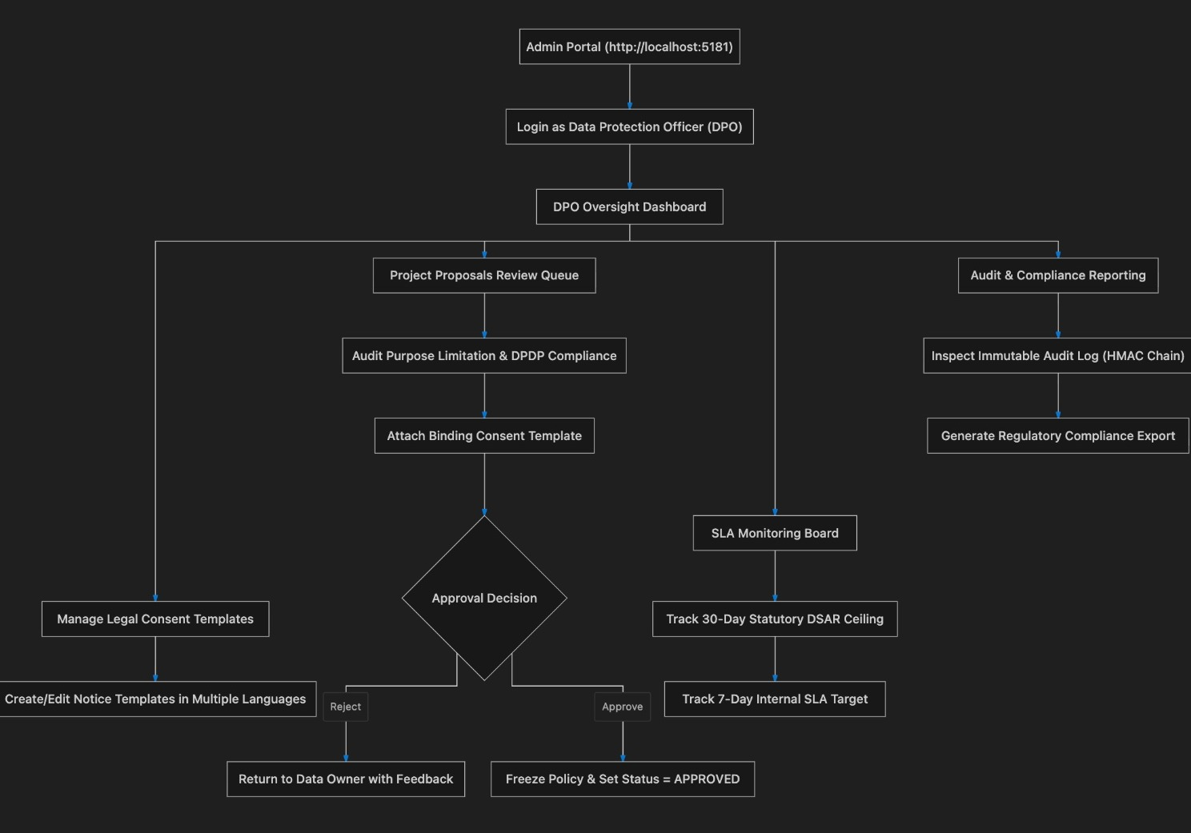
5 - ROLE FLOWS
DPO: govern, approve, monitor the clocks, report
Data Protection Officer under §10(2)(a). Owns the notice text, the approval gate and the compliance record.
Notice templates
Multi-language consent templates. A template cannot be published without a grievance contact (§5(1)(c), §13).
Approval gate
Audit purpose limitation and attach the binding template. Approve freezes policy; reject returns to the data owner with feedback.
Two clocks on one board
The 30-day statutory ceiling and the 7-day internal target for every open request.
Evidence a regulator would ask for
Immutable HMAC-chained audit log, breach records, and a compliance export for any period.
PRISM · Project Review · 3 September 2026
12 / 19

Slide 13
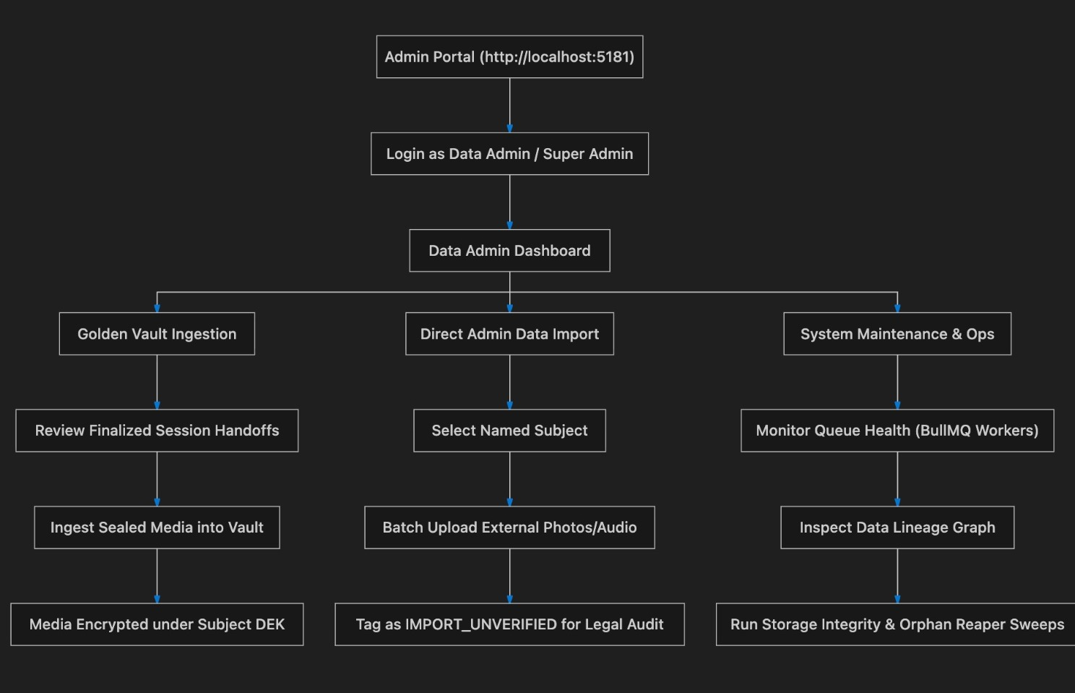
5 - ROLE FLOWS
Data admin and platform admin: vault, imports, operations
The DSAR executor and the operator. Break-glass access is logged, never silent.
Golden vault ingestion
Finalized handoffs are reviewed and sealed into the vault under the subject's DEK; the retention clock starts.
Direct import is its own inbound edge
Files for a named person are PII-masked but not face-blurred (detection never ran) and tagged IMPORT_UNVERIFIED so a DSAR answer never presents them as consented collection.
Operations
Queue health for the BullMQ workers, the data-lineage graph per person, storage-integrity and orphan-reaper sweeps.
DSAR execution
Discovery workspace, purge or export, evidence vault. Covered on the DSAR architecture slide.
PRISM · Project Review · 3 September 2026
13 / 19

Slide 14
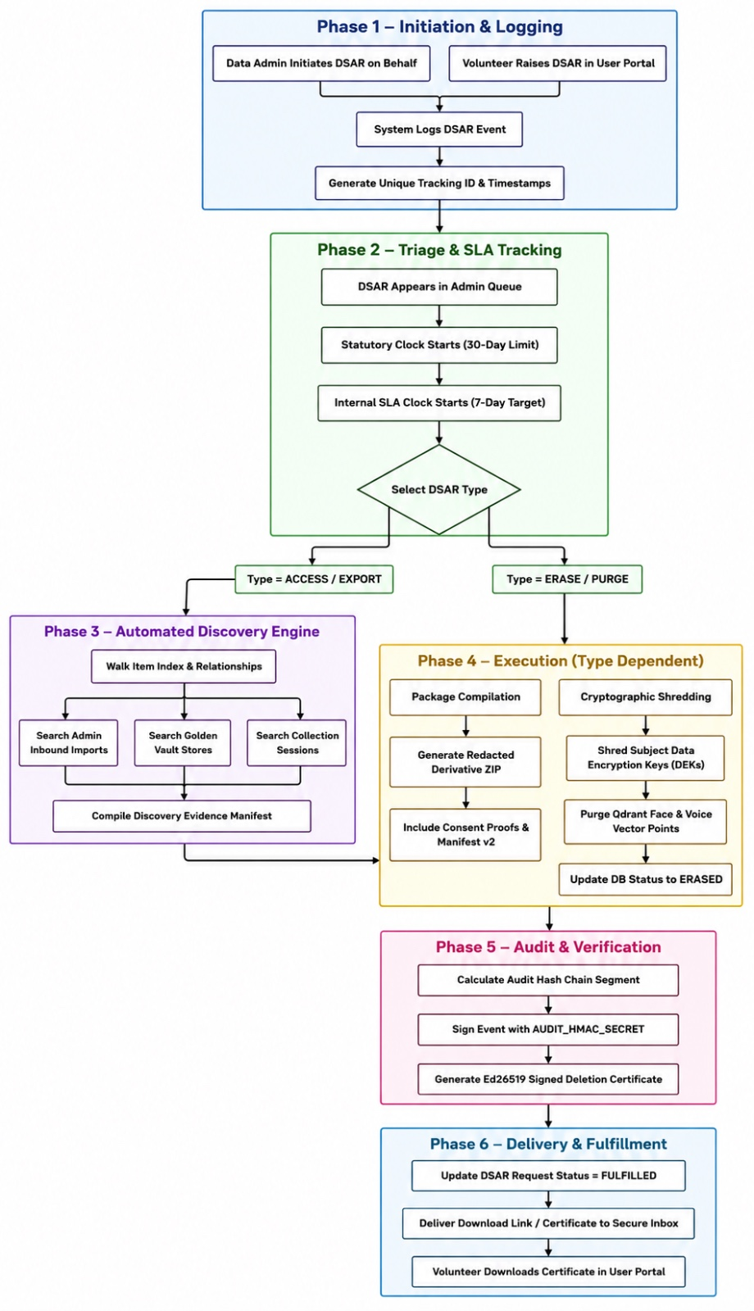
5 - ROLE FLOWS
DSAR lifecycle as a flowchart
The same six phases as the architecture slide, drawn end to end with the access and erase branches.
Two branches, one certificate
ACCESS compiles a redacted package with consent proofs and manifest; ERASE shreds the subject key, purges vectors and flips status to ERASED. Both end in a signed audit segment.
Clocks start at triage
Statutory 30 days and internal 7 days, tracked on the SLA board.
Delivery is pull, not push
The principal downloads the certificate or package from the secure inbox in their own portal.
PRISM · Project Review · 3 September 2026
14 / 19

Slide 15
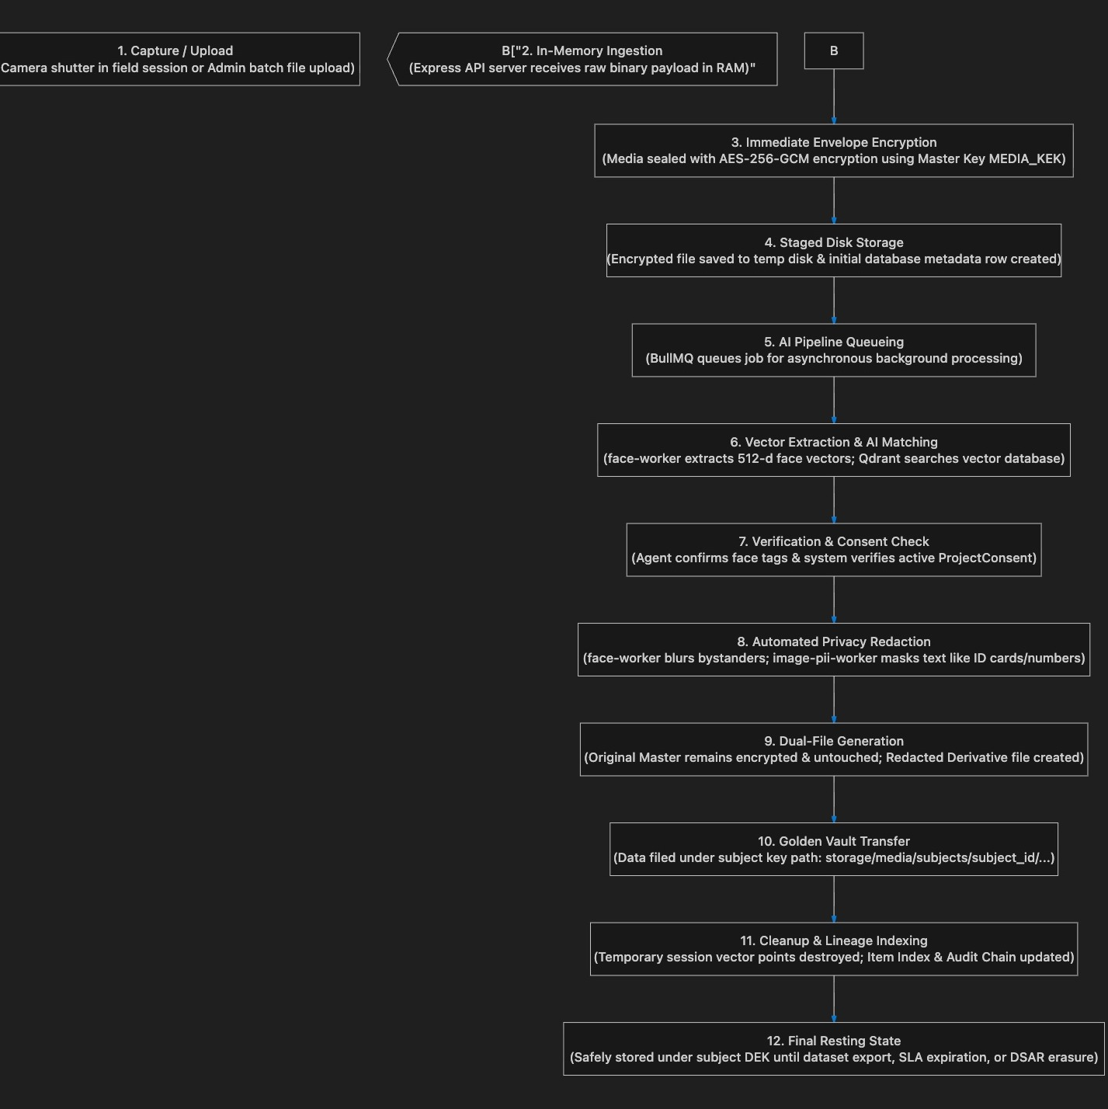
5 - ROLE FLOWS
Capture to storage in twelve steps
The numbered version of the architecture slide: what happens to one frame, in order.
Sealed before it is stored (steps 1-4)
Raw bytes arrive in RAM, are envelope-encrypted with AES-256-GCM under MEDIA_KEK, and only then hit staged disk with a metadata row.
Processed without human eyes (steps 5-8)
BullMQ queues the job; face-worker extracts vectors, Qdrant matches, the agent confirms tags, the backend checks consent, then blur and PII masking run.
Two files, one resting place (steps 9-12)
Original master stays sealed; the redacted derivative is what leaves. Filed under the subject key path, lineage indexed, temp vectors destroyed. Held until export, retention expiry or erasure.
PRISM · Project Review · 3 September 2026
15 / 19

Slide 16
6 - TECH STACK
The whole stack on one page
Two React SPAs, one Node.js/Express API with seven queue workers, five Python FastAPI microservices, three infrastructure services.
Frontends
Backend
Framework
React 19, React Router 7, Vite 8
Runtime
Node.js (ESM), Express 4, Prisma 5 on PostgreSQL 16 (~60 models)
Styling
Tailwind CSS 4, tailwind-merge, PostCSS
Queues
BullMQ 5 on Redis 7: recognition, redaction, purge, item-action, export, reaper, retention
UI
lucide-react icons, qrcode.react for session QR
Vectors
Qdrant v1.12 face and voice galleries
In-browser ML
@mediapipe/tasks-vision face-capture guidance
Auth
JWT, bcrypt, refresh cookies, OTP; five admin roles; helmet, cors, rate limiting, zod
Quality
oxlint; Vitest + Testing Library + jsdom
Crypto
AES-256-GCM envelope (MEDIA_KEK > HKDF per-subject DEK); Ed25519 signing; SHA-256
Ports
data principal :5173 · admin :5180
Media
sharp (redaction, thumbnails, EXIF/XMP stamps), multer, streamed ZIP; 215 node --test tests
AI core (5 FastAPI services)
Infrastructure and verification
face :8001
InsightFace buffalo_l (SCRFD + ArcFace), onnxruntime, Pillow
Containers
Docker Compose: dev stack with localdb / audio / video profiles; production compose
image-PII :8002
RapidOCR-ONNX + Presidio with Indian-identifier recognizers
Edge
Caddy 2 for TLS termination and static portal serving
audio :8003
faster-whisper, pyannote-audio 3.1, SpeechBrain ECAPA, Presidio, torch
Orchestration
concurrently starts 10 processes; setup-env.mjs mints per-machine secrets
text :8004
Presidio Analyzer + Anonymizer, spaCy, Streamlit demo, OpenAI SDK (demo only)
UI checks
Headless Chrome over raw CDP: route health per role, signup flow, capture-to-export flow
video :8005
InsightFace buffalo_l (shared volume), opencv-headless, IoU tracker
Proof scripts
verify-export.js, verify-dsar.js, inspect-photo-provenance.js, preflight.js
Common
Pydantic v2, uvicorn, Python 3.10-3.12, uv
Compliance
DPDP Act: consent, rights requests, signed certificates, retention, breach records, audit and access logs, DPIA
PRISM · Project Review · 3 September 2026
16 / 19

Slide 17
7 - PATENTABILITY
Patentability: five candidate inventions in what we built
Assessment by the team, not legal advice. 'Strength' is our estimate of distance from the closest prior art; the IP team's search decides.
Candidate invention | What PRISM does | Closest prior art | Where the novelty sits | Strength
1. Consent-keyed cryptographic erasure across multimodal derivatives | One HKDF-derived key per data principal seals every original, derivative, embedding and cache. Erasure destroys that key, purges vector-DB points, tombstones the item index and issues an Ed25519 certificate enumerating every location. | Crypto-shredding per user (well known); GDPR erasure tooling; certificate-of-destruction services. | Key scope bound to the consent record; shred extended to derived artefacts (per-person renders, video 'detected' derivative, Qdrant points); completeness proven by enumeration, not assertion. | High
2. Time-domain fail-closed video redaction from a consent-derived box schedule | Strided detection, IoU tracking, sparse per-track embedding. Backend turns the consent matrix into a blur schedule; the worker executes it with tracks that coast (HOLD_SEC), boxes dilated and held past track ends, partial encodes deleted. | Automatic face blurring in video (YouTube, Google, Brighter AI); person tracking for redaction. | Redaction driven by per-identity consent state rather than 'blur all faces'; explicit fail-closed rules in the time axis; decision (backend) separated from execution (stateless worker). | High
3. Detect / Decide / Redact architecture with consent-blind AI workers | Five stateless modality workers report findings and execute rectangle, interval or span lists. Only one component reads consent. Workers hold no database and no memory between calls. | Microservice ML pipelines; privacy-by-design architectures; policy decision / enforcement point separation (XACML). | PDP/PEP separation applied to biometric redaction so an ML fault cannot expose an unconsented person, with one uniform contract across image, video, audio and text. | Medium: strong as a system claim, weak alone
4. Consent-bound provenance stamps on redacted exports | Every exported image carries an Ed25519-signed stamp in EXIF and XMP naming project, session, consent record and export-scoped pseudonyms. A photo found alone still proves lawful origin without revealing a name. | C2PA / Content Credentials; watermarking; signed manifests. | Signing the consent record, not just authorship; pseudonyms scoped per export so two exports cannot be joined; the mapping file inside the archive is the only key. | Medium
5. Speaker-identity consent muting with ephemeral per-session voice galleries | Diarize, transcribe, match each speaker turn against enrolled ECAPA voice prints, mute turns of anyone without consent plus spoken PII, then destroy the session gallery at finalize. | Speaker diarization; voice-based redaction in call centres; PII masking in transcripts. | Per-turn consent decision keyed to enrolment, combined with a gallery lifetime bound to the session: data minimisation as a mechanism, not a policy. | Medium
Weaker as stand-alone claims, useful as dependent claims: the principal-confirmed erasure gate, IMPORT_UNVERIFIED lawful-basis tagging on inbound files, policy-version freezing at approval, the nullable-session completeness rule in discovery.
PRISM · Project Review · 3 September 2026
17 / 19

Slide 18
7 - PATENTABILITY
Patentability: the legal test, the drafting route, and timing
India, where Samsung R&D Institute Bangalore would file first, has a specific bar for software. The claims have to be written for it.
The Indian test: Section 3(k), Patents Act 1970
'A mathematical or business method or a computer programme per se or algorithms' is not an invention.
Not fatal for software. The 2017 CRI guidelines and Ferid Allani v Union of India (Delhi HC, 2019) let claims through when they show a technical effect or technical contribution beyond ordinary program execution.
Our technical effects: irreversible destruction proven by key erasure; a video file that cannot expose a face for a single frame; a redaction pipeline that cannot leak through a failed worker.
How to draft so it passes
Claim the system and the method, not the software: 'a data processing system comprising a key store, a plurality of stateless redaction workers, a consent matrix...'
Lead with the technical problem: frame-level re-identification in redacted video, incomplete erasure of derived artefacts, an ML fault exposing unconsented persons.
Keep the DPDP purpose in the description and out of the claims. Compliance is a business benefit; the examiner scores the mechanism.
Candidates 1 and 2 are the strongest independent claims. 3, 4 and 5 work as dependent claims or a second filing.
Jurisdictions and the cost of waiting
India: no general grace period. A public disclosure (paper, public demo, open repository) before filing destroys novelty. Section 31 covers only exhibitions and learned-society papers, for 12 months.
USA: 12-month grace after the inventor's own disclosure (35 USC 102(b)(1)). Korea: 12 months. EPO: none.
Practical rule: file an Indian provisional before anything leaves the mentors' review. Internal review under NDA is not a disclosure.
1
Invention disclosure
2
Prior-art search
3
Evidence pack
4
Provisional filing
5
Publish after filing
One IDF per candidate through the SRIB IP portal. Inventors: everyone who contributed to the claimed mechanism, not the whole team.
Terms: cryptographic erasure per data subject, consent-driven video redaction, face-track blur schedule, signed deletion certificate, provenance-signed pseudonymous export.
Commit history and dated design documents (DPIA, handoff notes, data-flow document) already fix conception dates. Export them with hashes.
An Indian provisional secures a priority date for 12 months while the complete specification is written; a PCT application within that year keeps US and KR open.
The monthly review deck, the model report and any paper go out only once the priority date exists.
PRISM · Project Review · 3 September 2026
18 / 19

Slide 19
8 - GLOSSARY
Glossary: platform acronyms and DPDP Act vocabulary
Left: what our acronyms mean. Middle: terms that match the Digital Personal Data Protection Act, 2023. Right: terms in our UI that do not, and what the Act says instead.
Platform acronyms
DPDP Act 2023 terms we use correctly
Terms we use that are not DPDP terms
DSAR
Data Subject Access Request: our name for any rights request
Data Principal
§2(j) the individual. Used in the user portal and backend.
Consent Manager
DPO
Data Protection Officer
Data Fiduciary
§2(i) Samsung, who decides purpose and means. Certificate issuer.
In the Act (§2(g), §6(7)-(9)) a separate entity registered with the Board, acting for the principal. Our label 'Consent Manager v6.21' is a misuse. Say 'Consent Hub'.
DPIA
Data Protection Impact Assessment
Data Subject / Subject
SLA
Service Level Agreement: 7-day internal, 30-day statutory
Data Processor
§2(k) the AI workers processing on the fiduciary's behalf.
GDPR term, used across the admin portal (Subject Verification, 'data subject request'). Act says Data Principal.
PII
Personally Identifiable Information (US/NIST term)
Data Protection Officer
§10(2)(a) mandatory for a Significant Data Fiduciary. Our DPO role.
OCR / NER
Optical Character Recognition / Named Entity Recognition
Notice
§5 what the consent template renders, in the principal's language.
DSAR
KEK / DEK
Key Encryption Key / per-subject Data Encryption Key
GDPR acronym. The Act has no acronym and we also use it for erasure, grievance and nomination. Say 'rights request'.
HKDF
Derives each subject's DEK from the master KEK
Consent / withdrawal
§6 free, specific, informed, unambiguous; withdrawal as easy as giving it.
AES-256-GCM
Authenticated encryption for every stored blob and vector
Right to access
§11 the My Data summary and the ACCESS request.
PII
US/NIST term (47 UI uses, PiiStatus). Act says personal data §2(t).
Ed25519
Signatures on certificates, exports and image provenance
Correction and erasure
§12(1) CORRECT and §12(3) ERASE requests.
HMAC
Keyed hash chaining the audit log
Sensitive personal data
SHA-256
Content hash recorded before a file is destroyed
Grievance redressal
§13 GRIEVANCE request; §8(10) mechanism; contact on every notice.
No such category in the 2023 Act (dropped from the 2019 bill).
JWT / RBAC / OTP
Session token / role-based access / one-time passcode
Nominate
§14 NOMINATION request.
SCRFD / ArcFace
InsightFace face detector / 512-d face embedding
Data Owner
ECAPA-TDNN
SpeechBrain 192-d voice embedding
Personal data breach
§2(u), §8(6) our breach records and runbook.
Internal role name. The Act avoids ownership language for personal data. 'Project Owner' is safer.
BullMQ
Redis-backed job queue for the seven backend workers
Purpose limitation
§4, §6 the DPO approval gate and frozen policy version.
Data Admin, Collection Agent, Super Admin, Purge, Handoff
Qdrant
Vector database for session face and voice galleries
Significant Data Fiduciary
§10 the category that makes a DPO and a DPIA mandatory.
Internal operational names. No DPDP meaning either way; fine to keep.
EXIF / XMP
Image metadata blocks carrying the provenance stamp
Data Protection Board
§18 the regulator. Not yet named in our notice: §5(1)(c) requires it.
QR / TTL / CDP
Invite code / retention time-to-live / Chrome DevTools Protocol
Fix is display strings only: enum values (AdminRole, DsarType, PiiStatus) can stay, so migration risk is zero.
PRISM · Project Review · 3 September 2026
19 / 19

