Slide 1

Mood Companion
Deep Sentiment-Conditioned Neural Contextual Bandits
for Real-Time Interactive Desktop Companions
Foundations of Deep Learning
Academic Year 2026–27 | 31 October 2026
Team Members
Reuben Sabu V (MUT23CA060)
Sidharth Ravi (MUT23CA063)
Jino Jenz (MUT23CA035)
Nikhil Jimmy (MUT23CA055)
1

Slide 2
Problem Statement
Desktop companions and chat assistants reply to every user the same way, whatever their mood. Fixed, hand-written rules cannot tell whether a stressed user wants a joke, a break or a breathing exercise, and they never improve from feedback. This project builds a lightweight, real-time companion that reads the user's emotion from text with a deep neural network and uses a neural contextual bandit to choose the response style most likely to help, learning from each thumbs-up / thumbs-down so that it personalises itself to the user while it runs.
Mood Companion, Dept of AI and DS
2

Slide 3
Objectives
O1
Detect emotion: Train a deep MLP on TF-IDF features to classify text into 6 emotions.
O2
Build context: Combine emotion probabilities, time of day, session length and last reward into a 10-d context.
O3
Decide: Use a neural contextual bandit (MLP + ε-greedy) to pick 1 of 8 companion actions.
O4
Learn online: Update the bandit in real time from user thumbs-up / thumbs-down rewards.
O5
Evaluate & demo: Compare against random, fixed and oracle policies; deliver an interactive Streamlit app.
Mood Companion, Dept of AI and DS
3

Slide 4
Project Overview
Problem
Motivation
Need
SDG 3
Assistants give one-size-fits-all replies and cannot adapt to a user's mood.
The wrong reply at a stressful moment annoys users; the right one supports them.
A model that senses emotion and learns which response works, from live feedback.
Good Health and Well-being
Target 3.4
Promote mental health and well-being.
Mood Companion notices stress, sadness or anger and responds with breaks, breathing exercises or support — adapting to what helps each user.
Target Users
Scope
Expected Impact
Students, remote workers and anyone using a desktop assistant for long sessions.
Text emotion model, neural bandit, simulator and a 4-page Streamlit web app.
Responses that fit the user's mood and improve with every interaction.
Mood Companion, Dept of AI and DS
4

Slide 5
Progress since First Review
Parameter | Initial Plan | Current Status (31 Oct 2026)
Problem / Scope | Mood-aware companion idea | Sentiment-conditioned neural bandit companion
Dataset | Emotion text data from Kaggle | Kaggle Emotions dataset (6 labels) via kagglehub
Emotion Model | TF-IDF + small neural network | TF-IDF → MLP (128-64-6) trained and saved
Decision Model | Contextual bandit for responses | Neural bandit (10→64→64→8) with ε-greedy
Evaluation | Simulated user planned | Done: 70.4% reward vs 40.6% for random
Platform | Streamlit web app | 4-page app built and browser-tested
Key Change since Review 1 | Outcome
1. Kaggle access may be blocked offline | Added built-in sample data so the app always runs
2. Context made sentiment-conditioned | Bandit learns a different best action per mood
Mood Companion, Dept of AI and DS
5

Slide 6
System Requirements and Design
Presentation
Dataset &
Training page
Live
Companion
Bandit
Simulation
How it
Works
User Message
Emotion Model
Model
(PyTorch)
Emotion model
TF-IDF → MLP
Context
builder (10-d)
Neural bandit
MLP + ε-greedy
Response
templates
Context Builder
Learning
Reward
(up/down)
Replay
buffer
Online update
(Adam, MSE)
Simulated
user
Neural Bandit
Feedback
Learner
Data &
Storage
Kaggle dataset
(kagglehub)
Offline
sample CSV
models/
*.pt weights
Streamlit
session state
Companion Response
(a) Overall system architecture
(b) Simplified module block diagram
Software: Python 3.10+, PyTorch, scikit-learn, Streamlit, kagglehub, pandas. Hardware: any 4-core CPU, 8 GB RAM; no GPU needed (training ≈ 1 min).
Mood Companion, Dept of AI and DS
6

Slide 7
Methodology
Start
Processing steps & workflow
1. Data: Kaggle emotions dataset via kagglehub.
2. Features: TF-IDF, 5,000 uni- and bi-grams.
3. Emotion MLP: 5000→128→64→6, ReLU, Dropout 0.3.
4. Context: emotion probs + time + session + last reward.
5. Reward net: MLP 10→64→64→8, one output per action.
6. ε-greedy: explore with prob. ε (0.3 → 0.05).
7. Online learning: replay buffer, 4 Adam steps, MSE.
8. Evaluation: vs random, fixed and oracle policies.
User types a message
Emotion MLP → 6 probs
Build 10-d context
Explore:
random action
yes
rand < ε ?
no
Exploit: best
predicted action
Show response
next
message
AI-project items
• Dataset: ~20k sentences, 6 emotions (16k/2k/2k).
• Pre-processing: label filtering, TF-IDF.
• Training: 8 epochs, batch 64, Adam lr 1e-3, CPU.
• Testing: accuracy, confusion matrix, simulation.
• Deployment: Streamlit web app.
Thumbs up / down = reward
Update bandit (MSE, decay ε)
Flowchart of the Sense → Decide → Learn loop
Mood Companion, Dept of AI and DS
7

Slide 8
Technology Used
Category | Choice | Why it was selected
Programming language | Python 3.10+ | Standard language for deep learning and data science
Deep learning | PyTorch 2.x | Simple, flexible neural networks; runs well on CPU
Feature extraction | scikit-learn (TF-IDF) | Fast, reliable text-to-vector conversion
Web framework | Streamlit | Interactive Python web app with no front-end code
Dataset access | kagglehub | One-line download of the Kaggle dataset
Data handling | pandas, NumPy | Loading, cleaning and numeric processing
Visualisation | Streamlit charts, matplotlib | Loss curves, confusion matrix, reward plots
Testing | Playwright (headless Chromium) | Automated check that every app page works
IDE & tools | VS Code, Git / GitHub | Shared team tooling and version control
Hardware | 4-core CPU, 8 GB RAM; no GPU | Small models train in about a minute on CPU
Mood Companion, Dept of AI and DS
8

Slide 9
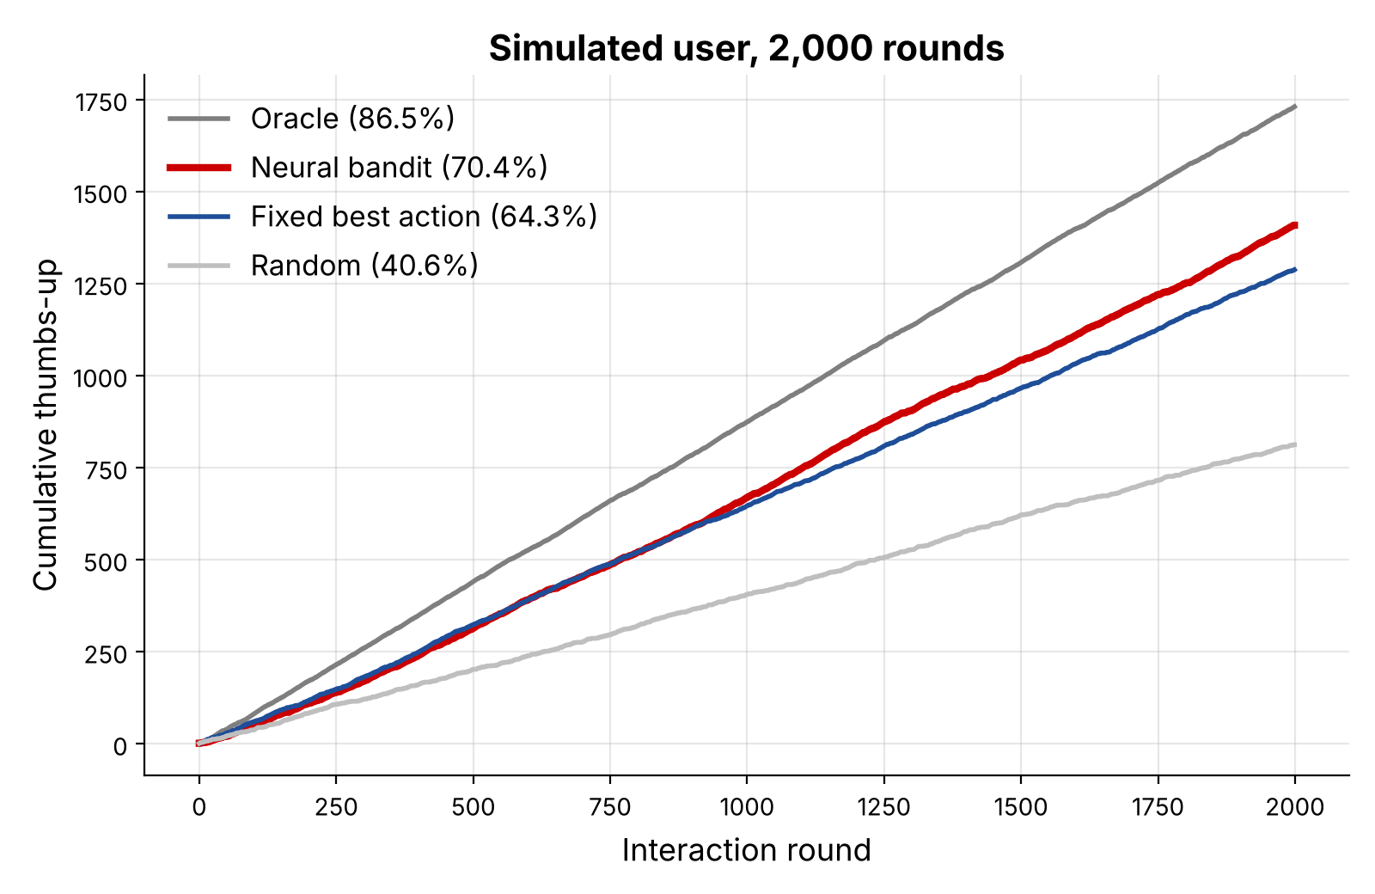
Results
70.4%
40.6%
86.5%
neural bandit
thumbs-up rate*
random-choice
baseline*
oracle upper
bound*
3.5 ms
6 → 8
4 / 4
per online update
on CPU
emotions mapped
to actions
app pages pass
browser test
*Simulated user, 2,000 rounds, assuming accurate emotion detection
Performance indicator | Expected | Achieved
Emotion classifier accuracy | ≥ 80% on test set | [fill in after full Kaggle training]
Bandit beats random policy | Clearly higher reward | Yes: 70.4% vs 40.6%
Bandit beats fixed best action | Higher reward | Yes: 70.4% vs 64.3%
Real-time learning | < 100 ms per feedback | ~3.5 ms per update on CPU
Mood Companion, Dept of AI and DS
9

Slide 10
Remaining Work
Activity | Deliverable | % Completed
Full training | Train on full Kaggle data; report accuracy | 50%
User study | Real users rate responses to validate the bandit | 0%
Better model | Upgrade emotion model to a transformer (DistilBERT) | 0%
Exploration | Compare ε-greedy with NeuralUCB / Thompson sampling | 10%
Desktop app | Always-on-top desktop overlay version of the companion | 0%
Documentation | Project report, user guide and presentation | 60%
Overall completion ≈ 70% of planned scope
Mood Companion, Dept of AI and DS
10

Slide 11
Updated Timelines
Completed
Ongoing
Pending
Problem study & literature survey: Oct 2026
Emotion MLP + neural bandit: Oct 2026
Streamlit app (4 pages): Oct 2026
Simulation evaluation: Oct 2026
Full Kaggle training & accuracy: Nov 2026
Exploration-strategy comparison: Nov 2026
Project report: Nov 2026
Real-user study: Nov–Dec 2026
Transformer emotion model: Dec 2026
Final presentation & viva: Dec 2026
Mood Companion, Dept of AI and DS
11

Slide 12
References
[1] L. Li, W. Chu, J. Langford and R. E. Schapire, "A contextual-bandit approach to personalized news article recommendation," WWW, 2010.
[2] C. Riquelme, G. Tucker and J. Snoek, "Deep Bayesian bandits showdown," ICLR, 2018.
[3] D. Zhou, L. Li and Q. Gu, "Neural contextual bandits with UCB-based exploration," ICML, 2020.
[4] R. Allesiardo, R. Féraud and D. Bouneffouf, "A neural networks committee for the contextual bandit problem," ICONIP, 2014.
[5] E. Saravia et al., "CARER: Contextualized affect representations for emotion recognition," EMNLP, 2018.
[6] R. S. Sutton and A. G. Barto, Reinforcement Learning: An Introduction, 2nd ed., MIT Press, 2018.
[7] I. Goodfellow, Y. Bengio and A. Courville, Deep Learning, MIT Press, 2016.
[8] T. Lattimore and C. Szepesvári, Bandit Algorithms, Cambridge University Press, 2020.
[9] A. Paszke et al., "PyTorch: An imperative style, high-performance deep learning library," NeurIPS, 2019.
[10] F. Pedregosa et al., "Scikit-learn: Machine learning in Python," JMLR, 2011.
[11] P. Govi, "Emotions dataset for NLP," kaggle.com/datasets/praveengovi/emotions-dataset-for-nlp.
[12] Streamlit Inc., "Streamlit documentation," docs.streamlit.io, 2025.
[13] Kaggle, "kagglehub," github.com/Kaggle/kagglehub, 2025.
Mood Companion, Dept of AI and DS
12

Slide 13
Thank You
Mood Companion: emotion → context → neural bandit → personalised response
Questions?
Mood Companion, Dept of AI and DS
13

