Slide 1
Twitter Sentiment Analysis

Slide 2

Contents
Introduction
Data Acquisition and Preprocessing
Exploratory Data Analysis
Model Development
Results
Conclusion

Slide 3
Introduction
Twitter is a social media platform where it has around 450 million monthly active users as of 2023 and users can tweet, up to 280 characters. Twitter is extensively used for exchanging thoughts and ideas, networking, marketing, and promoting organizations and products.
The goal of sentiment analysis, a Natural Language Processing (NLP) technique, is to recognize and extract subjective information from text sources. Twitter sentiment analysis involves analyzing the sentiments expressed in tweets to gain insights into public opinion.
It is also helpful for political analysis, public opinion research, and other fields where it's important to comprehend people's thoughts and emotions.

Slide 4
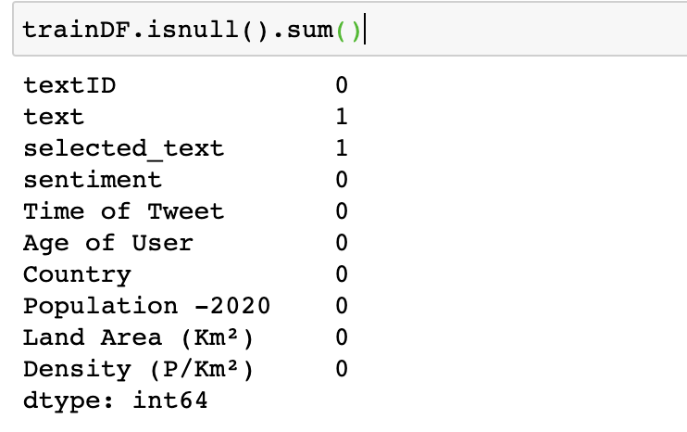
About the Dataset and Preprocessing
Null Values in dataset
The project will utilize a dataset called Twitter Sentiment Analysis, which was sourced from Kaggle. This dataset contains a total of 27480 tweets.
The Twitter Sentiment Analysis dataset consists of attributes including TextID, Text, Selected_text, Sentiment, Time of Tweet, Age of user, Country, Population of the country, Land area, and Density.
One of the essential steps in dataset analysis is handling missing values. As shown in the figure, there was only a single missing value in the ‘text’ and ‘selected_text’ fields. The variables ‘Population -2020’, ‘Land Area (Km²)’, ‘Density (P/Km²)’ which are not necessary for this project, were also removed, along with the missing data.

Slide 5
Text Preprocessing
To ensure that the model analysis is not affected, we started by creating a regular expression to eliminate URLs from tweets, and then substituted them with a blank space.
Then, we used NLTK library packages (word_tokenize, stopwords, WordNetLemmatizer) to tokenize the words, remove stop words, punctuation and special characters.
We used Universal POS tag which is important to correctly lemmatize words.
The goal is to transform the text into numerical feature vectors using the Bag of Words strategy and TF-IDF Vectorization.

Slide 6
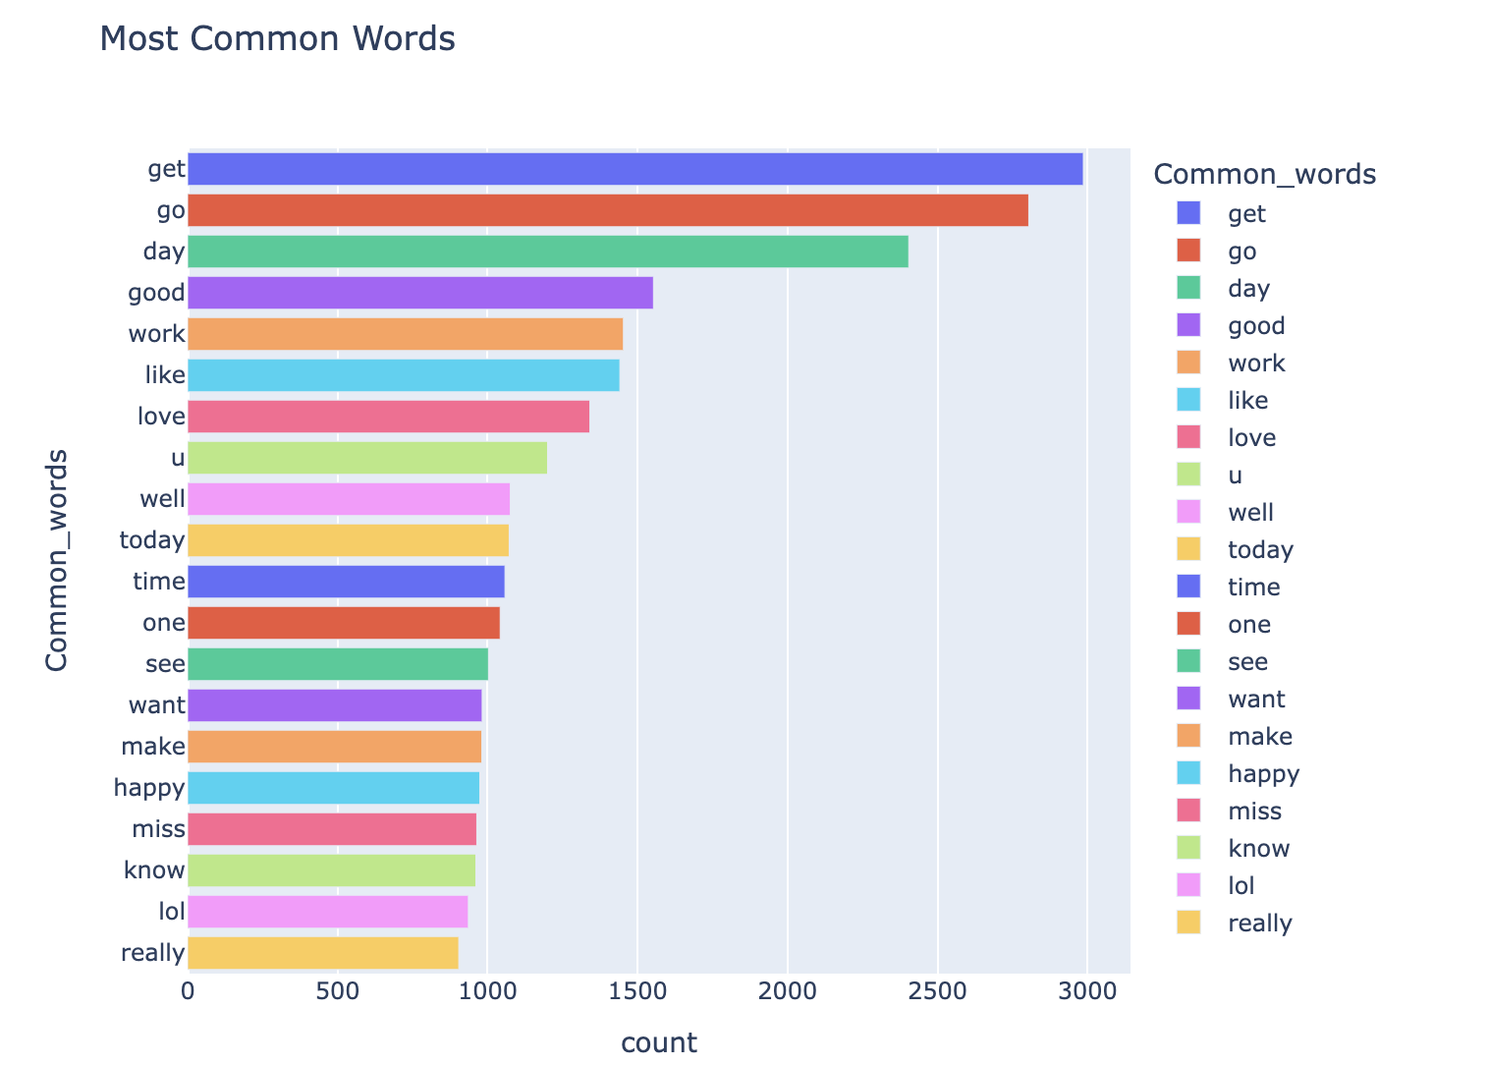
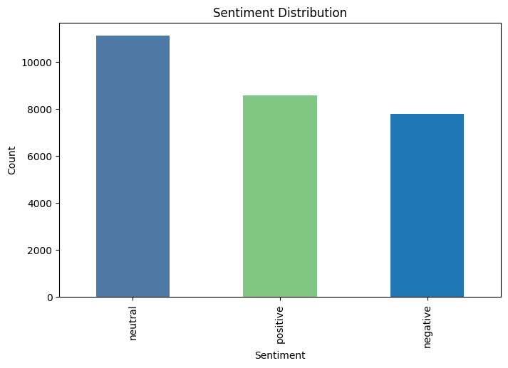
Exploratory Data Analysis
First figure shows the distribution of the sentiment column with the positive, negative and neutral labels.
The second figure displays a list of the most frequently occurring words in the tweets.

Slide 7
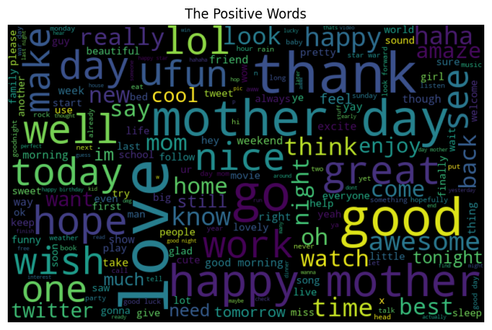
Exploratory Data Analysis
Word clouds are a visualization technique used to represent textual data.
This technique is used to group words together in a random arrangement, with the size of each word indicating its frequency of occurrence in the text
This figure shows the word cloud for Positive tweets.

Slide 8
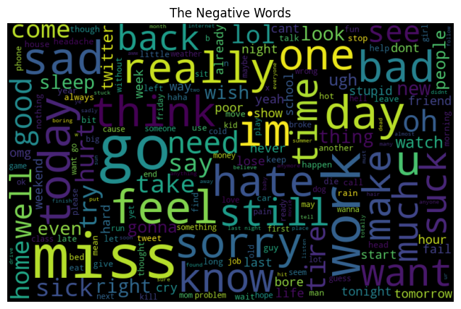
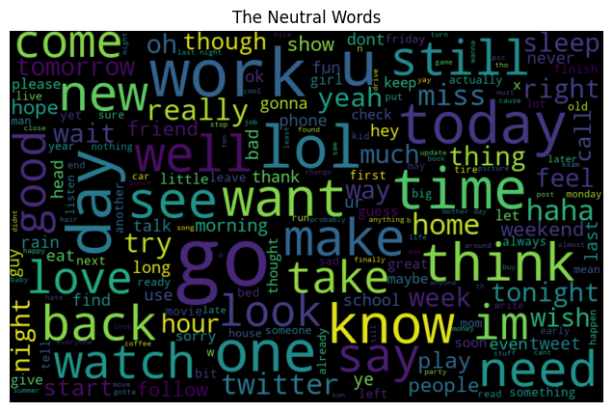
Exploratory Data Analysis
The two figures presented display word clouds for negative and neutral sentiment.

Slide 9
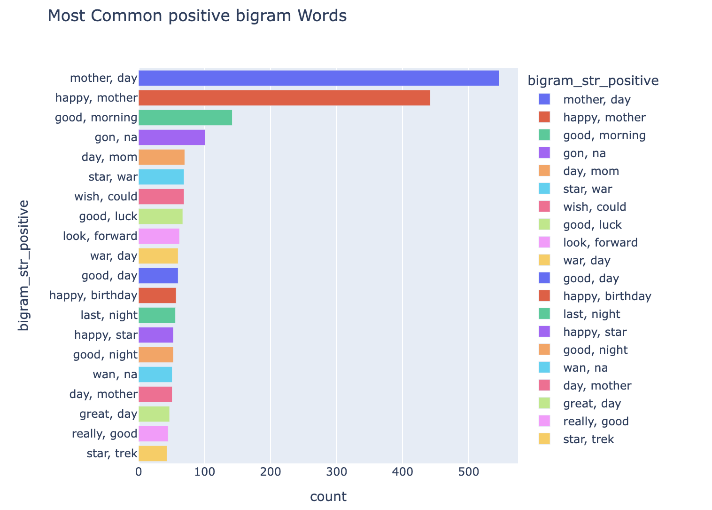
Exploratory Data Analysis
One technique for text analysis is the use of n-gram, which are contiguous sequences of n items from a given sample of text.
In sentiment analysis, n-grams can be used to identify key phrases or combinations of words that are strongly associated with a particular sentiment or emotion
The figure shows the most frequent bigram in tweets based on positive sentiment.

Slide 10
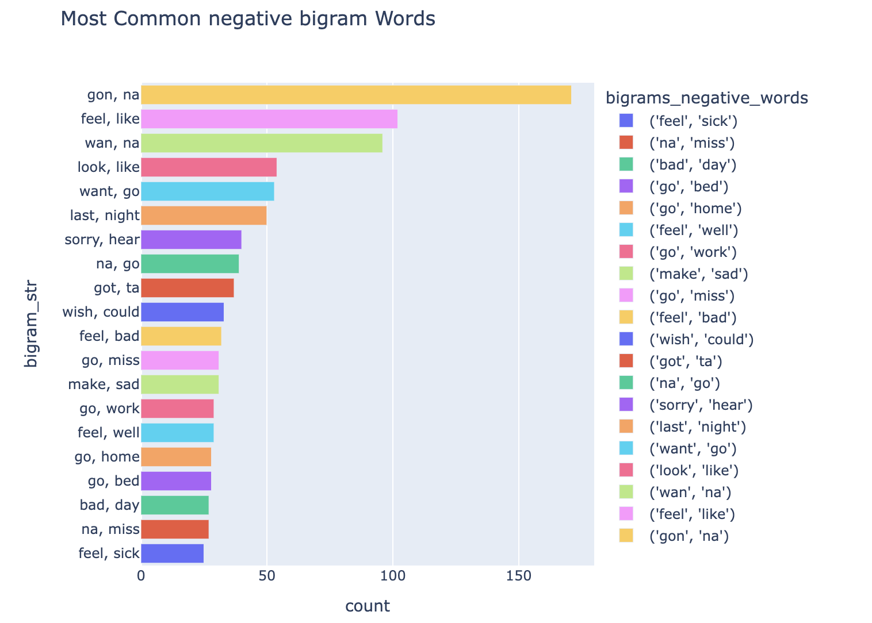
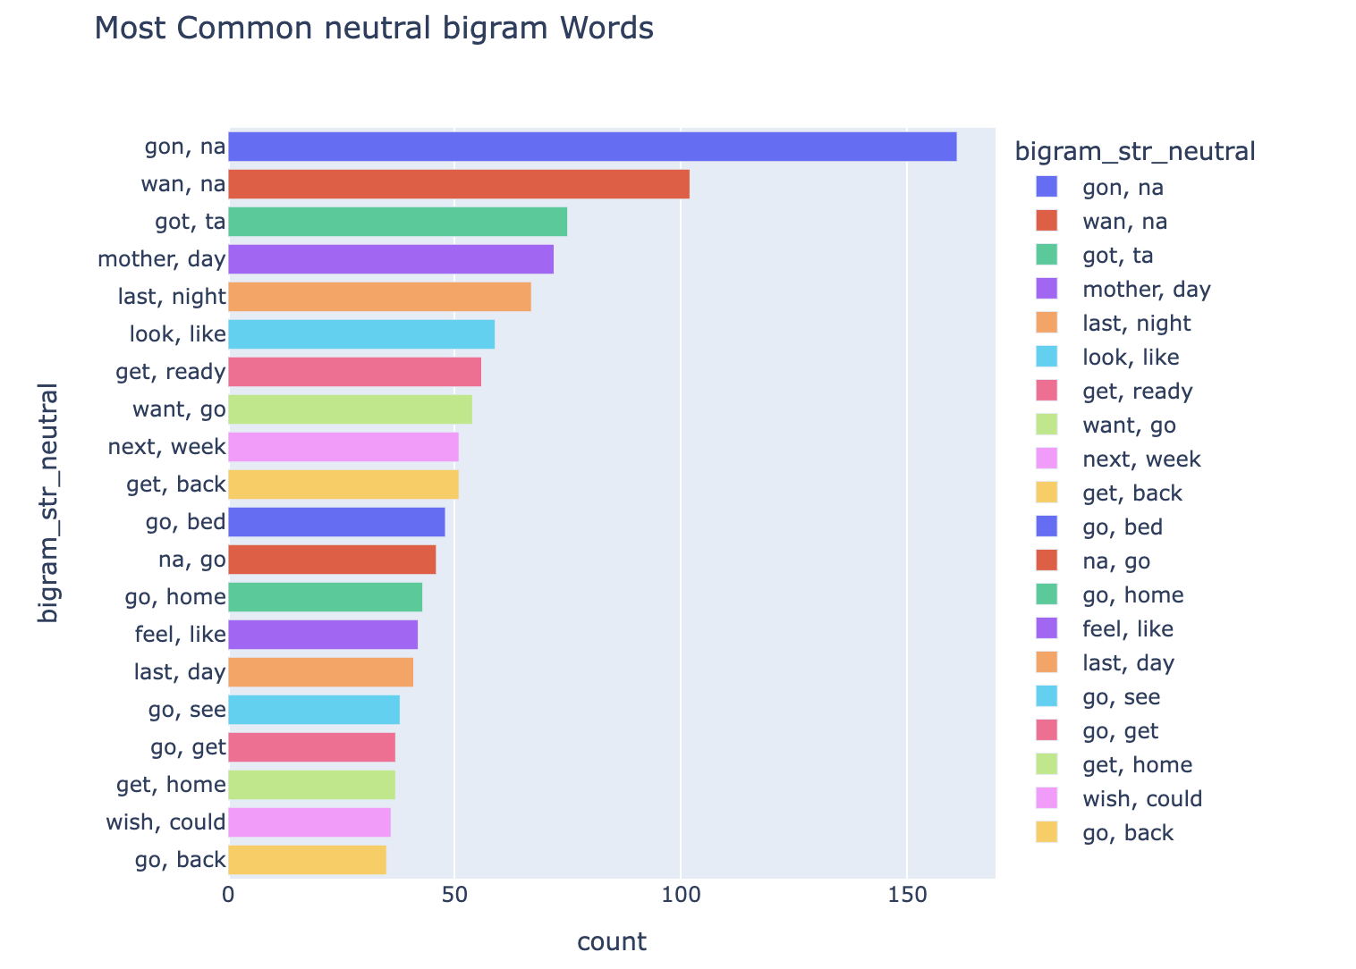
Exploratory Data Analysis
The two figures presented display the most frequent bigram in tweets based on negative and neutral sentiment.

Slide 11
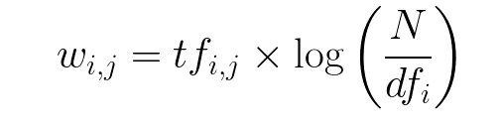

Model Development TF-IDF
TF-IDF Vectorization
The TF-IDF Vectorization converts a collection of raw documents into a matrix of TF-IDF features.
The term frequency-inverse document frequency (TF-IDF) is a numerical statistic that reflects how important a word is to a document in a collection or corpus.
The resulting feature matrices can be used as input to a machine learning model for sentiment analysis.

Slide 12
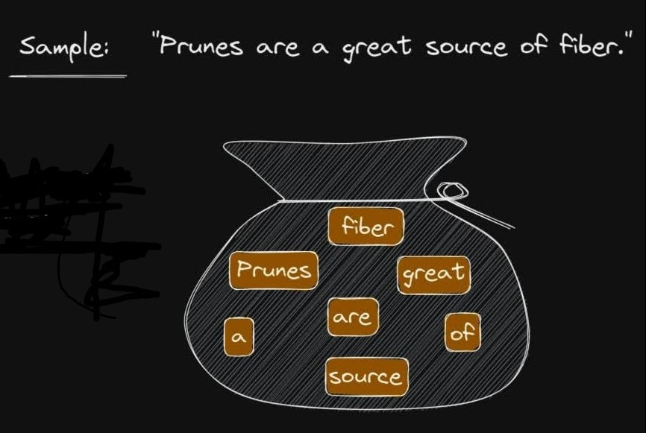
Model Development - BoW
Bag Of Words
Bag of Words is a text representation technique used to convert a text document into a numerical vector.
The BoW model treats a text document as a "bag" or collection of words, ignoring the order in which they appear and focusing only on their frequency of occurrence.
The process of creating a BoW representation typically involves two steps: tokenization, which involves splitting the text into individual words or tokens, and counting, which involves tallying the frequency of each word in the document.
It is a simple and effective approach for many text-based tasks.

Slide 13
Model Development
The sentiment attribute represents the sentiment of the tweet, which can be positive, negative, or neutral. It is the target variable for the sentiment analysis, and it is based on the selected text of the tweet.
Sentiment classification can be accomplished using machine learning techniques. This project uses several machine learning models including K-Nearest Neighbors (KNN), Support Vector Classifier (SVC), Random Forest, and Decision Tree Classifiers to accomplish this analysis.
The performance of each model is evaluated using three metrics: Test Accuracy, Test Precision, and Test Recall.

Slide 14
Model Development
Test Accuracy measures the proportion of correctly classified samples out of the total number of samples in the testing dataset.
Test Precision measures the proportion of true positive samples (i.e., samples correctly identified as positive) out of the total number of positive samples identified by the model.
Test Recall measures the proportion of true positive samples out of the total number of actual positive samples in the testing dataset.

Slide 15
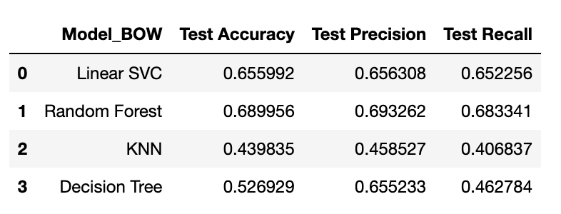
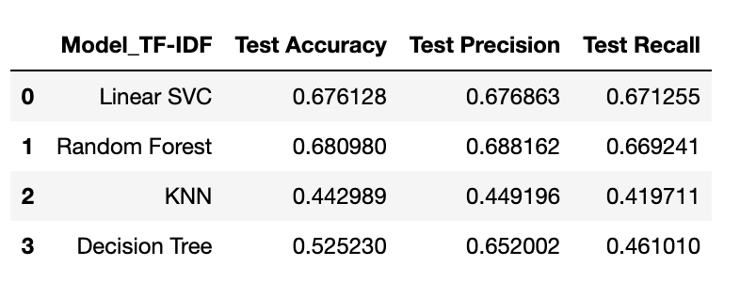
Results
The first table shows the performance of machine learning models for sentiment classification using the Bag-of-words technique. We can see that RandomForestClassifier achieved the highest Test Accuracy.
The second table shows the performance of models for sentiment classification using the TF-IDF (Term Frequency-Inverse Document Frequency) technique. We can see that RandomForestClassifier achieved the highest Test Accuracy.
However, the best model should be selected based on a balance between high accuracy, precision, and recall, and not just based on a single metric.

Slide 16
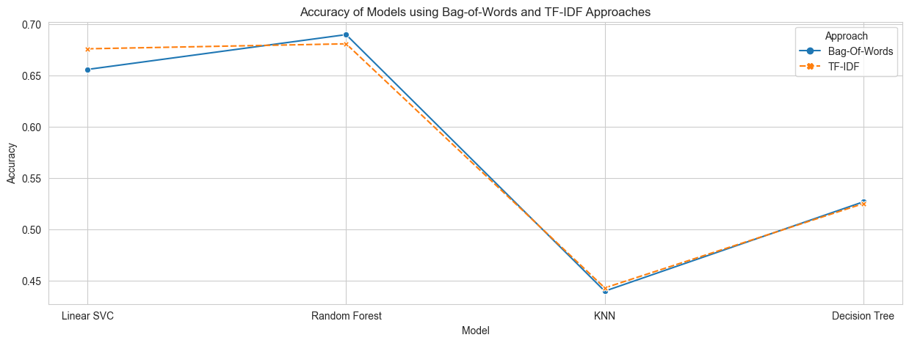
Results
This plot shows the Test Accuracy of different machine learning models for sentiment classification using both Bag-of-Words (BOW) and TF-IDF approaches. The x-axis represents the different machine learning models being evaluated, and the y-axis represents the Test Accuracy metric.
The results show that the RandomForestClassifier consistently achieves the highest accuracy with both Bag of Words and TF-IDF vectorization. Therefore, we can conclude that the RandomForestClassifier is the most suitable model for classifying tweets based on sentiment in our dataset.

Slide 17
Conclusion
In conclusion, this Twitter sentiment analysis project demonstrated the process of collecting, preprocessing, analyzing, and classifying tweets based on their sentiment.
This analysis has many potential applications, including brand monitoring, market research, and political analysis.
We used TF-IDF and BoW approach in our analysis, each approach has its own strengths and limitations, and the choice of method will depend on factors such as the size of the dataset, the level of accuracy required, and the resources available.
Overall, Twitter sentiment analysis is a powerful tool for gaining insights into public opinion and sentiment on a variety of topics.

Slide 18
References
[1] Sentiment Analysis: Machine Learning Approach. (n.d.). Retrieved from https://www.kaggle.com/code/poojag718/sentiment-analysis-machine-learning-approach#Twitter-Sentiment-Analysis
[2] NLTK :: Natural Language Toolkit. (n.d.). Retrieved from https://www.nltk.org/
[3] AminiMotlagh, M., Shahhoseini, H., & Fatehi, N. (2022, December 12). A reliable sentiment analysis for classification of tweets in social networks. https://doi.org/10.1007/s13278-022-00998-2
[4] Matplotlib — Visualization with Python. (2023, February 14). Retrieved from https://matplotlib.org/
[5] scikit-learn: machine learning in Python &mdash; scikit-learn 1.2.2 documentation. (n.d.). Retrieved from https://scikit-learn.org/stable/

Slide 19
Thank you

