Slide 1
University Admissions Data Analysis

Slide 2
Overview:
The goal of this project is to select, explore, and describe different aspects of a data set using a combination of graphics and statistical models.
The dataset we have chosen for this project is Data for Admission in the University. (Source : Kaggle datasets)
This dataset includes various information like GRE Score (260 to 340 ), TOEFL Score (0 to 120 ), University Rating (1 to 5 ) , SOP (Statement of Purpose)(1 to 5 ), LOR (Letter of Recommendation)(1 to 5 ), CGPA(1 to 10 ), Research(0 or 1 )and Chance of Admit(0 to 1 ).

Slide 3
Analysis:
What variable significantly affects the Chance of Admit: GRE, TOEFL, Rating, SOP, LOR, CGPA, Research?
Which data values are negatively affecting the response variable?
What effect does the statistically insignificant predictors have on the model? How does the model improve after removing them from the model selection process?

Slide 4
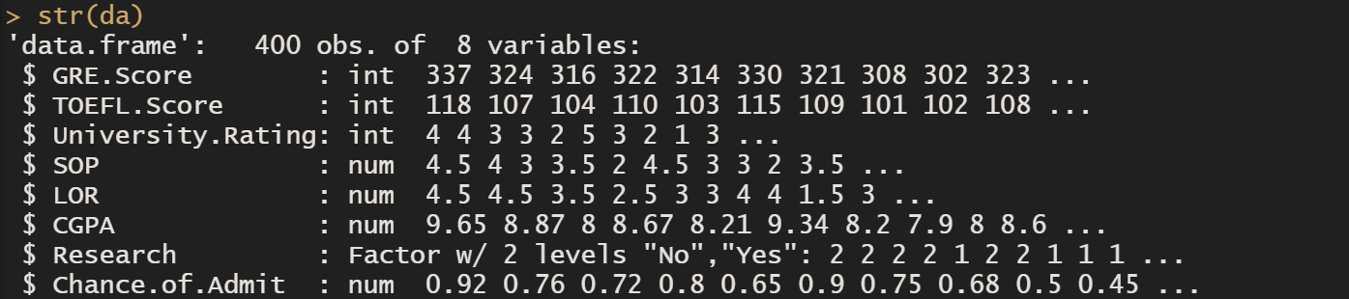
Data Pre-processing:
From the dataset, we have removed a column named Serial Number as it is the least significant variable of the dataset and then we converted the values of Research which are 0 and 1 to No and Yes for better user understanding and then converted the column to a factor.

Slide 5
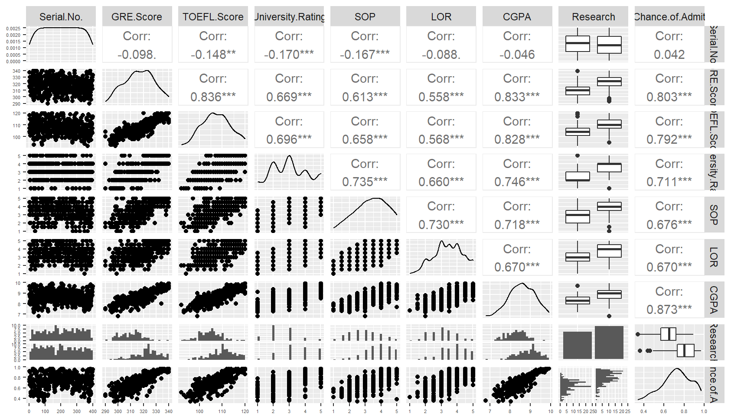
1.Scatter Plot matrix(Correlation):
GRAPHICS
As we can see from the matrix, least correlation with the response variable (Chance of Admit) is Serial Number as it has no predictive power in the model and the highest correlation value is from CGPA (0.873)

Slide 6
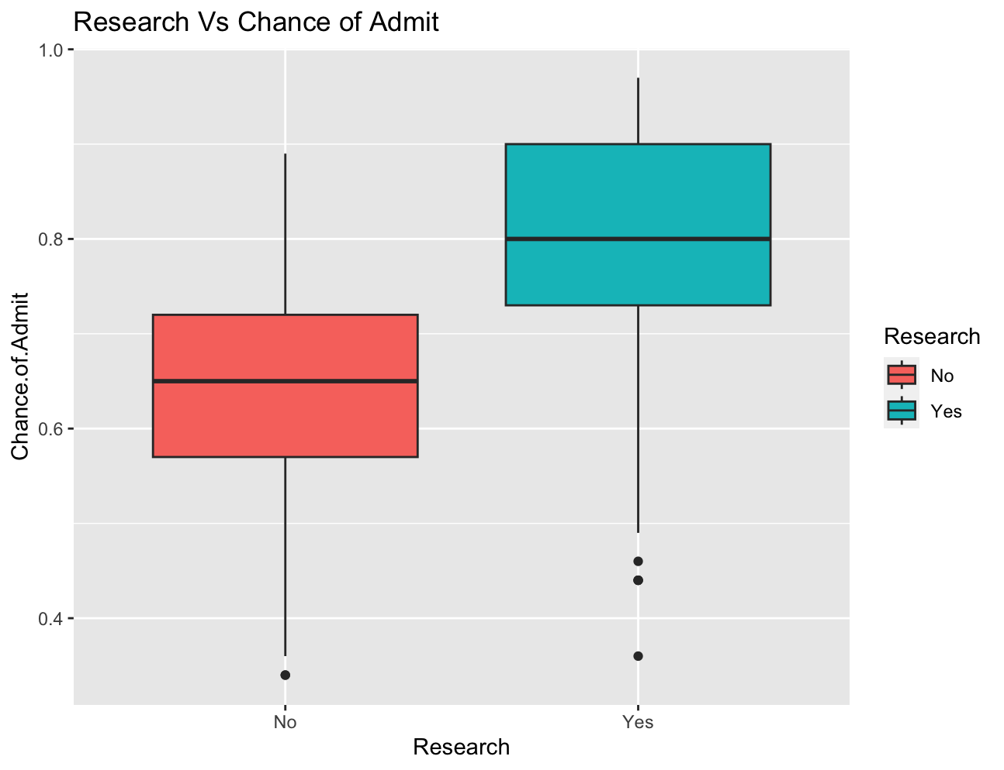
2. Boxplot for Chance of Admit vs Research
After converting research variable to a factor, we can observe from the box plot that if the research value is one i.e., research exists for that student , then there is a higher chance for the student to get admitted into the university compared to the research value with 0 i.e., research doesn’t exist for that student .

Slide 7
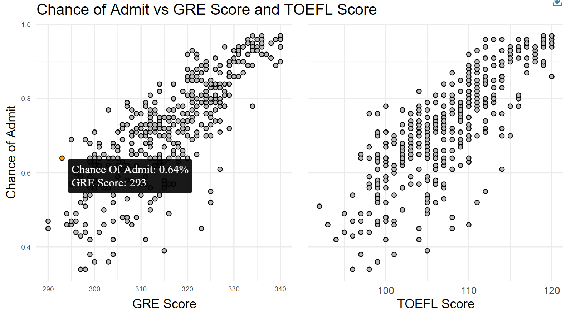
3. Interactive Scatter Point Plot
Interactive scatter point plot for Chance of Admit vs GRE Score and TOEFL Score using Ggiraph package and ggplot2.
The points when hovered display the Chance of Admit percentage and the GRE or TOEFL Score for that point.

Slide 8
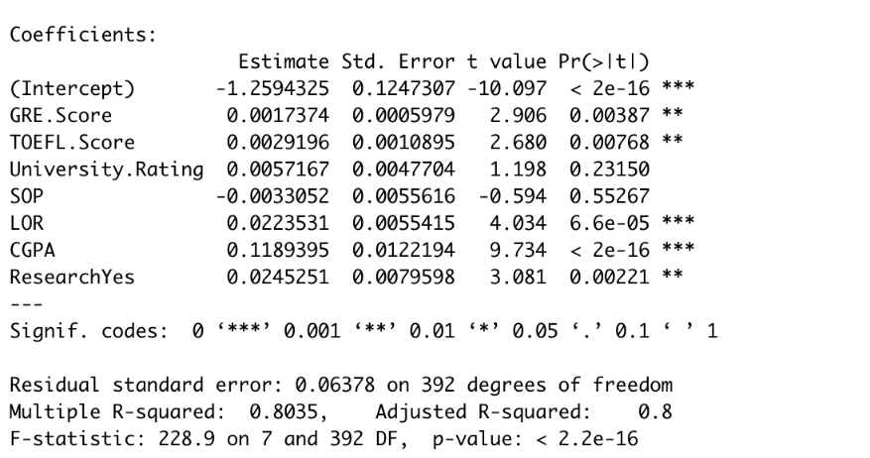
1. Linear Regression:
MODELS
From the summary of the Linear Regression model, we can see the significant variables are GRE Score, TOEFL Score, Letter of Recommendation, Cumulative Grade Point Average and Research.

Slide 9
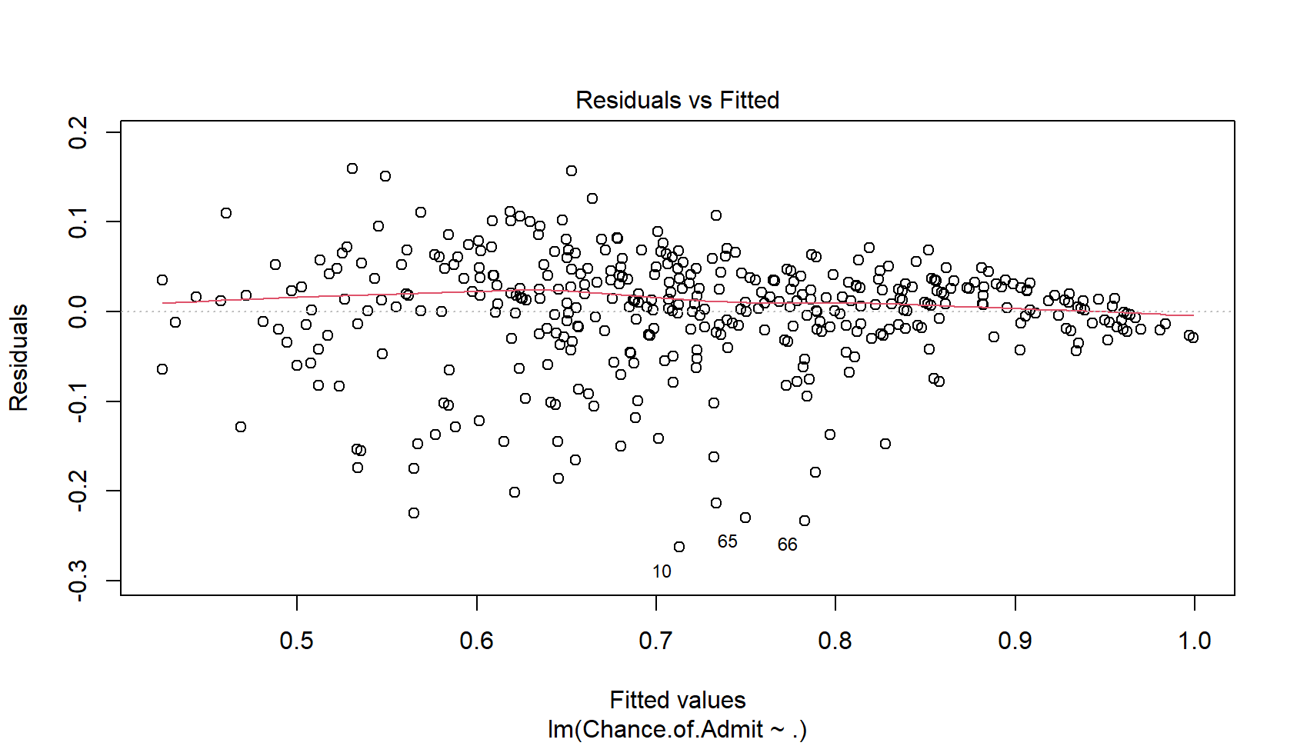
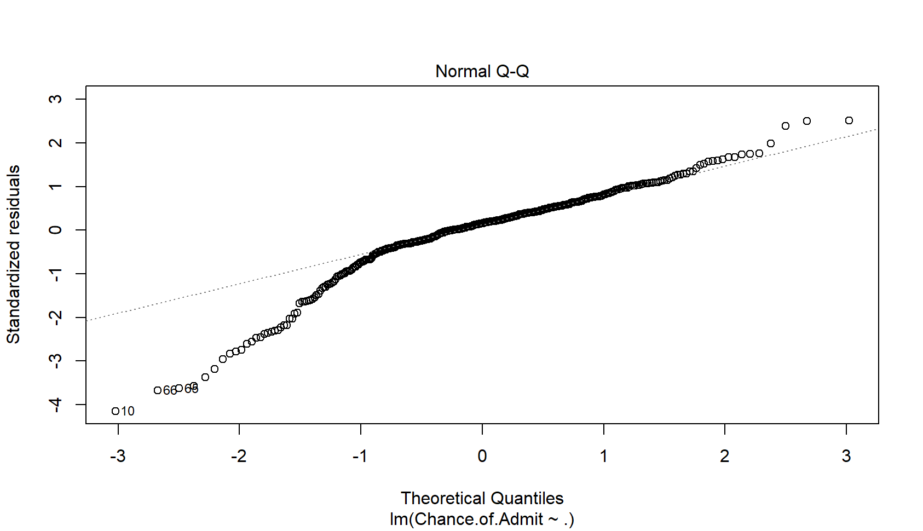
Diagnostic Plots:
Linearity Assumption: From the Residual vs Fitted plot we can assume that linearity assumption is valid.(Random fluctuations of the residual values about zero indicates linearity and systematic patterns in the non-zero residuals indicates non-linearity)
Normality Assumption: From the Normal Q-Q plot we can assume that the plot shows normality. (The residuals should mostly follow a straight line to satisfy normality)

Slide 10
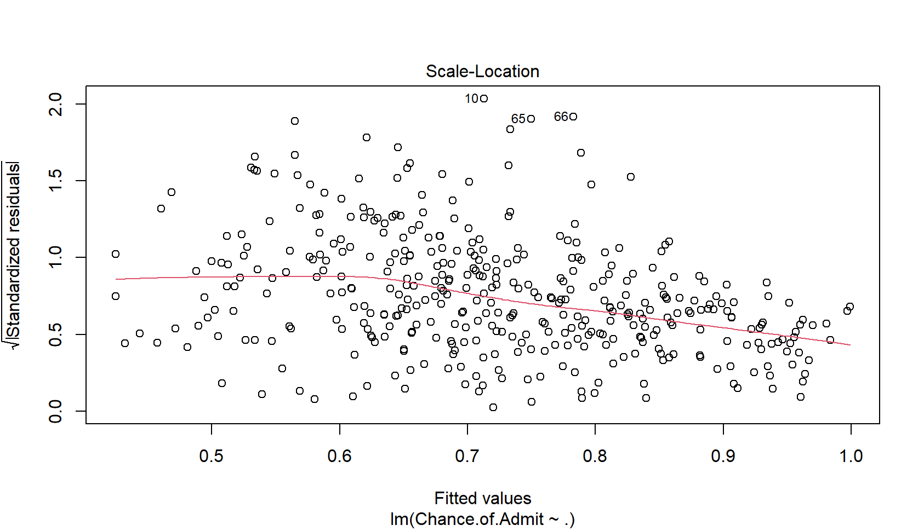
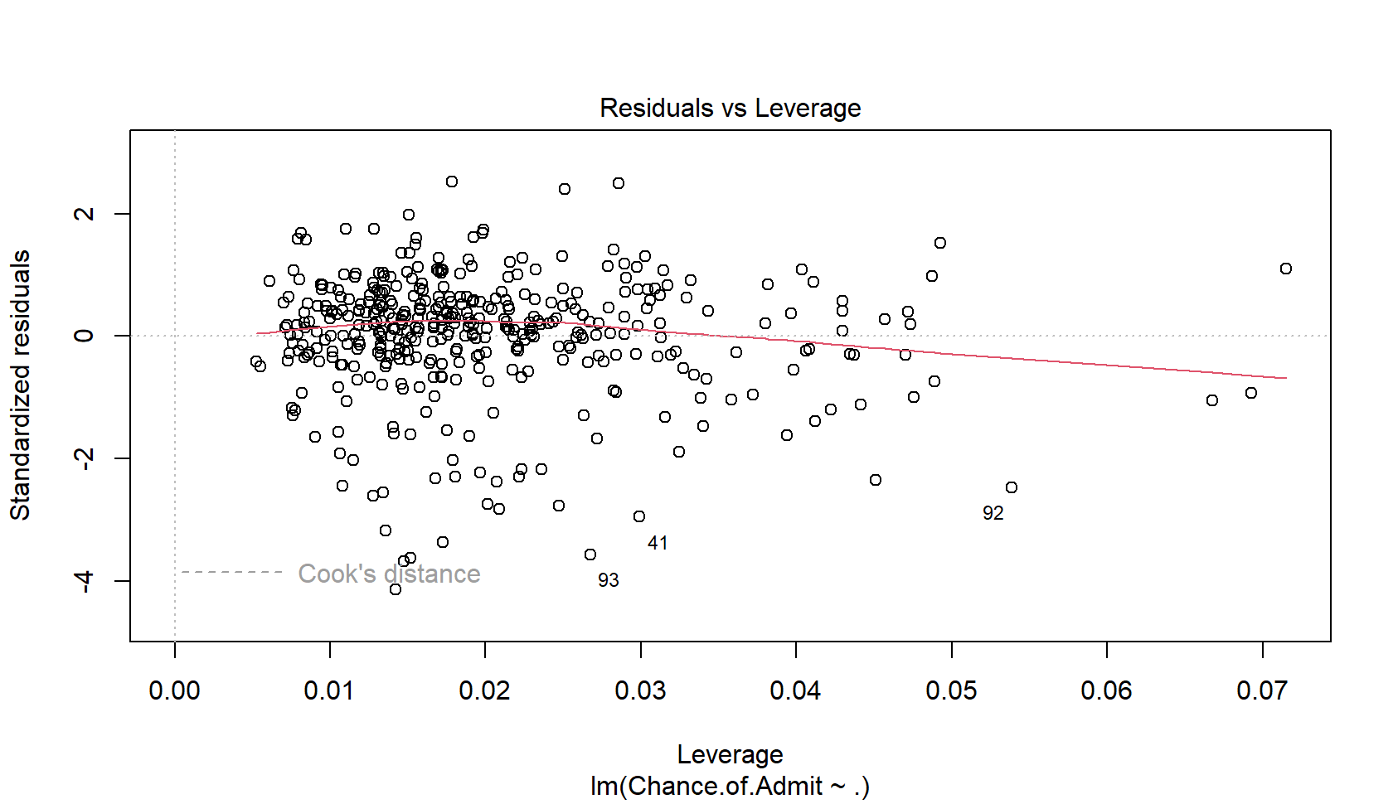
Diagnostic Plots:
Equal- Variance Assumption: From the scale-location plot we can assume that plot violates equal variance assumption holding heteroscedasticity. (points should be equally spread and presence of horizontal line indicates homoscedasticity)
Influential points: From the Residuals vs Leverage we can say that data doesn’t show any influential points because all the points are well inside the Cook’s distance. (Influential points are generally located at the upper right corner or lower right corner)

Slide 11
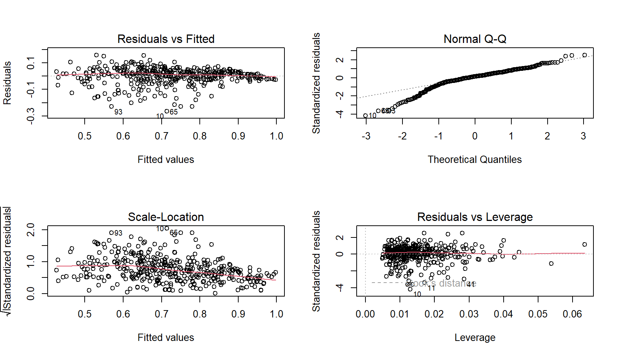
Backward Model:
To fit a better model and remove less significant variables, we fit a backward model for the dataset.
From the backward fit model diagnostic plots, Residuals vs fitted plot holds linearity assumption, Q-Q plot holds Normality assumption, Scale-location holds equal-variances better compared to previous model and Residuals Vs Leverage plot fits a lot better compared to linear model diagnostic plot of Residuals vs Leverage plot. In that plot we can see that at the end the line moves away from the center and in the backward fit model the line is aligned to the center.
Diagnostic Plots:

Slide 12
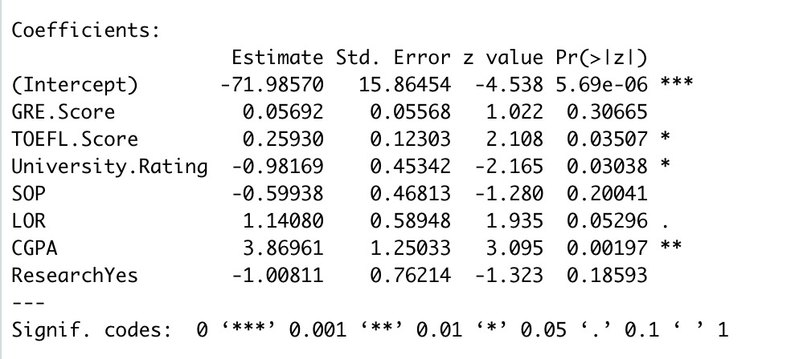
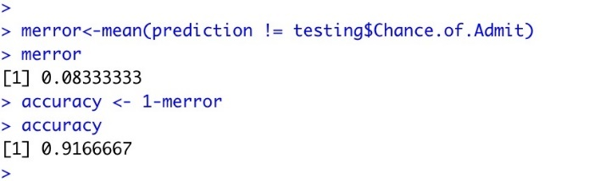
2. Logistic Regression:
To fit a logistic model for the data, we had to categorize the Chance of Admit column as the response variable is not categorized. So, we categorized the data by taking the Chance of Admit values < 0.5 as No and > 0.5 as Yes and converted the column to a factor. Then we fit a logistic model for the data.
From the logistic model summary, the significant variables are CGPA, University Rating and TOEFL Score with CGPA being the highest. Misclassification error of the model was 0.08 and the accuracy was 0.92.
Logistic Model Summary:
Misclassification Error

Slide 13
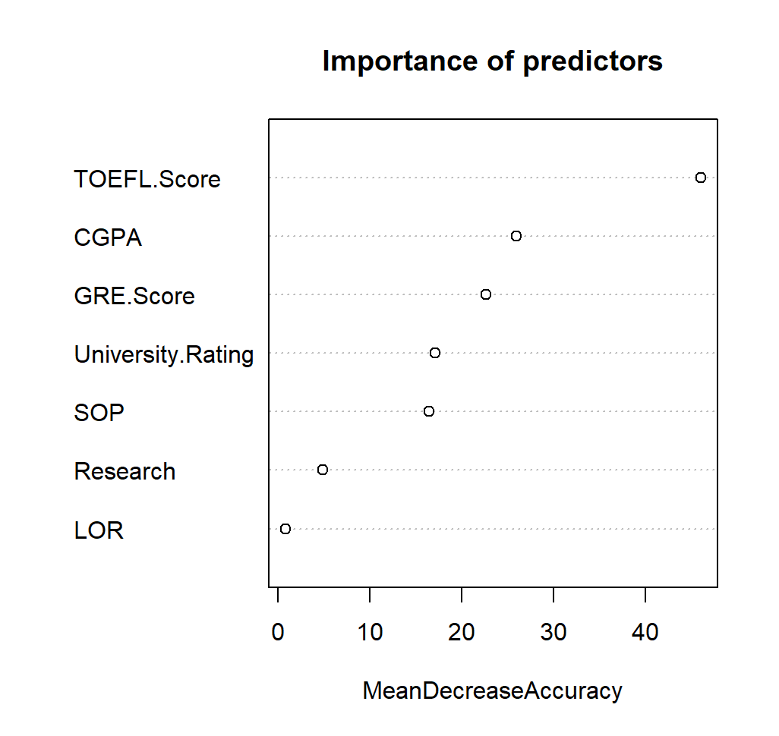
3.Random Forest Classification:
From the random forest model, we can find out the most significant predictor in the data using the varImpPlot() function. From the plot of Mean decrease in accuracy, we can see that TOEFL Score is the most significant variable as it has highest mean decrease accuracy.
The conclusion we can draw from this model is that the most important variable is not CGPA as shown in the Logistic Regression but it is TOEFL Score.

Slide 14
Conclusion:
From the Random Forest model, TOEFL Score is the most significant variable which affects the Chance of Admit.
The most insignificant variables are Serial Number and SOP which had very less correlation with the response variable.
In the backward fit model, we eliminated statistically insignificant variables SOP and University Rating. The plots were more aligned to the center and did not deviate as much as they did before in linear regression fit which made the model entirely significant.

