Slide 1
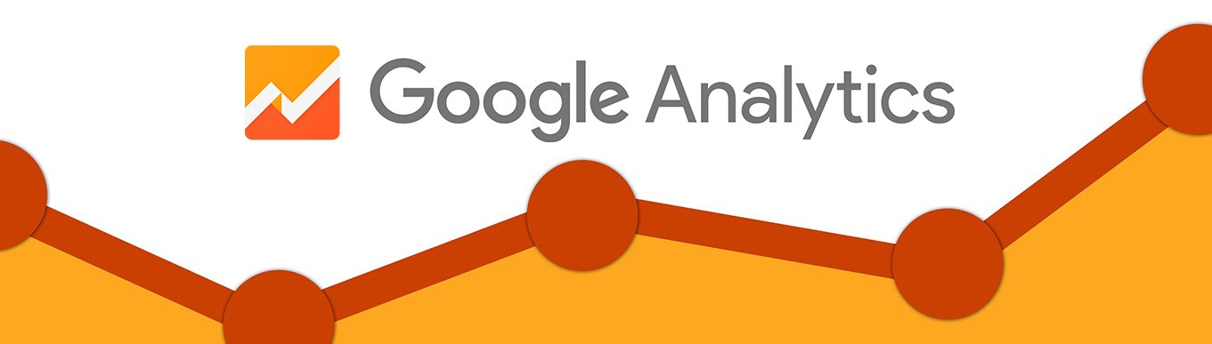
Google Merchandise Store Analytics
A visual insight and recommendation for the Google Merchandising Store Management Team
Nikhil Korati Prasanna
108190828

Slide 2
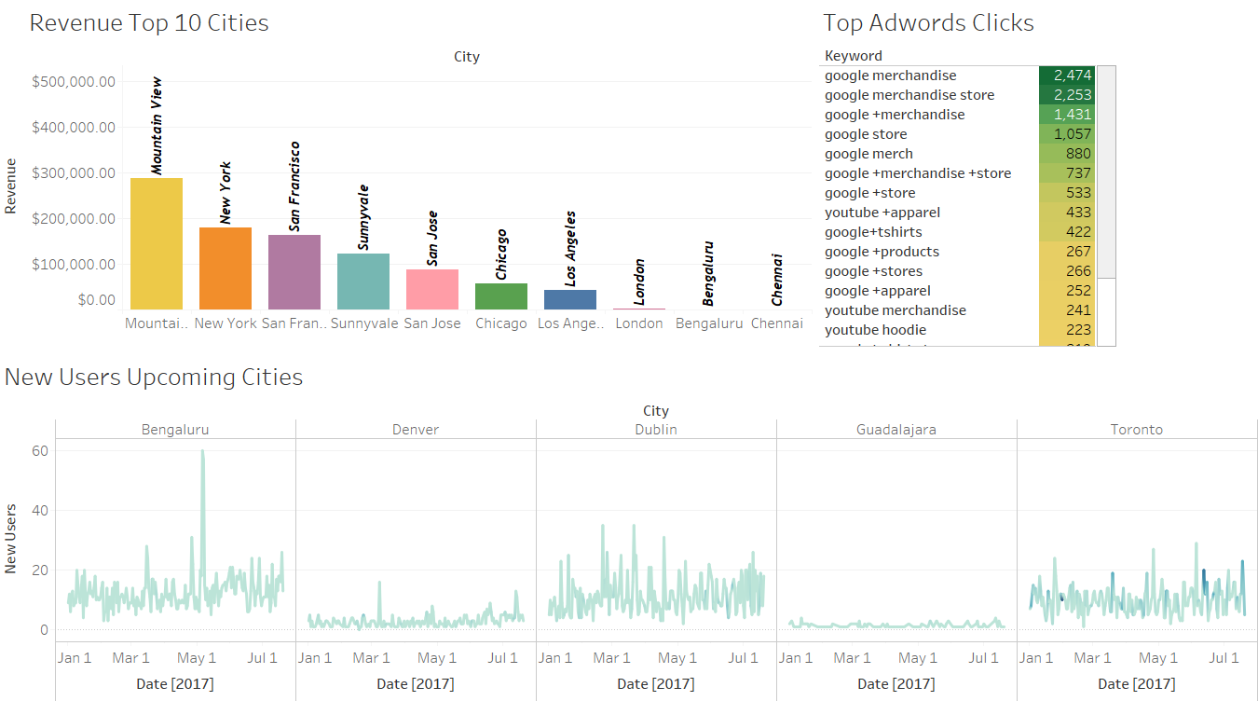
Marketing Dashboard

Slide 3
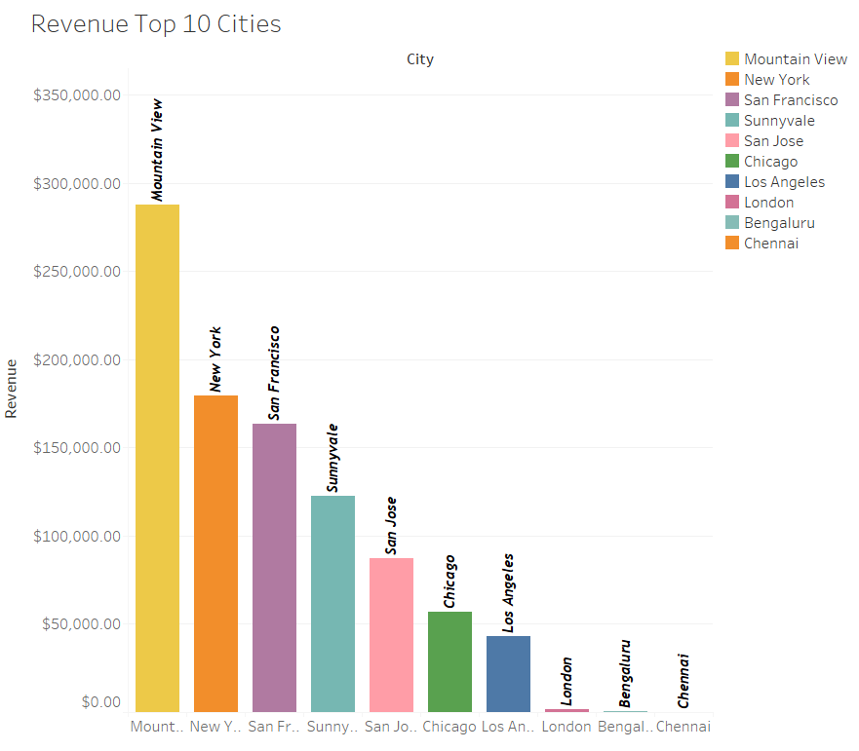
These are the cities where
software companies are abundant
Clearly mountain view has the highest
revenue of $280,000 which is because
people are familiar with the
google merchandise store in this city
which is home to Google HQ
Concentrating on NYC, Chicago, London,
Bengaluru will help in market expansion
and new users will surely be acquired
due to the presence of high amount of
technophiles in these cities

Slide 4
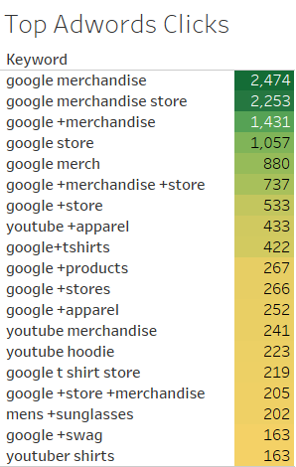
Clearly google merchandise store with 2474 clicks
is the word that is generating most clicks
We can also notice that most of the ad word campaign
is focused on the google merchandise word
The marketing team should focus on expanding to
other keywords if they want to expand their markets into
places like China, Russia, Korea where Google merchandise
products are not familiar among people

Slide 5
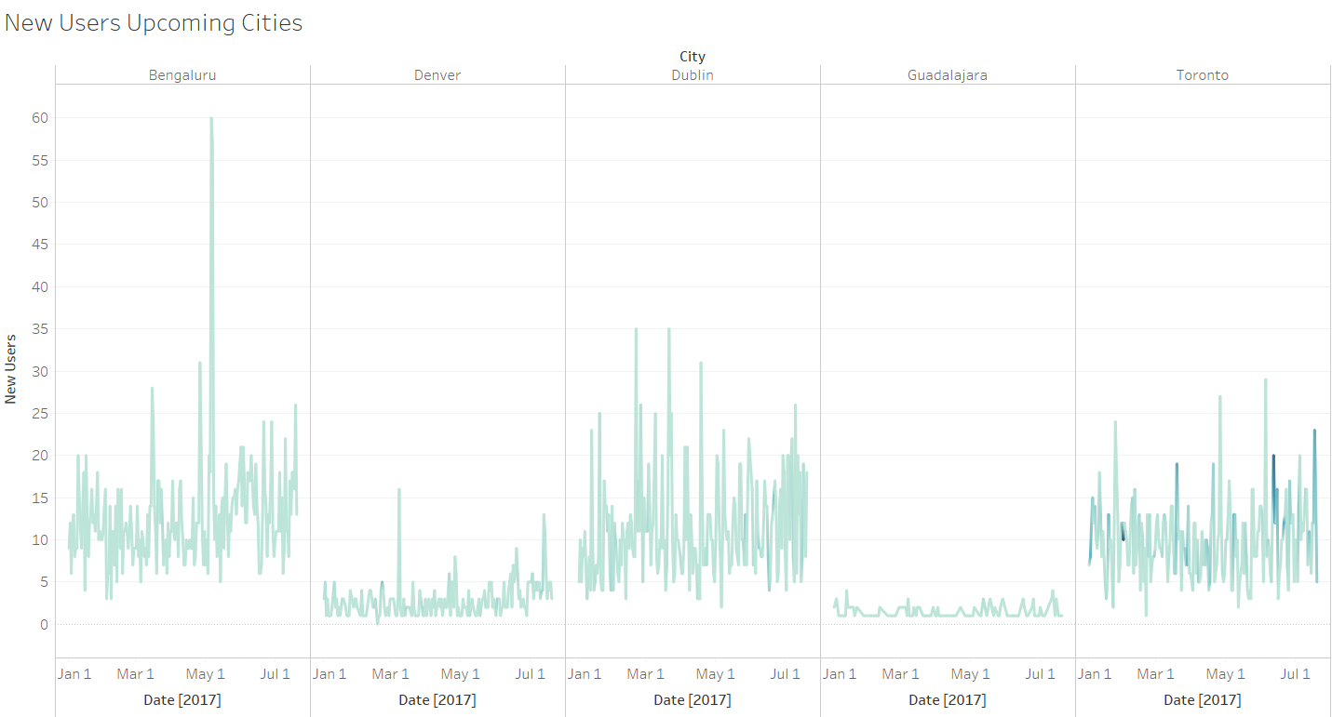
This the data of new users from Jan 1 2017 to July 1 2017, clearly the new users acquisition rate is
stagnant in all these cities which are touted to be software hubs of the future
Expanding and marketing the google merchandise store rigorously in these cities will help in increased
customer acquisition and higher number of purchases

Slide 6
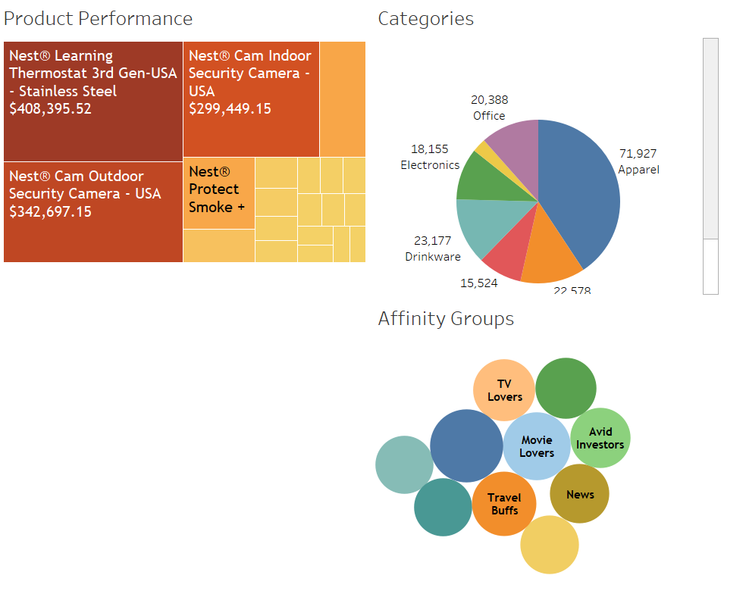
Products and Sales Dashboard

Slide 7
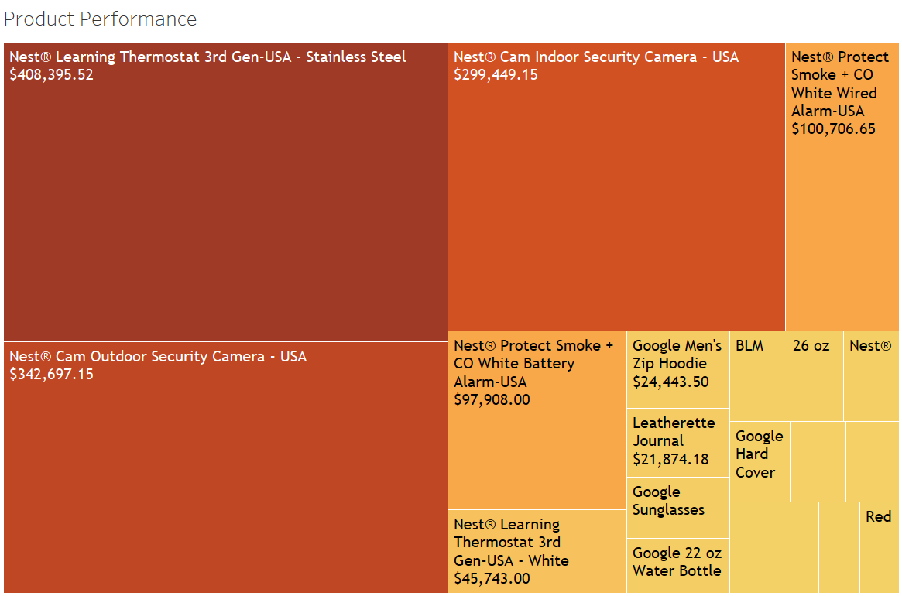
This treemap shows the top 15
products with highest revenue
Stainless Steel thermostat from
Nest is highest revenue generating
product
Clearly all the popular products are
daily use products. This shows people
are interested in using google
products in their day to day lifestyle
Improving the quality and introducing
new products on similar product lines
will lead to higher purchase count

Slide 8
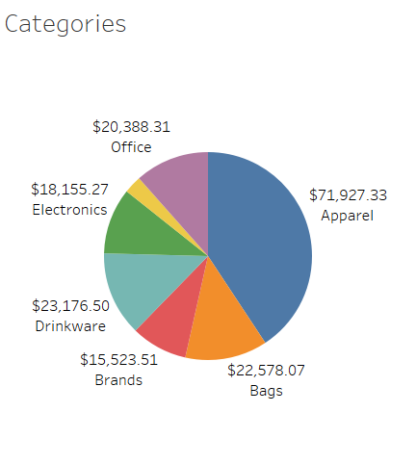
The highest revenue generating category is
Apparel
The product management team should
concentrate on improving the quality of
office, drinkware and bags category as daily use
products are most preferred by the people and
that clearly reflects in the revenue
More and more products in these categories will lead
increased revenue

Slide 9
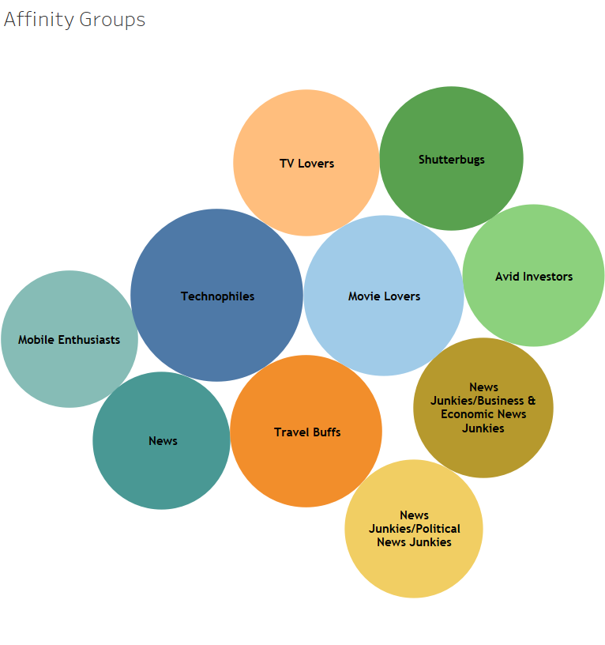
As expected Technophiles is the most popular
user group that is generating most of the revenue
Movie Lovers, Shutterbugs, Investors, Travelers,
Mobile enthusiasts are also equally popular user groups
Introducing products that cater to these user groups
will make them shop for more on the site

Slide 10
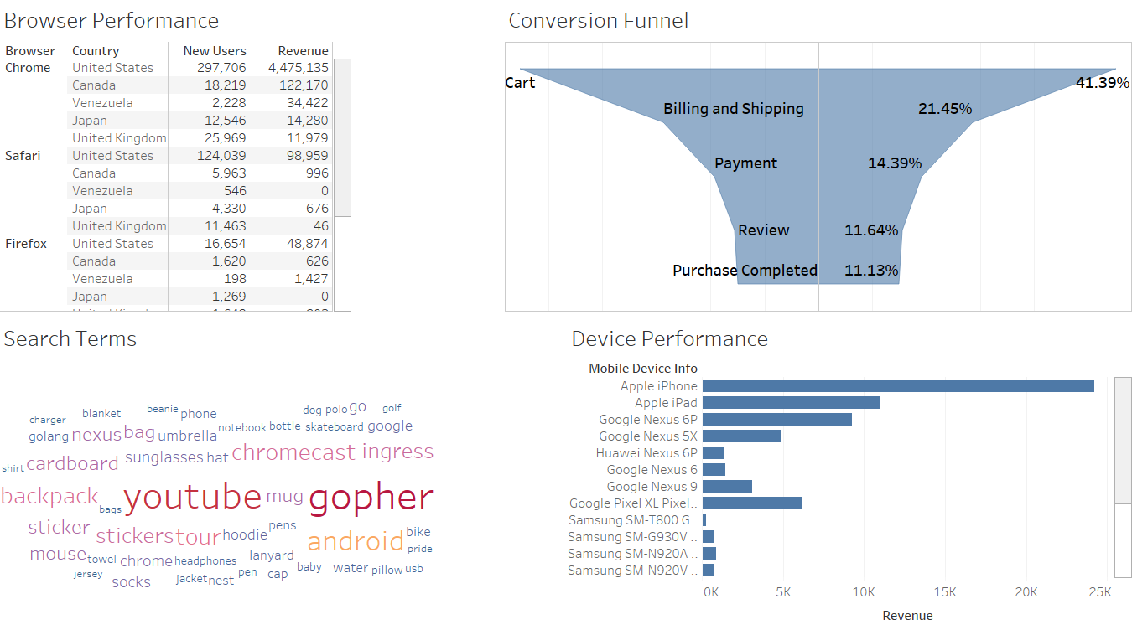
IT Dashboard

Slide 11
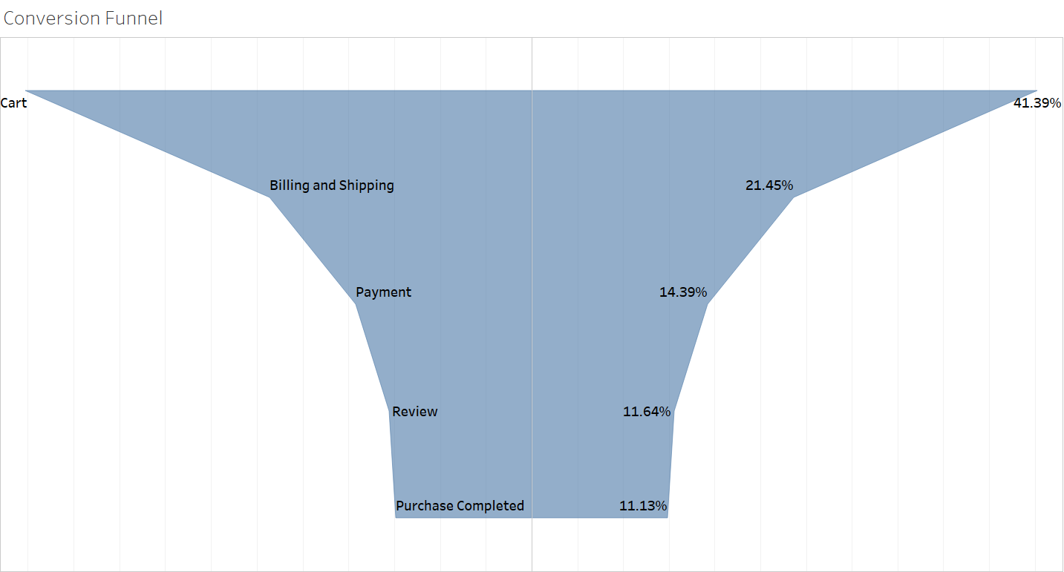
From the conversion funnel there is a huge
50% drop from shopping cart to
shipping and billing page clearly
indicating high cart abandonment rate
At the end only 11% of users from 41% users
completed their purchases which is very
less in terms of revenue generation
Performing A/B tests on the shopping cart
page will decrease the cart
abandonment rate
A simplified, easy to use shopping cart page
may be the answer

Slide 12
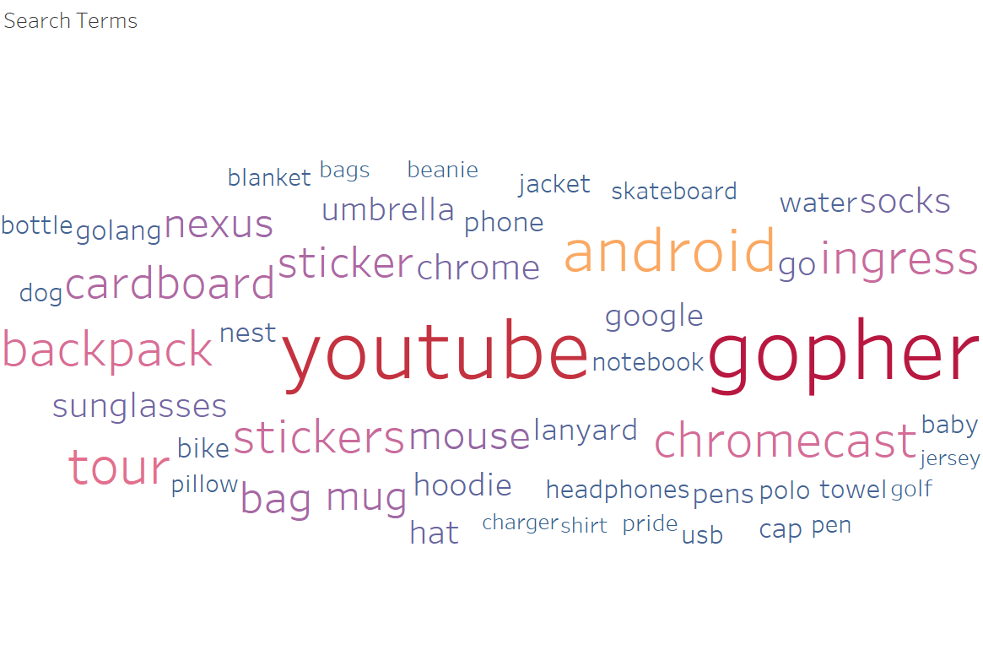
From this word cloud youtube, android,
gopher, cardboard, ingress are the most
searched words using the
site search engine
Improving site search engine with
relevant search results for other terms
may result in better site performance

Slide 13
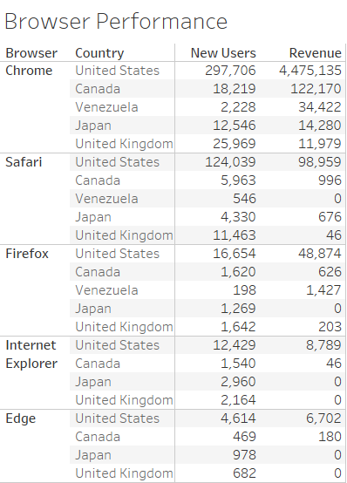
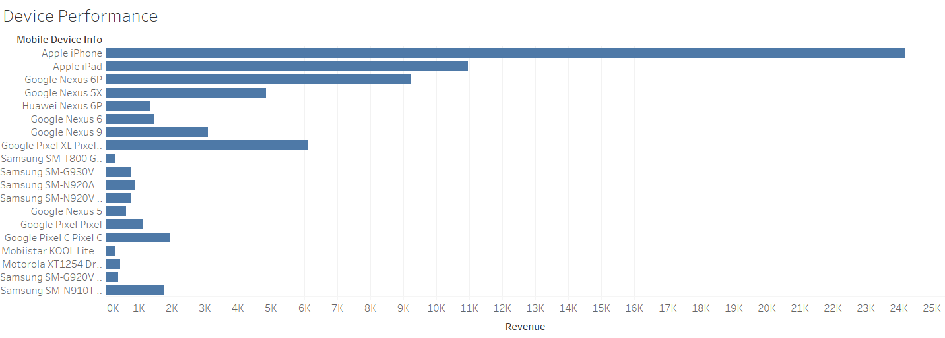
Clearly Chrome browser is outperforming other top browsers in terms of new user acquisition and revenue.
improving user experience and user interface design on other browsers will result in more and more people
to use Safari, Firefox, Edge
Apple iPhone is the only phone generating most revenue, improving the mobile version of the site and
screen compatibility on other mobile devices will result in increased usage on these devices

Slide 14
Thank you
Q&A

