Slide 1
US Temperature Index Time Series Analysis Case Study 2 – BANA 6630
Jai Katariya
Nikhil Korati Prasanna

Slide 2
Summary of the Case Study
Explore Data
Transformation, Differencing, Seasonal Differencing
SARIMA Model Building
and Testing
Model Selection
Prediction

Slide 3
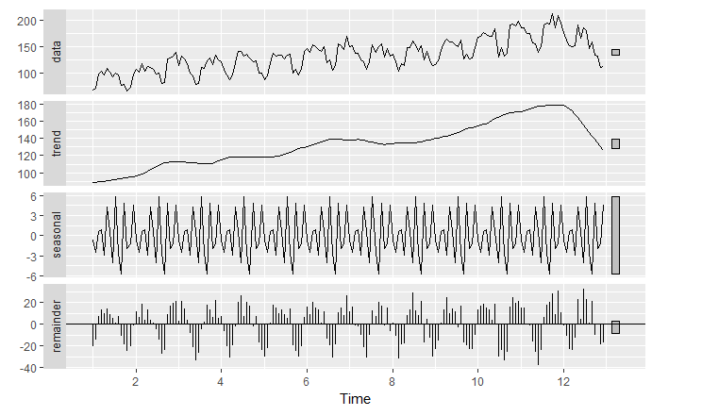
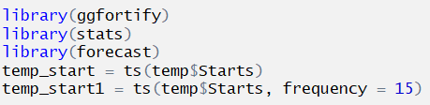
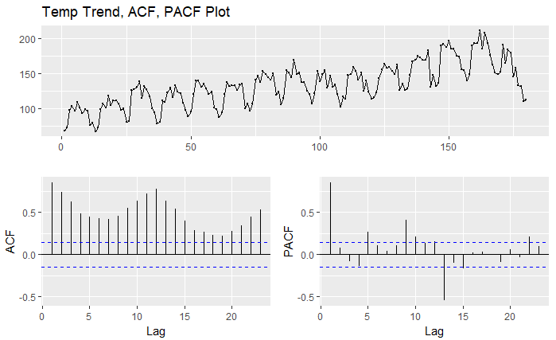
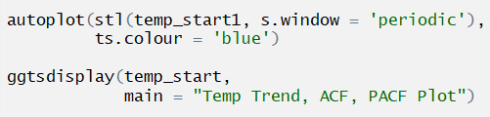
Exploratory Analysis

Slide 4
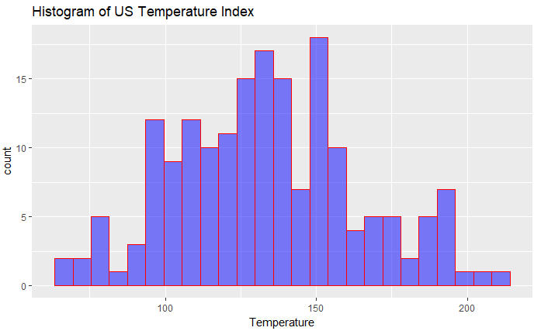
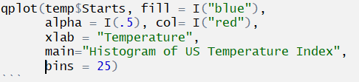
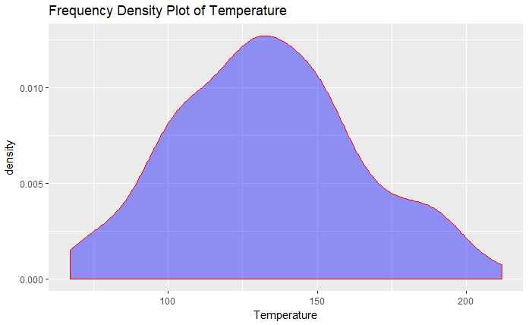
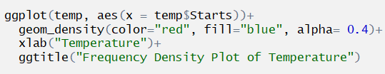
Exploratory Data Analysis

Slide 5
Transformations and Differencing
Differencing Raw Data
Double Differencing Raw Data
Differencing Log Transformation
Double Differencing Log Transformation
Seasonal Differencing Raw Data
Log Transformation
Seasonal Differencing Log Data
Double Seasonal Differencing Log Data

Slide 6
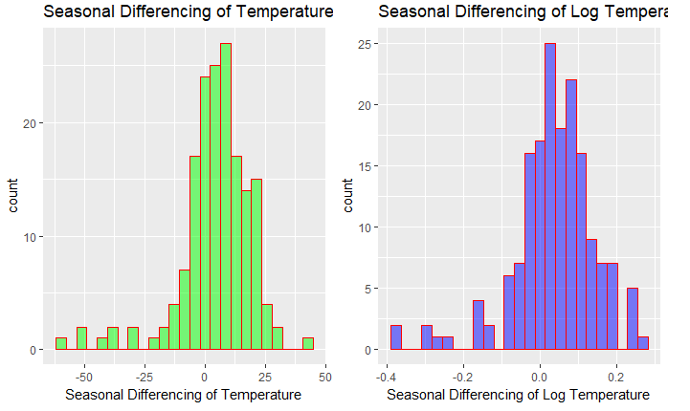
Compare Seasonal Diff Raw Data and Seasonal Diff Log

Slide 7
Model Building Raw Data and Log(Temp)
Model | Model AIC with Raw Temp | Model AIC with log(temp)
ARMA (4,0,0) Seasonal (0,1,2) | 1188.6 | -461.37
ARMA (4,0,4) Seasonal (0,1,1) | 1179.4 | -475.28

Slide 8
Model | AIC | Box Test(p-value) | tsdiag | Significant Co-efficient > 2 | ADF Test(p value) | ACF of residuals
ARMA (4,0,0) Seasonal (0,1,2) | -461.37 | 0.372 | Looks Good | Yes | <0.01 | Lag crossing blue line
ARMA (4,0,6) Seasonal (0,1,1) | -476.67 | 0.7492 | Looks Good | NaN produced | <0.01 | Looks Good
ARMA (4,0,4) Seasonal (0,1,1) | -475.28 | 0.3621 | Looks Good | Yes | <0.01 | Lag crossing blue line
ARMA (4,0,0) Seasonal (0,1,1) | -454.1 | 0.4326 | Looks Good | Yes | <0.01 | Lag crossing blue line
ARMA (4,0,6) Seasonal (0,1,2) | -474.49 | 0.5663 | Looks Good | NaN produced | <0.01 | Looks Good

Slide 9
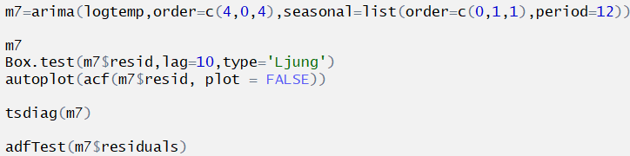
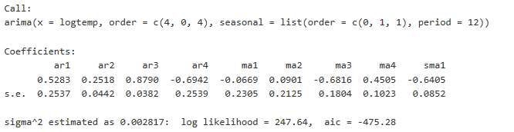
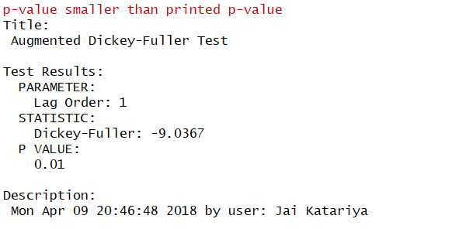

Model Selection

Slide 10
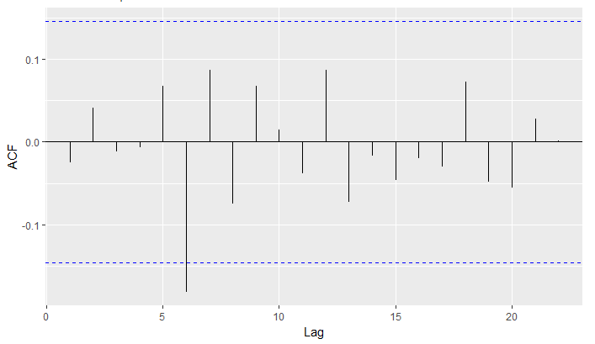
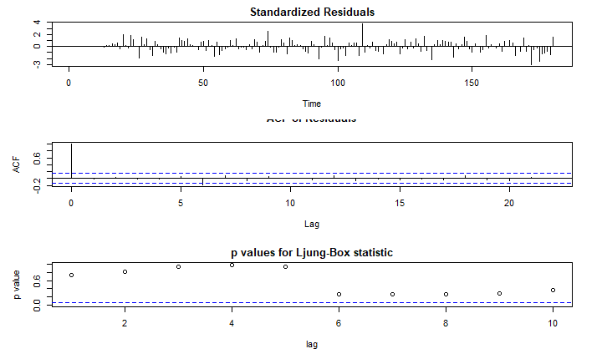
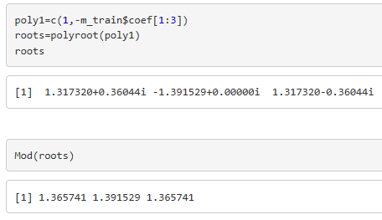
Model Selection

Slide 11
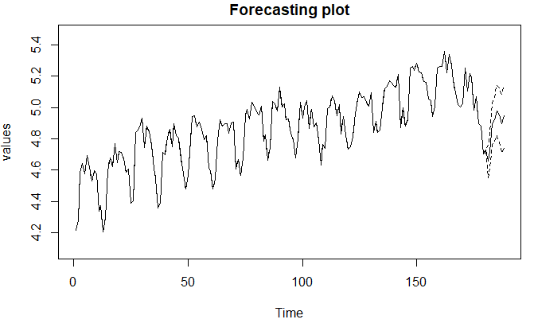
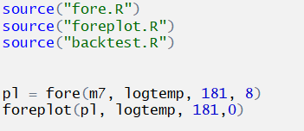
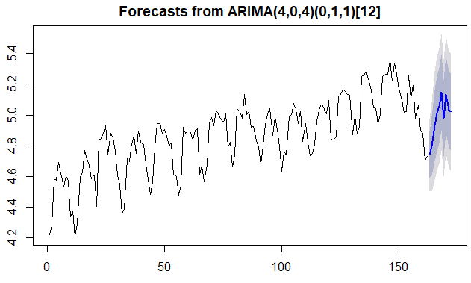

Forecasting
Notes:
Need to add backtest results here

Slide 12
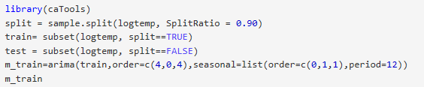
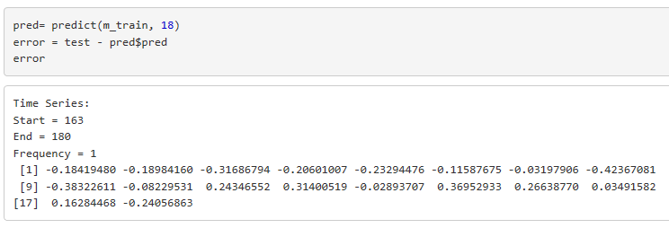
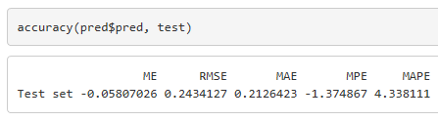
Train Test Split – Predicting 18 months

Slide 13
Recommendations
Seasonal ARIMA captures the seasonal component of the time series
Overall the accuracy of 76.67%
Enhance the model by applying Cox or other transformations and see if you can get better results
Try other order combinations and see if you get a better model
Need to encounter ARCH/GARCH models and see how they perform

