Slide 1
S&P500 and MSFT Time Series Analysis Case Study 1 – BANA 6630
Jai Katariya
Nikhil Korati Prasanna

Slide 2
Case Study Summary
Obtain S&P 500 data from 2014 to 2018
Obtain MSFT minutes data for a random day
Perform Exploratory Analysis on S&P500 and MSFT time series data
Transform S&P500 and MSFT data to fit time series models
Analyze transformed data
Fit time series models
Select the best model for S&P500 and MSFT
Use the selected model for S&P500 to predict for next 10 days
Use the selected model for MSFT to predict for next 10 minutes

Slide 3
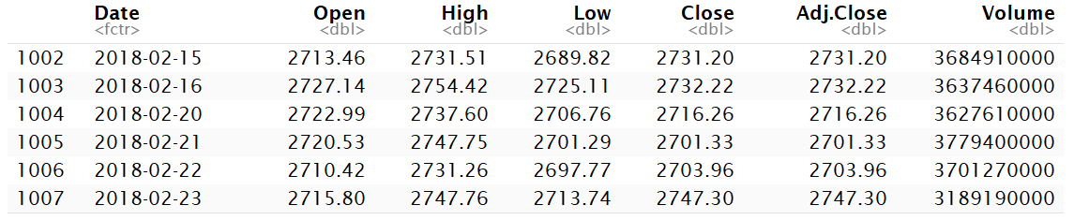
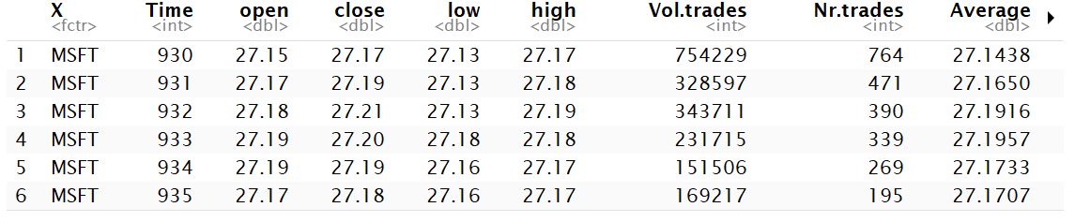
S&P500 and MSFT dataset
S&P500 from
02-26-2014 to 02-23-2018
MSFT

Slide 4
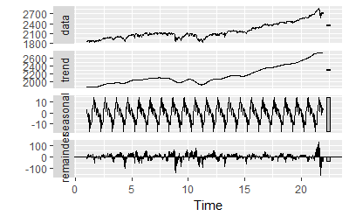
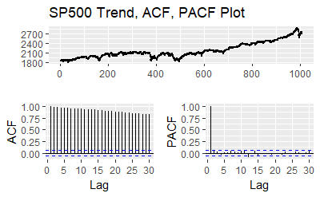
S&P500 Exploratory Data Analysis

Slide 5
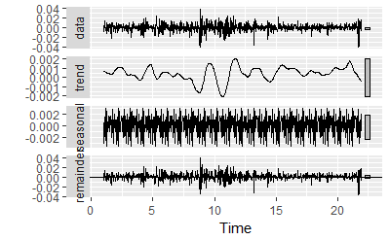
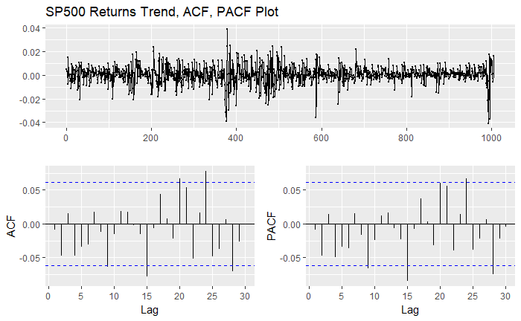
S&P500 Daily Returns
Data is nearly stationary with slight variance
Trend shows dips at certain intervals
No significant autocorrelation between the lags

Slide 6
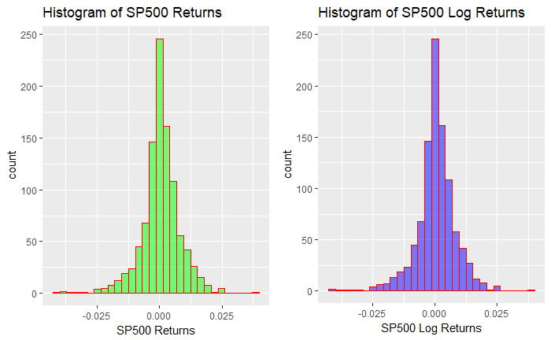
Comparing Daily and Log Returns
The Log returns is nothing different compared to daily return, both look similar

Slide 7
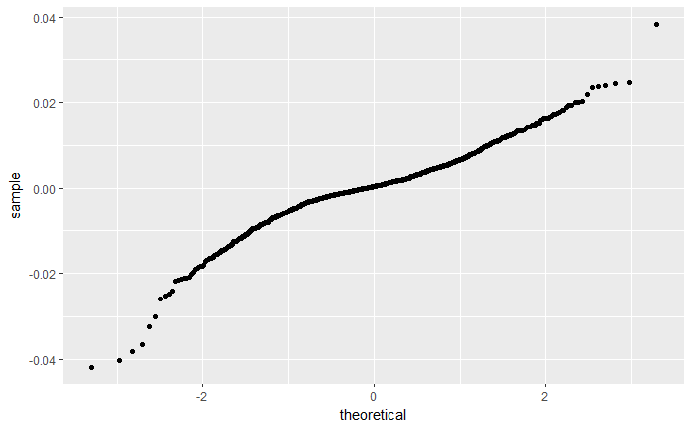
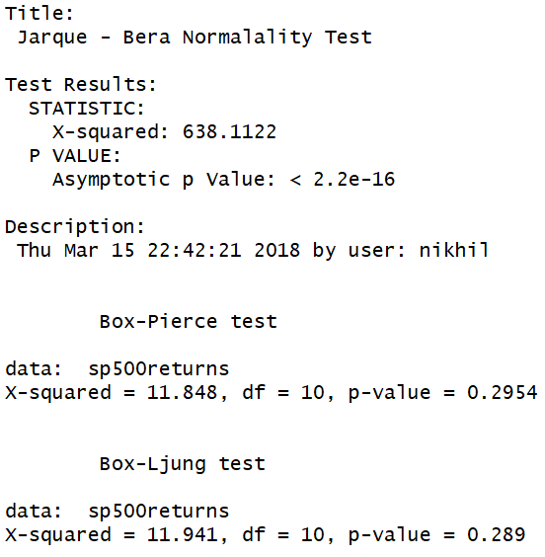
Tests for normality and independence S&P500 daily returns
Looking at qqplot we can say time series is not normal
p value is less than alpha: from JB test we can say that times series is not normally distributed
p value is greater than alpha: from Box test we fail to reject the null so we can say the lags are independent

Slide 8
Model Building and Selection
Developed multiple arima models and selected the model with a low AIC score and significant coefficients
Model | AIC | Significant coefficients
AR(“mle”)
arima(0,0,1) | -6899.4
arima(1,1,1) | -6884.6
arima(1,0,1) | -6905.41 | ✔
arima(2,1,2) | -6883.9 | ✔
arima(3,0,2) | -6901.82 | ✔
arima(3,0,3) | -6900.17 | ✔

Slide 9
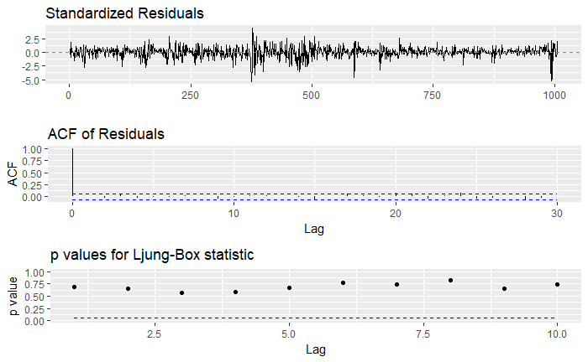
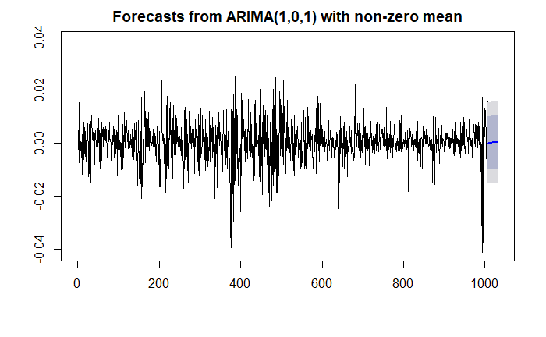
ARIMA(1,0,1) for S&P500 daily returns
p values are greater than 0.5
All the lags are below the blue cross line
The roots are also above 1 so it is stationary

Slide 10
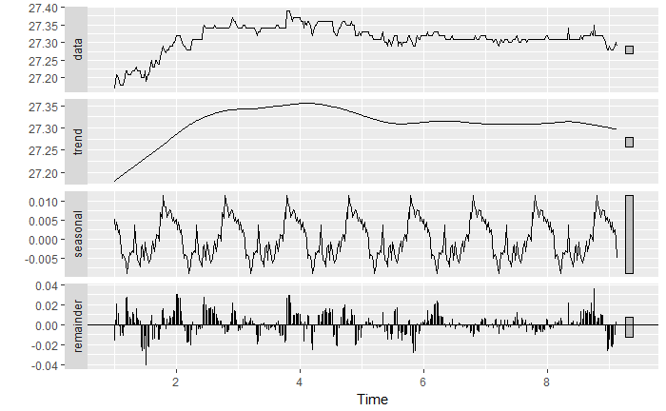
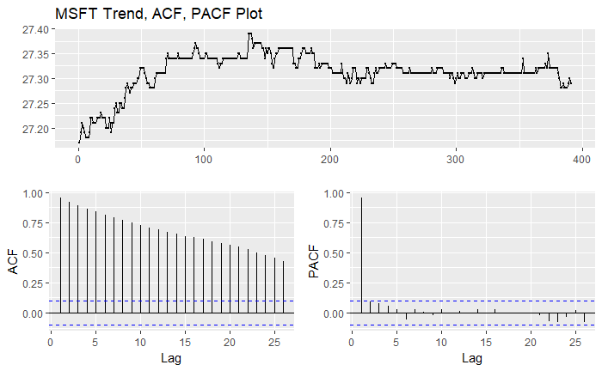
MSFT Exploratory Data Analysis

Slide 11
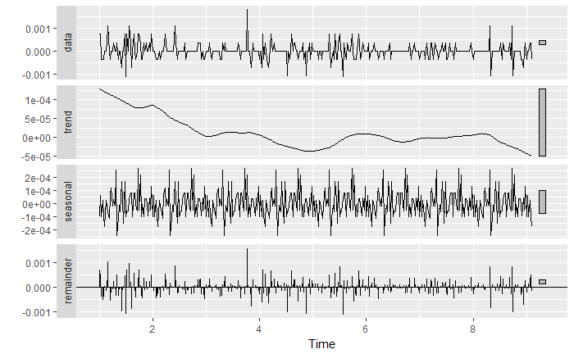
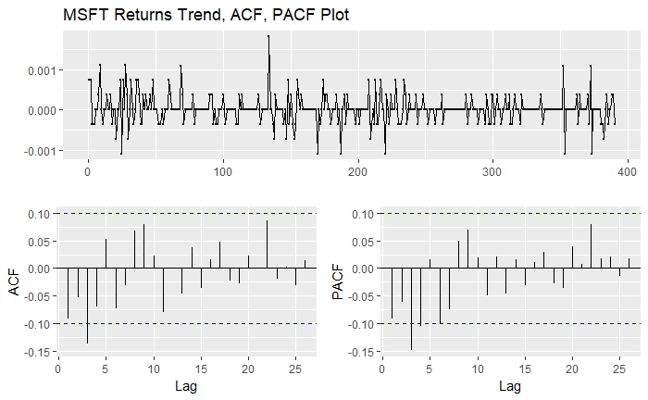
MSFT Minute Returns
Data is nearly stationary with slight variance
There is a downward trend
Significant autocorrelation between the lags

Slide 12
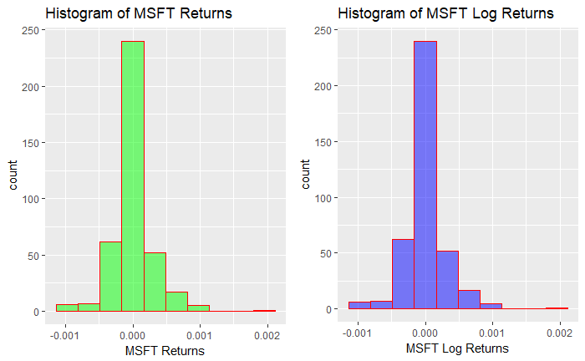
Comparing Minute and Log Returns
The Log returns is nothing different compared to minute returns, both look similar

Slide 13
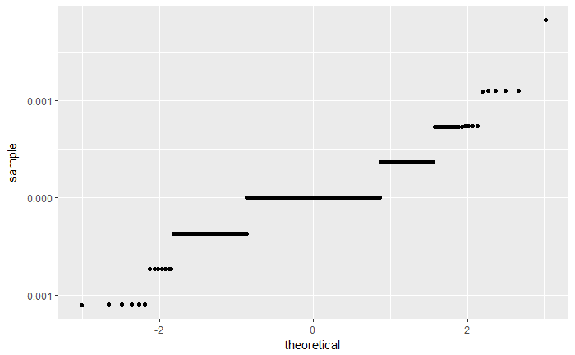
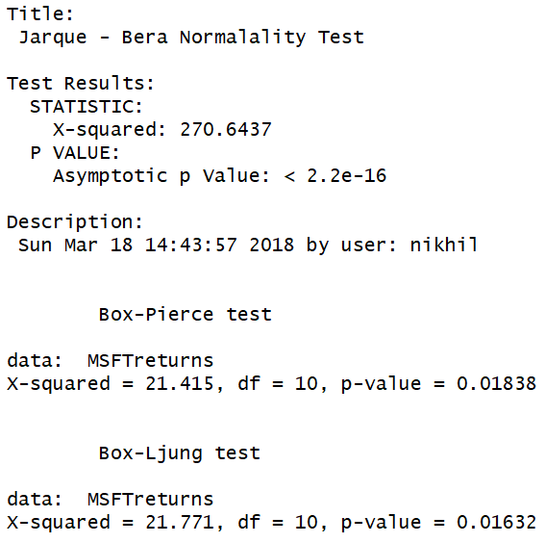
Tests for normality and independence MSFT minute returns
Looking at qqplot we can say time series is not normal, it looks like a step function
p value is less than alpha: from JB test we can say that times series is not normally distributed
p value is less than alpha: form Box test we reject the null hypothesis so the lags are dependent

Slide 14
Model Building and Selection
Developed multiple models arima models and selected the model with a low AIC score and significant coefficients
Model | AIC | Significant coefficients
AR(“mle”)
arima(4,0,3) | -5131
arima(3,0,4) | -5130.99 | ✔
arima(3,0,3) | -5132.95 | ✔
arima(6,0,6) | -5131.08 | ✔
✔

Slide 15
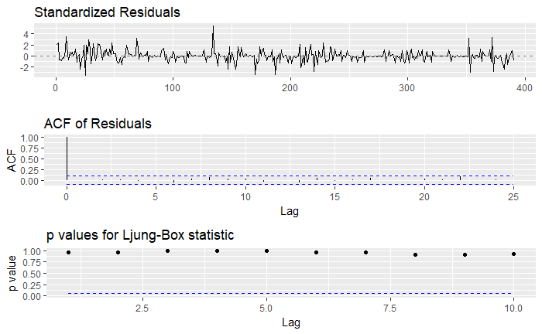
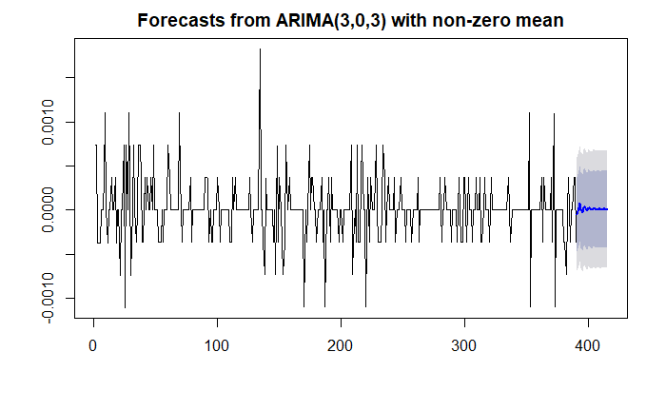
ARIMA(3,0,3) for MSFT minute returns
p values are greater than 0.5
All the lags are below the blue cross line
The roots are also above 1 so it is stationary

Slide 16
Conclusion
We need to de-difference the prediction and compare it with the actual values to see how well both the models predict and how much is the forecast error
We can also try other models like ARCH/GARCH and see how they perform
We can also try different transformation techniques

