Slide 1
Trainee Task
Time Series Data

Slide 2
EDA and Pre-processing
Basic Statistics: Calculated summary statistics such as mean, median, and standard deviation for numerical features.
Handling Missing Values: Checked for missing values and handled them (either through removal or imputation).
Feature Engineering: Created new features, such as lag variables, which add past data points to the current feature set (particularly important for time-series data), generated derived columns like percentage changes and daily fluctuations.
Visualizations: Performed visualizations using scatter plots, histograms, and possibly correlation heat maps to explore relationships between variables.
Correlation Analysis: Computed a correlation matrix to identify linear relationships between numerical features.
Pre-processing Steps: Data Cleaning: Removed outliers or anomalous values, filtered out any unwanted or irrelevant columns.
Feature Scaling: Scaled/normalized numerical features to ensure uniformity, especially for machine learning models.
Train-Test Split:
Split the data into training and testing sets (80/20 ratio) for supervised learning tasks.
Ensured the features and target variables were correctly separated before splitting.
Training set shapes: Xtrain : (13935,13), ytrain : (13935).
Test set shapes: Xtest : (3484,13), ytest : (3484).
Saving Pre-processed Data: Saved the processed data (training and test sets) to CSV files for further analysis or modeling.

Slide 3
Feature Engineering
New Feature Creation:
Percentage Change (Daily_Return): Created from the closing price as a measure of the day-to-day return.
Price Range (Price_Range): Calculated as the difference between the highest and lowest prices of the day.
Price Range Percentage (Price_Range_Percentage): Normalized the price range by dividing it by the opening price to express the range as a percentage.
Lagged Features:
Lag Variables: Generated lag features for closing price and volume. Lags of 1, 2, 3, 5, and 10 days were introduced to capture past behaviours in the data for predictive modeling.
Examples:
Closing_Price_Lag_1: Closing price from the previous day.
Volume_Lag_5: Volume from 5 days ago.
Sequence Creation:
Created sequences for time-series data with a sequence length of 10 to capture temporal dependencies.
These sequences were used for modeling, especially for models that require sequential input like RNNs or LSTMs.
Normalization:
Scaled numerical features such as closing price, opening price, high price, low price, and volume using MinMaxScaler to normalize the values between 0 and 1, ensuring consistent input ranges for models.

Slide 4
Model – 1: LSTM
Long-term dependencies: LSTMs are specifically designed to capture long-term dependencies in sequential data, making them ideal for stock price prediction where past trends can influence future prices.
Selective memory: The gating mechanism in LSTMs allows the model to selectively remember or forget information, which is crucial for identifying relevant patterns in noisy financial data.
Multivariate input: LSTMs can easily handle multiple input features (opening price, volume, etc.), making them suitable for analyzing complex market dynamics
.Vanishing gradient solution: LSTMs address the vanishing gradient problem, allowing them to learn from both recent and distant past events in the time series.
Adaptability: They can adapt to various time scales and patterns in the data, which is beneficial for capturing both short-term fluctuations and long-term trends in stock prices.

Slide 5
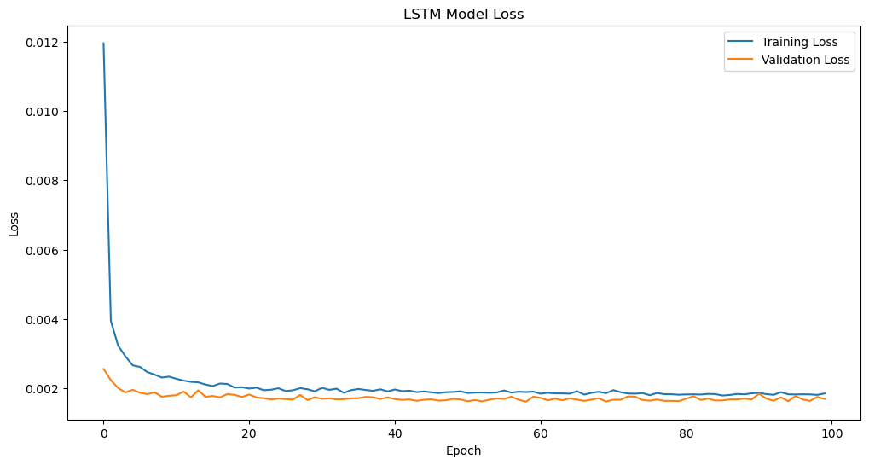

Slide 6
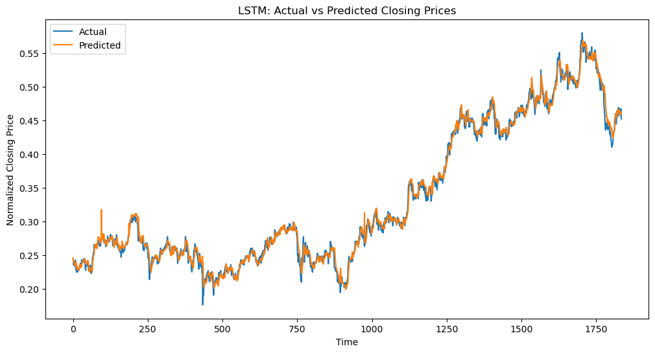

Slide 7
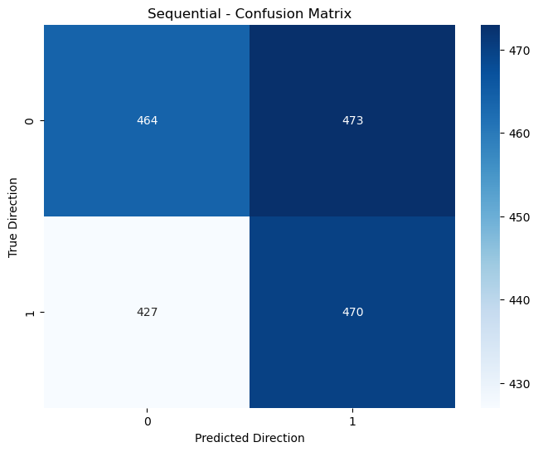

Slide 8
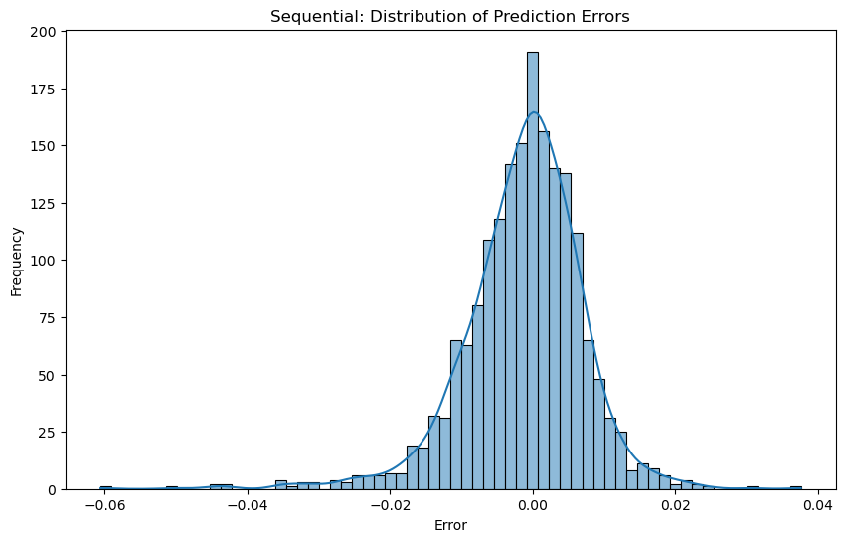

Slide 9
Evaluation
Mean Squared Error: 0.0009808307801629796
Mean Absolute Error: 0.012859255713500717
R-squared Score: 0.8272729527715399

Slide 10
Model 2: GRU
Simplified architecture: GRUs have a simpler structure compared to LSTMs, potentially leading to faster training and reduced overfitting risk.
Efficient computation: With fewer parameters than LSTMs, GRUs can be more efficient, especially beneficial when dealing with large datasets of stock information.
Effective for shorter sequences: GRUs often perform well on shorter sequences, which can be advantageous for predicting near-future stock prices.
Balanced memory-computation trade-off: GRUs offer a good balance between capturing long-term dependencies and computational efficiency.
Adaptability to different time scales: Like LSTMs, GRUs can adapt to various time scales in the data, capturing both rapid changes and slower trends in stock prices.

Slide 11
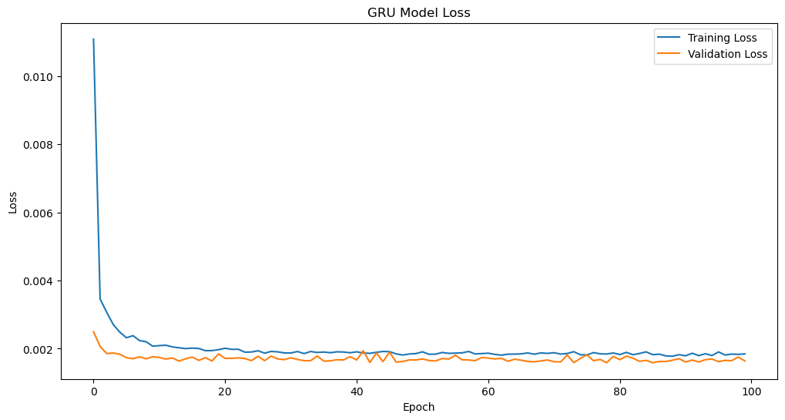

Slide 12
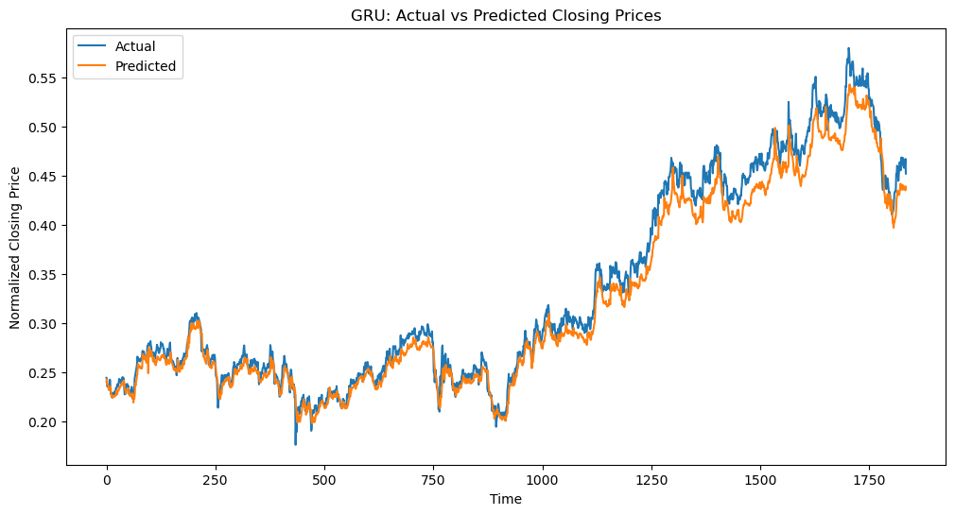

Slide 13
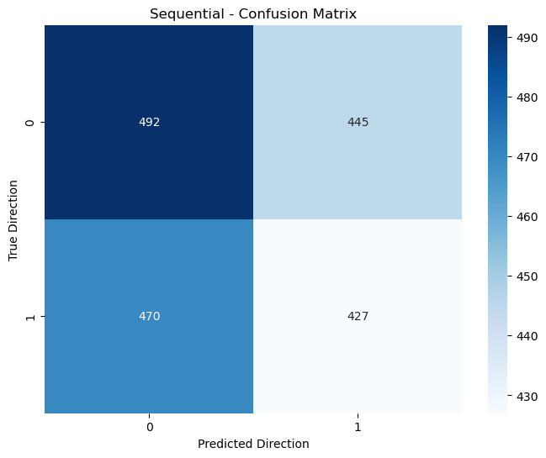

Slide 14
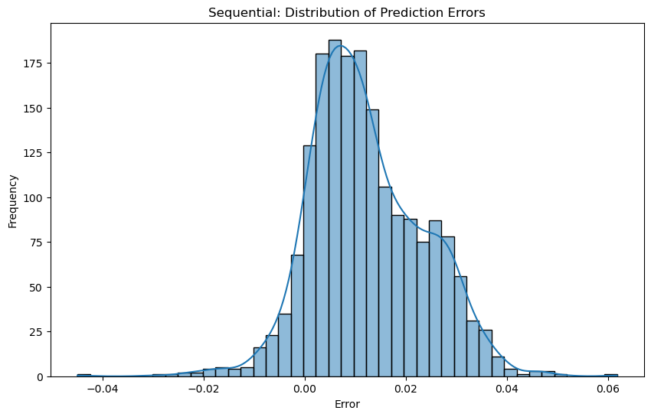

Slide 15
Evaluation
Mean Squared Error: 0.0010654958999574706
Mean Absolute Error: 0.017874308756622166
R-squared Score: 0.8241953140181908

Slide 16
Model 3: 1D-CNN
Local pattern recognition: 1D-CNNs excel at identifying local patterns in sequential data, which can be crucial for detecting short-term trends and patterns in stock prices.
Feature extraction: The convolutional layers can automatically extract relevant features from the raw time series data, potentially identifying important indicators without manual feature engineering.
Spatial hierarchies: By stacking convolutional layers, 1D-CNNs can capture hierarchical patterns in the data, from fine-grained details to broader trends.
Efficient parallelization: CNNs are highly parallelizable, potentially leading to faster training and inference times compared to recurrent models.
Robustness to time warping: 1D-CNNs can be more robust to small shifts or warps in the time series, which is beneficial when dealing with the inherent volatility of stock prices.

Slide 17
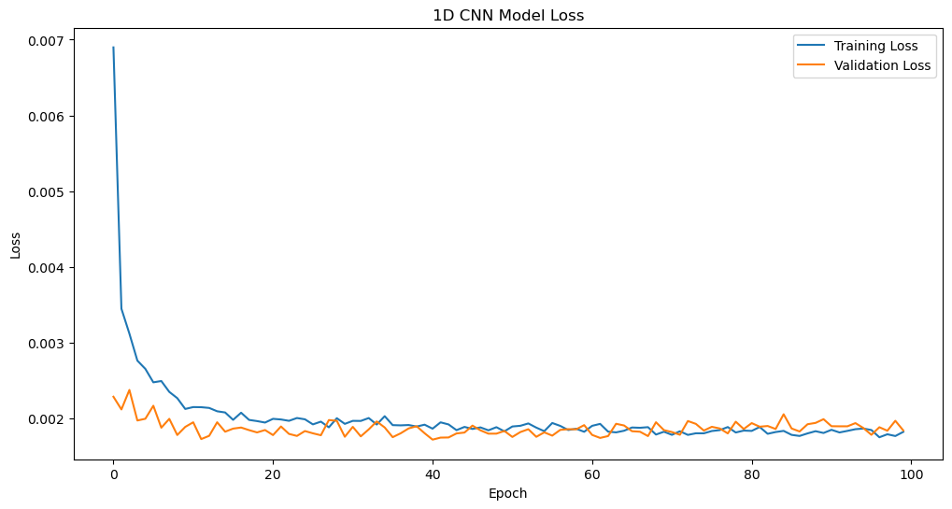

Slide 18
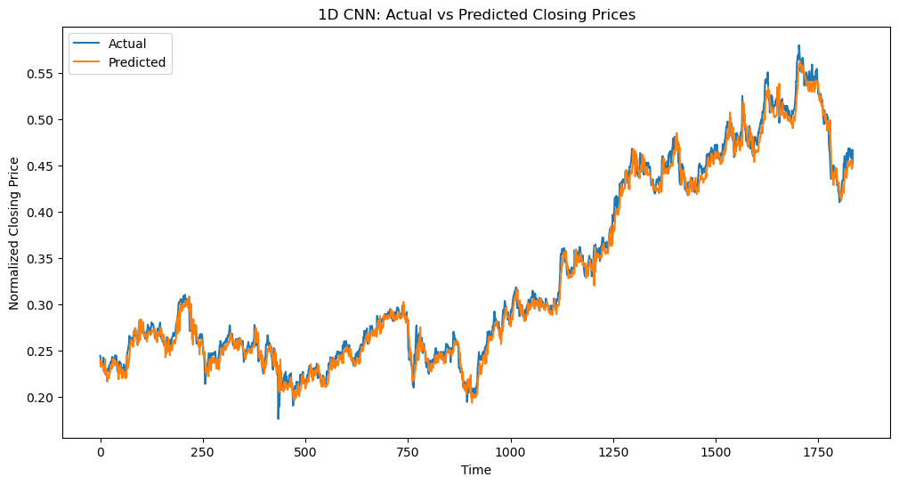

Slide 19
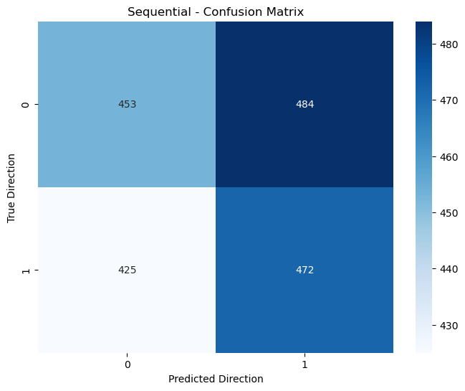

Slide 20
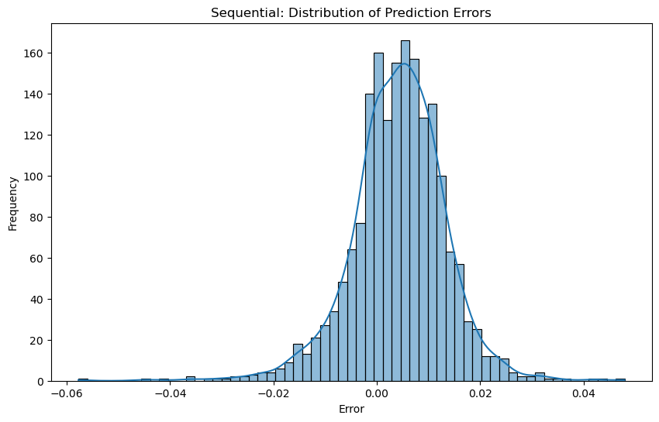

Slide 21
Evaluation
Mean Squared Error: 0.001076974729600427
Mean Absolute Error: 0.01592780200633523
R-squared Score: 0.8118042447226097

Slide 22
Model 4: Transformers
Parallel processing: Transformers process all time steps simultaneously, leading to faster training on large datasets compared to sequential models like LSTMs or GRUs.
Attention mechanism: The self-attention mechanism allows the model to weigh the importance of different time steps dynamically, potentially capturing complex dependencies in stock price movements.
No recurrence: The absence of recurrence allows Transformers to avoid issues like vanishing gradients, enabling them to capture very long-range dependencies effectively.
Positional encoding: Transformers use positional encodings to maintain the order of the sequence, allowing them to understand the temporal aspect of the data without explicit recurrence.
Multi-head attention: This feature allows the model to focus on different aspects of the input simultaneously, potentially capturing various factors influencing stock prices in parallel.
Scalability: Transformers have shown excellent performance on very large datasets and can potentially leverage vast amounts of historical stock data effectively.

Slide 23
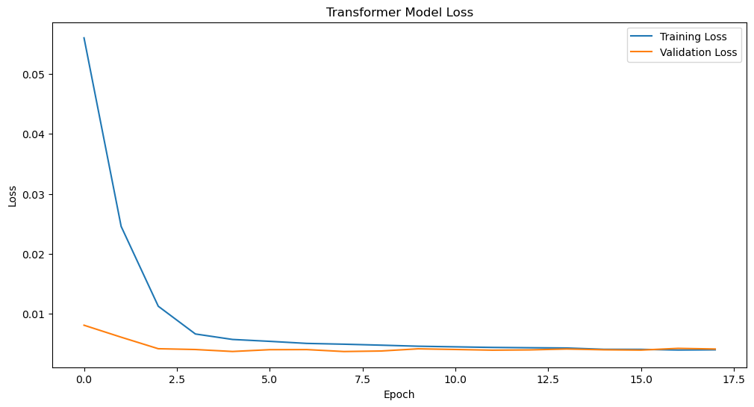

Slide 24
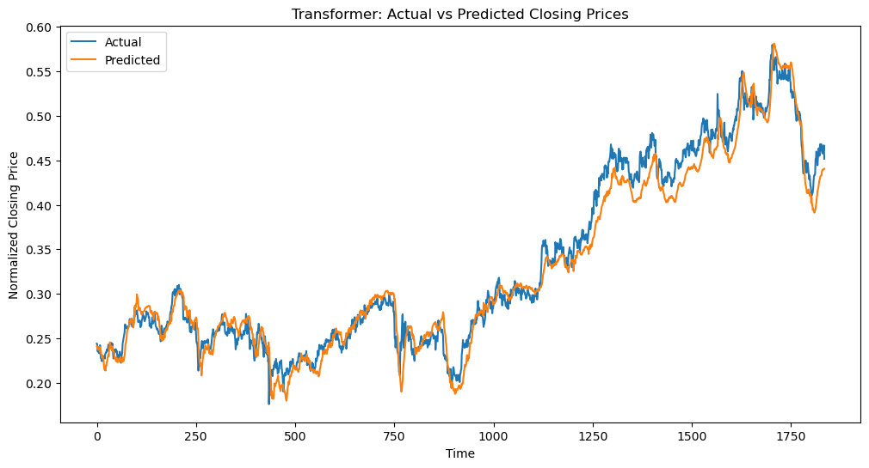

Slide 25
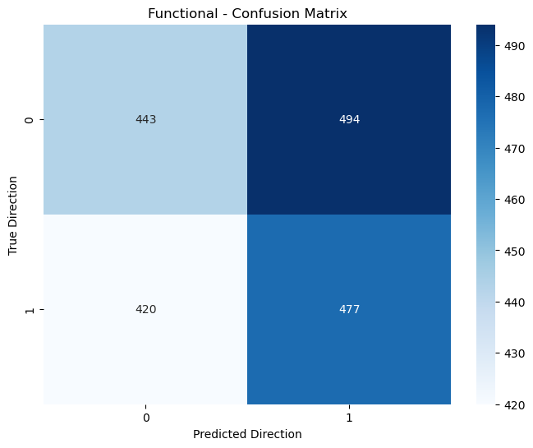

Slide 26
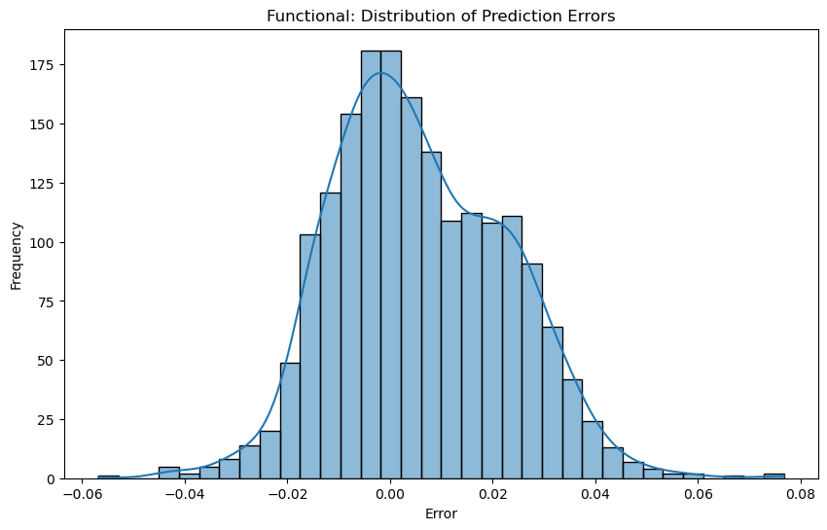

Slide 27
Conclusion
All the above mentioned models can successfully predict the closing prices for each day.

