Slide 1
AI Engineer task
Multivariate Time Series Analysis

Slide 2
EDA: Exploratory Data Analysis
Basic Data Exploration: Initial inspection of the dataset to check for missing values, data types, and the structure of the dataset.
Summary statistics to understand the distribution of numerical features.
Visualization: Graphical representations such as histograms or scatter plots to observe the distribution of key features.
Correlation Analysis: Correlation matrix to examine relationships between different features, possibly using Pearson or Spearman correlations.
Handling Missing Values: Either removal or imputation (likely depending on the specific data and goal).

Slide 3
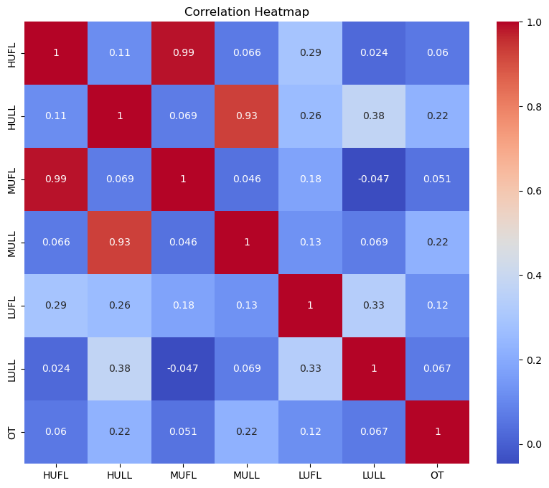

Slide 4
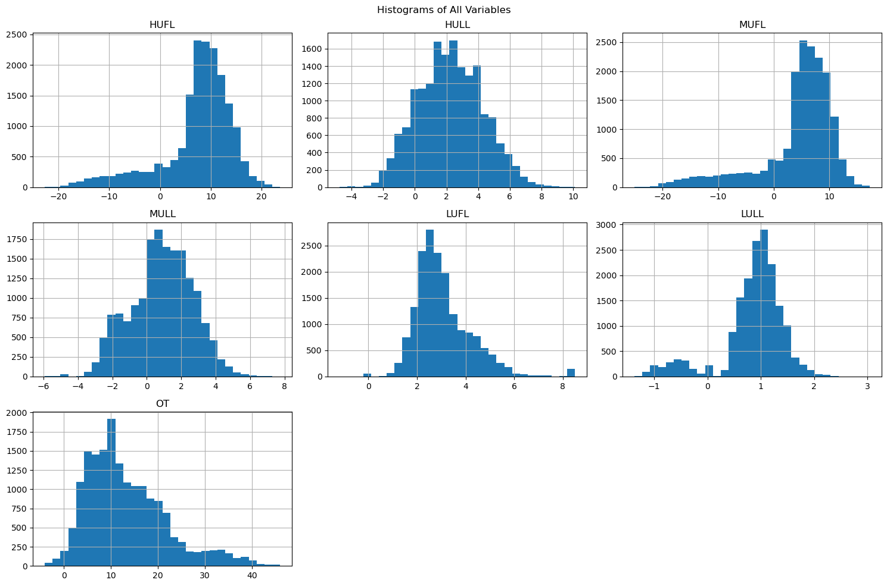

Slide 5
Pre-Processing
Data Loading: The dataset 'ett.csv' is loaded into a pandas DataFrame.
The 'date' column is parsed and set as the index.
Missing Value Handling: Checked for missing values in the dataset. Used KNN Imputer to fill any missing values, though there were no missing values in this case.
Data Normalization: Applied MinMaxScaler to normalize all features to a range between 0 and 1.
Feature Engineering: Created lag features for each column with a lag of 1 time step. This means for each feature, a new column was added containing the value of that feature from the previous time step. For example, if 'HUFL' is a column, a new column 'HUFL_lag_1' was created with the previous time step's value.
Data Preparation: Combined the normalized data with the newly created lag features. Removed any rows with NaN values resulting from the lag feature creation. Split the data into features (X) and target (y), assuming 'OT' as the target variable.
Train-Test Split: Split the data into training (80%) and testing (20%) sets.
Data Export: Saved the pre-processed and split data (X_train, X_test, y_train, y_test) to separate CSV files.

Slide 6
Feature Engineering
Purpose of Lag Features: Lag features are used to capture time-dependent patterns in the data. They allow the model to consider past values when making predictions, which is crucial in time series analysis.
Implementation: A custom function create_lag_features() was defined to create these features. It takes two parameters: the data and the lag value (default is 1).
Process: For each column in the original dataset, a new column is created. The new column contains the values from the original column, shifted by the specified lag. In this case, with lag=1, each new column contains the values from 1 time step earlier.
Naming Convention: The new columns are named by appending "_lag_1" to the original column name. For example, if the original column was "HUFL", the new column would be "HUFL_lag_1".
Data Structure: The lag features are initially created as a separate DataFrame. This new DataFrame is then concatenated with the original data horizontally (axis=1).
Handling Edge Cases: The first row of each lag feature will contain NaN values, as there's no previous data for the first time step. These NaN values are removed using dropna() to ensure clean data for modeling.
Impact on Dataset: The number of features doubles (assuming lag=1 for all columns).The number of rows decreases slightly due to the removal of NaN values.
Potential Benefits: Helps capture short-term dependencies in the data. Can improve model performance for time series forecasting tasks. Allows the model to consider trends or patterns from the immediate past.
Considerations: The choice of lag (1 in this case) affects how far back the model can "see". Multiple lags could be used to capture different time scales (e.g., lag=1, lag=7 for weekly patterns).The optimal lag value often depends on the specific problem and data characteristics.

Slide 7
Model 1: LSTM
Designed for sequence data: LSTMs are specifically designed to handle sequential data, making them well-suited for time series analysis.
Long-term dependencies: LSTMs can capture long-term dependencies in the data, which is crucial for time series where past events may influence future outcomes.
Multivariate capability: LSTMs can easily handle multiple input features, making them ideal for multivariate time series.
Non-linear relationships: LSTMs can model complex, non-linear relationships between variables and across time steps.
Adaptive learning: LSTMs can adapt to changes in the time series patterns over time, which is useful for capturing evolving trends or seasonality.

Slide 8
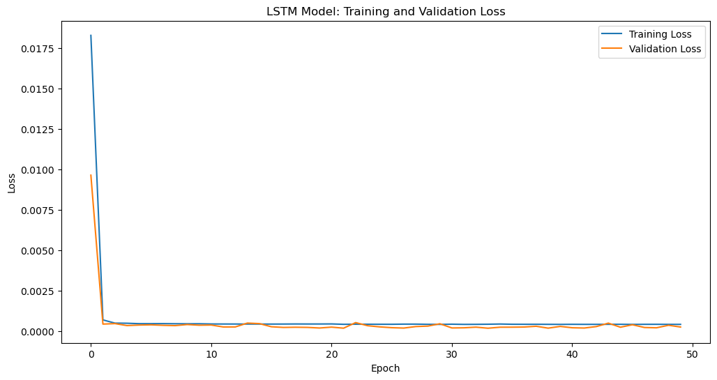

Slide 9
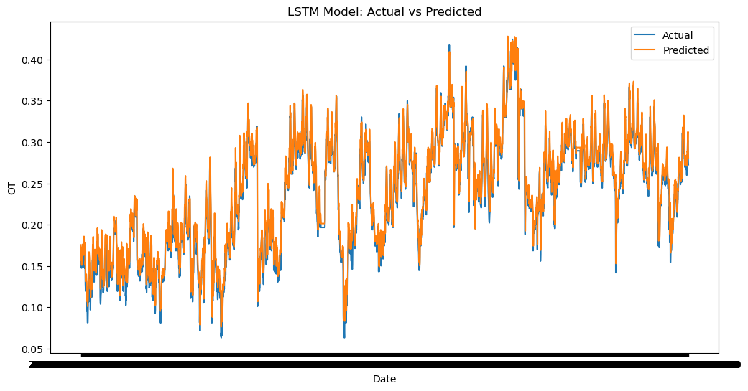

Slide 10
Evaluation
Mean Squared Error: 0.00020478184311924612
Mean Absolute Error: 0.010257819301366844
Root Mean Squared Error: 0.014310200666630994

Slide 11
Model 2: XGBoost
Handling non-linear relationships: XGBoost excels at capturing non-linear relationships between features and the target variable.
Feature importance: XGBoost provides built-in feature importance scores, helping identify which variables are most predictive of the target.
Robustness to outliers: XGBoost is relatively robust to outliers, which can be beneficial in time series data that may contain anomalies.
Regularization: XGBoost includes built-in regularization, which can help prevent overfitting, especially useful with limited data.
Speed and scalability: XGBoost is known for its computational efficiency, allowing for quick training and prediction on large datasets.
Handling missing values: XGBoost can handle missing values in the data, which can be useful if there are gaps in the time series.

Slide 12
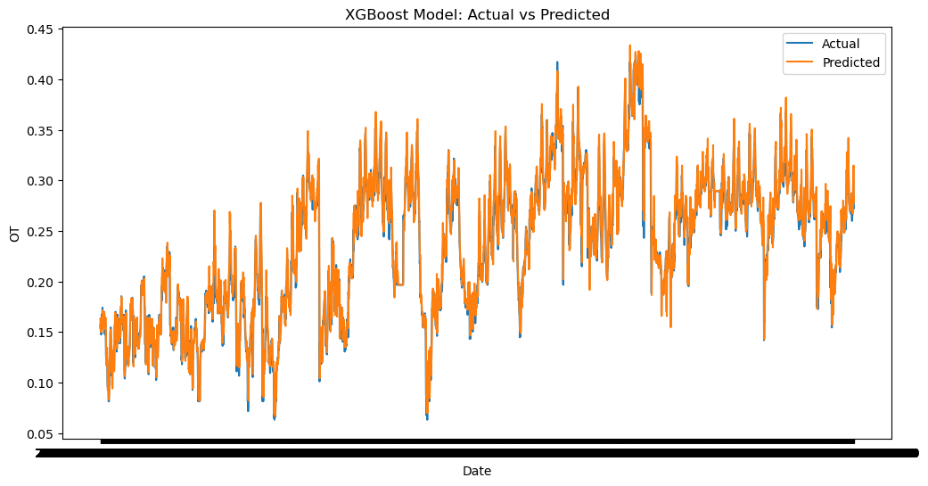

Slide 13
Evaluation
Mean Squared Error: 0.00019682872496271661
Mean Absolute Error: 0.009716307311765237
Root Mean Squared Error: 0.014029566100301058

Slide 14
Model 3: Random Forests
Ensemble method: As an ensemble of decision trees, Random Forests can capture complex patterns in the data without overfitting.
Feature importance: Like XGBoost, Random Forests provide feature importance scores, helping understand which variables are most predictive.
Handling non-linear relationships: Random Forests can model non-linear relationships between variables effectively.
Robustness to outliers: Random Forests are less sensitive to outliers compared to some other methods.
No assumption of data distribution: Random Forests don't assume any particular distribution of the data, making them flexible for various types of time series.
Parallel processing: Random Forests can be easily parallelized, allowing for efficient computation on large datasets.

Slide 15
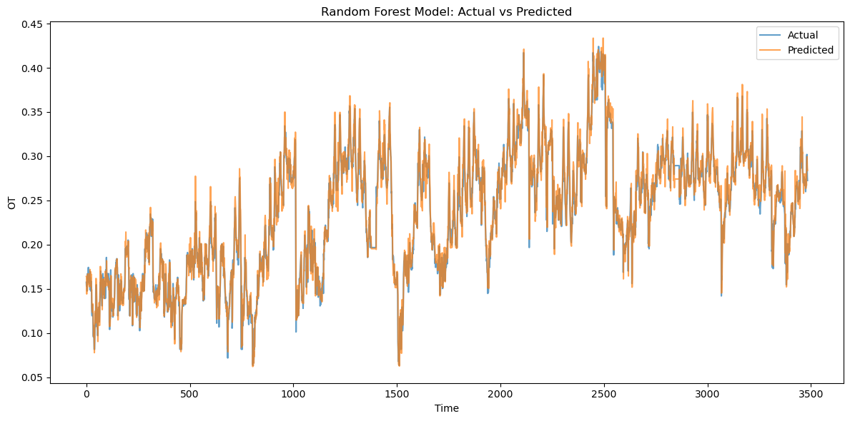

Slide 16
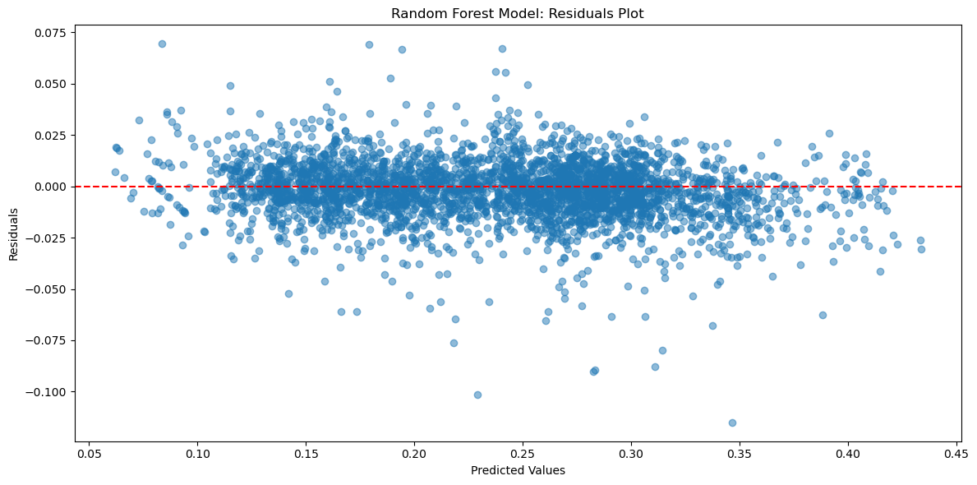

Slide 17
Evaluation
Mean Squared Error: 0.00021075048389814367
Mean Absolute Error: 0.010387580836607806
Root Mean Squared Error: 0.014517247807285775
R-squared Score: 0.9554752326155276

Slide 18
Conclusion
The models shown are known to be well performing with the given data.
I had also trained the dataset on some different model’s such as Prophet, 1D-CNN, Transformers, which weren’t performing well. These have also been included within the repository for future references.

