Slide 1
AI Credit Risk & Loan Default Prediction Platform
Bank + Client Portals with Explainable AI and Live Market Signals
K. Nikhil Kumar
Dept of CSE (AI & ML), DRK Institute of Science and Technology

Slide 2
Abstract
End-to-end AI platform for credit risk and loan default prediction.
Secure dual-portal system for banks and clients.
Explainable risk scoring with model analytics and feature importance.
Affordability analysis using DTI and EMI capacity.
Live stock holdings integrated into client creditworthiness.

Slide 3
Introduction
Banking requires fast, transparent, and accurate risk assessment.
Traditional rule-based scores are static and opaque.
Machine learning enables richer signals and explainability.
CreditAI provides real-time risk evaluation with human-readable insights.

Slide 4
Problem Statement & Motivation
Loan risk evaluation needs to balance accuracy, speed, and transparency.
Borrower affordability is dynamic and influenced by assets and expenses.
Stakeholders need dashboards for both institutional and client views.
Goal: deliver a practical, explainable AI system for lending decisions.

Slide 5
Existing Systems & Limitations
Static credit scores ignore real-time financial context.
Black-box models reduce trust and auditability.
Limited integration of alternative assets (e.g., stocks).
User experience often lacks client-facing transparency.

Slide 6
Proposed System
Supervised ML pipeline with engineered financial features.
Explainable risk scoring and model analytics dashboard.
Secure login with role-based navigation (Bank / Client).
Client portal for eligibility estimation and live stock valuation.
Market Watch page for real-time stock changes.

Slide 7
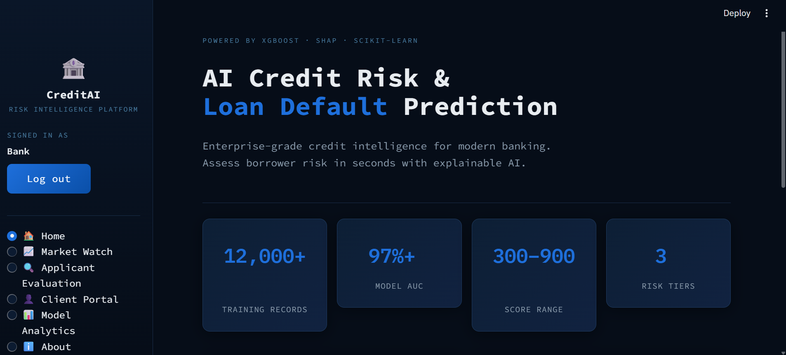
System Interface (Bank Dashboard)

Slide 8
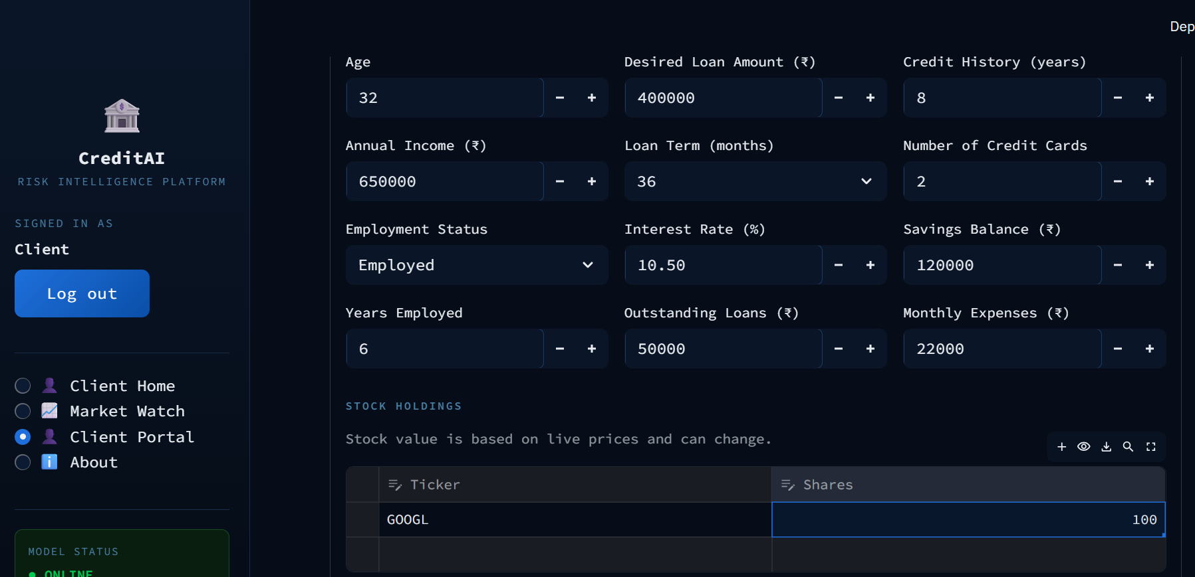
Client Portal & Stock Holdings

Slide 9
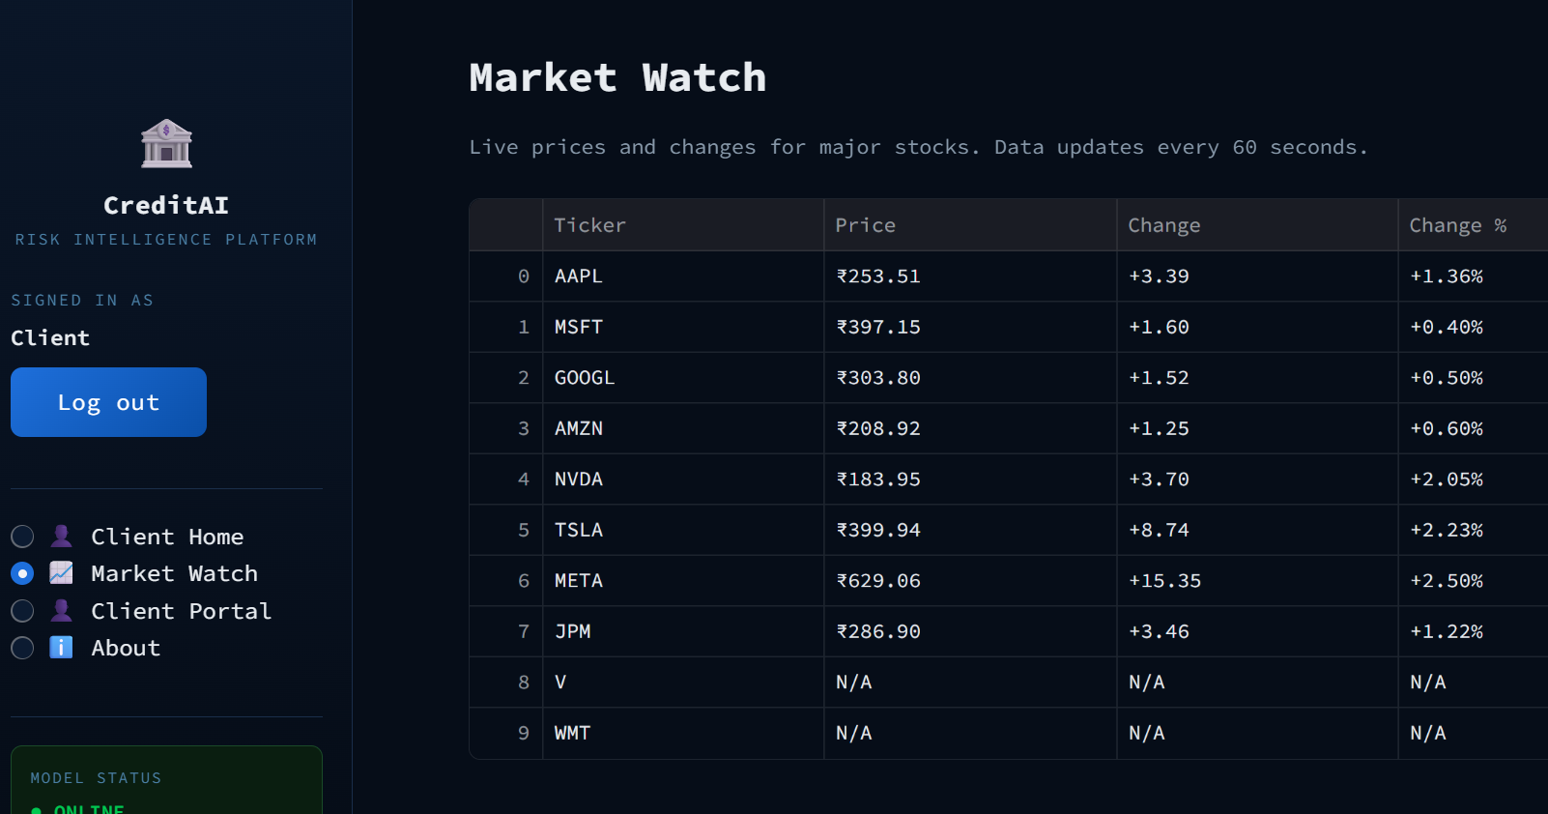
Market Watch

Slide 10
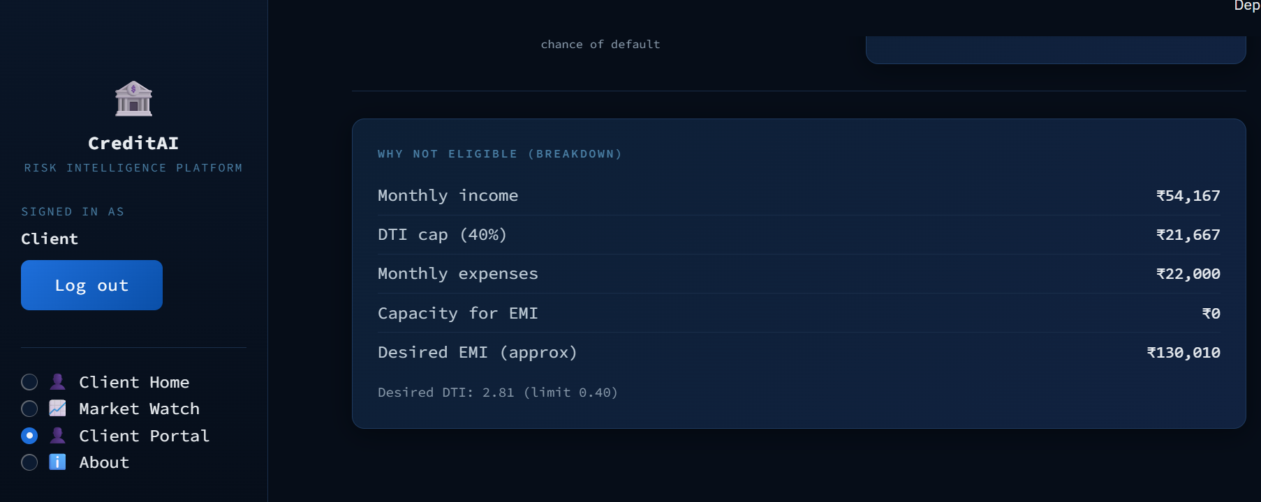
Eligibility Breakdown

Slide 11
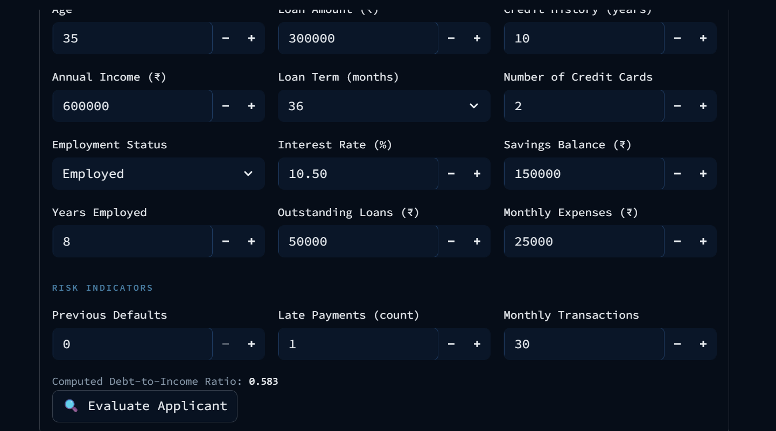
Applicant Evaluation (Bank)

Slide 12
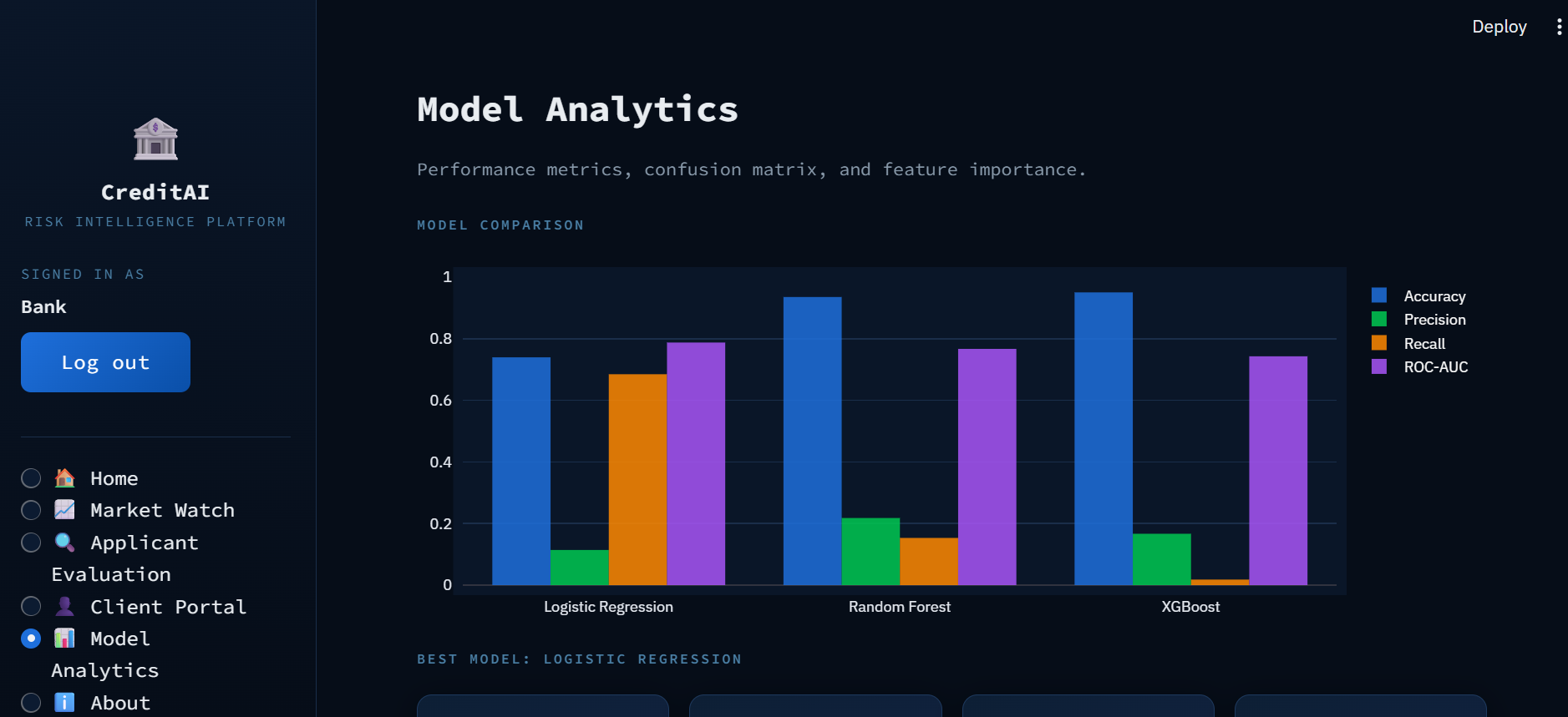
Model Analytics

Slide 13
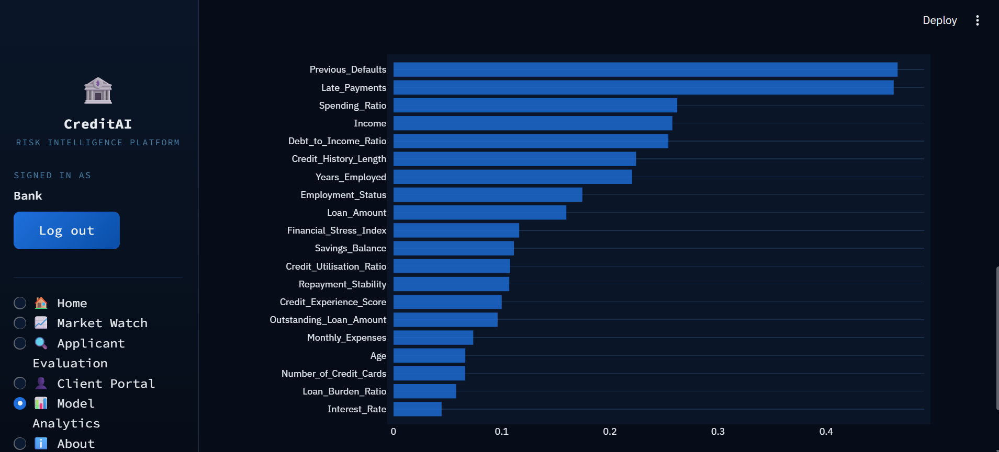
Feature Importance

Slide 14
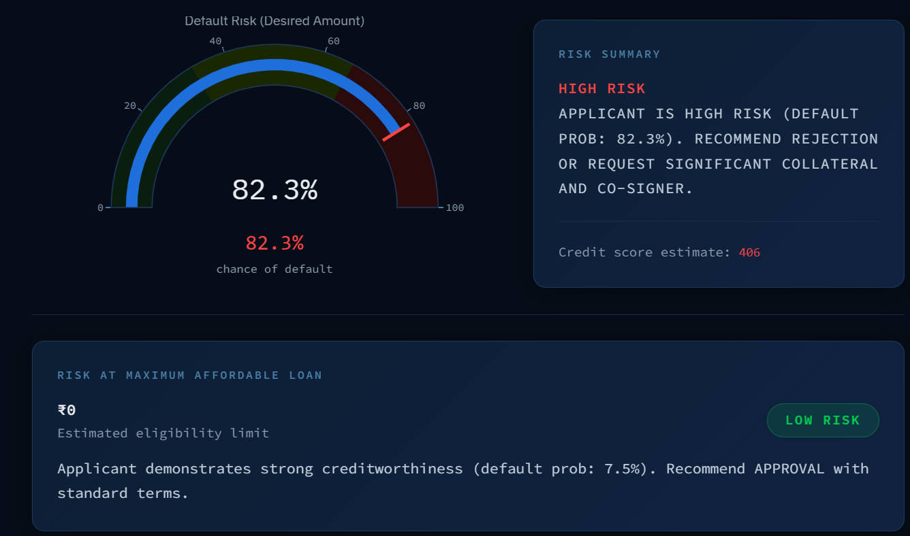
Risk Output & Recommendation

Slide 15
Results Summary
Best model: Logistic Regression.
Logistic Regression: Acc 0.740, ROC-AUC 0.788, Precision 0.114, Recall 0.685
Random Forest: Acc 0.935, ROC-AUC 0.767, Precision 0.218, Recall 0.153
XGBoost: Acc 0.950, ROC-AUC 0.743, Precision 0.167, Recall 0.018

Slide 16
Conclusion
CreditAI delivers fast, explainable loan risk assessment.
Dual-portal design supports banks and clients with tailored views.
Live stock assets improve affordability estimation.
System is extensible for bureau data and advanced calibration.

Slide 17
Future Scope
Institution-specific policy calibration and model governance.
Integration of bureau scores and cash-flow analytics.
Expanded market watch coverage and alternative assets.
Automated model cards and audit-ready reporting.

Slide 18
Thank You
Questions & Discussion

