Slide 1
Use cases and ensuring requirements
Saikiran Gandham
Teja Naraharishetty
Kranthi Kumar Mukka
Mallikharjhuna Rao Dande

Slide 2
Agenda
How to gather requirements
Characteristics of good requirements
Ensuring requirements are complete
Testing requirements
Use case
Demo

Slide 3
How to gather requirements
Interviews
Questionnaires
Prototyping
Use cases
Request for proposals
Notes:
Requirements play’s major role in any project. Collecting requirements is the main task in project. The only way to know the requirements is interacting with client. You cannot guess what the client needs. We should let the client do the talking. How do you get the client talking?...exactly...by asking questions.

Slide 4

Interviews
Notes:
Interviews may be one-on-one or group. The most common technique for gathering requirements is to sit down with the clients and ask them what they need. There are many good ways to plan the interview, but generally you want to ask open-ended questions to get the interviewee to start talking and then ask probing questions to uncover requirements.

Slide 5

Questionnaire
Notes:
Questionnaires are much more informal, and they are good tools to gather requirements from stakeholders in remote locations or those who will have only minor input into the overall requirements. Questionnaires can also be used when you have to gather input from dozens, hundreds, or thousands of people.

Slide 6
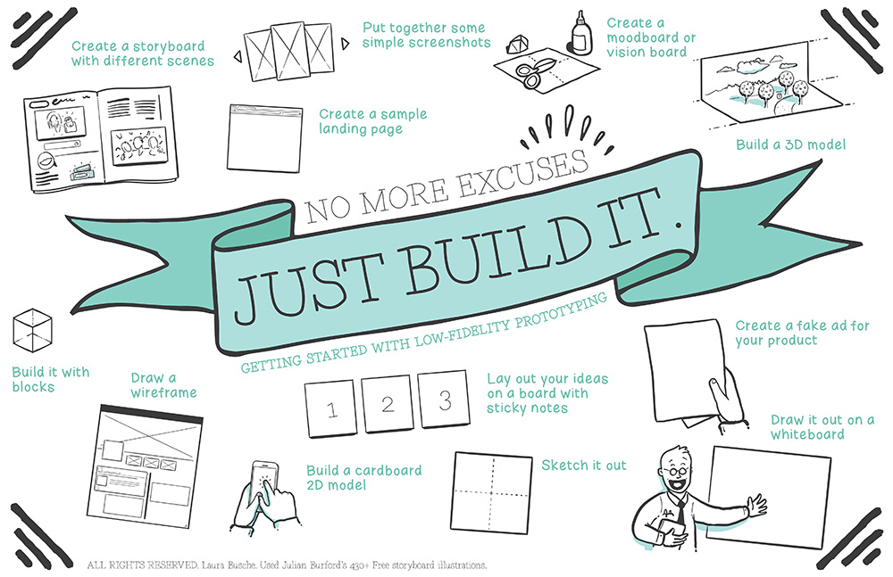
Prototyping
“All things are created twice; first mentally; then physically. The key to creativity is to begin with the end in mind, with a vision and a blue print of the desired result.” — Stephen Covey
Notes:
Prototyping is a relatively modern technique for gathering requirements. In this approach, you gather preliminary requirements that you use to build an initial version of the solution — a prototype.

Slide 7
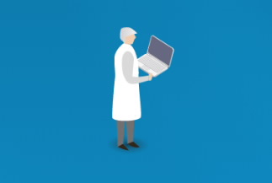
Use cases
Notes:
Use cases are basically stories that describe how discrete processes work. Use cases may be easier for the users to articulate, although the use cases may need to be distilled later into the more specific detailed requirements.

Slide 8
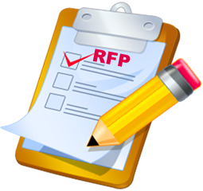
Request for proposals
Notes:
RFP is used where the request requires technical expertise, specialized capability, or where the product or service being requested does not yet exist and the proposal may require research and development to create whatever is being requested.

Slide 9
Characteristics of good requirements
Testable (verifiable)
Clear (concise, terse, simple, precise)
Correct
Understandable
Feasible (realistic, possible)
Necessary
Implementation-free (abstract)

Slide 10
Testability
Testability, a property applying to an empirical hypothesis
Logical
practical
Notes:
Testers should be able to verify whether the requirement is implemented correctly. The test should either pass or fail.

Slide 11
Clear & Correct
Requirements should not contain unnecessary information.
If a requirement contains facts, these facts should be true

Slide 12
Understandable & Feasible
Standard conventions should be used.
The requirement should be doable within existing constraints such as time, money, and available resources

Slide 13
Necessary & Implementation-free
A requirement is unnecessary if None of the stakeholders needs the requirement.
Requirements should not contain unnecessary design and implementation information

Slide 14
Ensuring requirements are complete
The state of requirements (quality of information),
The format of requirements (template and techniques used for visualizing requirements), and
The process through which these artifacts are achieved.

Slide 15
Testing requirements
Identifies the “WHAT” of testing
What needs to be tested, AND
What are you going to validate about it
Includes both normal and error conditions
Covers business rules, functionality, non-functional standards

Slide 16
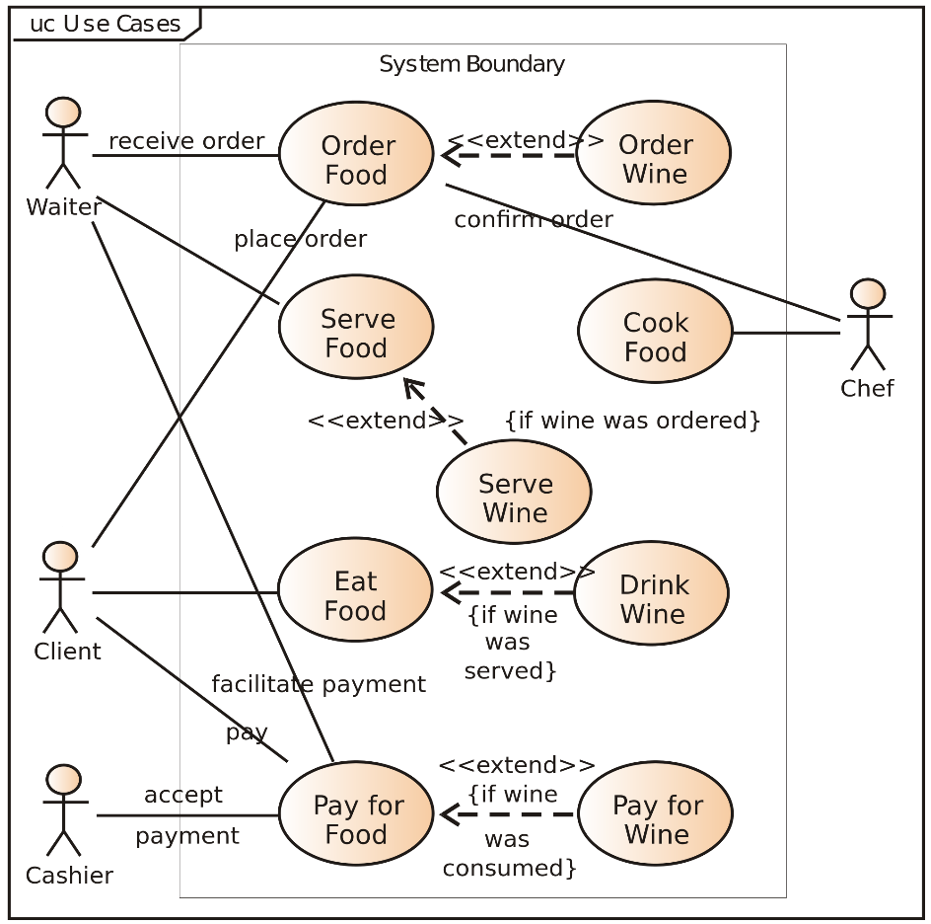
What is a use case?
It is a list of actions or event steps, typically defining the interactions between a role and a system, to achieve a goal. The actor can be a human or an external system.
In system analysis to identify, clarify and organize system requirements.
It should contain all system activities that have significance to the users.
Collection of possible scenarios related to a particular goal.

Slide 17
Characteristics of use case
Organizes functional requirements
Models the goals of system and actor(user) interactions
Records the scenarios from trigger events to goals
Describes the main flow of events and possibly the exceptional flows of events(alternate actions)
Is multi-level, so that one use case can use the functionality of another one

Slide 18
Elements in a use case:
Name
Brief Description
Actors
Preconditions
Basic Flow
Alternate Flows
Exception Flows
Post Conditions

Slide 19
Advantages:
Project planning skeleton
Everyone involved in the agreement as to what the system will basically do and what it will not do
Look ahead mechanism, so the stakeholders can spot issues which are to be answered by the development team
Identification of exceptional scenarios
Can be utilized in other aspects of software development like cost estimation and project planning

Slide 20
Disadvantages and Misconceptions:
No fully standard definition and so changes according to project
Do not capture the non-functional requirements
There might be a learning curve for the developer or client in using the use cases
Difficult to determine the user interface dependency
Use cases are mainly diagrams
Use cases have too much UI related content
Writing use cases for large systems are tedious and waste of time

Slide 21
Demonstration
http://creately.com/

Slide 22
Determining Flow from Requirements
Scenario:
Basic Flow:
Opening a bank account
Alternate Flow:
Update Balance (Withdraw or Deposit Funds)
Exception Flow:
Low Balance

Slide 23
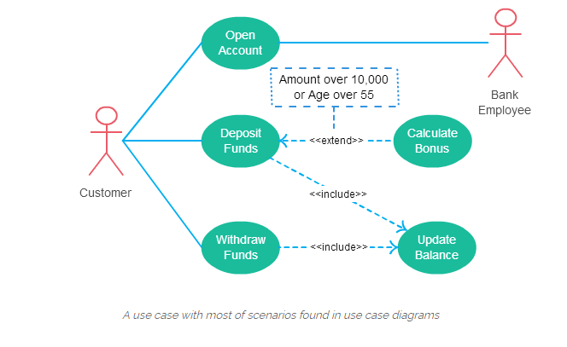
The Use Case Diagram

Slide 24


Slide 25
References
http://creately.com/blog/diagrams/use-case-diagram-tutorial/
http://www.bridging-the-gap.com/what-is-a-use-case/
http://searchsoftwarequality.techtarget.com/definition/use-case

Slide 26


