Slide 1

Course Scheduling Assistant
End-Term Presentation
TeamD Sigma:
Sanket Selokar
Harika Malempati
SaiKiran Gandham
Sravya Kandepu
Nikhil Kumar Vemula
Niteesha Kotagiri

Slide 2

Course Scheduling Assistant
Client & Mentor: Dr. Michael Oudshroon
Associate professor in the School of Computer Science and Information System
Notes:
We team members are thanking you for your guidance and support given thus far.
Our client was not satisfied with current procedure, so he given us a project to develop a web application for Course Scheduling by considering all the possibilities.

Slide 3

AGENDA
Project Briefing.
Status Report.
Project Management Plan.
Issues.
Use Cases.
Strategy.
Conclusion.
Notes:
This is the agenda, today we are going to tell about project management plan, issues, prototypes, use cases, strategies

Slide 4
Project Briefing:
Goal is to Automatically schedule courses and rooms for faculty.
Current System is a manual process.
Faculty schedule is provided in an excel sheet.
Tedious task for the faculty and chances of class room collisions are more. This project would reduce such collisions and make it easy for the faculty.

Slide 5
Status Report:
Gathered the client Requirements.
Developed User Interface prototypes.
Developed Use Cases based on our project functionality.
Prepared project management plan.
Prepared the cost estimation of the project.

Slide 6
Project Management Plan:
Project Deliverables:
Web based application based on functionalities and specifications given by the client.
Project Organization:
Each member in the team will be reporting to the supervisor and will be working according to the roles and responsibilities assigned.

Slide 7
Project Management Plan(Cont’d):
Project Budget Allocation:
Each person
1 Week = 15 hours
1 Semester = 14 Weeks = 14*15 = 210 hours
2 Semesters = 2*210 = 420 hours.
For team
420*6 = 2520 hours.
Notes:
Time is Cost in an Industry.

Slide 8
Project Management Plan(Cont’d):
Scheduling:
Project start date: 08/31/2016
Project end date: 04/22/2017
Documentation:
Requirement Specification
Project Management Plan
Test plan
User Manual
Cost Estimation plan

Slide 9
Issues:
How to handle database.
How to handle server connectivity issues.
What port number to be opened for the socket connection.
Displaying the schedule of the faculty in the calendar format.
How to avoid the class room collisions.

Slide 10
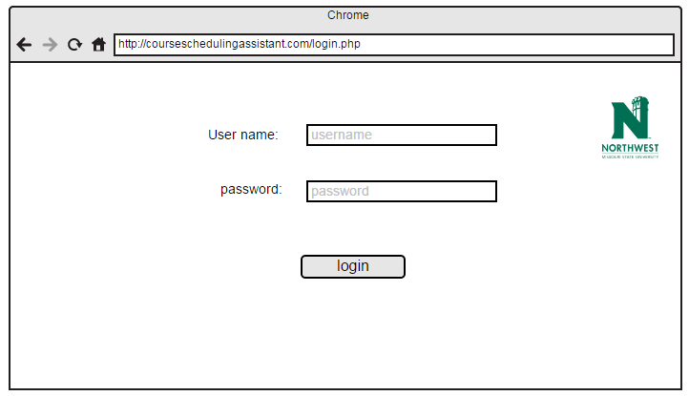
User Interface: Admin/faculty login page

Slide 11
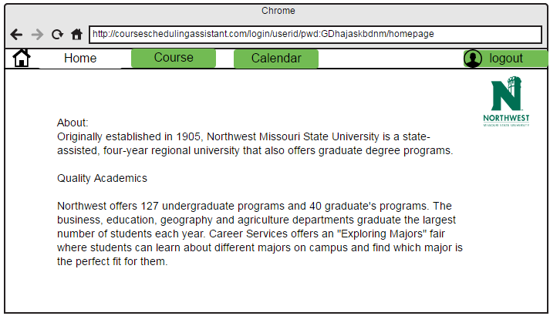
Faculty Homepage:

Slide 12
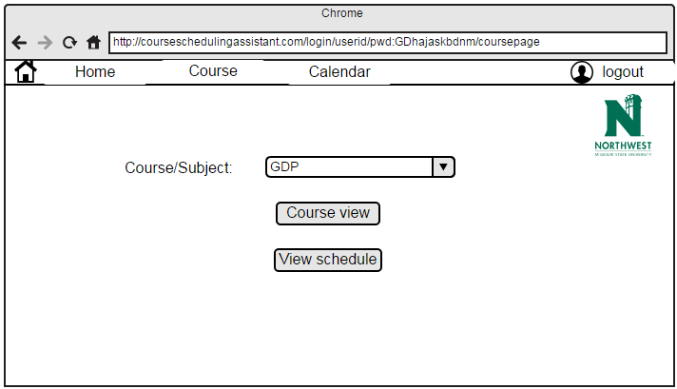
Faculty Course page:

Slide 13
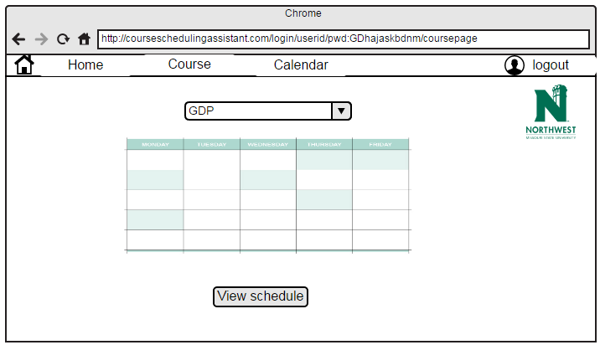
Faculty Course page(Cont’d):

Slide 14
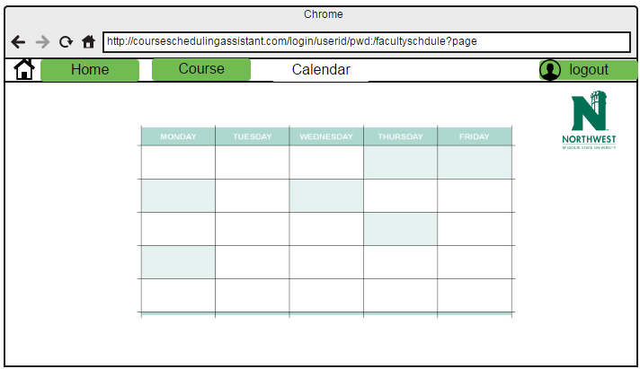
Faculty Calendar page:

Slide 15
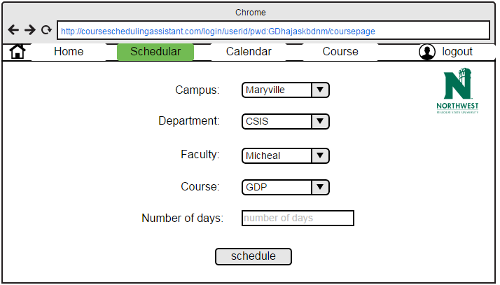
Admin Scheduler page:

Slide 16
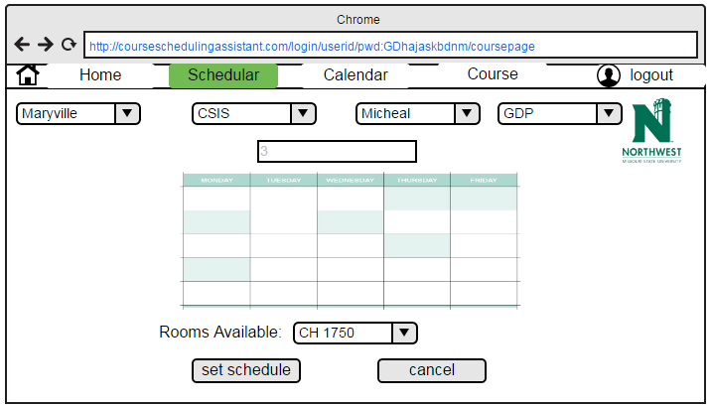
Admin Scheduler page(Cont’d):

Slide 17
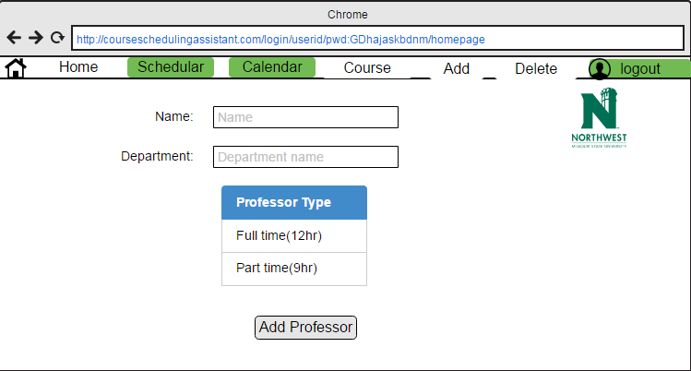
Admin Add page:

Slide 18
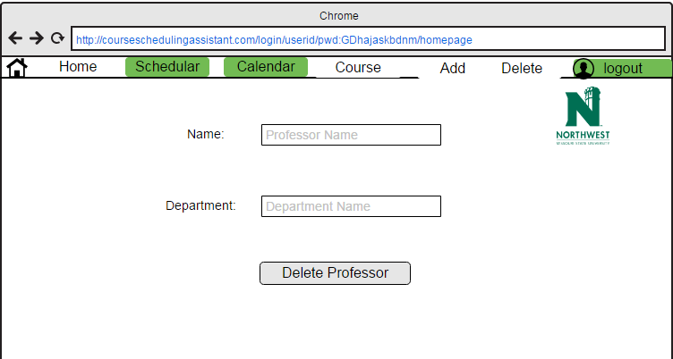
Admin Delete page:

Slide 19
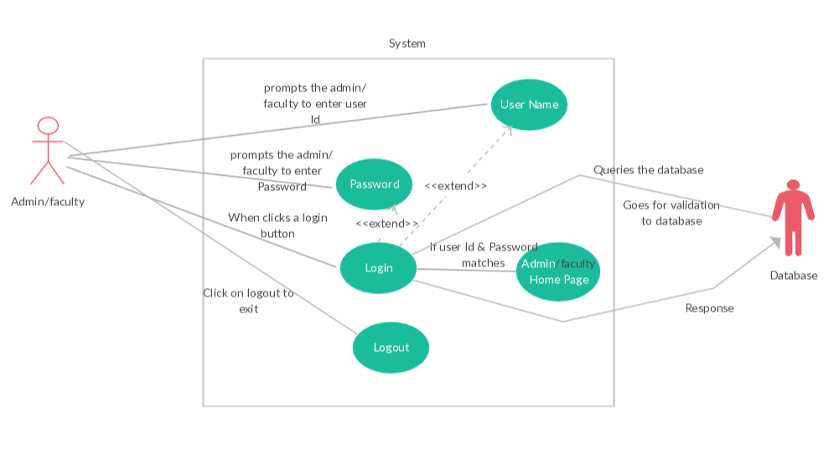
Use Cases: Admin/faculty login page

Slide 20
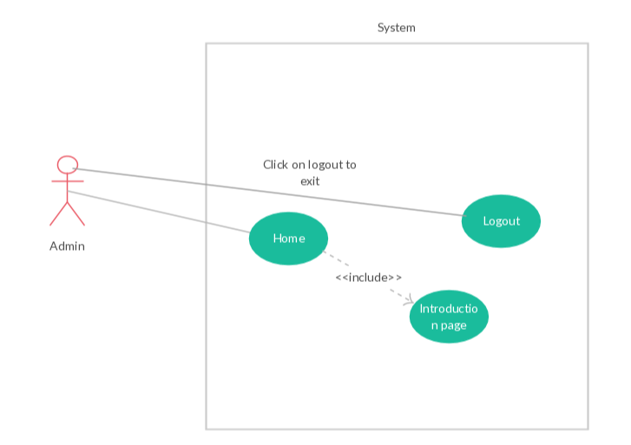
Admin Home Page use case:

Slide 21
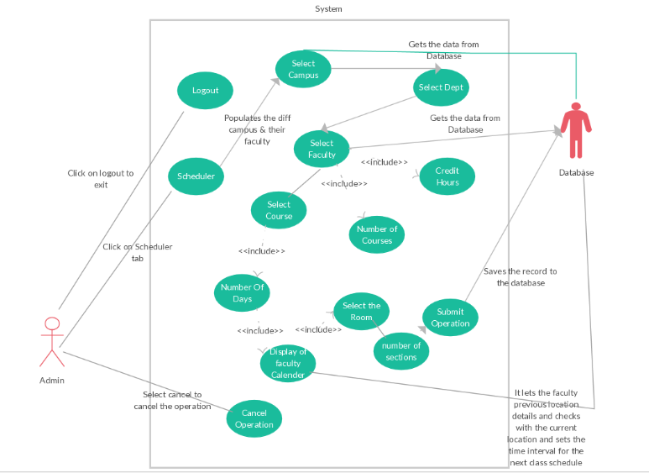
Admin Scheduler use case:

Slide 22
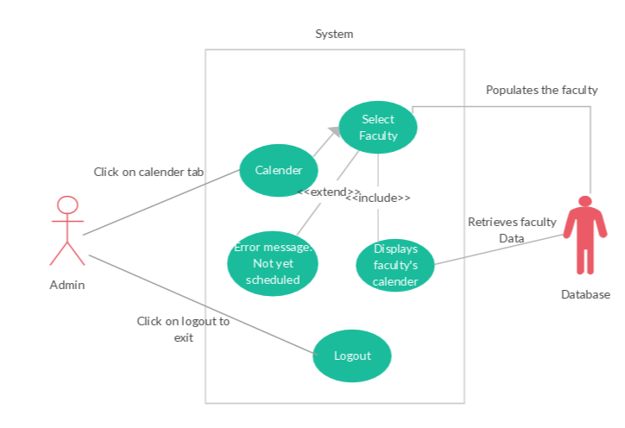
Admin Calendar use case:

Slide 23
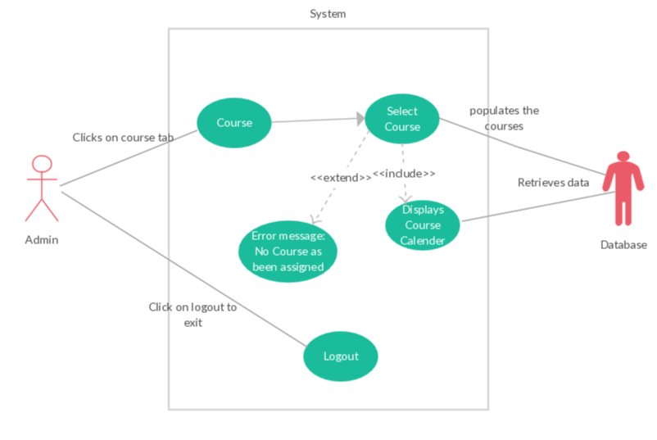
Admin Course use case:

Slide 24
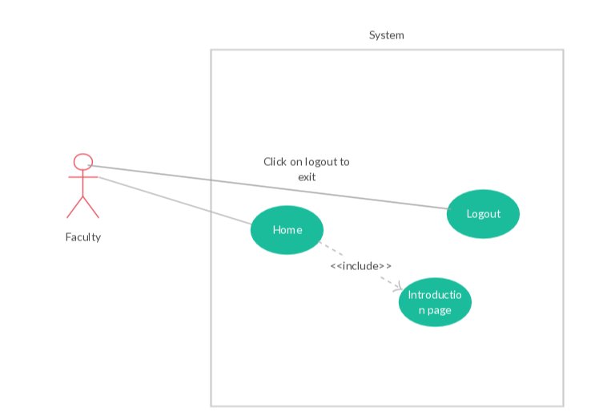
Faculty Homepage use case:

Slide 25
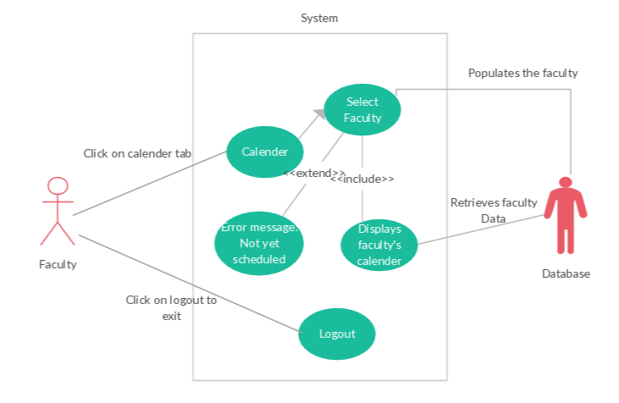
Faculty Calendar page use case:

Slide 26
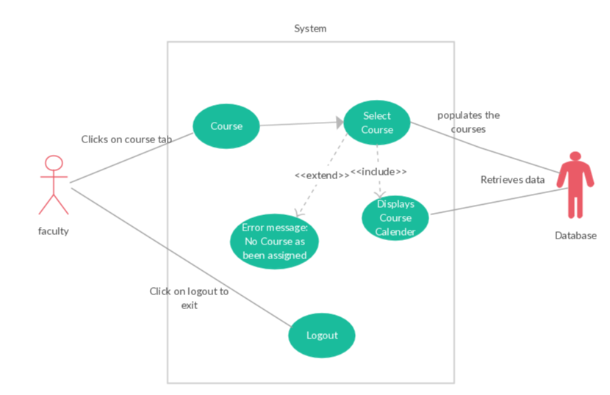
Faculty Course page use case:

Slide 27
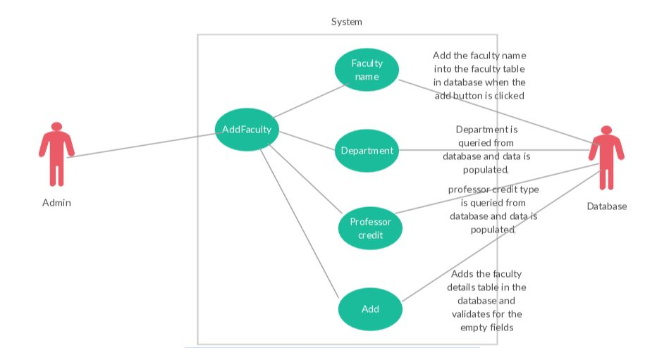
Faculty Add page use case:

Slide 28
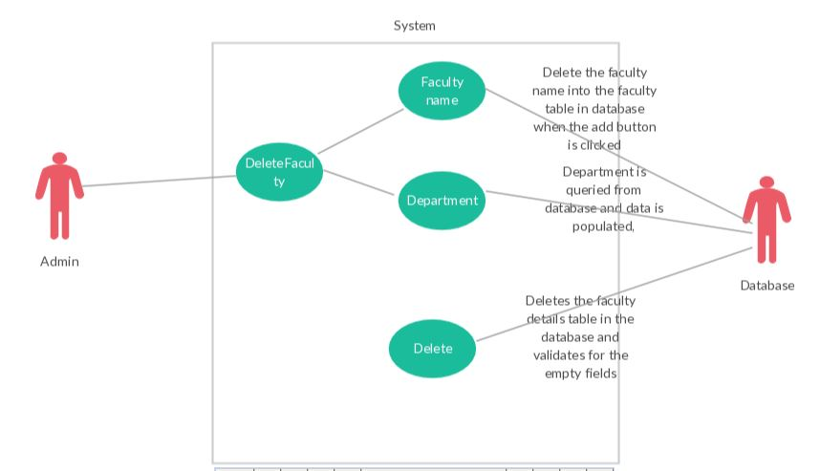
Faculty Delete page use case:

Slide 29
Strategy:
Start implementing small chunks of requirements.
Show some individual modules to the client regularly for checking our progress is in the right direction.
Will start from admin’s page functionality and then faculty’s page functionality.

Slide 30
Conclusion:
Gathered the requirements according to the client communication.
Updated the Prototypes and Use cases based on the new requirement given by the client
Need to address few issues like server and database connectivity.
Documentation required for the project is done.
.

Slide 31
Thank You

