Slide 1
PROSPECTIVE AREA TO SET-UP GYM IN NEW YORK
- Karthika Kumaran

Slide 2
BACKGROUND
Setting up a Business (GYM) in a new city is a challenging task
Different factors are considered, such as prime location for the business, financial factors, commutation , market factors etc. for the longevity of the business
This project serves as a stepping stone for those who are planning to set-up any new business(GYM) in a new city

Slide 3
BUSINESS PROBLEM
To find the best neighborhood in New York to open Gym
Gym must be located in an area which is close to prominent Metro Stations so that will be easy for the customers to commute
Gym should be set up in a neighborhood with few competitors so as to
reduce the risk of competition.

Slide 4
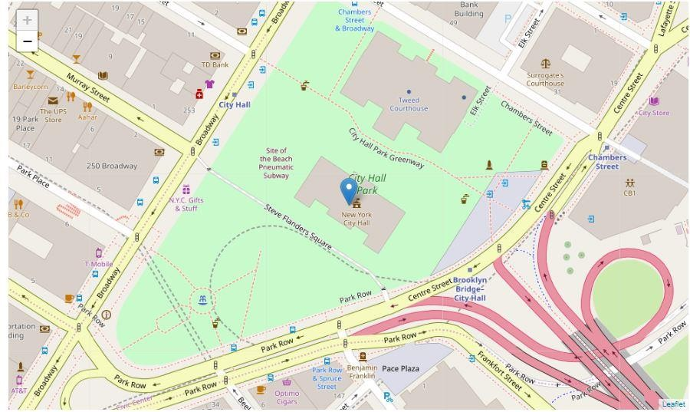
DATA
Considering New York as the city to
set-up the gym:
The dataset for New York is
readily available on the web and
the link is:
https://geo.nyu.edu/catalog/nyu_2
451_34572
Geospatial coordinates of New
York is obtained by using geopy library
Retrieve all the metro stations in
a radius of 15 kms around New
York using Foursquare API
Data for all the gyms located in a
Fig: Map of New York
radius of 750 meters for every
metro stations are obtained using
Fourquare API

Slide 5
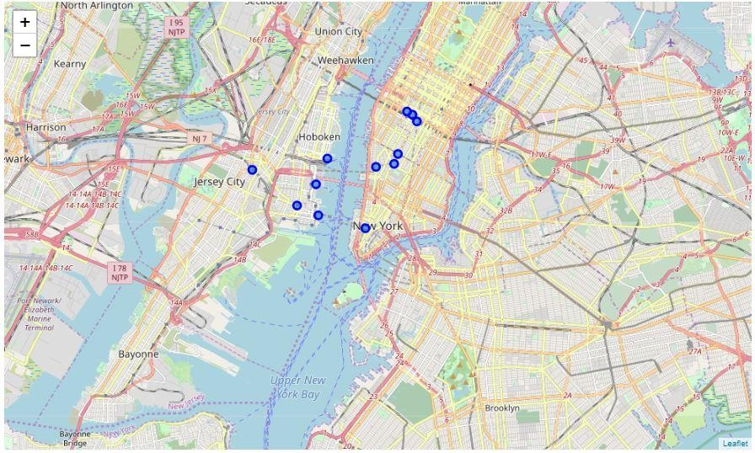
DATA (CONTD…)
Using the collected data, following are calculated:
the number of existing gyms near each station
the minimum distance of a gym for every metro station
This data will be then used as
input to K-means clustering
algorithm to obtain the
clusters of areas (metro
stations)
Fig : Map of New York with Metro Stations

Slide 6
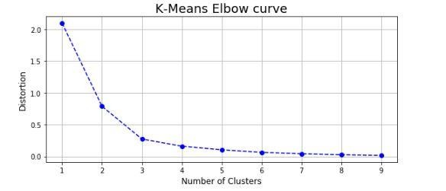
METHODLOGY
Machine Learning clustering algorithm was used to divide the stations and gyms data set into clusters of similar locations
The elbow method was used to find the most suitable number of clusters (3 clusters)
Fig : Elbow Curve

Slide 7
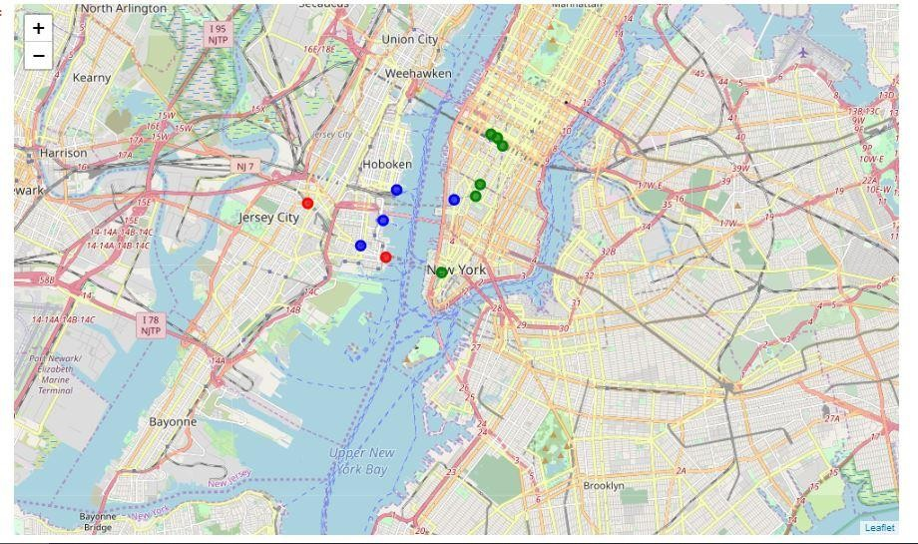
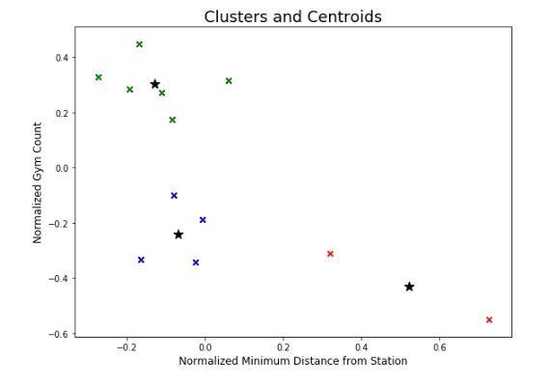
RESULT
After executing the K-Means clustering algorithm three clusters of Metro stations were created, identified by their respective colors on the following map
A graph of
the distribution of
clusters and their final centroids (center points) in black is shown below
Fig : Three Clusters of Metro Stations
Fig : Clusters and Centroids

Slide 8
RESULT (CONTD.. )
Cluster 1 [Cluster Label 0] (Green color on the map):
There are already many existing gyms in the area and the nearest gym is in most cases in a relatively short distance from the station
Cluster 2 [Cluster Label 1] (Red color on the map):
There are not many already existing gyms in the area and the nearest gym is in most cases relatively not in a short distance to the metro station
Cluster 3 [Cluster Label 2] (Blue color on the map):
Although not a prohibitive metro station to open a gym in its vicinity, there is already a fair number of gyms in the area and the nearest one is not far from the metro station.
Fig : Clusters and Centroids

Slide 9
DISCUSSION
Clusters of areas (in our case Metro stations) were identified as groups of similar in their potential locations for opening a gym
Some examples of extra factors can be :
Population density in that neighborhood
Number of business operating in that neighborhood ( people might want their workplace close to the gym )
Age
Average income of the people in that neighborhood
Property prices in that neighborhood

Slide 10
CONCLUSION
The above results can be a good starting point for a businessman who wants to set-up their gym in a new and happening city like New York. Similar methodology can be used for setting up any business, probably with customized criteria

Slide 11
THANK YOU

