Slide 1
Capstone Project Presentation

Slide 2
Exploration and Modelling of Factors Leading to Readmission of Diabetes Patients
Domain : Healthcare Analytics
Group : 4
Mentor Name : Mr. Srikar Muppidi
Team Members : 1. Faiqua Saman
2. Madhu OG
3. Nikhil Manchanda
4. Pragati Khedkar
5. Sri Hari Reddy Pydala

Slide 3
Understanding the problem
Section 1

Slide 4
Problem Definition
Problem : One of the problems faced in treatment of diabetes by the healthcare industry in U.S. is readmission of patients within 30 days, which is often due to improper diagnosis and treatment.
Importance : In 2011, American hospitals spent over $41 billion on diabetic patients who got readmitted within 30 days of discharge. Patient re-admission cost is generally more than the healthcare premium paid by the consumer especially in US healthcare industry Being able to determine factors that lead to higher readmission in such patients, and correspondingly being able to predict which patients will get readmitted can help hospitals save millions of dollars while improving quality of care.
Value Addition : We aim at building a model for the prediction of the fact that the diabetic patient will probably be re-admitted to the hospital within 30 days of discharge or not and recognizing patterns that explain re-admission so that treatment and diagnosis criteria can be improved and millions of dollars can be saved while improving quality of healthcare.

Slide 5
Overall Process Flowchart :
DATA
Pre processing
EDA
Statistical Test
Model Building(Base model)
Feature Selection
RFE
SFS
SMOTE
SMOTE
Model building
Model Building
Comparison
Final Model

Slide 6
Information about Dataset
Section 2

Slide 7
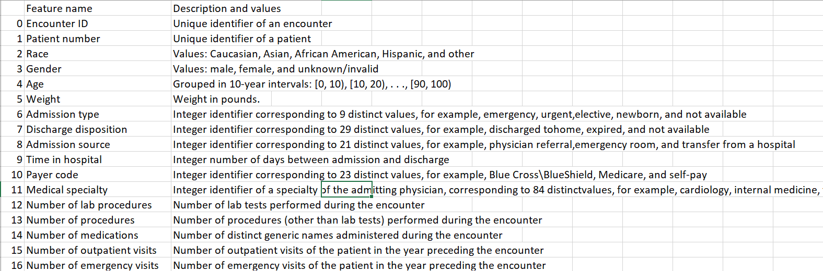
Basic Introduction to Data
Dataset - Diabetes 130-US hospitals for years 1999-2008 Data Set.
Shape - 101766 records and 50 attributes.
Variable Description -

Slide 8
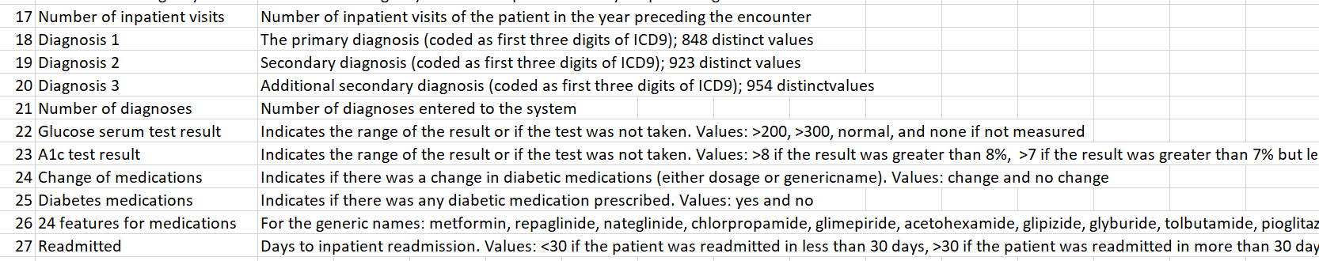
Types of columns as initially given :
Quantitative : 13 columns : admission_type_id,discharge_disposition_id, admission_source_id, time_in_hospital, num_lab_procedures, num_procedures, num_medications, number_outpatient, number_emergency, number_inpatient, number_diagnoses, encounter_id, patient_nbr,
Qualitative : 36 columns : race, gender, age, weight, payer_code, medical_specialty, diag_1, diag_2, diag_3, max_glu_serum, A1Cresult, metformin, repaglinide, nateglinide, chlorpropamide, glimepiride, acetohexamide, glipizide, glyburide, tolbutamide, pioglitazone, rosiglitazone, acarbose, miglitol, troglitazone, tolazamide, examide, citoglipton, insulin, glyburide-metformin, glipizide-metformin, glimepiride-pioglitazone, metformin-rosiglitazone, metformin-pioglitazone, change, diabetesMed
Target : readmitted

Slide 9
Summary of Pre-processing
Section 3

Slide 10
Steps of Pre-Processing
Dropping encounters which were readmitted after more than 30 days - This is done keeping in mind that according to business point of view, patients that get readmitted before 30 days is a class that needs the maximum attention. Also >30 can mean any number of days, months, or years, so this class does not seem relevant enough.
Imputation Techniques Used - Mode Imputation, Assigned Other category to NULL Values if there percentage is lesser than 3.5%.
Merged 19 out of 23 medication columns on the basis of failure in statistical tests into one column representing number of times the medicine level was changed.
Dropped some columns on the basis like, higher percentage of missing values, failure to prove significance, no relatable information for target columns.
Checked and Removed Outliers : Applied Power Transform and most of the outliers were handled.
Final categorisation of columns :
Categorical Attributes - 15 Attributes in total - race, gender, age, diag_1, diag_2, diag_3, max_glu_serum, A1Cresult, metformin, examide, citoglipton, insulin, change, diabetesMed, numchange
Quantitative Attributes - 8 Attributes in total - time_in_hospital, num_lab_procedures, num_procedures, num_medications, number_outpatient,number_emergency,number_inpatient, number_diagnoses
Target Feature - readmitted.

Slide 11
Exploratory Data Analysis
Section 4

Slide 12
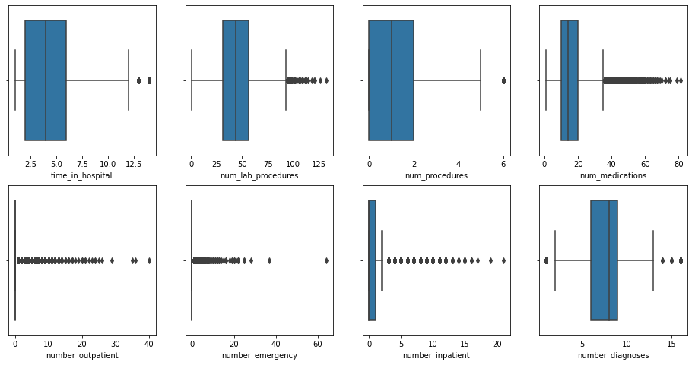
Analysing outliers using boxplot:
Most of the quantitative columns have huge number of outliers which we will treat before proceeding for modelling.

Slide 13
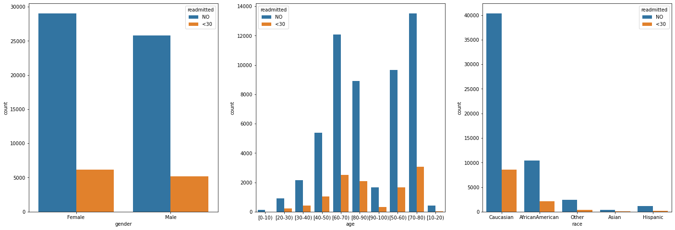
Analysing distribution of various features with respect to target column
More number of females got readmitted
People between age group 70-80 got readmitted more

Slide 14
Minimum amount of encounters are in these categories [Asian] with value 0.62%.
Maximum amount of encounters are in these categories [Caucasian] with value 74.77%.

Slide 15
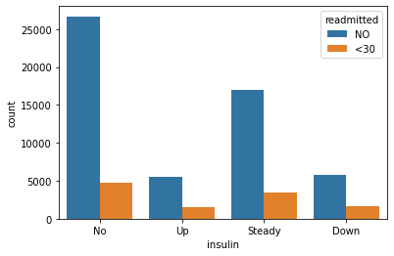
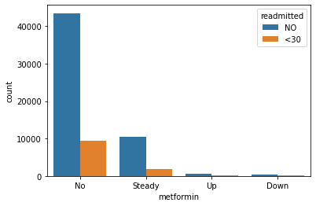
Analysing important medications with respect to target column
Both of these are most prescribed drugs. People who were not prescribes insulin and metaformin got readmitted more. Even if its dosage was kept steady then also more people got readmitted.

Slide 16
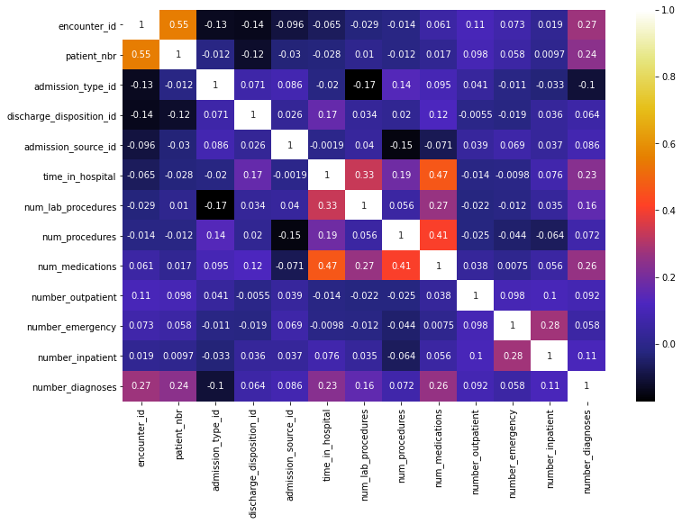
Heatmap Visualising Correlation
Most of the pairs have a very moderate correlation. Overall multicollinearity is very low, so PCA won’t be effective. Hence we have not used that technique.

Slide 17
Transforms and tests
Section 5

Slide 18
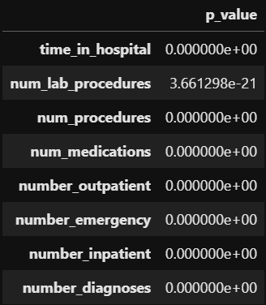
Shapiro test for normality
Hence no quantitative variable is having normal distribution.
So we opt for Non-parametric tests

Slide 19
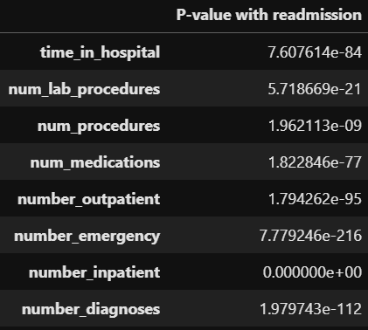
MannWhitneyu Test for Significance
All passed the test. Hence all are significant.

Slide 20
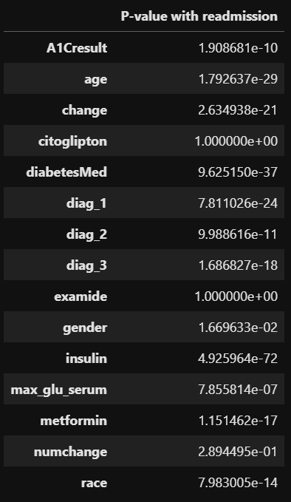
ChiSquare Test for Significance
Other than citoglipton, examide and numchange all are significant

Slide 21
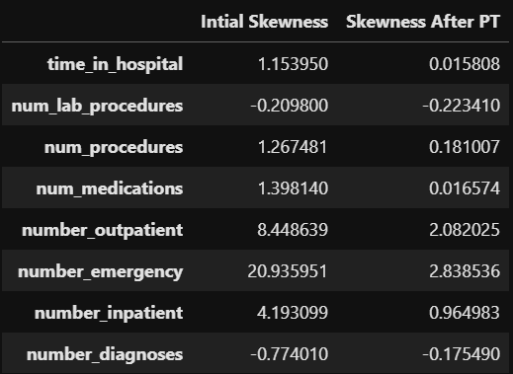
Effect of Power Transform on Skewness
After transform most of the attributes have skewness between the range of -0.5 to 0.5, which is a significant improvement.

Slide 22
MODELLING
Section 6

Slide 23
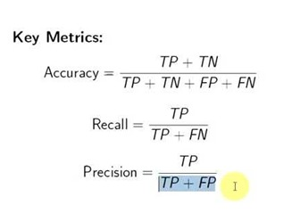
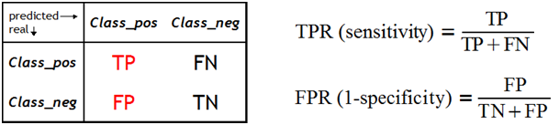
Metrics that can be used for evaluation of Models
Confusion Matrix: a table showing correct predictions and types of incorrect predictions.
Precision: the number of true positives divided by all positive predictions. Precision is also called Positive Predictive Value. It is a measure of a classifier’s exactness. Low precision indicates a high number of false positives.
Recall: the number of true positives divided by the number of positive values in the test data. The recall is also called Sensitivity or the True Positive Rate. It is a measure of a classifier’s completeness. Low recall indicates a high number of false negatives.
FPR and TPR :

Slide 24
Models based on all features
Used all the final features.
Random Forest is our Base Model.
Gboost is best among all these.
Model | Accuracy | Precision | Recall | Bias error | Variance error
RF | 0.763276 | 0.167768 | 0.097173 | 0.027683 | 0.001456
LogReg | 0.825137 | 0.151786 | 0.005006 | 0.011802 | 0.000952
NB | 0.829063 | 0 | 0 | 0.018715 | 0.001374
Boosted RF | 0.171339 | 0.170939 | 0.999411 | 0.02679 | 0.001704
GBoost | 0.422761 | 0.153324 | 0.525618 | 0.020799 | 0.000896
CatBoost | 0.574873 | 0.141641 | 0.293875 | 0.013991 | 0.000415

Slide 25
Recursive Feature Elimination
Applied Smote to handle imbalance of Categories of target variable.
Based on RFE we are going to use these 31 features : time_in_hospital, num_lab_procedures, num_procedures,
num_medications, number_outpatient, number_emergency, number_inpatient, number_diagnoses,
race_Caucasian, race_Other, age_[30-40), age_[40-50), age_[50-60), age_[70-80), age_[80-90), diag_1_Diabetes,
diag_1_Genitourinary, diag_1_Injury, diag_1_Neoplasms, diag_1_Respiratory, diag_2_Diabetes,diag_2_Genitourinary,
diag_2_Respiratory,diag_3_Diabetes, diag_3_Genitourinary, max_glu_serum_None, A1Cresult_Norm,metformin_No,
insulin_Steady, insulin_Up, diabetesMed_Yes
Model | Accuracy | Precision | Recall | Bias error | Variance error
LogReg | 0.81497 | 0.123656 | 0.013545 | 0.044273 | 0.003238
RF | 0.591886 | 0.144324 | 0.281508 | 0.062196 | 0.003361
NB | 0.829063 | 0 | 0 | 0.054718 | 0.005359
Boosted RF | 0.560175 | 0.140318 | 0.306832 | 0.058628 | 0.004581
GBoost | 0.727639 | 0.129732 | 0.103946 | 0.054718 | 0.005359
CatBoost | 0.752554 | 0.127451 | 0.076561 | 0.048876 | 0.004191

Slide 26
Sequential Feature Selector
Applied Smote to handle imbalance of Categories of target variable.
Based on SFS we are going to use these 17 features : race, gender, age, num_medications, number_outpatient, numchange, number_emergency, number_inpatient, diag_1, max_glu_serum, A1Cresult, metformin, examide, citoglipton, insulin, change, diabetesMed
Model | Accuracy | Precision | Recall | Bias error | Variance error
LogReg | 0.66 | 0.26 | 0.5 | 0.15 | 0.003
RF | 0.67 | 0.22 | 0.35 | 0.18 | 0.001
NB | 0.69 | 0.23 | 0.34 | 0.247 | 0.004
Boosted RF | 0.7 | 0.23 | 0.31 | 0.13 | 0.001
GBoost | 0.65 | 0.25 | 0.49 | 0.247 | 0.004
CatBoost | 0.752554 | 0.127451 | 0.076561 | 0.048876 | 0.004191

Slide 27
Selection of Final Model
On the basis of recall and Accuracy Gboost with all features seem to be best model.
Final Model | Accuracy | Precision | Recall | Bias error | Variance error
GBoost | 0.422761 | 0.153324 | 0.525618 | 0.020799 | 0.000896

Slide 28
Recommendations
Healthcare centres (especially the ones where readmission rate is high ) can implement this ML predictive modelling technique to check which patient has high chance of getting readmitted thereby prioritising their treatment thus reducing the patient readmission rate and improving the quality of service provided.
Flaws in the dataset (mentioned earlier like the missing values in weight column) can also be reduced if proper track of patient information is considered by the hospital.

Slide 29
Limitations of solution in real world
Accuracy Score: Accuracy of the final model is 0.422761, so the predicted output does not have 100% surety to be correct.
Number of False negatives: We have 8.1% of false negatives in our final model. It is extremely dangerous to have false negatives in the model output (especially in healthcare domain) because this shows that our model may miss out on detecting the disease (here the chance of readmission)
Number of False positives: We have 49% of false positives in our final model. This is not as bad as false negatives, but it does have a disadvantage that if a person if falsely detected with chance of getting readmitted, he/she would unnecessarily consume the resources at hospital. Also, the money spent by the patient and hospital in this case will be of no use.

Slide 30
References
False Positive v/s False negative: https://blogs.ams.org/mathgradblog/2016/08/06/false-positive-vs-false-negative/#:~:text=A%20false%20positive%20can%20lead,a%20disease%20has%20been%20ignored.
SFS : http://rasbt.github.io/mlxtend/user_guide/feature_selection/SequentialFeatureSelector/
Class imbalance treatment : https://www.analyticsvidhya.com/blog/2020/07/10-techniques-to-deal-with-class-imbalance-in-machine-learning/
Why precision score should be used in case of high data imbalance : https://towardsdatascience.com/what-metrics-should-we-use-on-imbalanced-data-set-precision-recall-roc-e2e79252aeba
Dealing with imbalanced data : https://www.geeksforgeeks.org/ml-handling-imbalanced-data-with-smote-and-near-miss-algorithm-in-python/

Slide 31
Thanks!

