Slide 1
Project Name: The Rising Sports Club (Sports Complex Management System)
Project Member:
Raghav Patil 210943120065
Nikhil Mane 210943120060
Shubham Singh 210943120100
Shubham Torkad 210943120111

Slide 2
Introduction:
A sport club management system provides and manages various club activities such as member registration, registration for various sports, getting sports details and finally getting score card and more. The sports club management system software is a system that manages the entire club activities and provides respective functionality for various types of visitors. It allows normal users to avail for club membership, to subscribe for desired game and achieve the membership through registration. The system is with built in security with two factor authentication.
This is a crucial factor in having an online sports club website, that keeps itself fresh and live and updated at all times. This is sport club management system...to be well organized sports activities it needs to be user friendly as well as well managed.

Slide 3
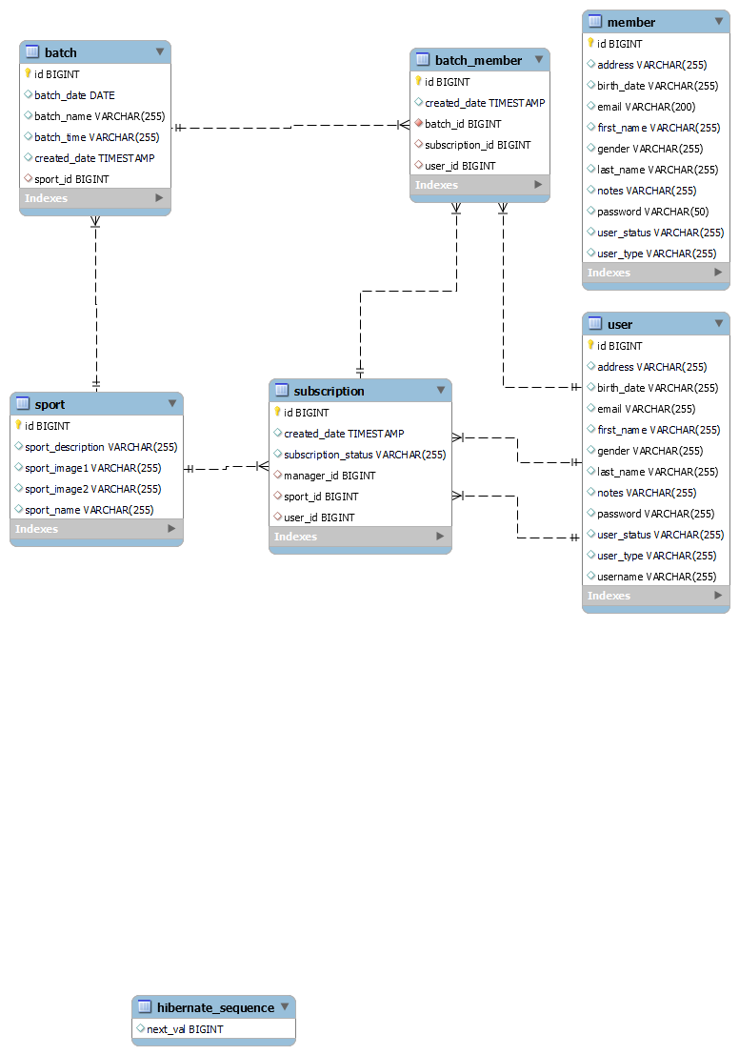
ERD:

Slide 4
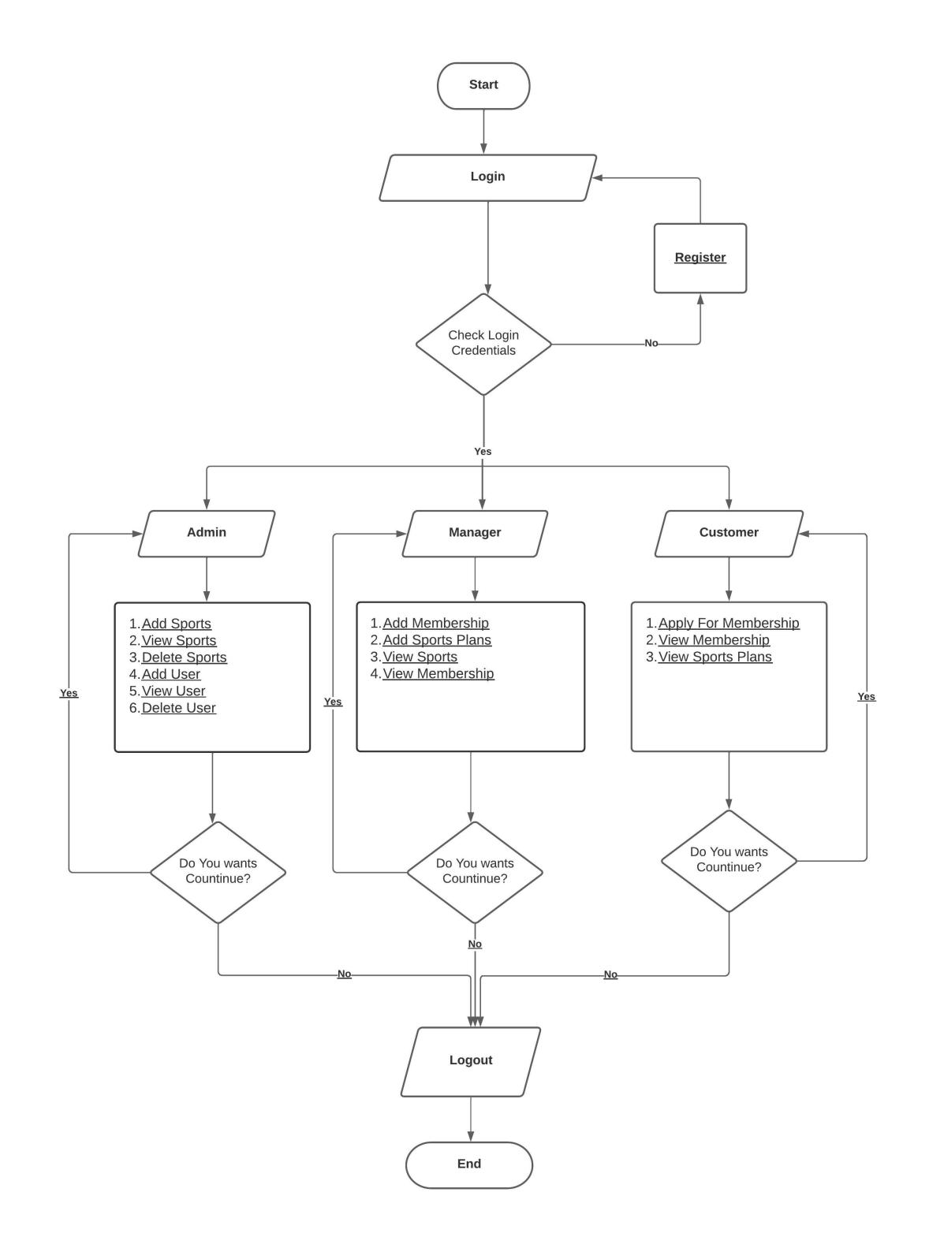
Flowchart:

Slide 5
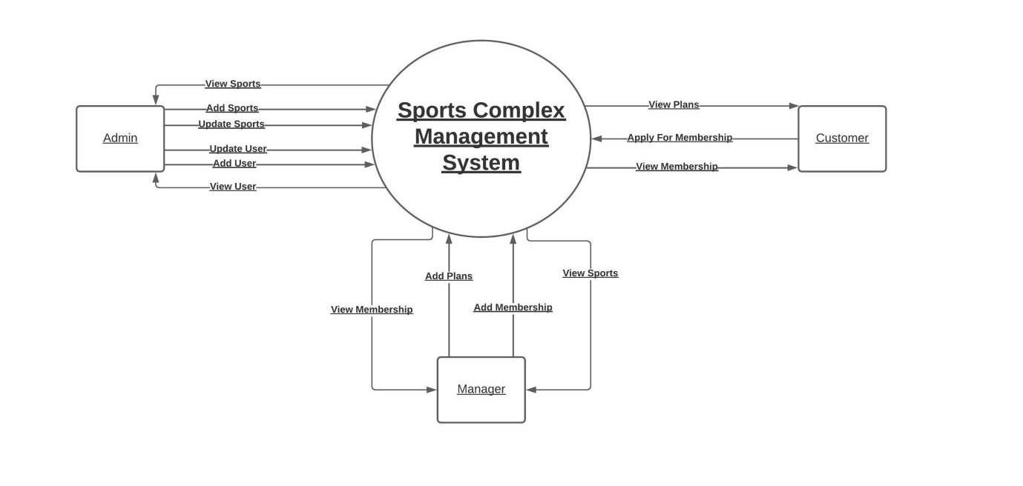
DFD:

Slide 6
Flow Of Project:
This system is being with three-layer management including three major roles for better safety, convenience & speed.
User: after login user will able to see the all sports which are available in club. When user will click on particular sport then he will get the details of that sport like offers, batch timings, fees if user wants to proceed further, he can subscribe to that sport.
Admin: Admin can check and verify various member details. He can approve or disapprove the membership. After user subscribing for particular sport, admin will transfer this to manager. If manager agree and accept then admin can add that user to that sport.
Manager: he will manage the sport created by admin, e.g., creating new batches, new offers according to season, scheduling sports and launching them...

Slide 7
Thank You!

