Slide 1
Geographical Original of Music
Group - 11
Nikhil Dupally, S20170010045.
Yashwanth Kikkuri, S20170010072.

Slide 2
Problem Statement: → Different music styles and genres are known to have unique sound wave characteristics. It is also speculated that different geographic regions have their own unique music style with its own unique characteristics. Instances in this dataset contain audio features extracted from 1059 wave files. The task associated with the data is to predict the geographical origin of music.

Slide 3
Dataset description:
→ The dataset is present in two files, where each file corresponds to a different feature sets.
→ Both files contain the audio features of 1059 tracks.
→ In the 'default_features_1059_tracks.txt' file, the first 68 columns are audio features of the track, and the last two columns are the origin of the music, represented by latitude and longitude.
→ In the 'default_plus_chromatic_features_1059_tracks.txt' file, the first 116 columns are audio features of the track, and the last two columns are the origin of the music.

Slide 4
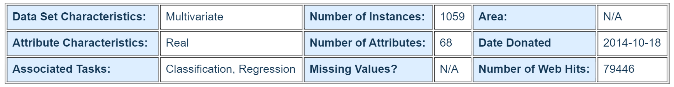
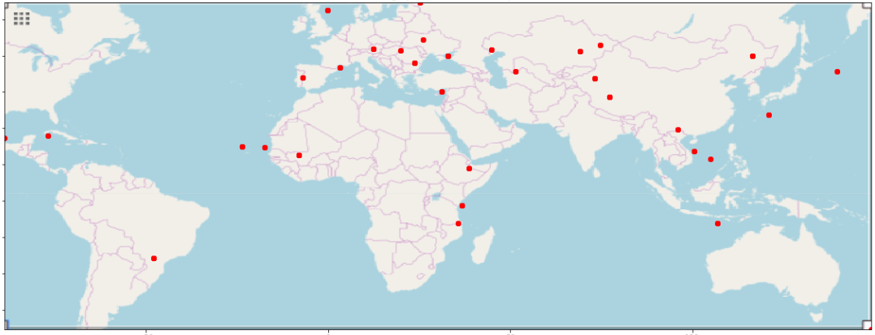
Data Description
Latitudes and longitudes locations on map

Slide 5
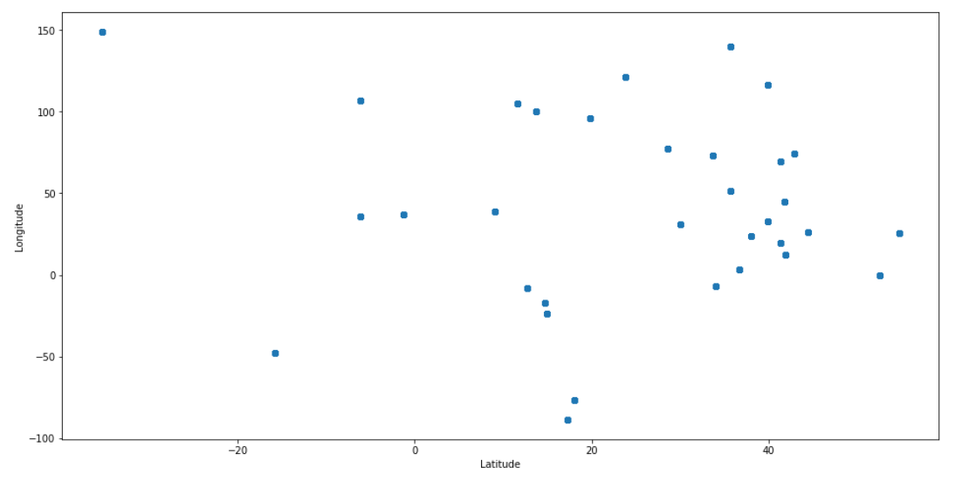
Methodology:
Missing values:
→ Checked for any missing values in our dataset. There are no missing values.
Outliers Detection :
Z-score:
→ Calculated Z-scores for all the data points. Took a threshold of 3.
All thee data points for which Z-score is greater than 3 or less than -3 are removed.

Slide 6
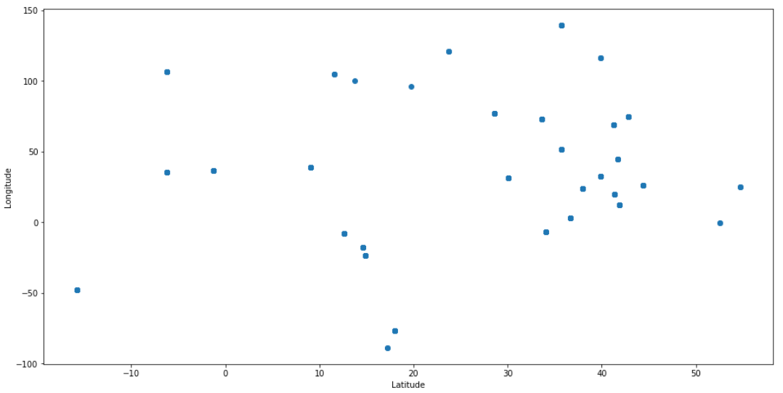
Inter Quartile Range:
→ Calculated Inter-Quartile range for the data --→ Any value less than (Q1 - 1.5 * IQR)) |(data > (Q3 + 1.5 * IQR) is suspected as outlier.
→ Q1 = first quartile , Q3 = third Quartile.

Slide 7
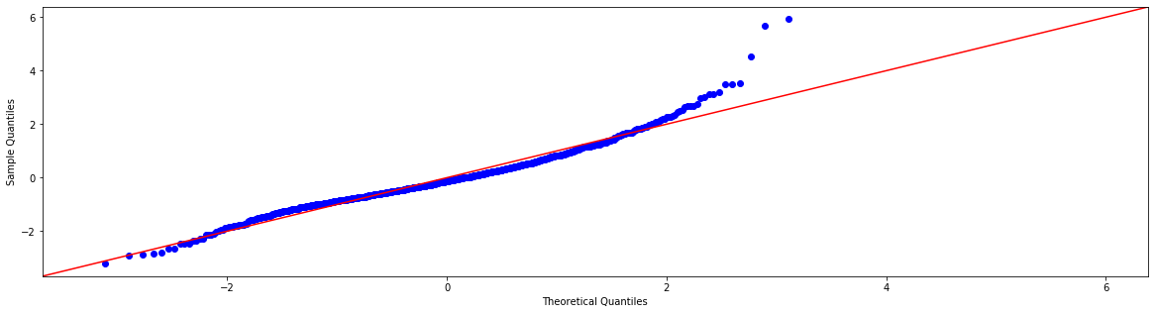
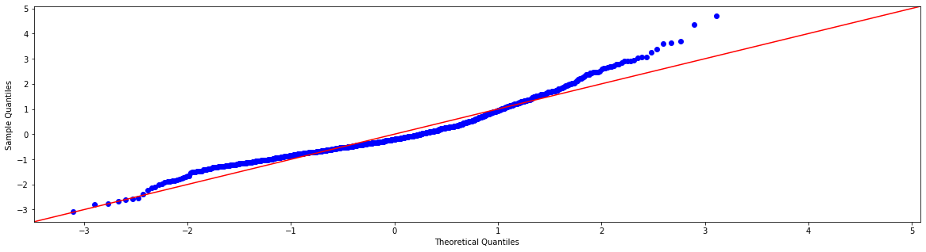
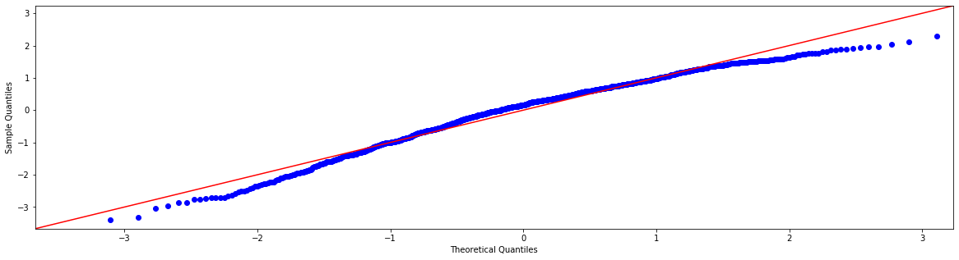
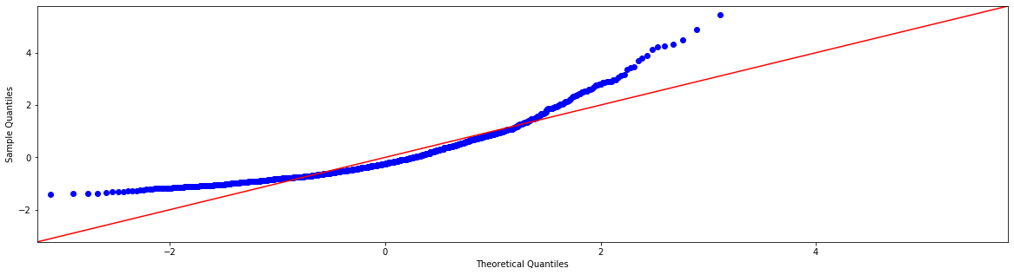
QQ plot
→ For features,
4,25,5,65 respectively

Slide 8
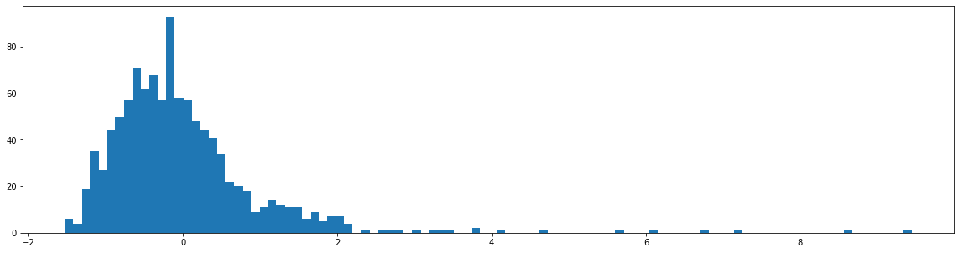
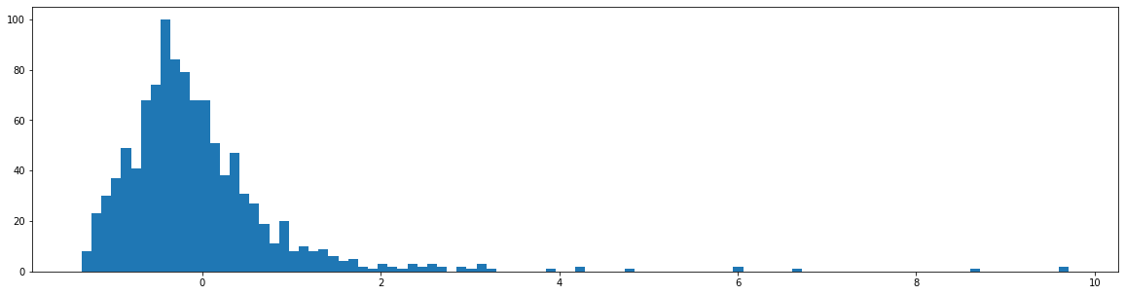
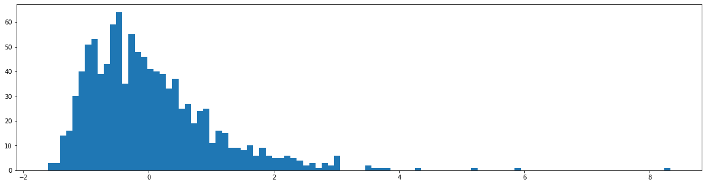
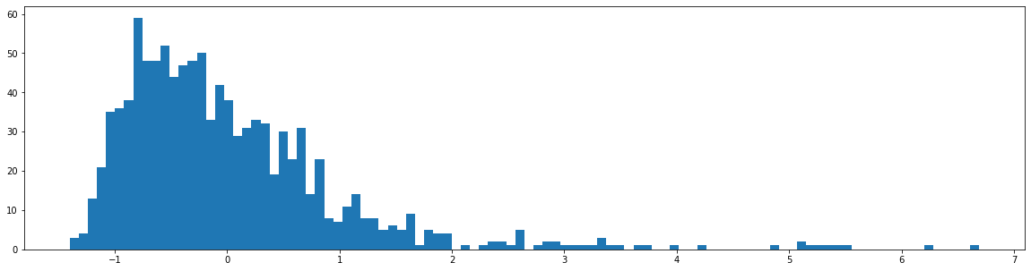
Histograms
→ For features,
1,19,63,45 respectively

Slide 9
Correlation:
Factor Analysis:
→ We performed factor analysis and found the no of relevant features(20).
→ We used eigen values of correlation for this.
Principal Component Analysis:
→ Applied PCA for different principal components varying from 1 to 68 and calculated the ratio of variance explained.

Slide 10
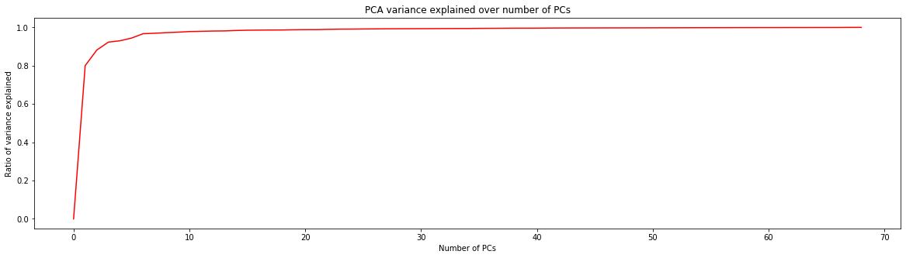
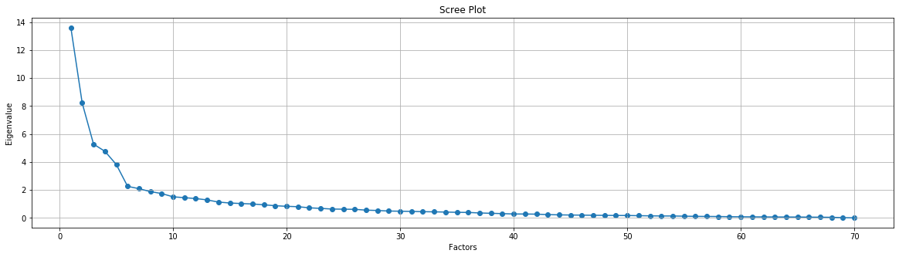
PCA
Factor Analysis

Slide 11
Feature Selection:
→ We used Python's RFE function to perform backward selection and the PCA function to reduce dimensionality by minimizing the lost variance.
→To make sure that we aren't making any assumptions in terms of which hyperparameters work best, we will apply grid search for each feature selection iteration. We can then use the best accuracy obtained for a specific number of features for each estimator.
→We considered the following estimators - random forest, SVM (SVC) with a linear kernel and Logistic Regression. K-nearestneighbours is another possible estimator, but because it does not perform well in high dimensionality, it is not included during the feature selection process.

Slide 12
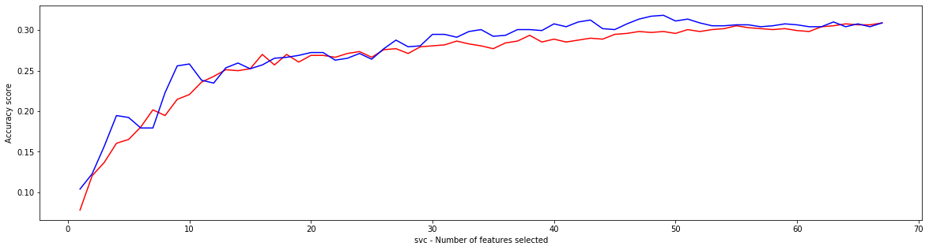
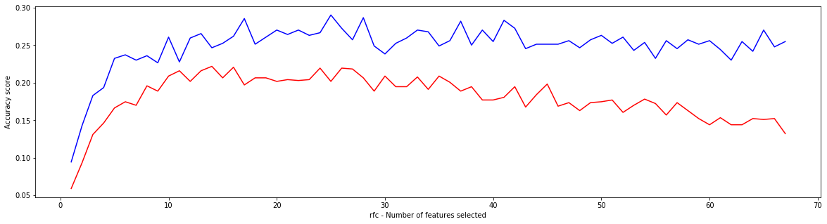
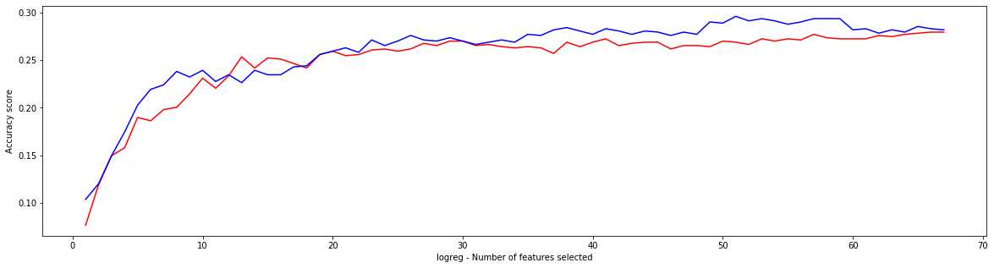
The red lines represent the PCA dimension reduction and the blue lines represent RFE for the different estimators used.

Slide 13
Model Building:
→ We used the above obtained features for different estimators.
→ Estimators: SVM , Random Forest Classifier , KNN.
From all the above estimators we found the best cross validation scores.
Accuracies of all the estimators for different cluster values are calculated.
For svc the best cv accuracy score is 0.3336777586448639
For rfc the best cv accuracy score is 0.35146589156457575
For knn the best cv accuracy score is 0.3548338174982911

Slide 14
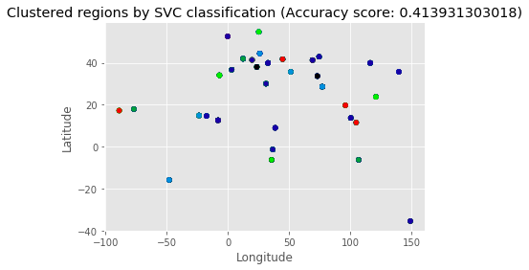
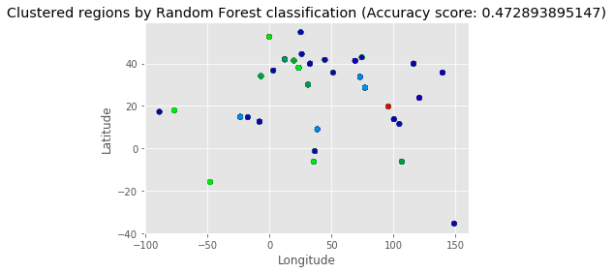
Details of best estimators:
Clustered regions by SVC classifier:
Clustered regions by rfc classifier:

Slide 15
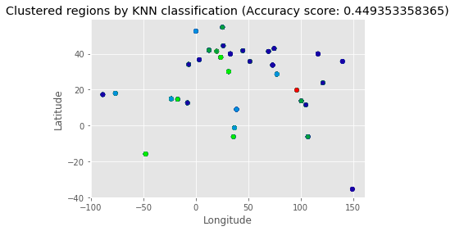
Clustered regions by KNN classifier:

Slide 16
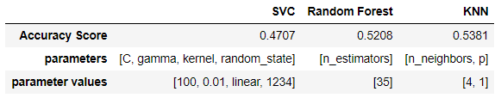
Results:
After Applying bagging on decision trees, the accuracy is
‘0.541085’.

Slide 17
Conclusions:
→ It is really difficult to classify songs by geographic location. In reality, it is a mixture of supervised and unsupervised learning. Feature selection makes it an even more demanding task.
→ Seeing that geographic locations can be mapped out, it might be a good idea to incorporate distances from the correct clusters in the accuracy calculation - it would be more acceptable if a wrong cluster has been selected that is on the same continent as the correct cluster, than choosing a cluster on the other side of the world.
→ In addition, exploring different sound wave features that have not been included in this dataset might results in higher accuracy scores. We do not have a lot of information about the features used in this model, but it would be fair to ask whether the features that we are using are sufficiently explaining the variance in song characteristics. It might be that these features aren't capturing the essential musical differences between regions.

Slide 18
Reference:
→Fang Zhou, Claire Q and Ross. D. King. Predicting the Geographical Origin of Music, ICDM, 2014.
→https://archive.ics.uci.edu/ml/datasets/Geographical+Original+of+Music

