Slide 1

Trending Movie Trailers and Rating System
CS-GY 9223 : Cloud Computing
Nikhil Nar - ncn252
Suraj Gowardhan Gaikwad - sgg339
Chinmay Wyawahare - cnw282

Slide 2
What’s Shazam?
Introduces an extraordinary story or transformation
Shazam is a source that allows users to explore the world of movies and decide what to watch
Along with trailers of the movies, the users are also given a choice to view the trailers of the Top-rated movies or the most trending movies

Slide 3
AWS Services

Slide 4













Amazon EMR
Amazon ElasticSearch
AWS SAM

Slide 5
Architecture

Slide 6
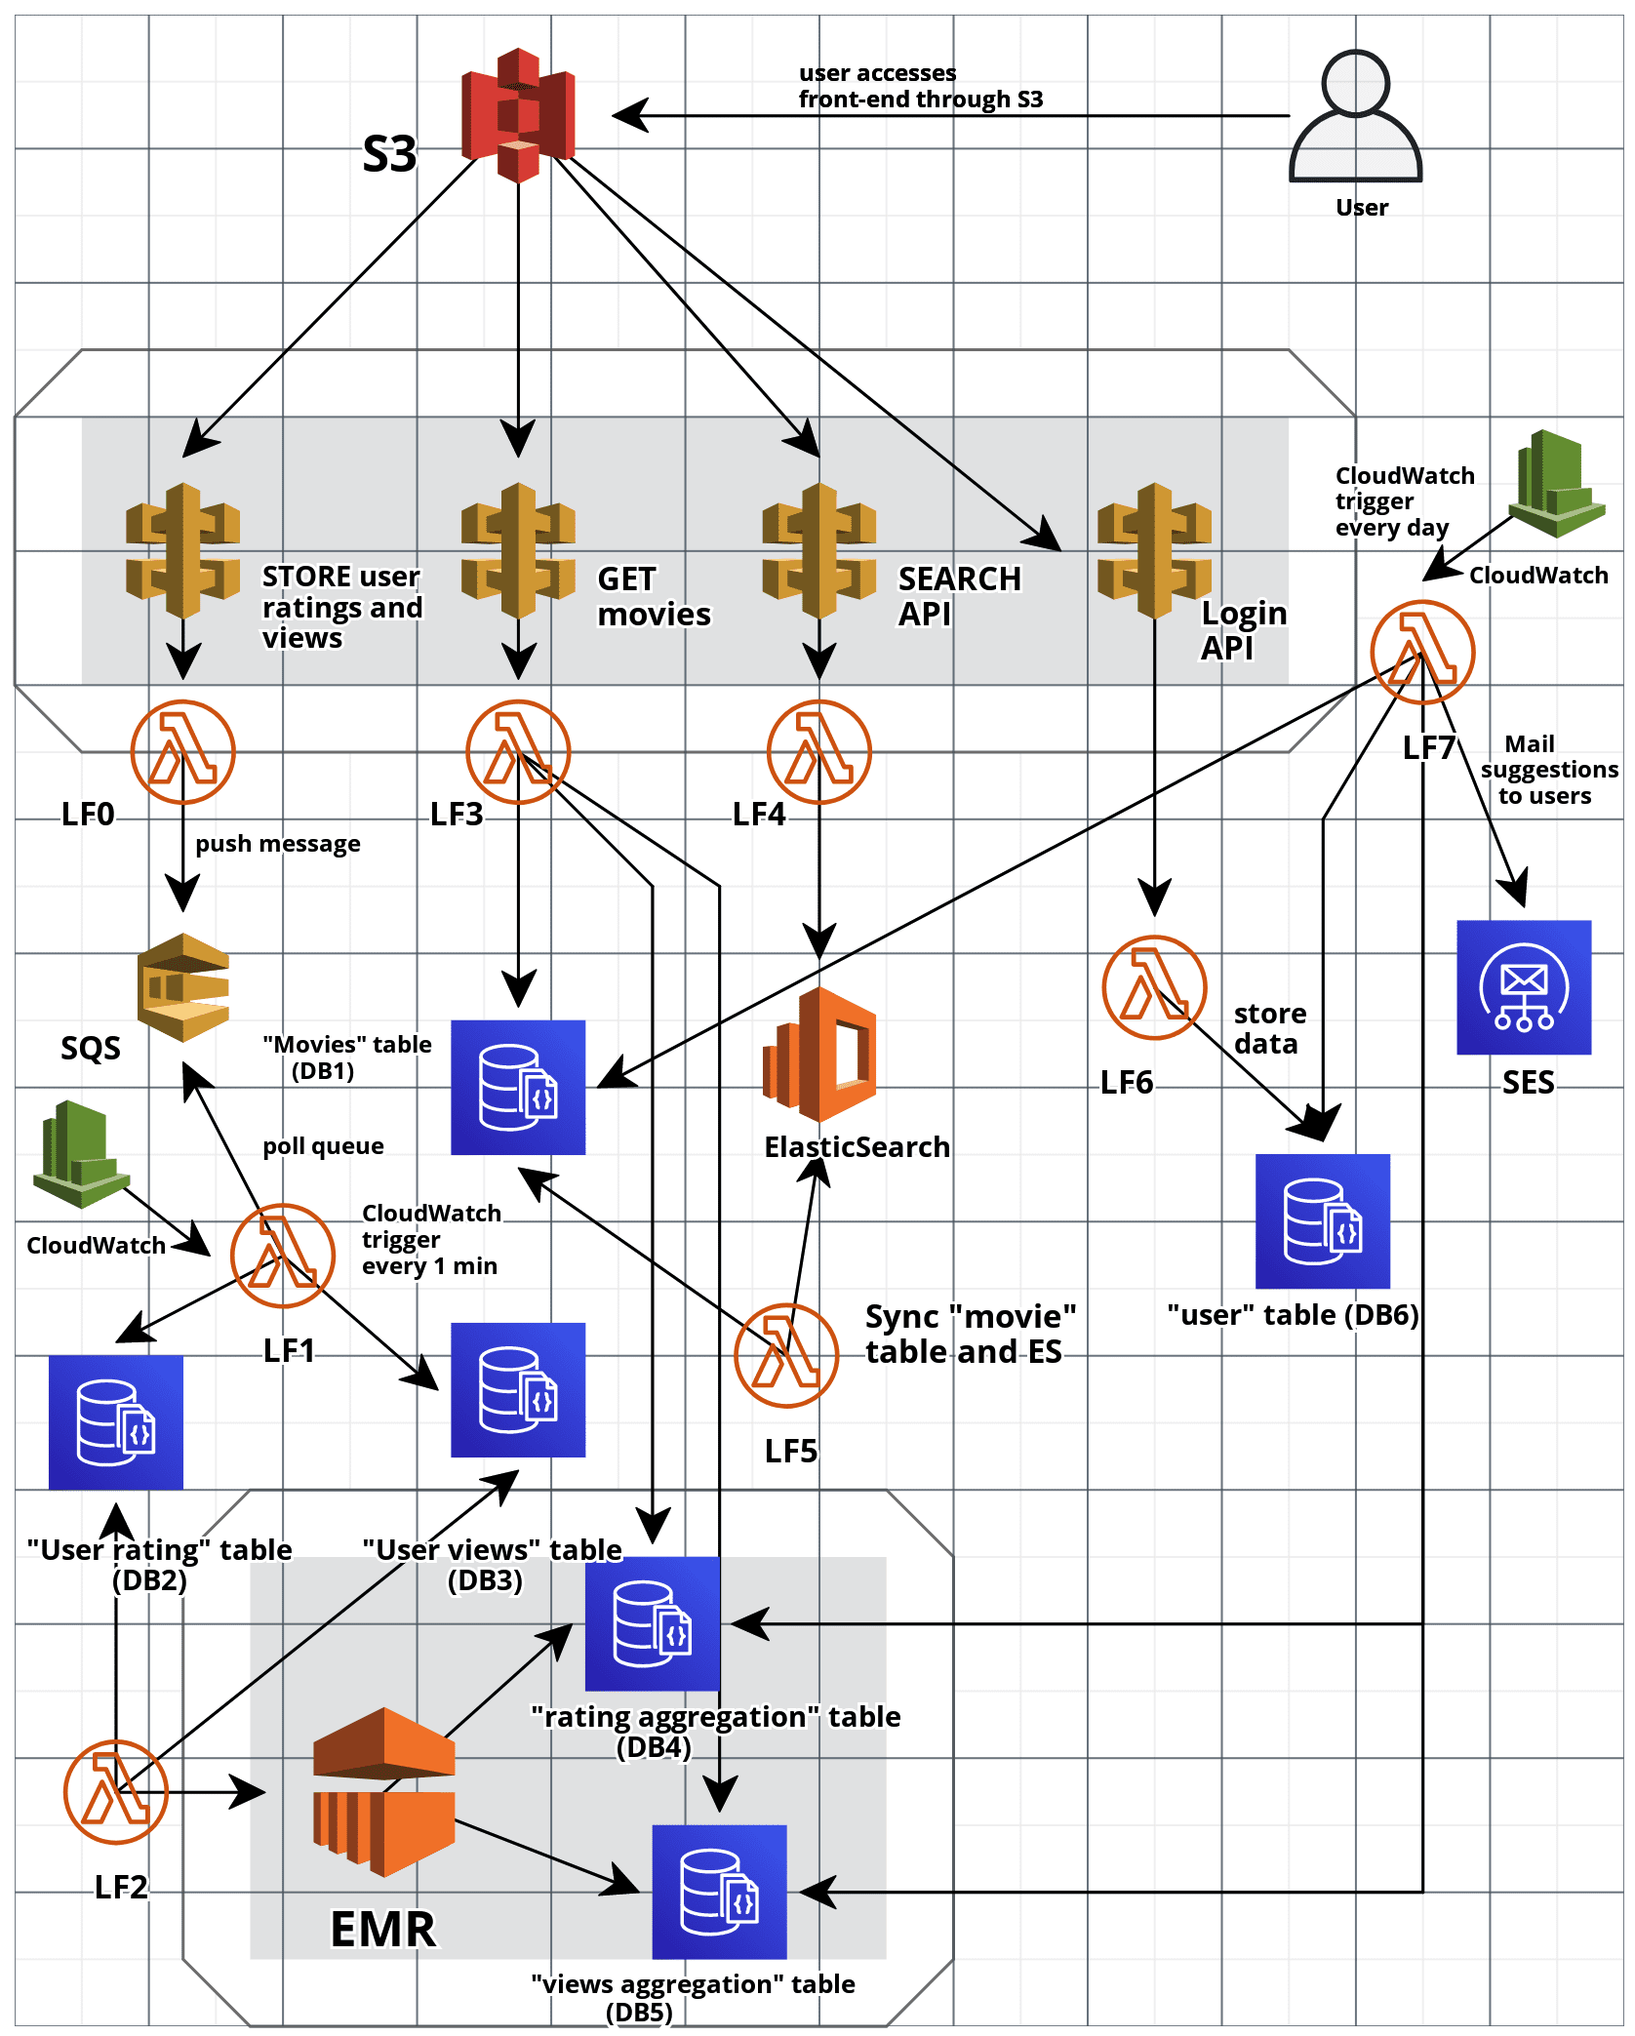
Shazam Architecture

Slide 7
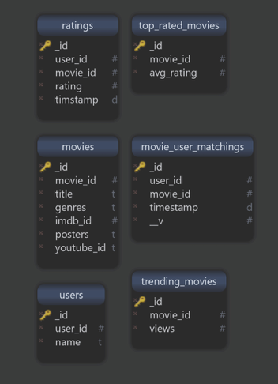
MongoDB schema

Slide 8
Future Scope
Based on the location of the user, we could accommodate a feature to show the nearby shows of upcoming/released movies
Localized trending videos based on the user’s location
AWS Cognito for user data profiling enabling easy login to the application
Get personalized recommendations based on the user preferences using AWS SNS

Slide 9
Shazam 2.0

Slide 10
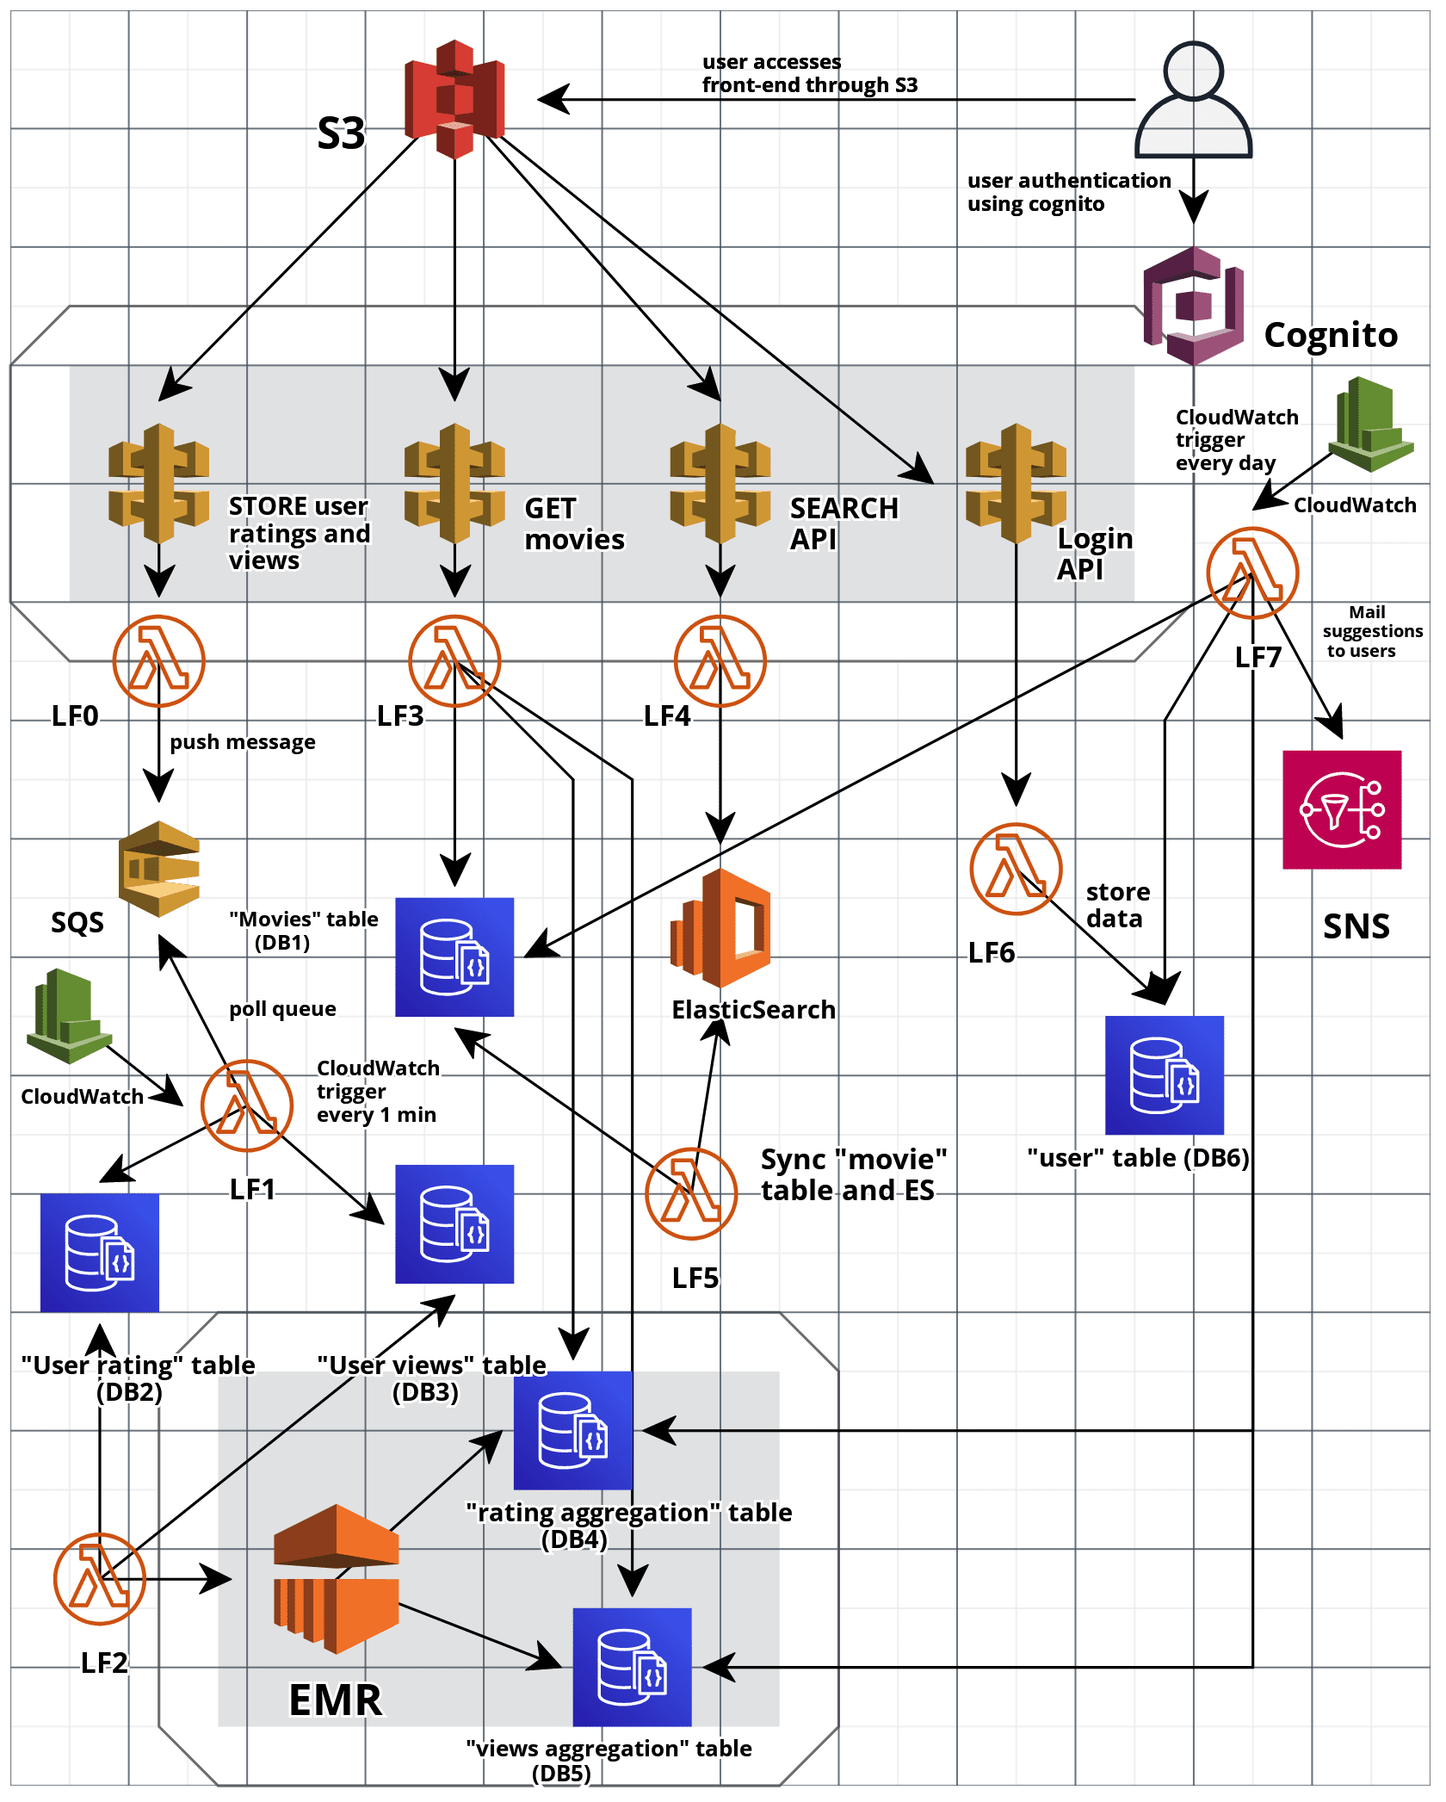
Shazam Architecture 2.0

