Slide 1
PPML Project Semi-Honest 4PC Q2 Protocol Implementation
Nikhil Pappu and Raja Rakshit

Slide 2
MPC for Small Number of Parties
Allows for simpler and more efficient protocols.
Are able to model a large number of real-life MPC applications.
E.g.: Statistical data analysis, email-filtering, distributed credential encryption, Danish sugar beet auction.

Slide 3
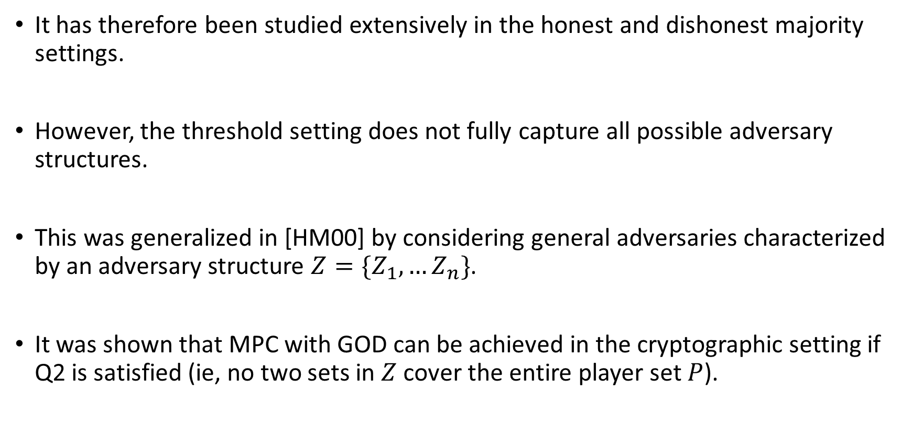
General Adversaries
It has therefore been studied extensively in the honest and dishonest majority settings.
However, the threshold setting does not fully capture all possible adversary structures.
This was generalized in [HM00] by considering general adversaries characterized by an adversary structure $Z=\{Z_{1}, …Z_{n}\}$.
It was shown that MPC with GOD can be achieved in the cryptographic setting if Q2 is satisfied (ie, no two sets in $Z$ cover the entire player set $P$).

Slide 4
General Adversaries
Efficient protocols for small number of parties tolerating general adversary structures have not been shown before.
We consider the 4PC setting. In this setting, honest majority implies only a single party can be corrupted.
Dishonest majority protocols have the disadvantage of relying on public key primitives. Also, it is impossible to achieve fairness or GOD.
However, if we consider Q2 adversary structures, we can achieve GOD using only symmetric key primitives while tolerating a stronger class of adversaries than the honest majority case.

Slide 5
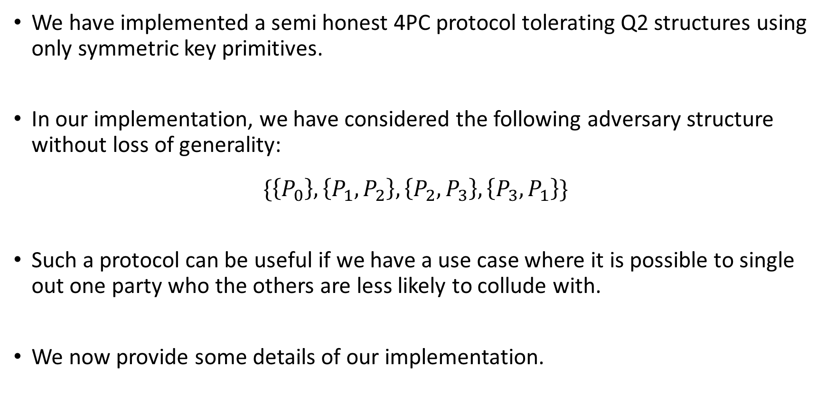
Our Implementation
We have implemented a semi honest 4PC protocol tolerating Q2 structures using only symmetric key primitives.
In our implementation, we have considered the following adversary structure without loss of generality:
$$\{\left\{P_{0}\right\}, \left\{P_{1},P_{2}\right\}, \left\{P_{2},P_{3}\right\}, \left\{P_{3},P_{1}\right\}\}$$
Such a protocol can be useful if we have a use case where it is possible to single out one party who the others are less likely to collude with.
We now provide some details of our implementation.

Slide 6
Implementation Details
Tools Used
Our implementation is written in C++.
We have used the cryptoTools library for performing networking and cryptographic (AES) operations.
We also used the Eigen library to perform matrix computations.
Our protocol does not directly depend on the code of ladnir/aby3 but shares similarities with it.

Slide 7
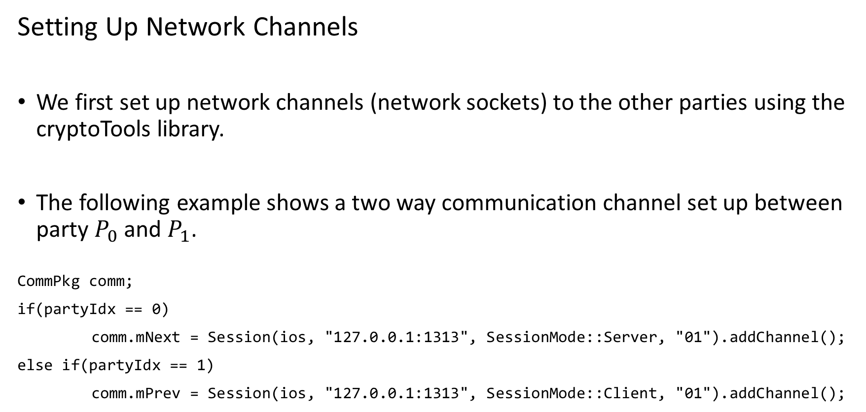
Implementation Details
Setting Up Network Channels
We first set up network channels (network sockets) to the other parties using the cryptoTools library.
The following example shows a two way communication channel set up between party $P_{0}$ and $P_{1}$.
CommPkg comm;
if(partyIdx == 0)
comm.mNext = Session(ios, "127.0.0.1:1313", SessionMode::Server, "01").addChannel();
else if(partyIdx == 1)
comm.mPrev = Session(ios, "127.0.0.1:1313", SessionMode::Client, "01").addChannel();

Slide 8
Implementation Details
Setting Up AES keys
Once the communication channels were set up, we had to establish some common randomness to be used in the protocols.
We implemented the functionality in the init() function of the class Sh4Encryptor which contains code for sharing and reconstruction.
Sh4Encryptor enc;
enc.init(partyIdx, comm, sysRandomSeed());
We passed the same random seed to pairs of parties who require common randomness. The random seed is used as the key for generating random values using the cryptoTools’ implementation of AES.

Slide 9
Implementation Details
The Share Data Type
Each party’s sharing in our sharing scheme consists of two field elements. We therefore defined a data type for the share of a party and overrided the basic operators to compute these shares.
struct si64
{
using value_type = i64;
std::array<value_type, 2> mData;
si64& operator=(const si64& copy);
si64 operator+(const si64& rhs) const;
si64 operator-(const si64& rhs) const;
si64 operator*(const int i) const;
value_type& operator[](u64 i) { return mData[i]; }
const value_type& operator[](u64 i) const { return mData[i]; }
};

Slide 10
Implementation Details
Sharing Functions
To perform the actual sharing of values, we make use of two Sh4Encryptor member functions localInt() and remoteInt().
The localInt() function is executed by the party that wants to share its input.
All the other parties run remoteInt() which involves sending some information to the party that wants to share as well as receiving the shares.
si64 sh;
if(partyIdx == 0)
sh = enc.localInt(comm, 60); //channels and input to be shared
else
sh = enc.remoteInt(comm, 0); //channels and index of sharing party

Slide 11
Implementation Details
Sharing Functions
The implementation of the localInt() and remoteInt() includes sending and receiving values using the communication channels.
comm.mPrev.asyncSendCopy(ret[0]);
comm.mPrev.recv(ret[1]);
Each call to the localInt() and remoteInt() functions calls a getShare() function.
This function essentially returns the random ciphertext obtained from AES using the common random seed. The AES function is called everytime the previously generated randomness gets used up over the course of multiple sharings.

Slide 12
Implementation Details
Other Functions
The multiplication and reconstruction functions are implemented in a similar fashion.
The multiplication function takes the communication channels, the shares of a and the shares of b and returns the shares of c. Its been implemented in a separate class Sh4Evaluator.
The reveal function takes the communication channels and the shares as parameters and returns the reconstructed integer value.
For implementing ML algorithms, we need to deal with matrices. The above protocols for sharing, rec and mul were modified using a sharing matrix data type. The matrix computations are done using the Eigen library so that they are optimized.
Computing a dot product requires only one multiplication operation as the parties compute shares after multiplying and adding up all the individual values.

Slide 13
Implementation Details
Asynchronous Programming
Asynchronous programming increases the throughput by utilizing multithreading.
Consider this problem:
If multiple sharing functions are called one after the other and if each of these functions has to wait to receive a value from an other party, then these functions will essentially block the computation and will execute only after the previous one finishes execution even though the computations are independent.
We can use asynchronous programming for this.

Slide 14
Implementation Details
Asynchronous Programming
auto fu = comm.mPrev.asyncRecv(dest[1]);
The code which waits to receive from another party will now be run in a different thread.
At a later point, we can call
fu.get();
This waits for the child thread to complete and obtains its returned value.
The advantage here is that if we use asyncRecv and call the .get() function for all of the sharing functions at a later point, then the rest of the computations in the functions can run faster as the bottleneck is removed.

Slide 15
Conclusion and Future Work
The code can be found at https://github.com/NikhilPappu/ppmlCode.
We tested the working of our code for small manually coded circuits by using separate threads for all 4 parties as we needed all of them to run in parallel.
Note that this is not a secure implementation and is only meant for demonstrating the working or for benchmarking of protocols.
Future work includes implementing floating point operations and a truncation protocol which are immediate extensions and allow us to perform linear regression.
Further extensions would involve making the involved protocols maliciously secure and boolean sharings and arithmetic boolean switching to implement logistic regression.

