Slide 1
Information Storage and Management

Slide 2
UNIT I - Introduction to Information Storage and Management
Introduction to Information Storage and Management: Storage System Environment, Information Storage, Evolution of Storage Technology and Architecture, Data Center Infrastructure, Key Challenges in Managing Information, Information Lifecycle Components of Storage System Environment, Disk Drive Components, Disk Drive Performance, Fundamental Laws Governing Disk Performance, Logical Components of the Host, Application Requirements and Disk Performance.
…Briefly described in UNIT III

Slide 3
Components of a Storage System Environment
The three main components in a storage system environment the host, connectivity, and storage are described in this section.

Slide 4
Host
Users store and retrieve data through applications. The computers on which these applications run are referred to as hosts.
Hosts can range from simple laptops to complex clusters of servers.
A host consists of physical components (hardware devices) that communicate with one another using logical components (software and protocols).
Access to data and the overall performance of the storage system environment depend on both the physical and logical components of a host .

Slide 5
Physical Components
Central processing unit (CPU)
Storage, such as internal memory and disk devices
Input/output (I/O) devices
CPU
Arithmetic Logic Unit (ALU)
Control Unit
Register
Level 1 (L1) cache

Slide 6
Storage
Random Access Memory (RAM)
Read-Only Memory (ROM)
Hard disk (magnetic)
CD-ROM or DVD-ROM (optical)
Floppy disk (magnetic)
Tape drive (magnetic)
I/O Devices
User to host communications
Host to host communications
Host to storage device communications

Slide 7
Connectivity
The discussion here focuses on the connectivity between the host and the storage device.
The components of connectivity in a storage system environment can be classified as Physical and Logical.
The physical components are the hardware elements that connect the host to storage and the logical components of connectivity are the protocols used for communication between the host and storage.

Slide 8
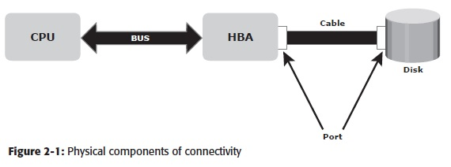
Physical Components of Connectivity

Slide 9
  The bus is the collection of paths that facilitates data transmission from one part of a computer to another, such as from the CPU to the memory.
  The port is a specialized outlet that enables connectivity between the host and external devices.
  Cables connect hosts to internal or external devices using copper or fiber optic media.
  Physical components communicate across a bus by sending bits (control, data, and address) of data between devices.
  These bits are transmitted through the bus in either of the following ways:
  Serially
  In parallel

Slide 10
Logical Components of Connectivity
The popular interface protocol used for the local bus to connect to a peripheral device is peripheral component interconnect (PCI). The interface protocols that connect to disk systems are Integrated Device Electronics/Advanced Technology Attachment (IDE/ATA) and Small Computer System Interface (SCSI).
  PCI
  IDE/ATA
  SCSI

Slide 11
Storage
A storage device uses magnetic or solid state media.
Disks, tapes, and diskettes use magnetic media. CD-ROM is an example of a storage device that uses optical media, and removable flash memory card is an example of solid state media.
Tapes are a popular storage media used for backup because of their relatively low cost.
In the past, data centers hosted a large number of tape drives and processed several thousand reels of tape.

Slide 12
However, tape has the following limitations:
  Data is stored on the tape linearly along the length of the tape. Search and retrieval of data is done sequentially, invariably taking several seconds to access the data.
  As a result, random data access is slow and time consuming. This limits tapes as a viable option for applications that require real-time, rapid access to data.
  Data stored on tape cannot be accessed by multiple applications simultaneously, restricting its use to one application at a time.

Slide 13
On a tape drive, the read/write head touches the tape surface, so the tape degrades or wears out after repeated use.
The storage and retrieval requirements of data from tape and the overhead associated with managing tape media are significant.

Slide 14
Disk Drive Components
A disk drive uses a rapidly moving arm to read and write data across a flat platter coated with magnetic particles.
Data is transferred from the magnetic platter through the R/W head to the computer.
Several platters are assembled together with the R/W head and controller, most commonly referred to as a hard disk drive (HDD).
Data can be recorded and erased on a magnetic disk any number of times.
This section details the different components of the disk, the mechanism for organizing and storing data on disks, and the factors that affect disk performance.

Slide 15
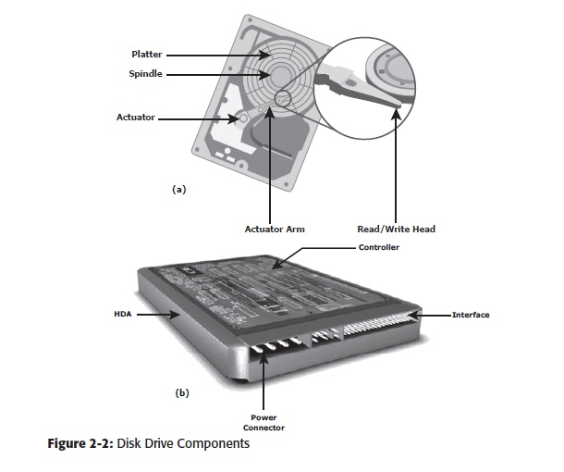
Key components of a disk drive (Figure 2-2):
Platter
Spindle
Read/Write Head
Actuator Arm Assembly
Controller
Physical Disk Structure
Zoned Bit Recording
Logical Block Addressing

Slide 16
Platter
A typical HDD consists of one or more flat circular disks called platters.
The data is recorded on these platters in binary codes (0s and1s).
The set of rotating platters is sealed in a case, called a Head Disk Assembly (HDA).
A platter is a rigid, round disk coated with magnetic material on both surfaces (top and bottom).
The data is encoded by polarizing the magnetic area, or domains, of the disk surface.

Slide 17
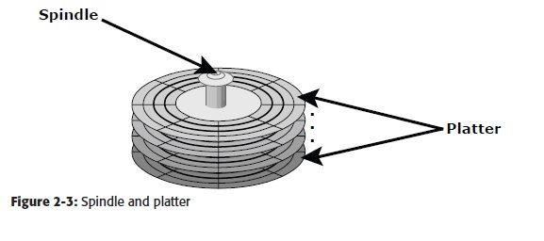
Spindle
A spindle connects all the platters, as shown in Figure 2-3, and is connected to a motor.
The motor of the spindle rotates with a constant speed. The disk platter spins at a speed of several thousands of revolutions per minute (rpm).
Disk drives have spindle speeds of 7,200 rpm, 10,000 rpm, or 15,000 rpm.
Disks used on current storage systems have a platter diameter of 3.5” (90 mm).
When the platter spins at 15,000 rpm, the outer edge is moving at around 25 percent of the speed of sound.

Slide 18
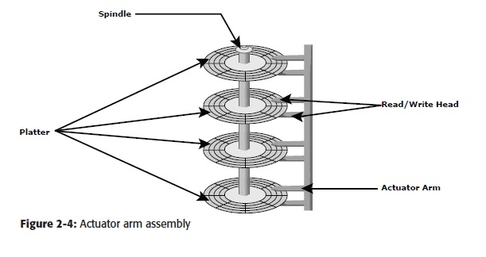

Slide 19
Read/Write Head
Read/Write (R/W) heads, shown in Figure 2-4, read and write data from or to a platter.
Drives have two R/W heads per platter, one for each surface of the platter.
The R/W head changes the magnetic polarization on the surface of the platter when writing data.
While reading data, this head detects magnetic polarization on the surface of the platter.
During reads and writes, the R/W head senses the magnetic polarization and never touches the surface of the platter.
When the spindle is rotating, there is a microscopic air gap between the R/W heads and the platters, known as the head flying height.
This air gap is removed when the spindle stops rotating and the R/W head rests on a special area on the platter near the spindle.
This area is called the landing zone. The landing zone is coated with a lubricant to reduce friction between the head and the platter.

Slide 20
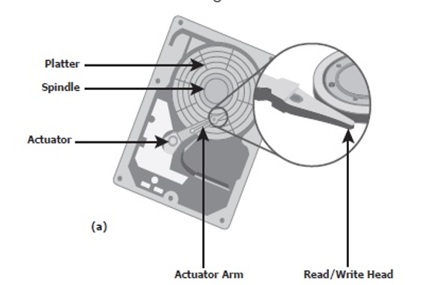
Actuator Arm Assembly
The R/W heads are mounted on the actuator arm assembly (refer to Figure 2-2 [a]), which positions the R/W head at the location on the platter where the data needs to be written or read.
The R/W heads for all platters on a drive are attached to one actuator arm assembly and move across the platters simultaneously.
Note that there are two R/W heads per platter, one for each surface, as shown in Figure 2-4.

Slide 21
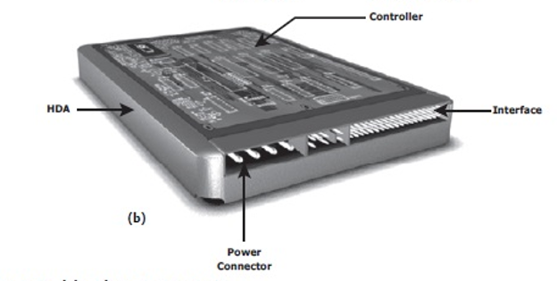
Controller
The controller (see Figure 2-2 [b]) is a printed circuit board, mounted at the bottom of a disk drive.
It consists of a microprocessor, internal memory, circuitry, and firmware.
The firmware controls power to the spindle motor and the speed of the motor.
It also manages communication between the drive and the host.
In addition, it controls the R/W operations by moving the actuator arm and switching between different R/W heads, and performs the optimization of data access.

Slide 22
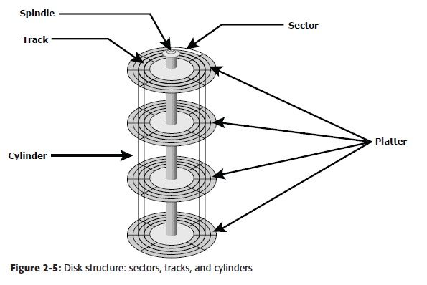
Physical Disk Structure
Data on the disk is recorded on tracks, which are concentric rings on the platter around the spindle, as shown in Figure 2-5.
The tracks are numbered, starting from zero, from the outer edge of the platter.
The number of tracks per inch (TPI) on the platter (or the track density) measures how tightly the tracks are packed on a platter.

Slide 23
Zoned Bit Recording
Because the platters are made of concentric tracks, the outer tracks can hold more data than the inner tracks, because the outer tracks are physically longer than the inner tracks, as shown in Figure 2-6 (a).
On older disk drives, the outer tracks had the same number of sectors as the inner tracks, so data density was low on the outer tracks.
This was an inefficient use of available space. Zone bit recording utilizes the disk efficiently.
As shown in Figure 2-6 (b), this mechanism groups tracks into zones based on their distance from the center of the disk. The zones are numbered, with the outermost zone being zone 0.

Slide 24
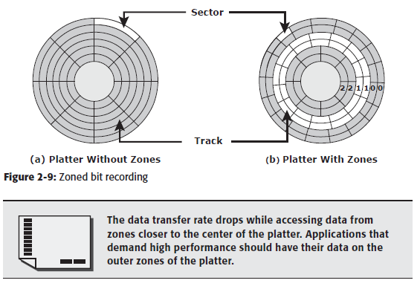

Slide 25
Logical Block Addressing
Earlier drives used physical addresses consisting of the cylinder, head, and sector (CHS) number to refer to specific locations on the disk, as shown in Figure 2-7 (a), and the host operating system had to be aware of the geometry of each disk being used.
Logical block addressing (LBA), shown in Figure 2-7 (b), simplifies addressing by using a linear address to access physical blocks of data.
The disk controller translates LBA to a CHS address, and the host only needs to know the size of the disk drive in terms of the number of blocks.
The logical blocks are mapped to physical sectors on a 1:1 basis.

Slide 26
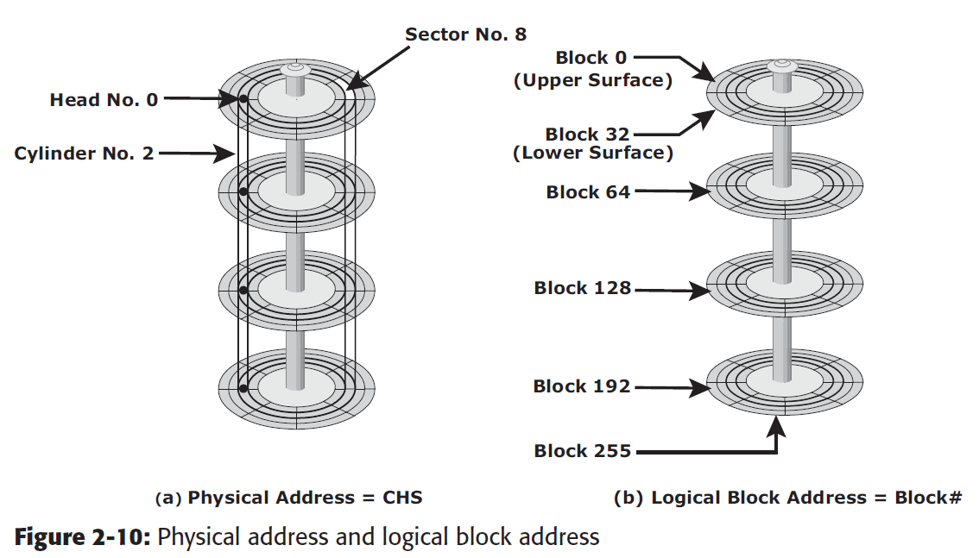

Slide 27
Disk Drive Performance
A disk drive is an electromechanical device that governs the overall performance of the storage system environment. The various factors that affect the performance of disk drives are discussed in this section.

Slide 28
Disk Service Time
Disk service time is the time taken by a disk to complete an I/O request. Components that contribute to service time on a disk drive are seek time, rotational latency, and data transfer rate.
Seek Time
Full Stroke
Average
Track-to-Track
Rotational Latency
Data Transfer Rate

Slide 29
The seek time (also called access time) describes the time taken to position and settle the arm and the head over the correct track.
Therefore, the lower the seek time, the faster the I/O operation.
Full Stroke: The time taken by the R/W head to move across the entire width of the disk, from the innermost track to the outermost track.
Average: The average time taken by the R/W head to move from one random track to another, normally listed as the time for one-third of a full stroke.
Track-to-Track: The time taken by the R/W head to move between adjacent tracks.
The average seek time on a modern disk is typically in the range of 3 to 15 milliseconds.

Slide 30
Rotational Latency
To access data, the actuator arm moves the R/W head over the platter to a particular track while the platter spins to position the requested sector under the R/W head.
The time taken by the platter to rotate and position the data under the R/W head is called rotational latency.
This latency depends on the rotation speed of the spindle and is measured in milliseconds. The average rotational latency is one-half of the time taken for a full rotation.
Similar to the seek time, rotational latency has more impact on the reading/writing of random sectors on the disk than on the same operations on adjacent sectors.
Average rotational latency is approximately 5.5 ms for a 5,400-rpm drive, and around 2.0 ms for a 15,000-rpm (or 250-rps revolution per second) drive as shown here:
Average rotational latency for a 15,000 rpm (RPS=15,000​/60=250 révolutions per second or 250 rps) drive = 0.5/250 = 2 milliseconds
Average Rotational Latency=1/2 ​×Time per Revolution

Slide 31
Rotational Latency
Average rotational latency is approximately 5.5 ms for a 5,400-rpm drive,
and around 2.0 ms for a 15,000-rpm (or 250-rps revolution per second) drive as
shown here:
Average rotational latency for a 15,000 rpm (or 250 rps)
drive = 0.5/250 = 2 milliseconds.

Slide 32
Data Transfer rate
The data transfer rate (also called transfer rate) refers to the average amount of data per unit time that the drive can deliver to the HBA.
In a read operation, the data fi rst moves from disk platters to R/W heads; then it moves to the drive’s internal buffer. Finally, data moves from the buffer through the interface to the host HBA.
In a write operation, the data moves from the HBA to the internal buffer of the disk drive through the drive’s interface. The data then moves from the buffer to the R/W heads. Finally, it moves from the R/W heads to the platters.
The data transfer rates during the R/W operations are measured in terms of internal and external transfer rates, as shown in Figure 2-11.

Slide 33
Data Transfer rate
The data transfer rate (also called transfer rate) refers to the average amount of data per unit time that the drive can deliver to the HBA.
In a read operation, the data first moves from disk platters to R/W heads; then it moves to the drive’s internal buffer. Finally, data moves from the buffer through the interface to the host HBA.
In a write operation, the data moves from the HBA to the internal buffer of the disk drive through the drive’s interface. The data then moves from the buffer to the R/W heads. Finally, it moves from the R/W heads to the platters.
The data transfer rates during the R/W operations are measured in terms of internal and external transfer rates, as shown in Figure 2-11.

Slide 34
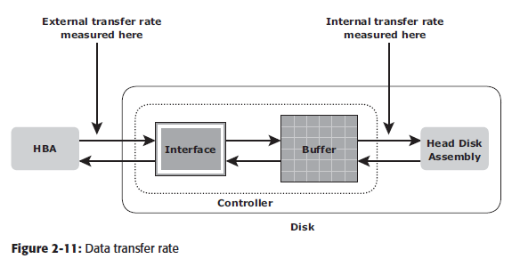
Data Transfer rate
Internal transfer rate is the speed at which data moves from a platter’s surface to the internal buffer (cache) of the disk.
The internal transfer rate takes into account factors such as the seek time and rotational latency. External transfer rate is the rate at which data can move through the interface to the HBA.
The external transfer rate is generally the advertised speed of the interface, such as 133 MB/s for ATA. The sustained external transfer rate is lower than the interface speed.

Slide 35
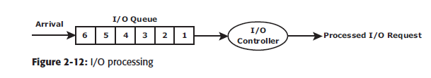
Disk I/O Controller Utilization
To understand the laws of disk performance, a disk can be viewed as a black box consisting of two elements:
Queue: The location where an I/O request waits before it is processed by the I/O controller.
Disk I/O Controller: Processes I/O s that are waiting in the queue one by one.

Slide 36
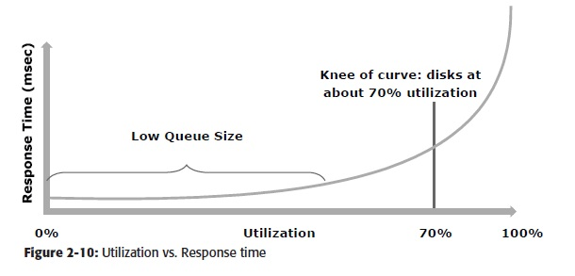
Disk I/O Controller Utilization
As a result, it can be concluded that by reducing the service time (the sum of seek time, latency, and internal transfer rate) or utilization by half, the response time can be reduced drastically (almost six times in the preceding example).
The relationship between utilization and response time is shown in Figure 2-10.
Response time changes are nonlinear as utilization increases.
When the average queue sizes are low, response time remains low.
Response time increases slowly with added load on the queue, and increases exponentially when utilization exceeds 70 percent.

Slide 37
Storage Design Based on Application Requirements and Disk Performance
Determining storage requirements for an application is estimated by the size and number of file systems and database components used by applications.
The I/O size, I/O characteristics, and the number of I/Os generated by the application at peak workload are other factors that affect disk performance, I/O response time, and design of storage systems.
The I/O block size depends on the file system and the database on which the application is built.
The disk service time (TS) for an I/O is a key measure of disk performance; TS, along with disk utilization rate (U), determines the I/O response time for an application.
The total disk service time (TS) is the sum of the seek time (T), rotational latency (L), and internal transfer time (X): TS = T + L + X

Slide 38
Storage Design Based on Application Requirements and Disk Performance
Consider an example with the following specifications provided for a disk:
The average seek time is 5 ms in a random I/O environment; therefore,
T = 5 ms.
Disk rotation speed of 15,000 revolutions per minute or 250 revolutions per second — from which rotational latency (L) can be determined, which is one-half of the time taken for a full rotation or L = (0.5/250 rps expressed in ms).
40 MB/s internal data transfer rate, from which the internal transfer time
(X) is derived based on the block size of the I/O — for example, an I/O with a block size of 32 KB; therefore X = 32 KB/40 MB.
Consequently, the time taken by the I/O controller to serve an I/O of block size 32 KB is
TS = 5 ms + (0.5/250) + 32 KB/40 MB = 7.8 ms.
Therefore, the maximum number of I/Os serviced per second or IOPS is
(1/TS) = 1/(7.8 × 10-3) = 128 IOPS.

Slide 39
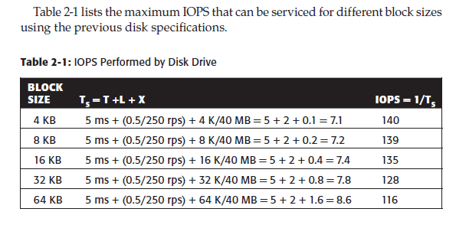
Storage Design Based on Application Requirements and Disk Performance

Slide 40
Storage Design Based on Application Requirements and Disk Performance
The application response time, R, increases with an increase in disk controller utilization.
For example, the response time (R) for an I/O with a block size of 32 KB at 96 percent disk controller utilization is
R = TS/(1 – U) = 7.8/(1 – 0.96) = 195 ms
If the application demands a faster response time, then the utilization for the disks should be maintained below 70 percent.
For the same 32-KB block size, at 70-percent disk utilization, the response time reduces drastically to 26 ms.
However, at lower disk utilization, the number of IOPS a disk can perform is also reduced.
In the case of a 32-KB block size, a disk can perform 128 IOPS at almost 100 percent utilization, whereas the number of IOPS it can perform at 70-percent utilization is 89 (128 x 0.7).
This indicates that the number of I/Os a disk can perform is an important factor that needs to be considered while designing the storage requirement for an application.
Therefore, the storage requirement for an application is determined in terms of both the capacity and IOPS.
If an application needs 200 GB of disk space, then this capacity can be provided simply with a single disk.
However, if the application IOPS requirement is high, then it results in performance degradation because just a single disk might not provide the required response time for I/O operations.
The total number of disks required (DR) for an application is computed as follows:
DR = Max (DC, DI)

Slide 41
Storage Design Based on Application Requirements and Disk Performance
The application response time, R, increases with an increase in disk controller utilization.
For example, the response time (R) for an I/O with a block size of 32 KB at 96 percent disk controller utilization is
R = TS/(1 – U) = 7.8/(1 – 0.96) = 195 ms
If the application demands a faster response time, then the utilization for the disks should be maintained below 70 percent.
For the same 32-KB block size, at 70-percent disk utilization, the response time reduces drastically to 26 ms.
However, at lower disk utilization, the number of IOPS a disk can perform is also reduced.
In the case of a 32-KB block size, a disk can perform 128 IOPS at almost 100 percent utilization, whereas the number of IOPS it can perform at 70-percent utilization is 89 (128 x 0.7).
This indicates that the number of I/Os a disk can perform is an important factor that needs to be considered while designing the storage requirement for an application.
Therefore, the storage requirement for an application is determined in terms of both the capacity and IOPS.
If an application needs 200 GB of disk space, then this capacity can be provided simply with a single disk.
However, if the application IOPS requirement is high, then it results in performance degradation because just a single disk might not provide the required response time for I/O operations.

Slide 42
Storage Design Based on Application Requirements and Disk Performance
The total number of disks required (DR) for an application is computed as follows: DR = Max (DC, DI)
Where DC is the number of disks required to meet the capacity, and DI is the number of disks required to meet the application IOPS requirement.
Eg: Consider an example in which the capacity requirement for an application is 1.46 TB. The number of IOPS generated by the application at peak workload is estimated at 9,000 IOPS. The vendor specifies that a 146-GB, 15,000-rpm drive is capable of doing a maximum 180 IOPS.
In this example, the number of disks required to meet the capacity requirements will be 1.46 TB/146 GB = 10 disks.
To meet the application IOPS requirements, the number of disks required is 9,000/180 = 50.
However, if the application is response-time sensitive, the number of IOPS a disk drive can perform should be calculated based on 70- percent disk utilization.
Considering this, the number of IOPS a disk can perform at 70 percent utilization is 180 x 0.7 = 126 IOPS.
Therefore, the number of disks required to meet the application IOPS requirement will be 9,000/126 = 72.
As a result, the number of disks required to meet the application requirements will be Max (10, 72) = 72 disks.
The preceding example indicates that from a capacity-perspective, 10 disks are sufficient; however, the number of disks required to meet application performance is 72.
To optimize disk requirements from a performance perspective, various solutions are deployed in a real-time environment.
Examples of these solutions are disk native command queuing, use of flash drives, RAID, and the use of cache memory.

Slide 43
Introduction to Flash Drives
Traditionally, high I/O requirements were met by simply using more disks.
Availability of enterprise class flash drives (EFD) has changed the scenario.
Flash drives, also referred as solid state drives (SSDs), are new generation drives that deliver ultra-high performance required by performance sensitive applications.
Flash drives use semiconductor-based solid state memory (flash memory) to store and retrieve data.
Unlike conventional mechanical disk drives, flash drives contain no moving parts; therefore, they do not have seek and rotational latencies.
Flash drives deliver a high number of IOPS with very low response times.
Also, being a semiconductor based device, flash drives consume less power, compared to mechanical drives.
Flash drives are especially suited for applications with small block size and random-read workloads that require consistently low (less than 1 millisecond) response times.
Applications that need to process massive amounts of information quickly, such as currency exchange, electronic trading systems, and real-time data feed processing benefit from flash drives.
Compared to conventional mechanical disk drives, EFD provides up to 30 times the throughput and up to one-tenth the response time (<1 ms compared with 6-10 ms).
In addition, flash drives can store data using up to 38 percent less energy per TB than traditional disk drives, which translates into approximately 98 percent less power consumption per I/O.

Slide 44
Components and Architecture of Flash Drives
Traditionally, high I/O requirements were met by simply using more disks.
Availability of enterprise class flash drives (EFD) has changed the scenario.
Flash drives, also referred as solid state drives (SSDs), are new generation drives that deliver ultra-high performance required by performance sensitive applications.
Flash drives use semiconductor-based solid state memory (flash memory) to store and retrieve data.
Unlike conventional mechanical disk drives, flash drives contain no moving parts; therefore, they do not have seek and rotational latencies.
Flash drives deliver a high number of IOPS with very low response times.
Also, being a semiconductor based device, flash drives consume less power, compared to mechanical drives.
Flash drives are especially suited for applications with small block size and random-read workloads that require consistently low (less than 1 millisecond) response times.
Applications that need to process massive amounts of information quickly, such as currency exchange, electronic trading systems, and real-time data feed processing benefit from flash drives.
Compared to conventional mechanical disk drives, EFD provides up to 30 times the throughput and up to one-tenth the response time (<1 ms compared with 6-10 ms).
In addition, flash drives can store data using up to 38 percent less energy per TB than traditional disk drives, which translates into approximately 98 percent less power consumption per I/O.

Slide 45
Components and Architecture of Flash Drives
Flash drives use similar physical form factor and connectors as mechanical disk drives to maintain compatibility.
This enables easy replacement of a mechanical disk drive with a flash drive in a storage array enclosure.
The key components of a flash drive are the controller, I/O interface, mass storage (collection of memory chips), and cache.
The controller manages the functioning of the drive, and the I/O interface provides power and data access.
Mass storage is an array of nonvolatile NAND (negated AND) memory chips used for storing data.
Cache serves as a temporary space or buffer for data transaction and operations.
A flash drive uses multiple parallel I/O channels (from its drive controller to the flash memory chips) for data access.
Generally, the larger the number of flash memory chips and channels, the higher the drive’s internal bandwidth, and ultimately the higher the drive’s performance.
Flash drives typically have eight to 24 channels.

Slide 46
Components and Architecture of Flash Drives
Memory chips in flash drives are logically organized in blocks and pages.
A page is the smallest object that can be read or written on a flash drive.
Pages are grouped together into blocks. (These blocks should not be confused with the 512-byte blocks in mechanical disk drive sectors.)
A block may have 32, 64, or 128 pages. Pages do not have a standard size; typical page sizes are 4 KB,
8 KB, and 16 KB. Because flash drives emulate mechanical drives that use logical block addresses (LBAs), a page spans across a consecutive series of data blocks.
For example, a 4-KB page would span across eight 512-byte data blocks with consecutive addresses. In flash drives, a read operation can happen at the page level, whereas a write or an erase operation happens only at the block level.

Slide 47
Features of Enterprise Flash Drives
The key features of enterprise class fl ash drives are as follows:
NAND flash memory technology: NAND memory technology is well suited for accessing random data. A NAND device uses bad block tracking and error correcting code (ECC) to maintain data integrity and provide the fastest write speeds.
Single-Level Cell (SLC)-based flash: NAND technology is available in two different cell designs. A multi-level cell (MLC) stores more than one bit per cell by virtue of its capability to register multiple states, versus a single-level cell that can store only 1 bit. SLC is the preferred technology for enterprise data applications due to its performance and longevity.
SLC read speeds are typically rated at twice those of MLC devices, and write speeds are up to four times higher.
SLC devices typically have 10 times higher write erase cycles, compared to MLC designs. In addition, the SLC flash memory has higher reliability because it stores only 1 bit per cell. Hence, the likelihood for error is reduced.
Write levelling technique: An important element of maximizing a flash drive’s useful life is ensuring that the individual memory cells experience uniform use. This means that data that is frequently updated is written to different locations to avoid rewriting the same cells. In EFDs, the device is designed to ensure that with any new write operation, the youngest block is used.

Slide 48
Concept in Practice: VMware ESXi
VMware is the leading provider for a server virtualization solution.
Vmware ESXi provides a platform called hypervisor.
The hypervisor abstracts CPU, memory, and storage resources to run multiple virtual machines concurrently on the same physical server.
VMware ESXi is a hypervisor that installs on x86 hardware to enable server virtualization. It enables creating multiple virtual machines (VMs) that can run simultaneously on the same physical machine.
A VM is a discrete set of fi les that can be moved, copied, and used as a template. All the files that make up a VM are typically stored in a single directory on a cluster file system called Virtual Machine File System (VMFS).
The physical machine that houses ESXi is called the ESXi host. ESXi hosts provide physical resources used to run virtual machines. ESXi has two key components: VMkernel and Virtual Machine Monitor.

Slide 49
Concept in Practice: VMware ESXi
VMkernel provides functionality similar to that found in other operating systems, such as process creation, file system management, and process scheduling.
It is designed to specifically support running multiple VMs and provide core functionality such as resource scheduling, I/O stacks, and so on.
The virtual machine monitor is responsible for executing commands on the CPUs and performing Binary Translation (BT).
A virtual machine monitor performs hardware abstraction to appear as a physical machine with its own CPU, memory, and I/O devices.
Each VM is assigned a virtual machine monitor that has a share of the CPU, memory, and I/O devices to successfully run the VM.

Slide 50
Logical Components of the Host
The logical components of a host consist of the software applications and protocols that enable data communication with the user as well as the physical components. Following are the logical components of a host:
Operating system
Device drivers
Volume manager
File system
Application

Slide 51
Operating System
An operating system controls all aspects of the computing environment.
It works between the application and physical components of the computer system.
One of the services it provides to the application is data access.
Device Driver
A device driver is special software that permits the operating system to interact with a specific device, such as a printer, a mouse, or a hard drive.
A device driver enables the operating system to recognize the device and to use a standard interface (provided as an application programming interface, or API) to access and control devices.
Device drivers are hardware dependent and operating system specific.

Slide 52
Volume Manager
Disk partitioning was introduced to improve the flexibility and utilization of HDDs. In partitioning, an HDD is divided into logical containers called logical volumes (LVs) (see Figure 2-11).
For example, a large physical drive can be partitioned into multiple LVs to maintain data according to the file system’s and applications’ requirements.
The partitions are created from groups of contiguous cylinders when the hard disk is initially set up on the host.
The host’s file system accesses the partitions without any knowledge of partitioning and the physical structure of the disk.
Concatenation is the process of grouping several smaller physical drives and presenting them to the host as one logical drive (see Figure 2-11).

Slide 53
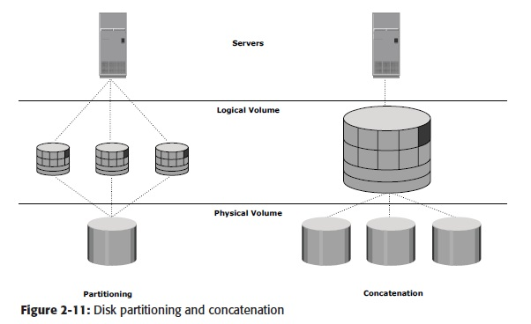

Slide 54
File System
A file is a collection of related records or data stored as a unit with a name.
A file system is a hierarchical structure of files.
File systems enable easy access to data files residing within a disk drive, a disk partition, or a logical volume.
A file system needs host-based logical structures and software routines that control access to files.
It provides users with the functionality to create, modify, delete, and access files.
Access to the files on the disks is controlled by the permissions given to the file by the owner, which are also maintained by the file system.
FAT 32 (File Allocation Table) for Microsoft Windows
NT File System (NTFS) for Microsoft Windows
UNIX File System (UFS) for UNIX
Extended File System (EXT2/3) for Linux

Slide 55
A file system block is the smallest “container” of physical disk space allocated for data.
Each file system block is a contiguous area on the physical disk.
The block size of a file system is fixed at the time of its creation.
File system size depends on block size and the total number of blocks of data stored.
A file can span multiple file system blocks because most files are larger than the predefined block size of the file system.
File system blocks cease to be contiguous (i.e., become fragmented) when new blocks are added or deleted.
Over time, as files grow larger, the file system becomes increasingly fragmented. Figure 2-12 shows the following process of mapping user files to the disk storage subsystem with an LVM:

Slide 56
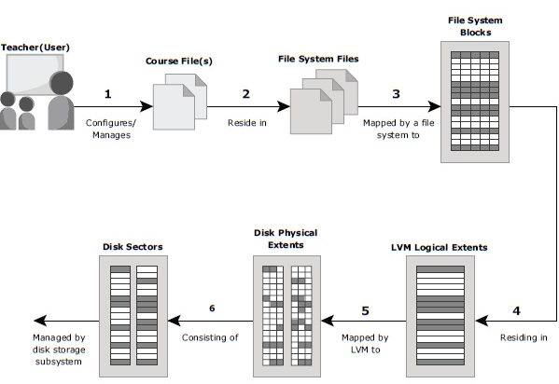

Slide 57
Files are created and managed by users and applications.
These files reside in the file systems.
The file systems are then mapped to units of data, or file system blocks.
The file system blocks are mapped to logical extents.
These in turn are mapped to disk physical extents either by the operating system or by the LVM.
These physical extents are mapped to the disk storage subsystem.

Slide 58
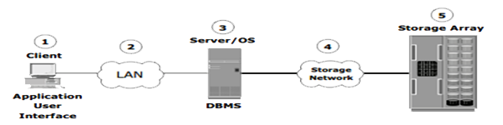
Core elements of a Data center
Application: An application is a computer program that provides the logic for computing operations.
Database : A Database is an organized collection of Data.
Server and operating system: A computing platform that runs applications and databases.
Network: A data path that facilitates communication between clients and servers or between servers and storage.
Storage array: A device that stores data persistently for subsequent use.

Slide 59
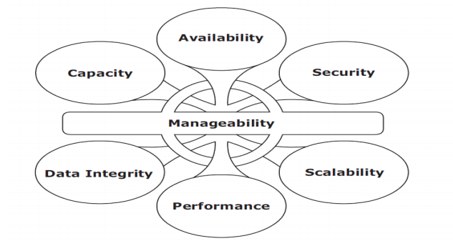
Key Requirements for Data Center Elements

Slide 60
Key Requirements for Data Center Elements
Availability : Accessibility should be insured for a business implementation.
Security : Polices, procedures, and proper integration of the data center core elements that will prevent unauthorized access to information must be established.
Scalability : Additional On-Demand services , without interrupting business operations.
Performance: All the core elements of the data center should be able to provide optimal performance and service all processing requests at high speed.
Data integrity : Mechanisms such as error correction codes and parity bits which ensure that data is written to disk exactly as it was received.
Capacity : To increase and decrease core elements capacity on demand.
Manageability: A data center should perform all operations and activities in the most efficient manner. Manageability can be achieved through automation and the reduction of human (manual) intervention in common tasks.

Slide 61
Evolution of Storage Technology and Architecture
Direct-attached storage (DAS)
Just a Bunch Of Disk(JBOD)
Redundant Array of Independent Disks (RAID)
Network-attached storage (NAS)
Storage area network (SAN)
Internet Protocol SAN (IP-SAN)

Slide 62
Information Lifecycle Management(ILM)
Information lifecycle management (ILM) is a proactive strategy that enables an IT organization to effectively manage the data throughout its lifecycle, based on predefined business policies.
This allows an IT organization to optimize the storage infrastructure for maximum return on investment.
An ILM strategy should include the following characteristics:
Business-centric: It should be integrated with key processes, applications, and initiatives of the business to meet both current and future growth in information.
Centrally managed: All the information assets of a business should be under the purview of the ILM strategy.
Policy-based: The implementation of ILM should not be restricted to a few departments. ILM should be implemented as a policy and encompass all business applications, processes, and resources.
Heterogeneous: An ILM strategy should take into account all types of storage platforms and operating systems.
Optimized: Because the value of information varies, an ILM strategy should consider the different storage requirements and allocate storage resources based on the information’s value to the business.

Slide 63
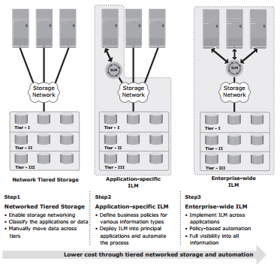
ILM Implementation
Classifying data and applications on the basis of business rules and policies to enable differentiated treatment of information
Implementing policies by using information management tools, starting from the creation of data and ending with its disposal
Managing the environment by using integrated tools to reduce operational complexity
Organizing storage resources in tiers to align the resources with data classes, and storing information in the right type of infrastructure based on the information’s current value

Slide 64
ILM Benefits
Improved utilization by using tiered storage platforms and increased visibility of all enterprise information.
Simplified management by integrating process steps and interfaces with individual tools and by increasing automation.
A wider range of options for backup, and recovery to balance the need for business continuity.
Maintaining compliance by knowing what data needs to be protected for what length of time.
Lower Total Cost of Ownership (TCO) by aligning the infrastructure and management costs with information value. As a result, resources are not wasted, and complexity is not introduced by managing low-value data at the expense of high-value data.

Slide 65
Key Challenges in Managing Information
Exploding digital universe: The rate of information growth is increasing exponentially. Duplication of data to ensure high availability and repurposing has also contributed to the multifold increase of information growth.
Increasing dependency on information: The strategic use of information plays an important role in determining the success of a business and provides competitive advantages in the marketplace.
Changing value of information: Information that is valuable today may become less important tomorrow. The value of information often changes over time. Framing a policy to meet these challenges involves understanding the value of information over its lifecycle.

