Slide 1
UNIT-II
Data Protection, Intelligent Storage system: Implementation of RAID, RAID Array Components, RAID Levels, RAID Comparison, RAID Impact on Disk Performance, Hot Spares Components of an Intelligent Storage System, Intelligent Storage Array

Slide 2
Business-critical applications require high levels of performance, availability, security, and scalability.
A hard disk drive is a core element of storage that governs the performance of any storage system.
Some of the older disk array technologies could not overcome performance constraints due to the limitations of a hard disk and its mechanical components.
RAID technology made an important contribution to enhancing storage performance and reliability, but hard disk drives even with a RAID implementation could not meet performance requirements of today’s applications.
With advancements in technology, a new breed of storage solutions known as an intelligent storage system has evolved.
The intelligent storage systems detailed in this chapter are the feature-rich RAID arrays that provide highly optimized I/O processing capabilities.

Slide 3
Components of an Intelligent Storage System
An intelligent storage system consists of four key components:
front end
cache
back end
physical disks
Figure 4-1 illustrates these components and their interconnections. An I/O request received from the host at the front-end port is processed through cache and the back end, to enable storage and retrieval of data from the physical disk. A read request can be serviced directly from cache if the requested data is found in cache.

Slide 4
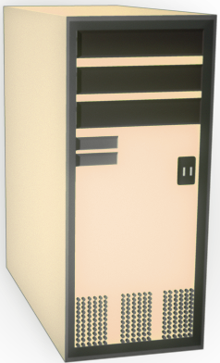
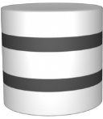
Components of an Intelligent Storage System
Intelligent Storage System
Host
Front End
Back End
Physical Disks
Cache
Connectivity
FC SAN

Slide 5
Intelligent Storage System: Front End
Intelligent Storage System
Host
Front End
Back End
Physical Disks
Cache
Connectivity
FC SAN
Ports
Controllers

Slide 6
Front End
The front end provides the interface between the storage system and the host.
It consists of two components: front-end ports and front-end controllers.
The front-end ports enable hosts to connect to the intelligent storage system.
Each front-end port has processing logic that executes the appropriate transport protocol, such as SCSI, Fibre Channel, or iSCSI, for storage connections.
Redundant ports are provided on the front end for high availability.
Front-end controllers route data to and from cache via the internal data bus. When cache receives write data, the controller sends an acknowledgment message back to the host.
Controllers optimize I/O processing by using command queuing algorithms.

Slide 7
Front-End Command Queuing
The most commonly used command queuing algorithms are as follows:
First In First Out (FIFO)
This is the default algorithm where commands are executed in the order in which they are received. There is no reordering of requests for optimization; therefore, it is inefficient in terms of performance.
Seek Time Optimization
Commands are executed based on optimizing read/write head movements, which may result in reordering of commands. Without seek time optimization, the commands are executed in the order they are received.

Slide 8
Front End Command Queuing
A
D
C
B
A
D
C
B
A
I/O Requests
I/O Processing
C
D
Order
B
Front-End
Cylinders
Controller
Without Optimization (FIFO)
A
D
C
B
A
D
B
C
A
I/O Requests
I/O Processing
C
D
Order
B
Front-End
Cylinders
Controller
With command queuing

Slide 9
For example, as shown in Figure, the commands are executed in the order A, B, C and D.
The radial movement required by the head to execute C immediately after A is less than what would be required to execute B.
With seek time optimization, the command execution sequence would be A, C, B and D as shown in the figure.

Slide 10
Access Time Optimization
Commands are executed based on the combination of seek time optimization and an analysis of rotational latency for optimal performance.

Slide 11
Intelligent Storage System: Cache
Intelligent Storage System
Host
Front End
Back End
Physical Disks
Cache
Connectivity
FC SAN

Slide 12
Cache
Cache is an important component that enhances the I/O performance in an intelligent storage system.
Cache is semiconductor memory where data is placed temporarily to reduce the time required to service I/O requests from the host.
Cache improves storage system performance by isolating hosts from the mechanical delays associated with physical disks, which are the slowest components of an intelligent storage system.
Accessing data from a physical disk usually takes a few milliseconds because of seek times and rotational latency.
If a disk has to be accessed by the host for every I/O operation, requests are queued, which results in a delayed response.

Slide 13
Structure of Cache
Cache is organized into pages or slots, which is the smallest unit of cache allocation.
The size of a cache page is configured according to the application I/O size.
Cache consists of the data store and tag RAM. The data store holds the data while tag RAM tracks the location of the data in the data store (Figure 4-3) and in disk.

Slide 14
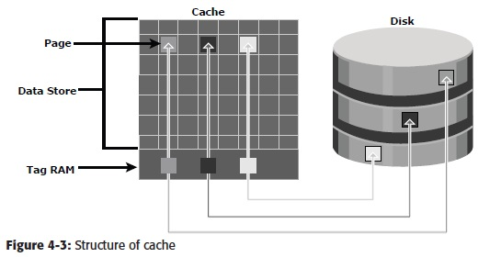

Slide 15
Read Operation with Cache
When a host issues a read request, the front-end controller accesses the tag RAM to determine whether the required data is available in cache.
If the requested data is found in the cache, it is called a read cache hit or read hit and data is sent directly to the host, without any disk operation (see Figure).
This provides a fast response time to the host (about a millisecond).
If the requested data is not found in cache, it is called a cache miss and the data must be read from the disk (see Figure).
The back-end controller accesses the appropriate disk and retrieves the requested data.
Data is then placed in cache and is finally sent to the host through the front-end controller.
Cache misses increase I/O response time.

Slide 16
Read Operation with Cache: ‘Hits’ and ‘Misses’
Data found in cache = ‘Hit’
Cache
Read
Request
No data found = ‘Miss’
Cache
Read
Request

Slide 17
Write Operation with Cache
Write operations with cache provide performance advantages over writing directly to disks.
When an I/O is written to cache and acknowledged, it is completed in far less time (from the host’s perspective) than it would take to write directly to disk.
Sequential writes also offer opportunities for optimization because many smaller writes can be coalesced for larger transfers to disk drives with the use of cache.
A write operation with cache is implemented in the following ways:
Write-back cache
Write-through cache

Slide 18
Write Operation with Cache
Write-through Cache
Cache
Write
Request
Acknowledgement
Write-back
Cache
Write
Request
Acknowledgement
Acknowledgement

Slide 19
Cache Implementation
Cache can be implemented as either dedicated cache or global cache.
With dedicated cache, separate sets of memory locations are reserved for reads and writes.
In global cache, both reads and writes can use any of the available memory addresses.
Cache management is more efficient in a global cache implementation, as only one global set of addresses has to be managed.

Slide 20
Cache Management
Cache is a finite and expensive resource that needs proper management.
Even though intelligent storage systems can be configured with large amounts of cache, when all cache pages are filled, some pages have to be freed up to accommodate new data and avoid performance degradation.
Various cache management algorithms are implemented in intelligent storage systems to proactively maintain a set of free pages and a list of pages that can be potentially freed up whenever required:
Least Recently Used (LRU)
Most Recently Used (MRU)
Idle flushing
High watermark flushing
Forced flushing

Slide 21
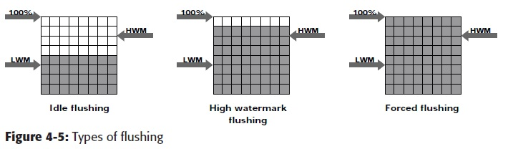

Slide 22
Cache Data Protection
Cache is volatile memory, so a power failure or any kind of cache failure will cause the loss of data not yet committed to the disk. This risk of losing uncommitted data held in cache can be mitigated using cache mirroring and cache vaulting:
Cache mirroring
Cache vaulting

Slide 23
Cache Management: Algorithms
Least Recently Used (LRU)
  Discards least recently used data
Most Recently Used (MRU)
  Discards most recently used data
  ( assumed that recent data may not be required for a while)
New Data
Oldest Data
Cache Implementation
Dedicated Cache
  Separate memory sets reserved for read and write
Global Cache
  Both read and write operation use available memory.
  More efficient

Slide 24
Cache Management: Watermarking
Manage peak I/O requests “bursts” through flushing/de-staging
  Idle flushing, High Watermark flushing and Forced flushing
For maximum performance:
  Provide headroom in write cache for I/O bursts
100 %
HWM
LWM
Idle flushing
High watermark flushing
Forced flushing

Slide 25
Cache Data Protection
Protecting cache data against failure: (power failure)
  Cache mirroring
    Each write to the cache is held in two different memory locations on two independent memory cards
    Cache coherency(only writes r mirrored)
  Cache vaulting
    Cache is exposed to the risk of uncommitted data loss due to power failure
    In the event of power failure, uncommitted data is dumped to a dedicated set of drives called vault drives

Slide 26
Intelligent Storage System: Back End
Intelligent Storage System
Host
Front End
Back End
Physical Disks
Cache
Connectivity
FC SAN
Controllers
Ports

Slide 27
Back End
The back end provides an interface between cache and the physical disks.
It consists of two components: back-end ports and back-end controllers.
The back end controls data transfers between cache and the physical disks.
From cache, data is sent to the back end and then routed to the destination disk.
Physical disks are connected to ports on the back end.
The back end controller communicates with the disks when performing reads and writes and also provides additional, but limited, temporary data storage.
The algorithms implemented on back-end controllers provide error detection and correction, along with RAID functionality.

Slide 28
Physical Disk
A physical disk stores data persistently. Disks are connected to the back-end with either SCSI or a Fibre Channel interface.
An intelligent storage system enables the use of a mixture of SCSI or Fibre Channel drives and IDE/ATA drives.

Slide 29
Logical Unit Number
Physical drives or groups of RAID protected drives can be logically split into volumes known as logical volumes, commonly referred to as Logical Unit Numbers (LUNs).
The use of LUNs improves disk utilization.
For example, without the use of LUNs, a host requiring only 200 GB could be allocated an entire 1TB physical disk.
Using LUNs, only the required 200 GB would be allocated to the host, allowing the remaining 800 GB to be allocated to other hosts.

Slide 30
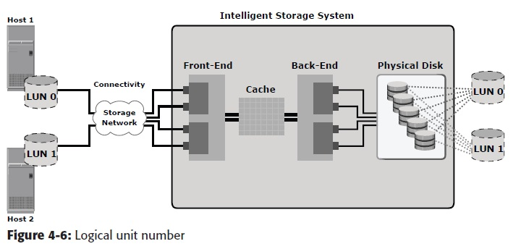

Slide 31
LUN Masking
LUN masking is a process that provides data access control by defining which LUNs a host can access. LUN masking function is typically implemented at the front end controller. This ensures that volume access by servers is controlled appropriately, preventing unauthorized or accidental use in a distributed environment. For example, consider a storage array with two LUNs that store data of the sales and finance departments. Without LUN masking, both departments can easily see and modify each other’s data, posing a high risk to data integrity and security. With LUN masking, LUNs are accessible only to the designated hosts.

Slide 32
Intelligent Storage Array
Intelligent storage systems generally fall into one of the following two categories:
High-end storage systems
Midrange storage systems

Slide 33
High-end Storage Systems
High-end storage systems, referred to as active-active arrays, are generally aimed at large enterprises for centralizing corporate data.
These arrays are designed with a large number of controllers and cache memory.
An active-active array implies that the host can perform I/O s to its LUNs across any of the available paths (see Figure 4-7).

Slide 34
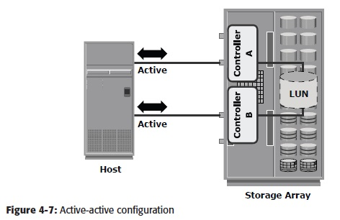

Slide 35
To address the enterprise storage needs, these arrays provide the following capabilities:
Large storage capacity
Large amounts of cache to service host I/O s optimally
Fault tolerance architecture to improve data availability
Connectivity to mainframe computers and open systems hosts

Slide 36
Availability of multiple front-end ports and interface protocols to serve a large number of hosts
Availability of multiple back-end Fibre Channel or SCSI RAID controllers to manage disk processing
Scalability to support increased connectivity, performance, and storage capacity requirements
Ability to handle large amounts of concurrent I/O s from a number of servers and applications
Support for array-based local and remote replication

Slide 37
Midrange Storage System
Midrange storage systems are also referred to as active-passive arrays and they are best suited for small- and medium-sized enterprises.
In an active-passive array, a host can perform I/Os to a LUN only through the paths to the owning controller of that LUN. These paths are called active paths.
The other paths are passive with respect to this LUN. As shown in Figure 4-8, the host can perform reads or writes to the LUN only through the path to controller A, as controller A is the owner of that LUN.
The path to controller B remains passive and no I/O activity is performed through this path.

Slide 38
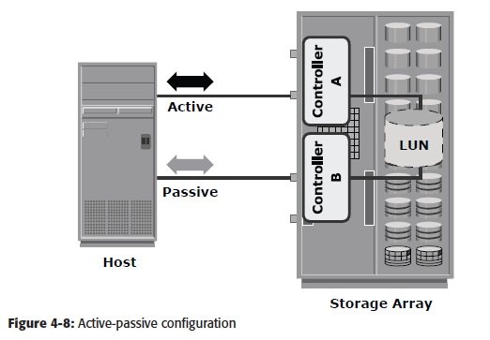

Slide 39
Symmetrix Storage Array
The EMC Symmetrix establishes the highest standards for performance and capacity for an enterprise information storage solution and is recognized as the industry’s most trusted storage platform. Figure 4-11 shows the EMC Symmetrix DMX-4 storage array. EMC Symmetrix uses the Direct Matrix Architecture and incorporates a fault tolerant design. Other features of the Symmetrix are as follows:
Incrementally scalable up to 2,400 disks
Supports Flash-based solid-state drives
Dynamic global cache memory (16 GB–512 GB)
Advanced processing power (up to 130 PowerPC)

Slide 40
Large number of concurrent data paths available (32-128 data paths) for I/O processing
High data processing bandwidth (up to 128 GB/s)
Data protection with RAID 1, 1+0 (also known as 10 for mainframe), 5, and 6
Storage-based local and remote replication for business continuity through Time Finder and SRDF software

Slide 41
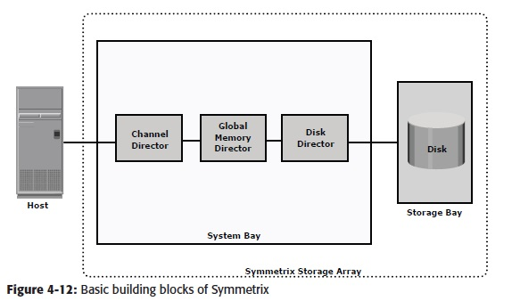
Symmetrix Component Overview
Figure 4-12 shows the basic block diagram of Symmetrix components.

Slide 42
The Symmetrix system bay consists of front-end controllers (called Channel Directors) for host connectivity, large amounts of global cache (called Global Memory Director [GMD]), and back-end controllers (called Disk Directors) for disk connectivity.
The storage bay is a disk enclosure that can house 240 drives in a cabinet.
Figure 4-13 shows the components of the Symmetrix system bay and storage bay.

Slide 43
Direct Matrix Architecture
Symmetrix uses the Direct Matrix Architecture consisting of dedicated paths for data transfer between the front end, global memory, and the back end. Key components of Symmetrix DMX are as follows:
Front end
Back end
Global Memory
XCM
Symmetrix Enginuity

Slide 44
Summary
This chapter detailed the features and components of the intelligent storage system — front end, cache, back end, and physical disks. The active-active and active passive implementations of intelligent storage systems were also described. An intelligent storage system provides the following benefits to an organization:
Increased capacity
Improved performance
Easier storage management

Slide 45
Improved data availability
Improved scalability and flexibility
Improved business continuity
Improved security and access control
An intelligent storage system is now an integral part of every mission-critical data center.
Although a high-end intelligent storage system addresses information storage requirements, it poses a challenge for administrators to share information easily and securely across the enterprise.
Storage networking is a flexible information-centric strategy that extends the reach of intelligent storage systems throughout an enterprise.
It provides a common way to manage, share, and protect information. Storage networking is detailed in the next section.

Slide 46
Data Protection: RAID
A RAID is a Redundant Array of Inexpensive/ Independent Disks

Slide 47
Data Protection: RAID
“Cheap” SCSI hard drives are now big enough for most applications
We use RAID today for
  Increasing disk throughput by allowing parallel access
  Eliminating the need to make disk backups
    Disks are too big to be backed up in an efficient fashion

Slide 48
Disk Arrays
Disk arrays with redundant disks to tolerate faults
If a single disk fails, the lost information is reconstructed from redundant information
Striping: simply spreading data over multiple disks
RAID: redundant array of inexpensive/independent disks

Slide 49
Why RAID?
Performance limitation of disk drive
An individual drive has a certain life expectancy
  Measured in MTBF (Mean Time Between Failure)
  The more the number of HDDs in a storage array, the larger the probability for disk failure. For example:
    If the MTBF of a drive is 750,000 hours, and there are 100 drives in the array, then the MTBF of the array becomes 750,000 / 100, or 7,500 hours
RAID was introduced to mitigate this problem
RAID provides:
  Increase capacity
  Higher availability
  Increased performance

Slide 50

RAID Array Components
Physical Array
Logical Array
RAID
Controller
Hard Disks
Host
RAID Array

Slide 51
RAID Controller
Hardware (usually a specialized disk controller card)
  Controls all drives attached to it
  Array(s) appear to host operating system as a regular disk drive
  Provided with administrative software
Software
  Runs as part of the operating system
  Performance is dependent on CPU workload
  Does not support all RAID levels

Slide 52
RAID Levels
RAID-0 Striped array with no fault tolerance
RAID-1 Disk mirroring
Nested RAID (i.e., 1 + 0, 0 + 1, etc.)
RAID-3 Parallel access array with dedicated parity disk
RAID-4 Striped array with independent disks and a dedicated parity disk
RAID-5 Striped array with independent disks and distributed parity
RAID-6 Striped array with independent disks and dual distributed parity

Slide 53
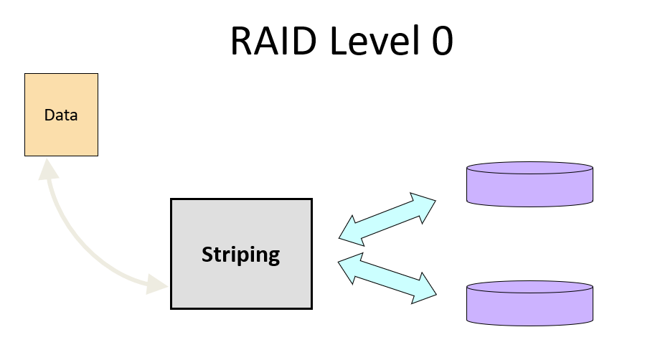
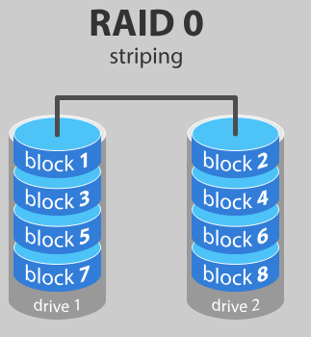
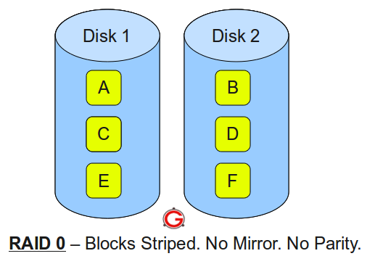
RAID Level 0
RAID Level 0 is a non-redundant disk array
Files are striped across disks, no redundant info
High read throughput
Best write throughput (no redundant info to write)
Any disk failure results in data loss; sometimes a file, sometimes the entire volume

Slide 54
RAID 0
Data is distributed across the HDDs in the RAID set.
Allows multiple data to be read or written simultaneously/concurrently, and therefore improves performance.
Does not provide data protection and availability in the event of disk failures.
No replication
Advantages:
  Simple to implement
  No overhead
Disadvantage:
  If array has n disks failure rate is n times the failure rate of a single disk

Slide 55
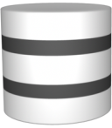
RAID 0
0
1
5
9
RAID
Controller
2
6
10
3
Host
7
11

Slide 56
RAID 1
Data is stored on two different HDDs, yielding two copies of the same data.
  Provides availability.
In the event of HDD failure, access to data is still available from the surviving HDD.
When the failed disk is replaced with a new one, data is automatically copied from the surviving disk to the new disk.
  Done automatically by RAID the controller.
Disadvantage: The amount of storage capacity is twice the amount of data stored.
Mirroring is NOT the same as doing backup!

Slide 57
RAID 1
Block 0
RAID
Controller
Block 1
Block 1
Block 1
Block 0
Block 0
Host

Slide 58
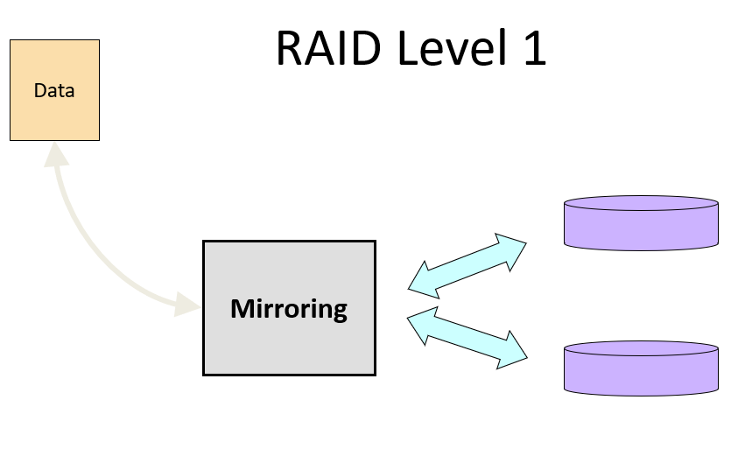

RAID Level 1
Mirroring
  Two copies of each disk block
Advantages:
  Simple to implement
  Fault-tolerant
Disadvantage:
  Requires twice the disk capacity of normal file systems
data disks
mirror copies

Slide 59
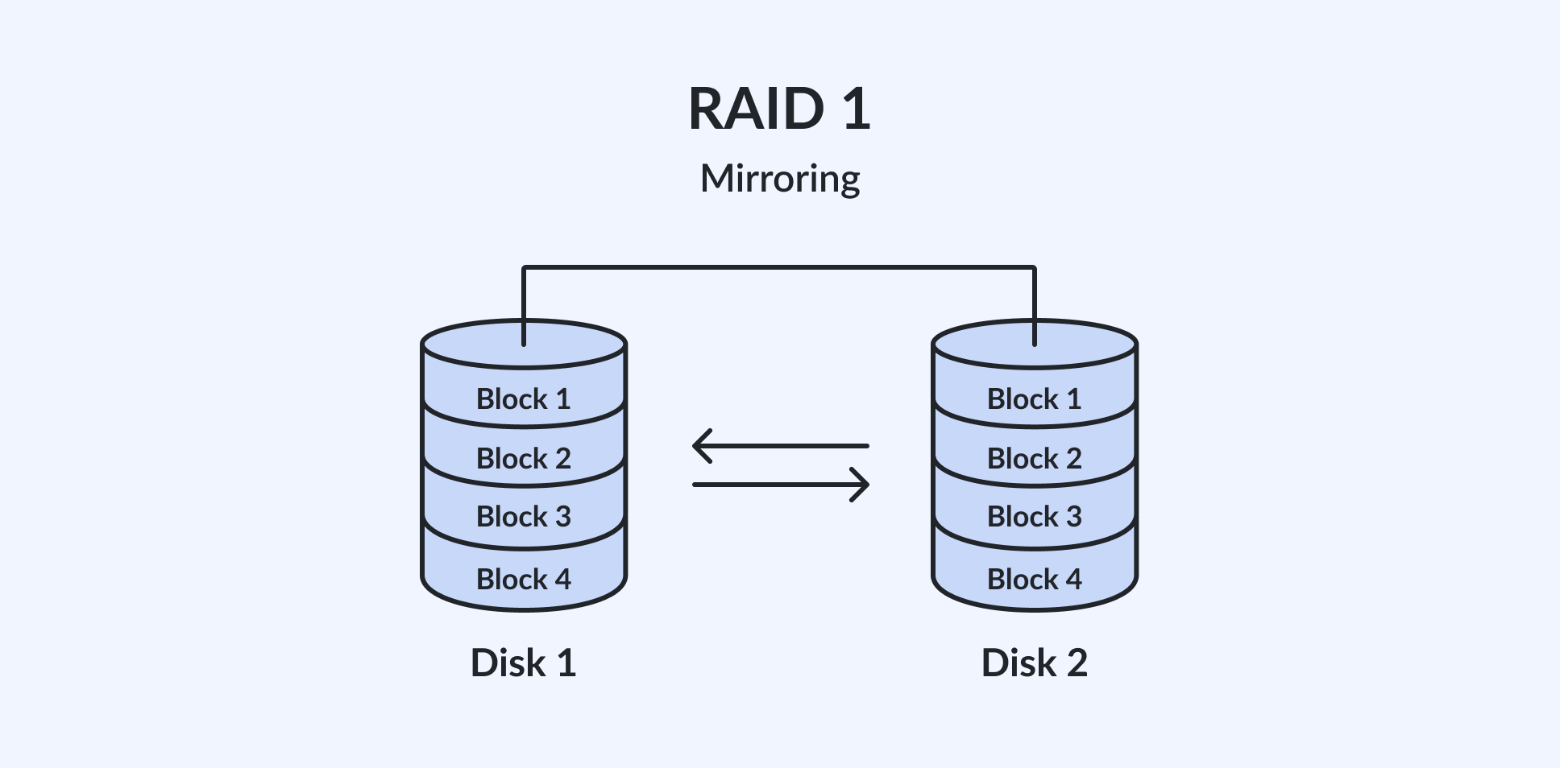
RAID 1
Mirroring or Shadowing
Two copies for every piece of data
one logical write = two physical writes
100% capacity/space overhead
RAID Level 1 is mirrored disks
Files are striped across (half) the disks
Data is written to multiple (two) places – data disks and mirror disks
On failure, just use the surviving disk(s)
Factor of N (2x) space expansion

Slide 60
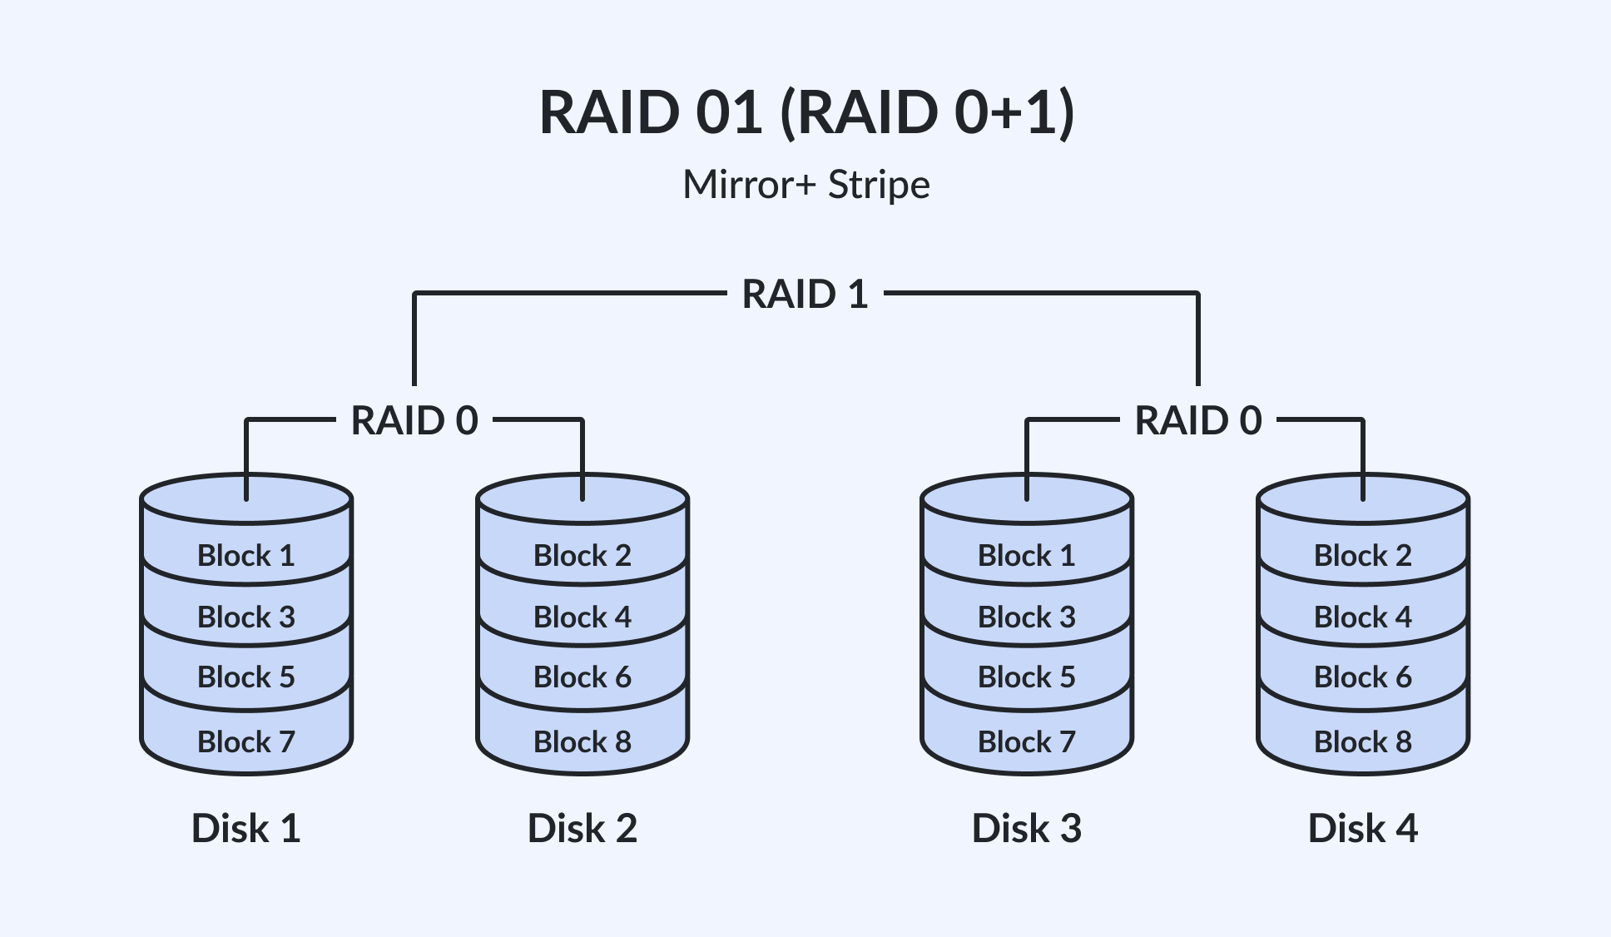
Nested RAID
Combines the performance benefits of RAID 0 with the redundancy benefit of RAID 1.
RAID 0+1 – Mirrored Stripe
  Data is striped across HDDs, then the entire stripe is mirrored.
  If one drive fails, the entire stripe is faulted.
  Rebuild operation requires data to be copied from each disk in the healthy stripe, causing increased load on the surviving disks.

Slide 61
Nested RAID – 0+1 (Striping and Mirroring)
RAID 1
Block 0
Block 2
Block 0
RAID
Controller
RAID 0
Block 3
Block 2
Block 1
Block 1
Host
Block 3

Slide 62
Nested RAID – 0+1 (Striping and Mirroring)
RAID 1
Block 0
Block 0
Block 0
Block 2
Block 2
Block 2
RAID
Controller
RAID 0
Block 1
Block 1
Block 1
Block 3
Block 3
Host
Block 3

Slide 63
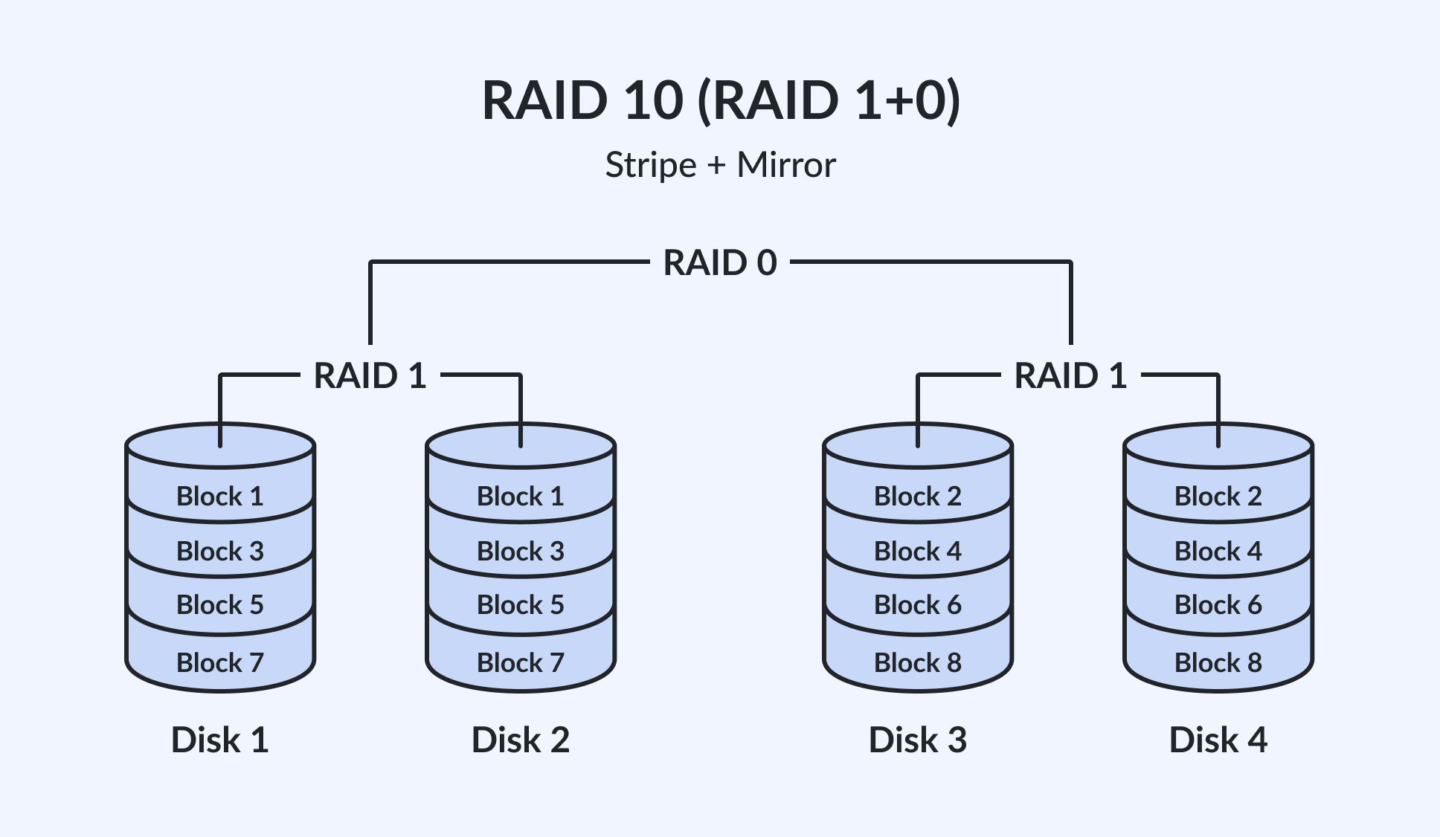
Nested RAID
RAID 1+0 – Striped Mirror
  Data is first mirrored, and then both copies are striped across multiple HDDs.
  When a drive fails, data is still accessible from its mirror.
  Rebuild operation only requires data to be copied from the surviving disk into the replacement disk.

Slide 64
Nested RAID – 1+0 (Mirroring and Striping)
RAID 0
Block 1
Block 3
Block 2
RAID
Controller
RAID 1
Block 2
Block 0
Block 0
Block 1
Host
Block 3

Slide 65
Nested RAID – 1+0 (Mirroring and Striping)
RAID 0
Block 0
Block 1
Block 2
Block 3
RAID
Controller
RAID 1
Block 0
Block 0
Block 1
Block 2
Host
Block 2
Block 3

Slide 66
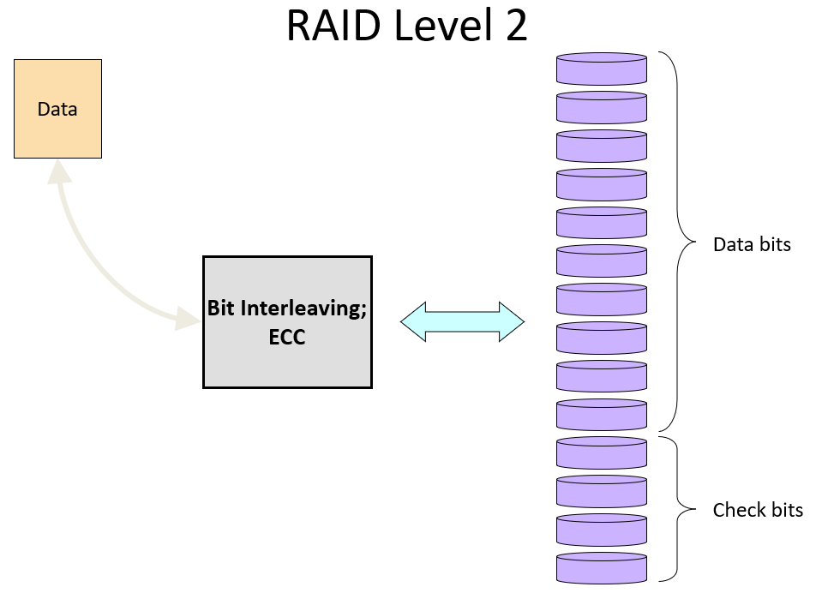
RAID LEVEL 2
Instead of duplicating the data blocks we use an error correction code
Very bad idea because disk drives either work correctly or do not work at all
  Only possible errors are omission errors
  We need an omission correction code
    A parity bit is enough to correct a single omission

Slide 67
RAID Levels 2, 3, and 4
RAID levels 2, 3, and 4 use ECC (error correcting code) or parity disks
  E.g., each byte on the parity disk is a parity function of the corresponding bytes on all the other disks
A read accesses all the data disks
A write accesses all the data disks plus the parity disk
On disk failure, read the remaining disks plus the parity disk to compute the missing data
data disks
parity disk

Slide 68
RAID Redundancy: Parity
0
4
1
6
5
9
RAID
Controller
1
?
3
7
Host
7
11
The middle drive fails:
Parity calculation 4 + 6 + 1 + 7 = 18
0 1 2 3
4 5 6 7
4 + 6 + ? + 7 = 18
? = 18 – 4 – 6 – 7
? = 1
18
Parity Disk

Slide 69
RAID LEVEL 3
Requires N+1 disk drives
  N drives contain data (1/N of each data block)
    Block b[k] now partitioned into N fragments b[k,1], b[k,2], ... b[k,N]
  Parity drive contains exclusive or of these N fragments
  p[k] = b[k,1] ⊕ b[k,2] ⊕ ... ⊕ b[k,N]

Slide 70
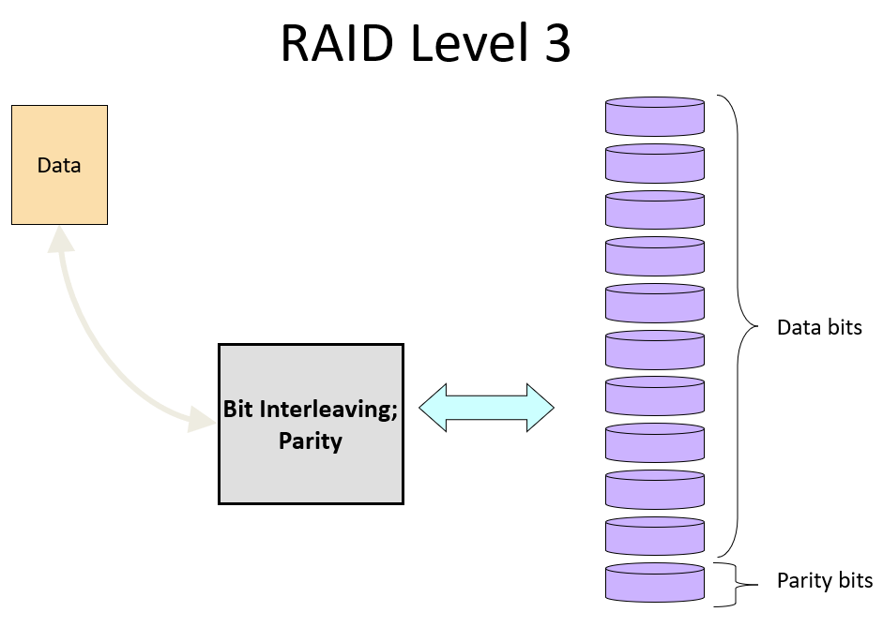

Slide 71
How parity works?
Truth table for XOR (same as parity)
A | B | A⊕B
0 | 0 | 0
0 | 1 | 1
1 | 0 | 1
1 | 1 | 0

Slide 72
Recovering from a disk failure
Small RAID level 3 array with data disks D0 and D1 and parity disk P can tolerate failure of either D0 or D1
D0 | D1 | P
0 | 0 | 0
0 | 1 | 1
1 | 0 | 1
1 | 1 | 0
D1⊕P=D0 | D0⊕P=D1
0 | 0
0 | 1
1 | 0
1 | 1

Slide 73
How RAID level 3 works (I)
Assume we have N + 1 disks
Each block is partitioned into N equal chunks
Block
N = 4 in
example
Chunk
Chunk
Chunk
Chunk

Slide 74
How RAID level 3 works (II)
XOR data chunks to compute the parity chunk
⊕
⊕
⊕
→
Parity
Each chunk is written into a separate disk
Parity

Slide 75
How RAID level 3 works (III)
Each read/write involves all disks in RAID array
  Cannot do two or more reads/writes in parallel
  Performance of array not better than that of a single disk

Slide 76
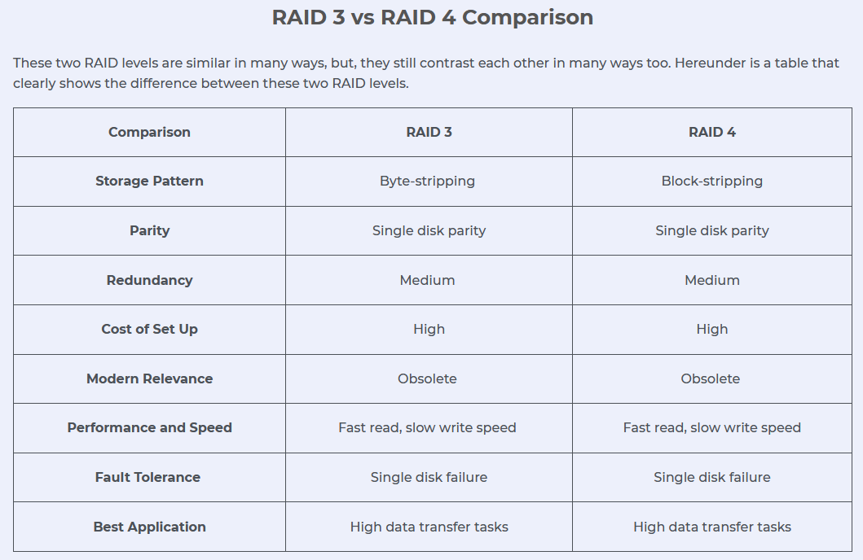
RAID 3 and RAID 4
Stripes data for high performance and uses parity for improved fault tolerance.
One drive is dedicated for parity information.
If a drive fails, data can be reconstructed using data in the parity drive.
For RAID 3, data read / write is done across the entire stripe.
  Provide good bandwidth for large sequential data access such as video streaming.
For RAID 4, data read/write can be independently on single disk.

Slide 77
RAID 3
Block 3
RAID
Controller
Block 2
Block 1
Block 0
Block 0
Block 1
Parity
Generated
Block 2
Host
Block 3
P 0 1 2 3

Slide 78
RAID LEVEL 4 (I)
Requires N+1 disk drives
  N drives contain data
    Individual blocks, not chunks
  Blocks with same disk address form a stripe
x
x
x
x
?

Slide 79
RAID LEVEL 4 (II)
Parity drive contains exclusive or of the
N blocks in stripe
  p[k] = b[k] ⊕ b[k+1] ⊕ ... ⊕ b[k+N-1]
Parity block now reflects contents of several blocks!
Can now do parallel reads/writes

Slide 80
RAID levels 4 and 5
Bottleneck
RAID level 4
RAID level 5

Slide 81
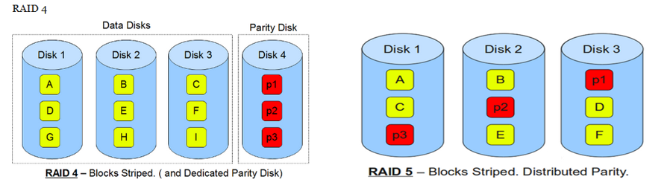
RAID LEVEL 5
Single parity drive of RAID level 4 is involved in every write
  Will limit parallelism
RAID-5 distribute the parity blocks among the N+1 drives
  Much better

Slide 82
RAID 5 and RAID 6
RAID 5 is similar to RAID 4, except that the parity is distributed across all disks instead of stored on a dedicated disk.
  This overcomes the write bottleneck on the parity disk.
RAID 6 is similar to RAID 5, except that it includes a second parity element to allow survival in the event of two disk failures.
  The probability for this to happen increases and the number of drives in the array increases.
  Calculates both horizontal parity (as in RAID 5) and diagonal parity.
  Has more write penalty than in RAID 5.
  Rebuild operation may take longer than on RAID 5.

Slide 83
RAID 5
Block 0
Block 0
Block 4
Block 4
Block 1
Block 5
Parity
Generated
Block 2
Parity
Generated
Block 4
RAID
Controller
Block 0
Block 0
Block 4
Block 6
P 0 1 2 3
P 4 5 6 7
Block 3
Host
P 4 5 6 7
P 4 5 6 7
P 0 1 2 3
P 0 1 2 3
Block 7

Slide 84
Other RAID organizations (I)
RAID 6:
  Two check disks
  Tolerates two disk failures
  More complex updates

Slide 85
RAID Comparison
RAID | Min Disks | Storage Efficiency % | Cost | Read Performance | Write Performance
0 | 2 | 100 | Low | Very good for both random and sequential read | Very good
1 | 2 | 50 | High | Good Better than a single disk | Good Slower than a single disk, as every write must be committed to two disks
3 | 3 | (n-1)*100/n where n= number of disks | Moderate | Good for random reads and very good for sequential reads | Poor to fair for small random writes Good for large, sequential writes
5 | 3 | (n-1)*100/n where n= number of disks | Moderate | Very good for random reads Good for sequential reads | Fair for random write Slower due to parity overhead Fair to good for sequential writes
6 | 4 | (n-2)*100/n where n= number of disks | Moderate but more than RAID 5 | Very good for random reads Good for sequential reads | Good for small, random writes (has write penalty)
1+0 and 0+1 | 4 | 50 | High | Very good | Good

Slide 86
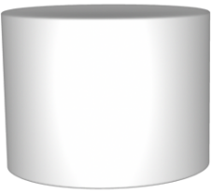

Hot Spares
If one of the drives within the disk fail, hot spare is ready to go, seamlessly taking over the functions of the failed drive without any action or intervention by the server's administrator.
A Cold Spare is a spare part that will require physical intervention by the user to engage the device.
RAID
Controller

Slide 87
What about flash drives?
Having no moving parts should mean fewer failures?
  Failures still happen
  Flash drives age as they are written to
  Irrecoverable red errors occur (at least as frequently as in magnetic disks?)
Pure Storage uses a proprietary 3D-RAID organization for their SSD stores

Slide 88
CONCLUSION (I)
RAID original purpose was to take advantage of Winchester drives that were smaller and cheaper than conventional disk drives
  Replace a single drive by an array of smaller drives
Current purpose is to build fault-tolerant file systems that do not need backups

Slide 89
CONCLUSION (II)
Low cost of disk drives made RAID level 1 attractive for small installations
Otherwise pick
  RAID level 6 for higher protection
    Can tolerate one disk failure and irrecoverable read errors

Slide 90
A review question
Consider an array consisting of four 750 GB disks
What is the storage capacity of the array if we organize it
  As a RAID level 0 array?
  As a RAID level 1 array?
  As a RAID level 5 array?

Slide 91
The answers
Consider an array consisting of four 750 GB disks
What is the storage capacity of the array if we organize it
  As a RAID level 0 array? 3 TB
  As a RAID level 1 array? 1.5 TB
  As a RAID level 5 array? 2.25 TB

Slide 92
Summary
Disks can cause reliability and performance problems
To mitigate such problems we can adopt “multiple disks” and accordingly gain:
  More capacity
  Redundancy
  Concurrency
To achieve only redundancy we can apply mirroring
To achieve only concurrency we can apply striping
To achieve redundancy and concurrency we can apply RAID (e.g., levels 2, 3, 4 or 5)

Slide 93
QUIZ
RAID Levels
RAID 0 (Striping):
  Purpose: High performance.
  No Redundancy: If one drive fails, data is lost.
  Use Case: Non-critical systems requiring high speed.
RAID 1 (Mirroring):
  Purpose: Redundancy.
  Data Safety: Copies data to multiple drives.
  Use Case: Critical systems with moderate performance needs.
RAID 5 (Striping with Parity):
  Purpose: Balance of redundancy and performance.
  Fault Tolerance: Can sustain one drive failure.
  Use Case: Databases or file servers.

Slide 94
QUIZ
RAID 6 (Striping with Dual Parity):
  Purpose: Enhanced redundancy.
  Fault Tolerance: Can sustain two drive failures.
  Use Case: Large storage systems with high fault tolerance.
RAID 10 (1+0):
  Purpose: Combines RAID 1 (mirroring) and RAID 0 (striping).
  High Cost: Requires at least four drives.
  Use Case: High-performance systems needing redundancy.
RAID 50 and 60:
  Purpose: Nested RAID levels offering more performance and redundancy.
  Use Case: Enterprise-level storage.

Slide 95
Solution
How many drives are required for each RAID level?
Solution:
  RAID 0: Minimum 2 drives.
  RAID 1: Minimum 2 drives.
  RAID 5: Minimum 3 drives.
  RAID 6: Minimum 4 drives.
  RAID 10: Minimum 4 drives.
5. What is the usable storage capacity of RAID arrays?
Solution:
  RAID 0: Total capacity = Sum of all drives.
  RAID 1: Total capacity = Capacity of one drive.
  RAID 5: Total capacity = (N-1) x Drive Capacity (where N = number of drives).
  RAID 6: Total capacity = (N-2) x Drive Capacity.
  RAID 10: Total capacity = 50% of total drive capacity.

Slide 96
1. Problem:
A RAID 10 array has 8 disks of 1 TB each. What is the usable storage capacity and fault tolerance?
2. Problem:
A RAID 6 array consists of 6 disks, each 10 TB. What is the total usable storage, and how many disk failures can it tolerate?
3. Problem:
A RAID 10 array has 8 disks of 1 TB each. What is the usable storage capacity and fault tolerance?
4. Problem:
Explain why RAID is not a substitute for backups.

Slide 97
Solutions
1. Problem:
A RAID 10 array has 8 disks of 1 TB each. What is the usable storage capacity and fault tolerance?
Solution:
Usable storage = Half the total disk size = (8 / 2) × 1 TB = 4 TB.
  Fault tolerance: Can tolerate multiple disk failures as long as no mirrored pair is lost.
2. Problem:
A RAID 6 array consists of 6 disks, each 10 TB. What is the total usable storage, and how many disk failures can it tolerate?
Solution:
  Usable storage = (Number of disks - 2) × Disk size = (6 - 2) × 10 TB = 40 TB.
  Tolerates up to 2 disk failures.
3. Problem:
A RAID 10 array has 8 disks of 1 TB each. What is the usable storage capacity and fault tolerance?
Solution:
  Usable storage = Half the total disk size = (8 / 2) × 1 TB = 4 TB.
  Fault tolerance: Can tolerate multiple disk failures as long as no mirrored pair is lost.
4. Problem:
Explain why RAID is not a substitute for backups.
Solution:
  RAID protects against hardware failures but not against data corruption, accidental deletion, or malware. Backups provide an independent data copy for recovery.

Slide 98
5. Problem
Calculate the probability of failure in a RAID 6 array with 5 disks, each with a 2% failure rate over a year.
6. Rebuilding a RAID 5 Array
RAID 5 setup with 4 disks: Disk A, Disk B, Disk C, and Disk D (parity disk rotates).
Each disk contains 4 blocks of data.
Disk A fails, and we need to rebuild its data using the parity information.
Data Structure Before Failure:
Block | Disk A | Disk B | Disk C | Disk D (Parity)
1 | 5 | 7 | 3 | P1
2 | 2 | 4 | 6 | P2
3 | 1 | 8 | 2 | P3
4 | 9 | 3 | 7 | P4

Slide 99
Solutions
5. Problem:
Calculate the probability of failure in a RAID 6 array with 5 disks, each with a 2% failure rate over a year.
Solution:
  Probability of a single disk failing = 0.02.
  Probability of two simultaneous failures ≈ (0.02 × 0.02) = 0.0004 or 0.04%.

Slide 100
Solutions
Parity Calculation (XOR for each block):
P1 = A1 ⊕ B1 ⊕ C1
P2 = A2 ⊕ B2 ⊕ C2, and so on.
Rebuilding Disk A (Example for Block 1):
Known values:
B1=7,C1=3,P1=1
Calculate missing A1:
A1=P1⊕B1⊕C1
A1=1⊕7⊕3
A1=5.
Repeat this calculation for all blocks to restore Disk A.

