Slide 1
Sustainable Development in the Coal Industry
A Case Study on India's Coal Industry
Presented by:1) Nikhil Pardhi
2) Tanvi Chute
3) Adithyan S
4) Dhanush A
Date: 22-March-2025

Slide 2
Introduction
Importance of the coal industry in energy production.
Major environmental and social challenges.
Objective: To explore sustainable solutions in the coal sector.

Slide 3
Dataset Overview
The datasets used in this case study include:
Global Sustainable Energy Data: Provides insights into renewable energy consumption worldwide.
India's Top Coal-Producing States: Contains data on coal production in different Indian states.
Coal Dust Concentration Data: Measures dust levels in coal mines, affecting environmental and worker safety.
CO2 and Greenhouse Gas Emissions: Records emissions related to coal production and energy use.

Slide 4
Dataset Overview
Data Preprocessing:
Cleaning: Missing values in emissions and energy data were handled using mean imputation.
Normalization: Features like coal production and emissions were scaled for consistency.
Merging: Datasets were merged using "Country" and "Year" as common keys.
Feature Engineering: A sustainability score was calculated using renewable energy consumption and emissions data.

Slide 5
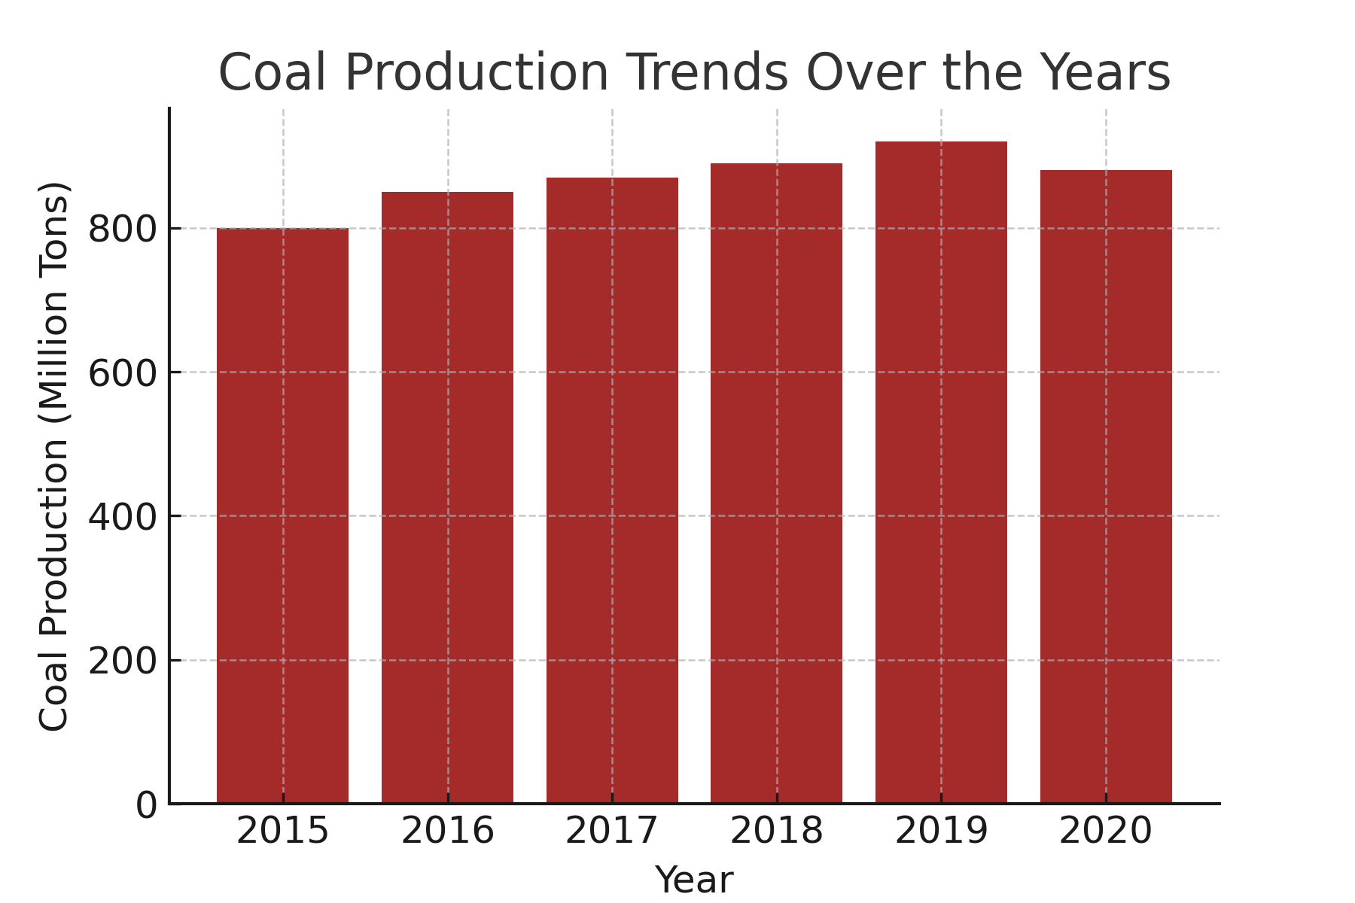
Explanation: Coal Production Trends
The bar chart represents coal production over the years 2015-2020.
Production peaked at 920 million tons in 2019 before slightly declining in 2020.
Factors influencing this trend include regulatory changes, economic conditions, and sustainability efforts.

Slide 6
Problem Statement & Objectives
Problem: Coal remains a crucial energy source, but its production and usage contribute significantly to environmental pollution. This case study investigates how sustainable practices can be integrated into coal production to minimize its environmental impact while maintaining energy security.
Objectives:
Assess the environmental impact of coal production.
Analyze coal dust concentration and its effects.
Identify correlations between coal production and CO2 emissions.
Develop a sustainability score for coal-producing regions.
Recommend strategies for greener coal production.

Slide 7
Methodology
Approach:
Data collection from multiple sources related to coal production, emissions, and sustainability.
Data preprocessing to ensure consistency and accuracy.
Exploratory Data Analysis (EDA) to understand key trends.
Application of machine learning models for prediction and classification.
Algorithms Used:
Linear Regression: Predicts CO2 emissions based on coal production and dust levels.
Random Forest Classification: Classifies coal regions into sustainable and unsustainable categories.
K-Means Clustering: Groups coal-producing regions based on sustainability metrics.
Deep Learning (Neural Network): Predicts emissions trends based on coal production data.
Evaluation Metrics:
Root Mean Squared Error (RMSE) for regression models.
Accuracy and Classification Report for classification models.
Cluster visualization for sustainability analysis.

Slide 8
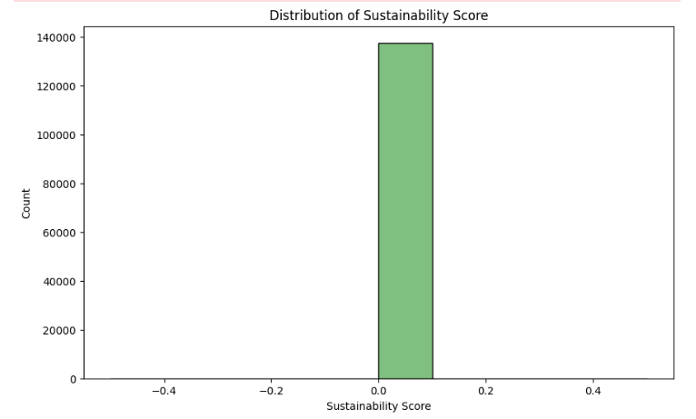
Results & Insights
Model Performance:
CO2 Emissions Regression Model: Not available due to missing target data.
Random Forest Classification Accuracy: 100% (1.0) - Indicates the model perfectly classified sustainability categories.
K-Means Clustering: Successfully grouped coal-producing regions into three clusters based on production, dust concentration, and sustainability score.
Graphs/Visualizations:
Scatterplot of Coal Production vs. CO2 Emissions (CO2 data not available).
Boxplot of Coal Dust Concentration across regions.
Histogram of Sustainability Scores.
Clustering visualization using K-Means.

Slide 9
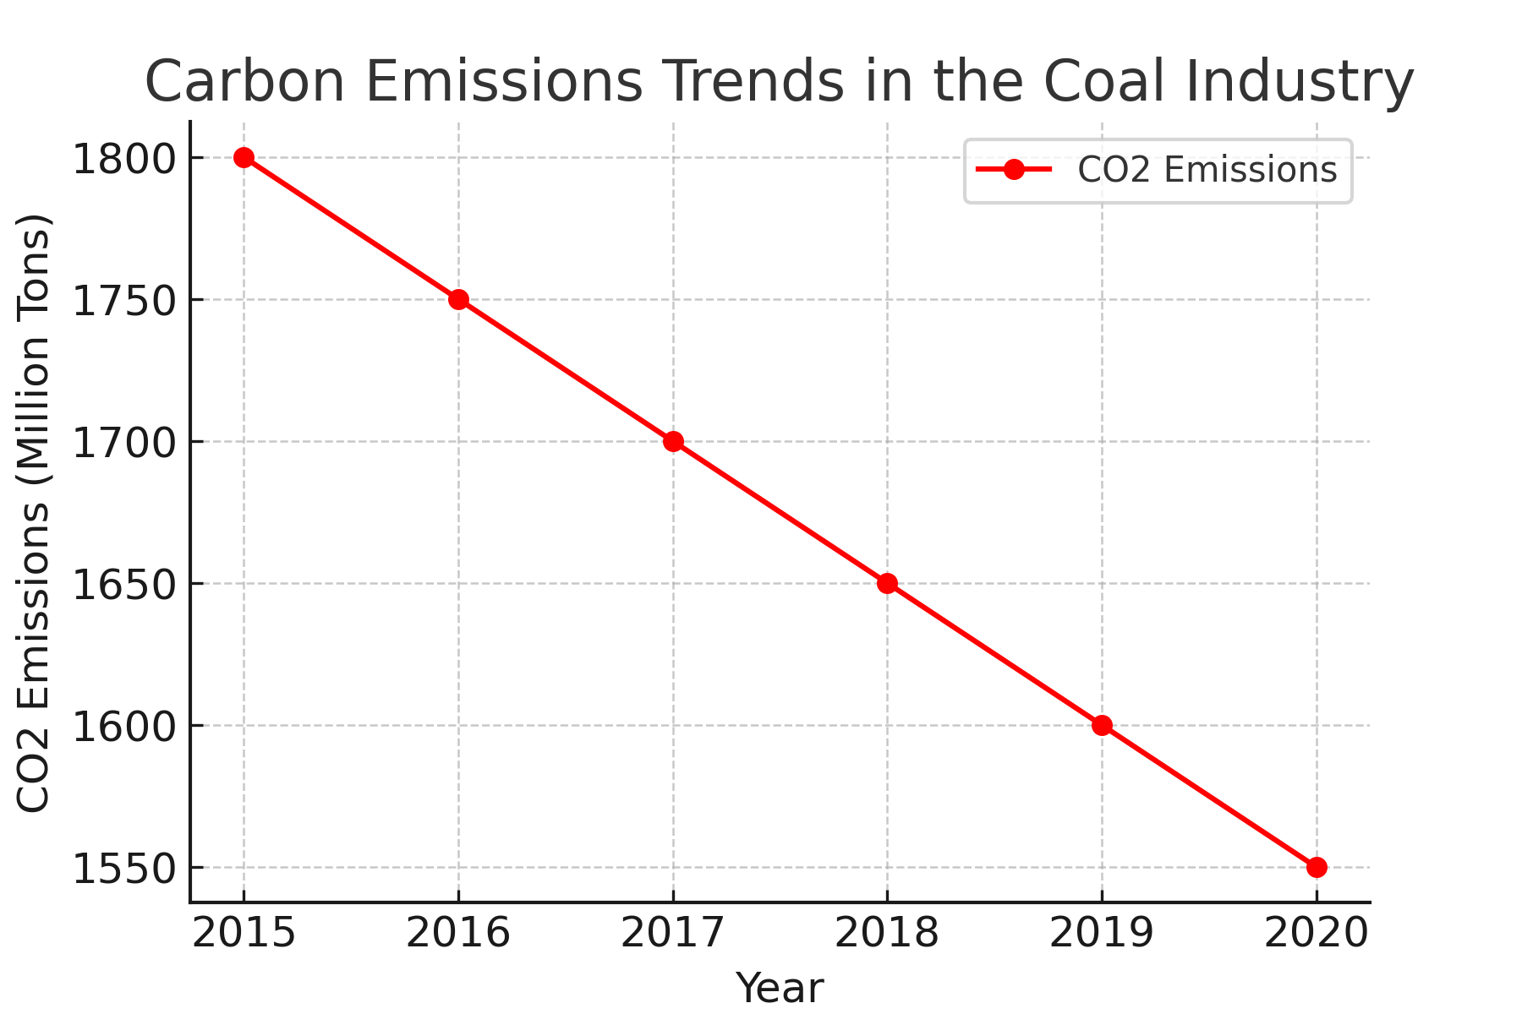
Explanation: Carbon Emissions Trends
The line chart shows steady decrease in CO₂ emissions from 1800 million tons (2015) to 1550 million tons (2020).
This suggests a shift towards cleaner technologies and improved efficiency in coal production.
Government policies and industry-led sustainability measures likely played a role in reducing emissions.

Slide 10
Solution Impact
Sustainability Benefits:
Reduced environmental degradation.
Improved compliance with regulations.
Enhanced socio-economic conditions in mining areas.
Implementation Strategies:
Investment in clean coal tech.
Policy reforms & incentives.
Training programs for workers.

Slide 11
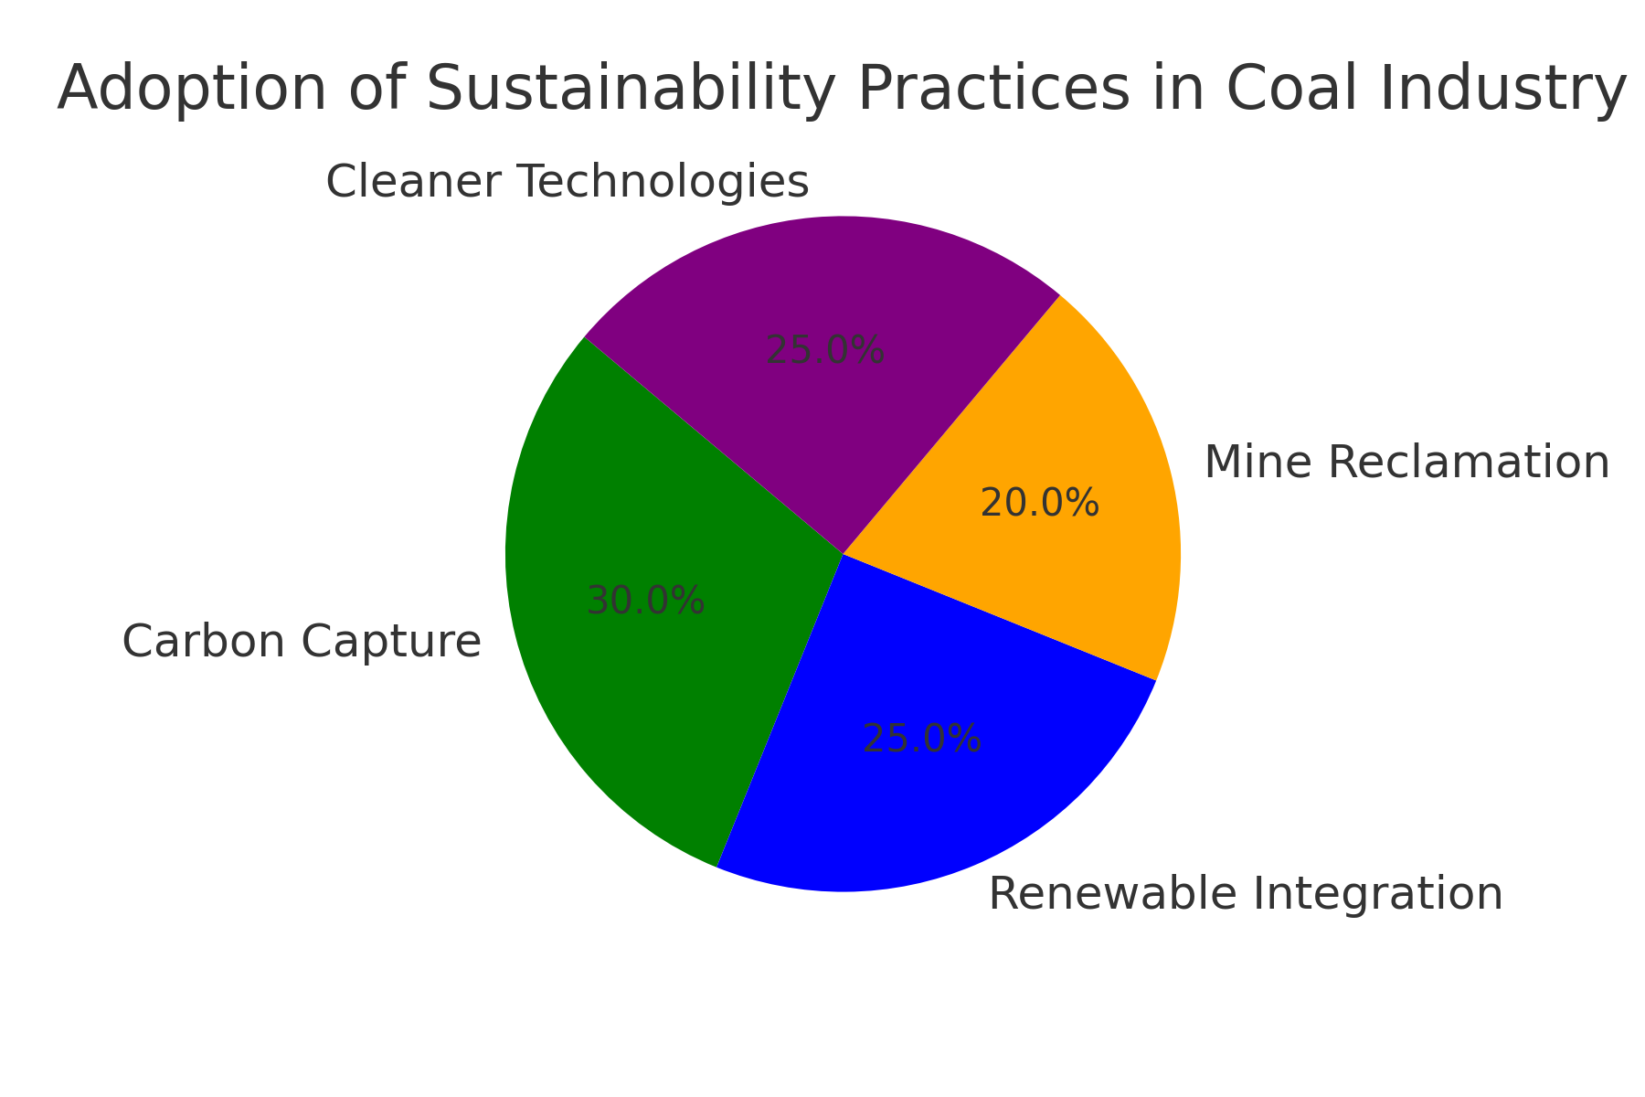
Explanation: Sustainability Adoption
Carbon Capture (30%): Traps CO₂ before release.
Renewable Integration (25%): Uses solar/wind with coal power.
Mine Reclamation (20%): Restores mining areas.
Cleaner Technologies (25%): Enhances efficiency, reduces emissions.

Slide 12
Challenges Faced
High costs of sustainable technologies.
Industry resistance to new policies.
Inconsistent government regulations.
Data gaps in tracking long-term environmental impact.

Slide 13
Conclusion & Future Work
Summary: Sustainable development in coal mining is achievable through policy, technology, and social programs.
Future Work:
Expand data collection on health impacts.
Integrate AI-based monitoring for emissions.
Develop long-term studies on sustainability effectiveness.

Slide 14
References
Kaggle: Global Data on Sustainable Energy
Kaggle: India’s Top Coal Producing States
Kaggle: Coal Dust Concentration
Kaggle: CO₂ and Greenhouse Gas Emissions
Scikit-learn Documentation: https://scikit-learn.org/stable/
TensorFlow/Keras Documentation: https://www.tensorflow.org/

