Slide 1
Business Profile Service
Nikhil Patwari • 06.10.2023

Slide 2
Overview
Requirements
Functional
Develop CRUD API’s for Business Profile
Create/Update to Business Profile must be approved by subscribed products.
Non Functional
Expected Load - 1000TPS
Expected response time - <100ms

Slide 3
Assumptions
Subscribed product discovery is done by saving/retrieving list of products from/to Business Profile
When create api called - Duplicacy check is done by checking for PAN or EIN
Business profile Create and updated api adds calling product to Subscribed Product List
Kubernetes used for deployment for ease of scaling and rolling updates and pod management
Whenever a new product is added its URL has to be added in application.properties
Assuming sufficient hardware resources are in place with optimal settings
Assuming Approval API does at most 1 db call

Slide 4
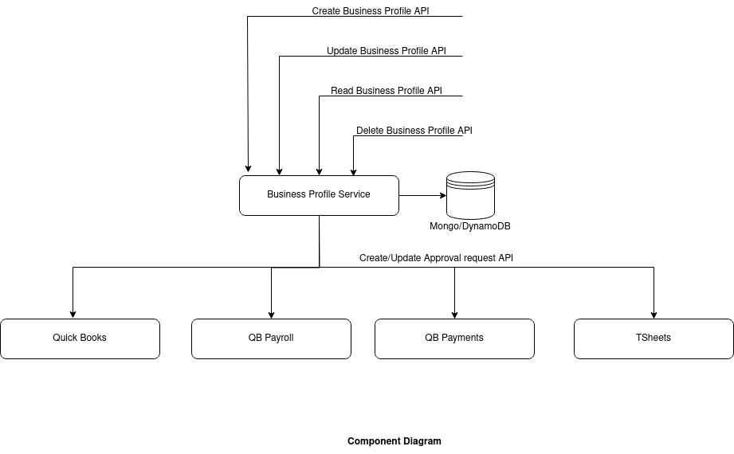
Component Diagram

Slide 5
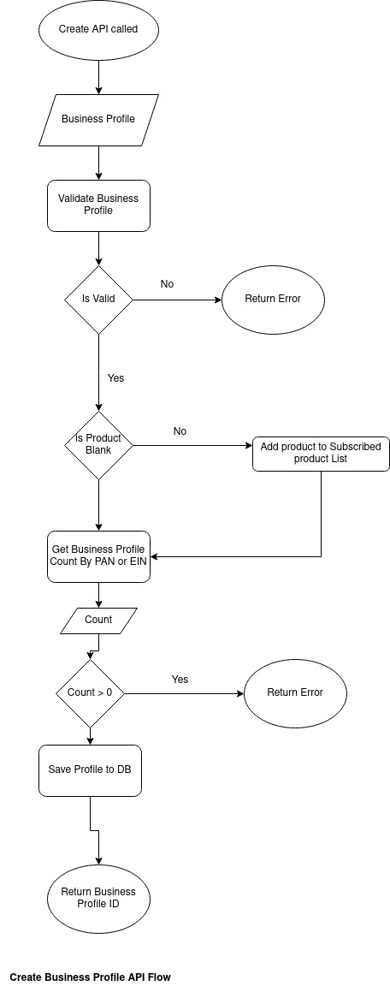

Slide 6
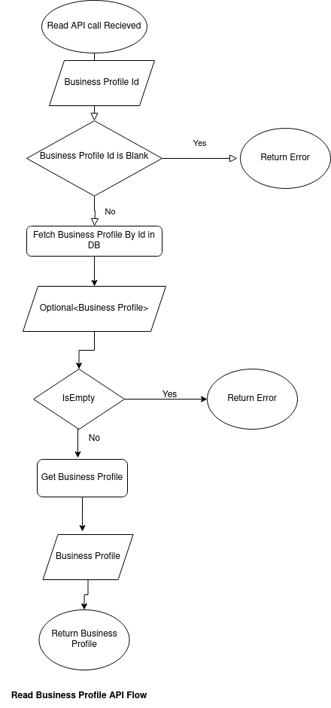

Slide 7
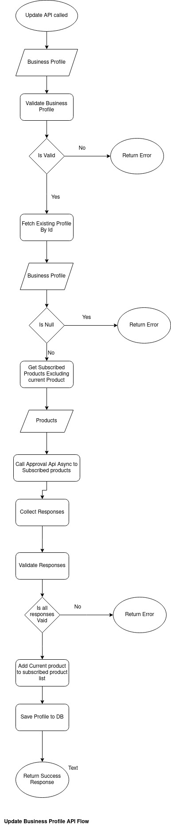

Slide 8
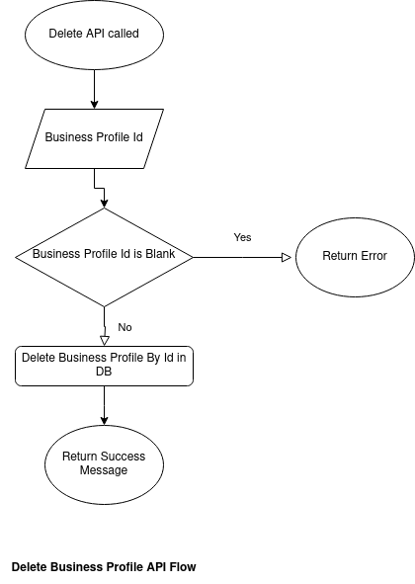

Slide 9
Optimizations
Database
Connection Pooling
Create indexes on fields id, pan, ein, pan&ein.
Approval API calls
Call Subscribed products excluding calling product.
Call all api in parallel
Thread pooling

Slide 10
Resilience
Hystrix
Timeout - 500ms
Error Threshold Percentage - 50
Request Volume threshold - 5
Http Status 4XX are ignored as the are expected
Retry
Retry count - 3
Only Failed responses are retried (Declined ie 4XX are ignored)

Slide 11
THANK YOU

