Slide 1
Technical Approach to AI-Powered Data Discovery
Advanced AI Solutions for Manufacturing Excellence

Slide 2
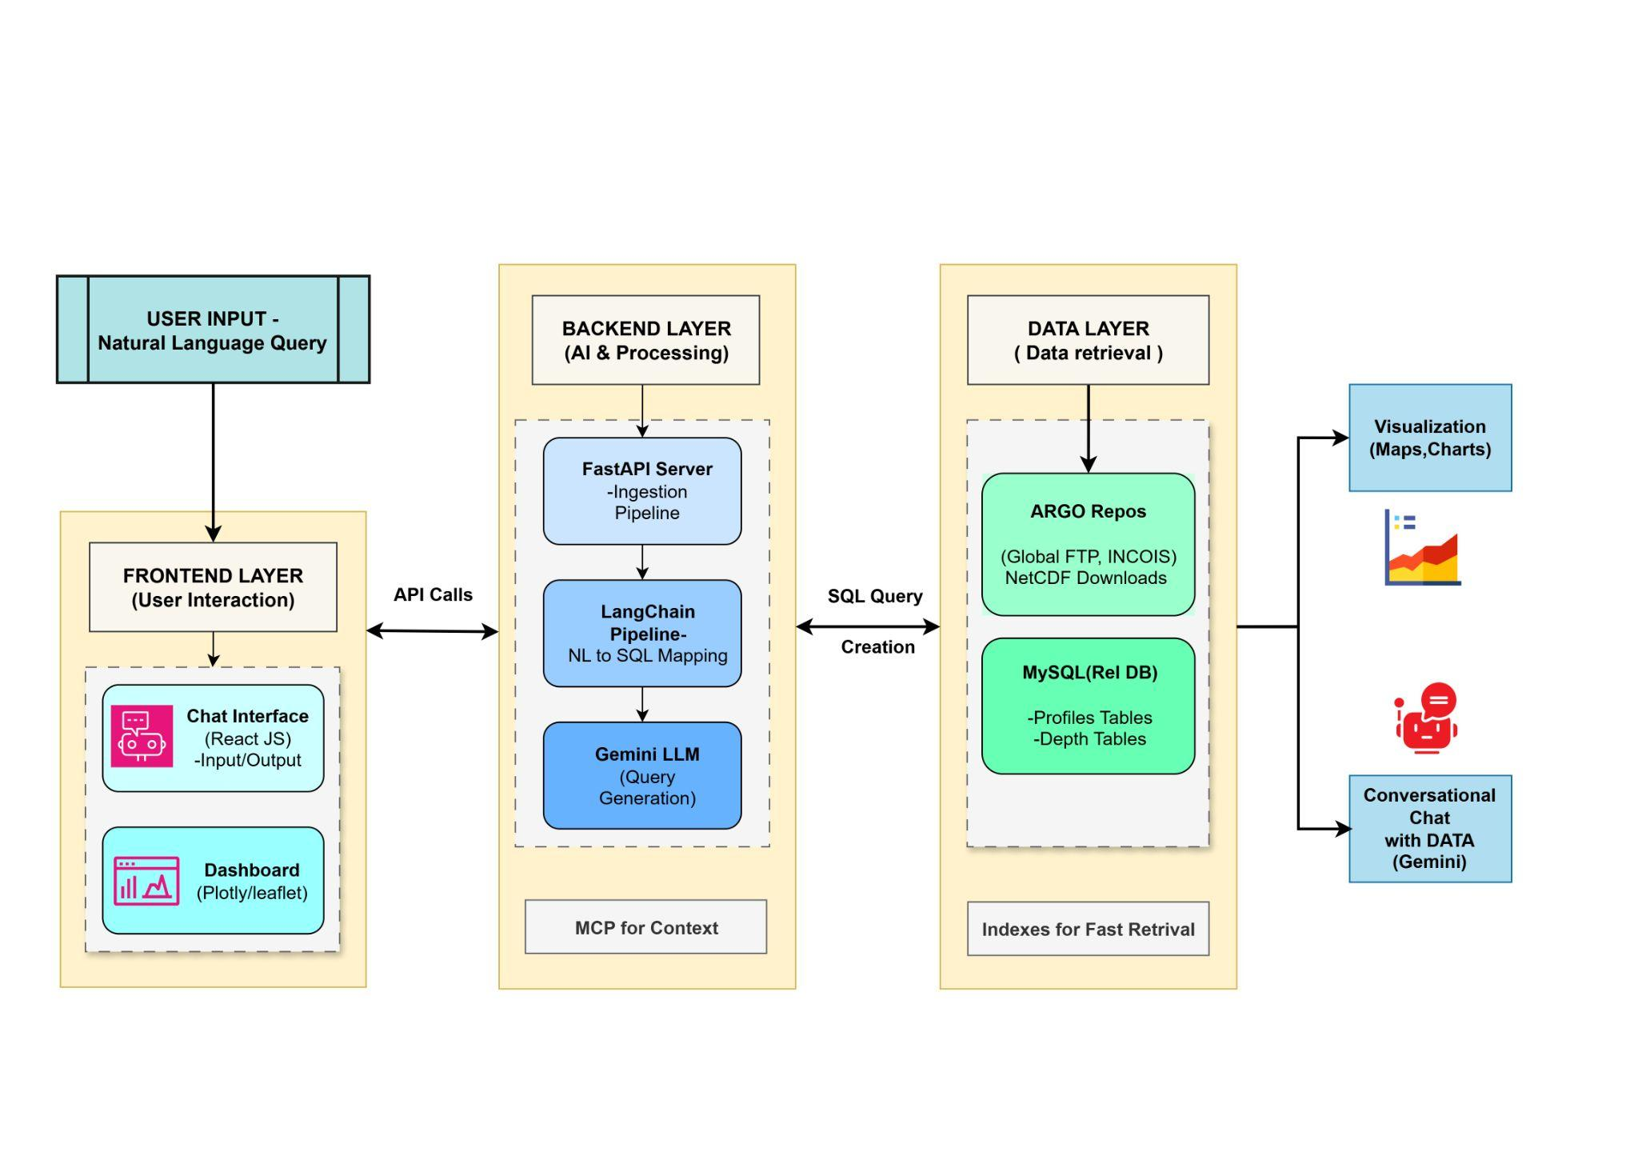
Overview of FloatChat
KEY POINTS
▸ • FloatChat is an AI-powered conversational interface designed for ARGO ocean data discovery.
▸ • Utilizes advanced technologies to enhance user interaction with complex datasets.
▸ • Focuses on providing a no-code solution for researchers and scientists, simplifying data access.
2/6

Slide 3
Technical Stack and Architecture
KEY POINTS
▸ • Built on a robust tech stack including Python, FastAPI, LangChain, Gemini, and MySQL.
▸ • Scalable architecture designed to handle high traffic and large datasets efficiently.
▸ • MySQL serves as a reliable database solution, supporting complex queries and future expansion.
🖼️
Visual Content
3/6

Slide 4
Risk Management Strategies
KEY POINTS
▸ • Market Risk: Building trust within the scientific community is crucial for user adoption.
▸ • Operational Risk: Dependency on external services necessitates a robust monitoring system.
▸ • Implement caching strategies to reduce costs and improve response times for frequent queries.
🖼️
Visual Content
4/6

Slide 5
Feasibility and Viability Analysis
KEY POINTS
▸ • High demand in academia for tools that simplify access to complex scientific data.
▸ • Limited competition in the market for conversational, no-code interfaces.
▸ • Technical risks include potential inaccuracies in SQL generation by the AI, impacting performance.
🖼️
Visual Content
5/6

Slide 6
Engagement and Feedback Mechanisms
KEY POINTS
▸ • Active engagement with university and research communities to gather feedback.
▸ • Ensuring the tool meets rigorous standards for precision and transparency.
▸ • Continuous improvement based on user insights to foster trust and enhance adoption.
🖼️
Visual Content
6/6

