Slide 1
Technical Approach to AI-Powered Data Accessibility
Advanced AI Solutions for Manufacturing Excellence

Slide 2
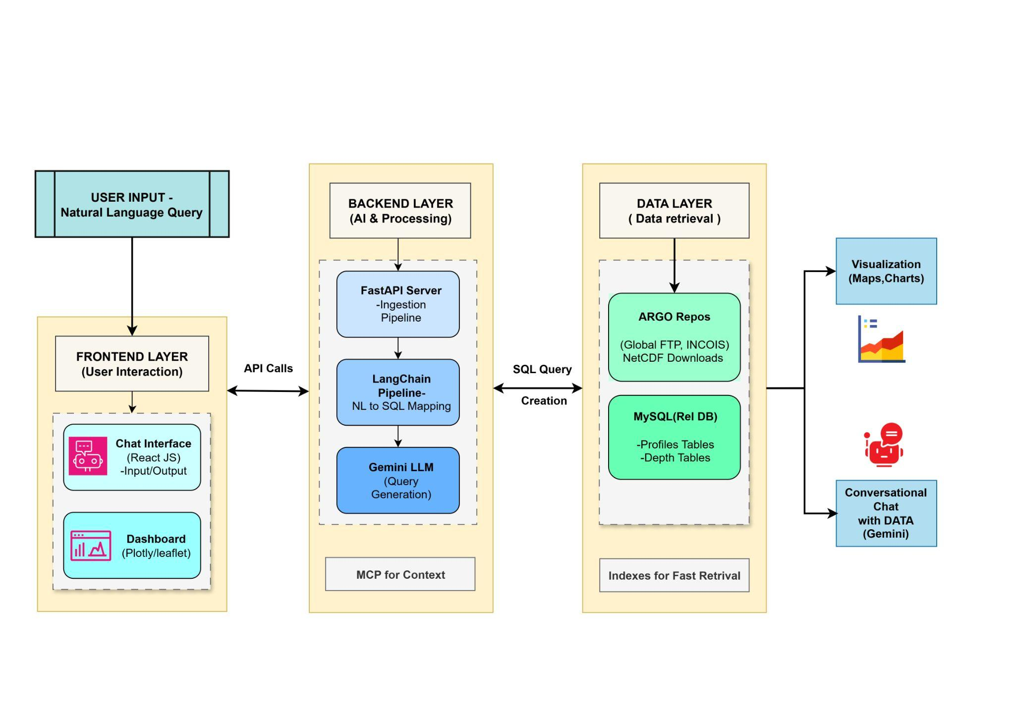
Overview of FloatChat
KEY POINTS
▸ • FloatChat is an AI-powered conversational interface designed for ARGO ocean data discovery and visualization.
▸ • Utilizes advanced technologies including Python, FastAPI, and MySQL for robust performance.
▸ • Empowers users to access complex oceanographic data without needing programming skills, democratizing data access.
2/6

Slide 3
Addressing Technical and Market Risks
KEY POINTS
▸ • Enhancing AI accuracy through advanced prompt engineering and a validation layer to ensure SQL correctness.
▸ • Engaging with the scientific community to build trust and ensure the tool meets rigorous standards.
▸ • Implementing a monitoring system for external services to mitigate operational risks and improve reliability.
🖼️
Visual Content
3/6

Slide 4
Unique Value Propositions
KEY POINTS
▸ • Democratized Data Access: Enables users to interact with scientific data without coding.
▸ • Accelerated Time-to-Insight: Reduces data analysis time from hours to seconds.
▸ • Zero Learning Curve: Intuitive interface eliminates the need for complex query languages.
🖼️
Visual Content
4/6

Slide 5
Impacts and Benefits
KEY POINTS
▸ • Supports advanced AI-driven oceanographic studies, enhancing research capabilities.
▸ • Facilitates evidence-based decision-making for marine conservation and climate policy.
▸ • Transforms education by providing interactive tools for students and educators to engage with real-world data.
🖼️
Visual Content
5/6

Slide 6
Feasibility and Scalability
KEY POINTS
▸ • Technical feasibility confirmed with a scalable architecture capable of handling large datasets.
▸ • Market demand is high for tools simplifying access to complex scientific data, with few competitors offering similar solutions.
▸ • Operational feasibility supported by a skilled team and a clear maintenance strategy for ongoing success.
🖼️
Visual Content
6/6

