Slide 1

Introduction to Aksha
AI-Powered Solution

Slide 2

What is Aksha?
• Aksha is an intelligent surveillance system designed for automated monitoring with minimal human intervention.
• Utilizes advanced technologies such as Computer Vision, Artificial Intelligence, and Generative AI.
• Capable of detecting objects and unusual situations, performing analysis, and initiating actions.
AI Presentation
2

Slide 3
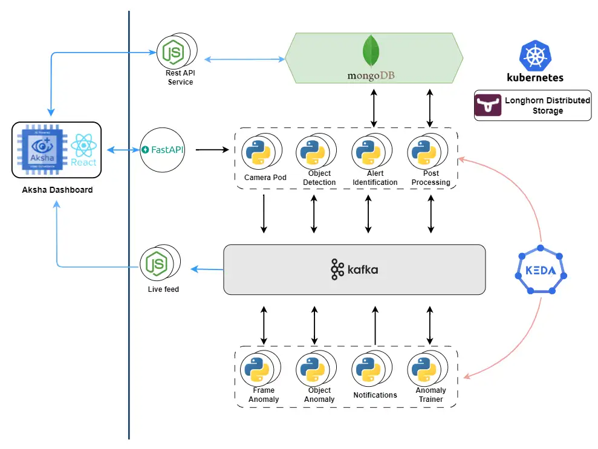
Architectural Approaches
• Offers multiple architectural configurations: On-Premise, Edge & Cloud, and UI on Cloud with Backend on Edge.
• Flexible deployment options to suit varying business needs and infrastructure.
• Supports seamless integration with existing systems for enhanced functionality.
AI Presentation
3

Slide 4
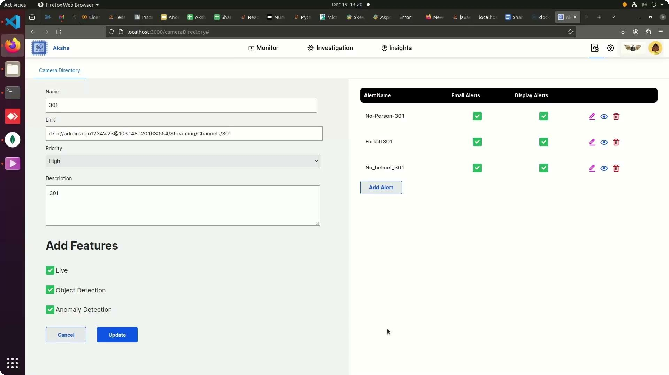
Key Features of Aksha
• Live data recording and processing with real-time object detection capabilities.
• Generates insightful reports and analysis using Generative AI for informed decision-making.
• Customizable alerts enabling users to respond promptly to detected anomalies.
AI Presentation
4

Slide 5
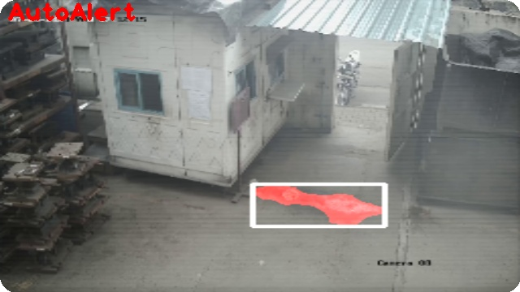
Collaboration and Customization
• Collaborated with NDIL to customize Aksha for enhanced worker safety, integrating Edge + Cloud solutions.
• Implemented three phases of development, including Gen AI enhancements for improved features.
• Successful proof of concept on Raspberry Pi 4B, showcasing adaptability and performance.
AI Presentation
5

Slide 6
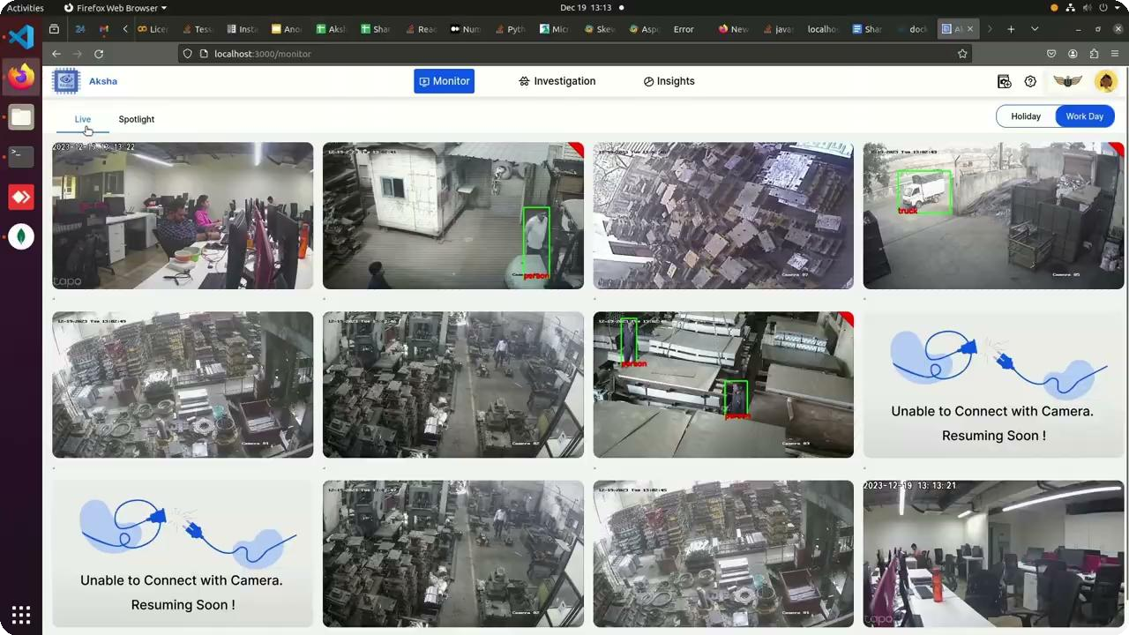
Customer Testimonials
• Clients report significant reductions in human monitoring efforts and improved detection of abnormal events.
• Positive feedback highlights the innovative use of CCTV technology for enhanced operational safety.
• Customers express eagerness for future updates and innovations from Aksha.
AI Presentation
6

Slide 7
Scalability and Architecture Advantages
• Effortless scalability through microservices managed by Kubernetes, accommodating high message volumes.
• Decoupled architecture enhances fault tolerance and simplifies service development and deployment.
• Real-time data processing capabilities ensure timely insights and actions, maintaining high availability.
AI Presentation
7

Slide 8
Installation and Compatibility
• Installation requires connecting to the same network or obtaining camera RTSP links.
• Compatible with any standard CCTV camera providing RTSP links, ensuring broad applicability.
• Streamlined installation process enhances user experience and operational efficiency.
AI Presentation
8

