Slide 1

Transforming Surveillance with Aksha: The Future of Intelligent Monitoring
AI-Powered Solution

Slide 2
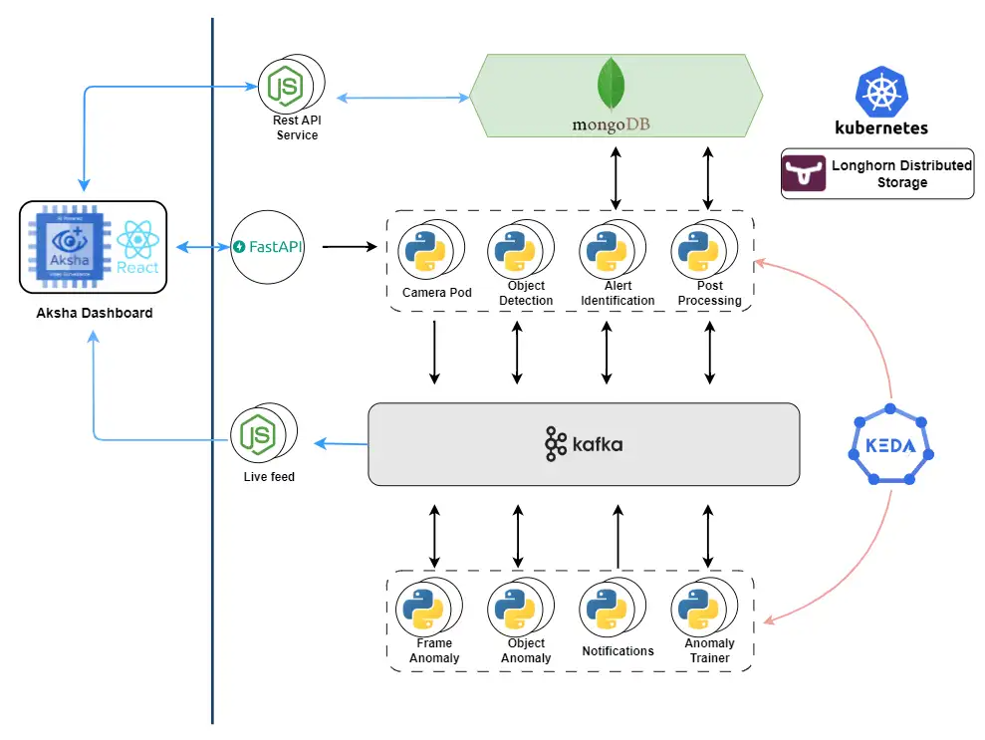
Introduction to Aksha
• Aksha is an intelligent surveillance system designed to enhance employee safety and operational efficiency.
• Utilizes advanced technologies like AI and Gen AI for real-time monitoring and anomaly detection.
• Minimizes human intervention by automatically detecting objects and unusual situations.
AI Presentation
2

Slide 3

Key Features of Aksha
• Live recording and data processing for continuous oversight.
• Customizable alerts for various scenarios, ensuring immediate response capabilities.
• Comprehensive object detection including people, vehicles, and specific behaviors (e.g., no helmet).
AI Presentation
3

Slide 4
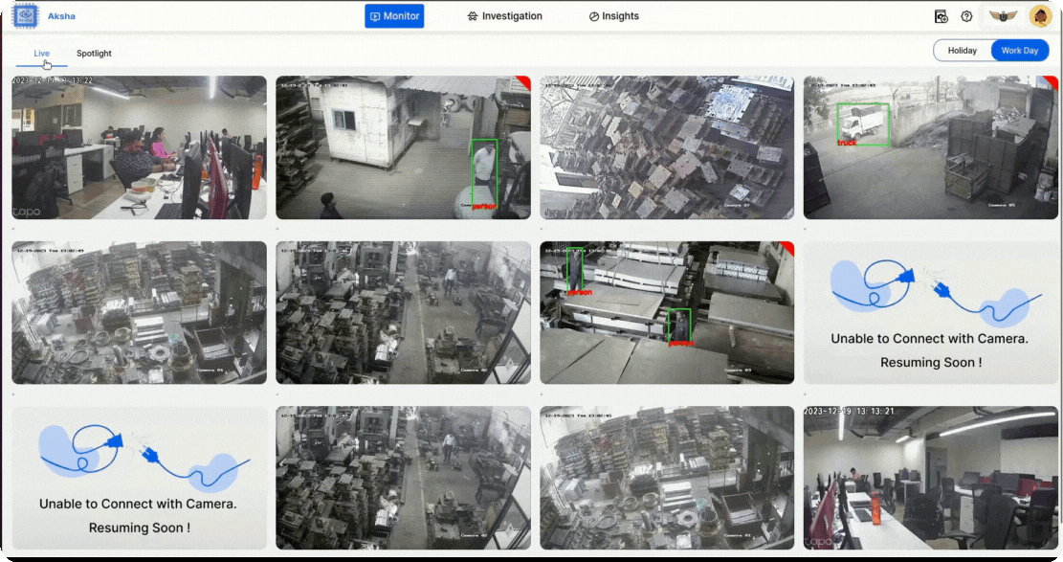
Business Value and Applications
• Transforms traditional CCTV setups into smart surveillance systems, enhancing security measures.
• Offers 24/7 monitoring with real-time alerts, reducing response times to incidents.
• Generates insightful reports for data-driven decision-making and operational improvements.
AI Presentation
4

Slide 5
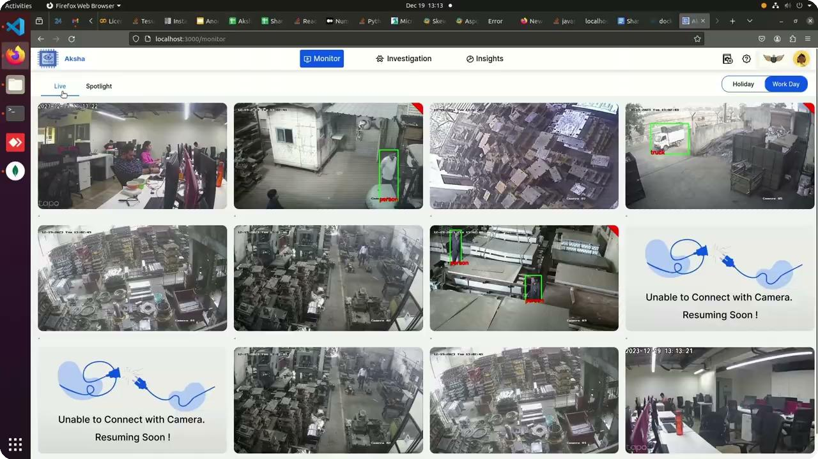
Seamless Integration and Compatibility
• Compatible with any standard CCTV camera that provides RTSP links, ensuring flexibility.
• Supports various architectural approaches including on-premise and cloud solutions.
• Easily integrates with third-party systems, enhancing existing security infrastructures.
AI Presentation
5

Slide 6
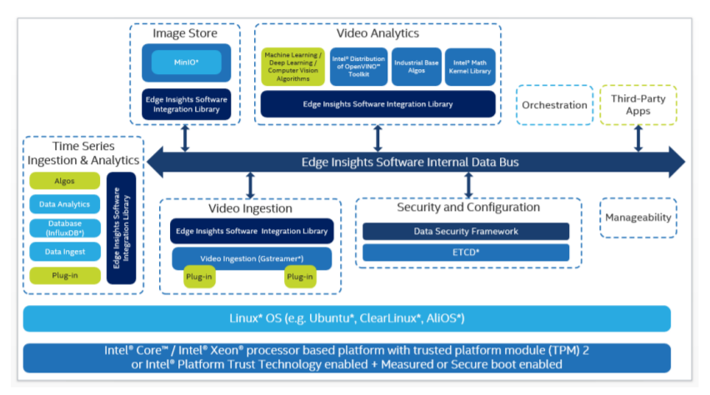
Getting Started with Aksha
• Simple installation process: Connect to the same network as your cameras and install Aksha on an edge device.
• Low capital expenditure with SaaS-based pricing models for cost-effective deployment.
• Contact us for a personalized demo and to explore how Aksha can meet your surveillance needs.
AI Presentation
6

