Slide 1
Unlocking Financial Insights with Algofabric

Slide 2
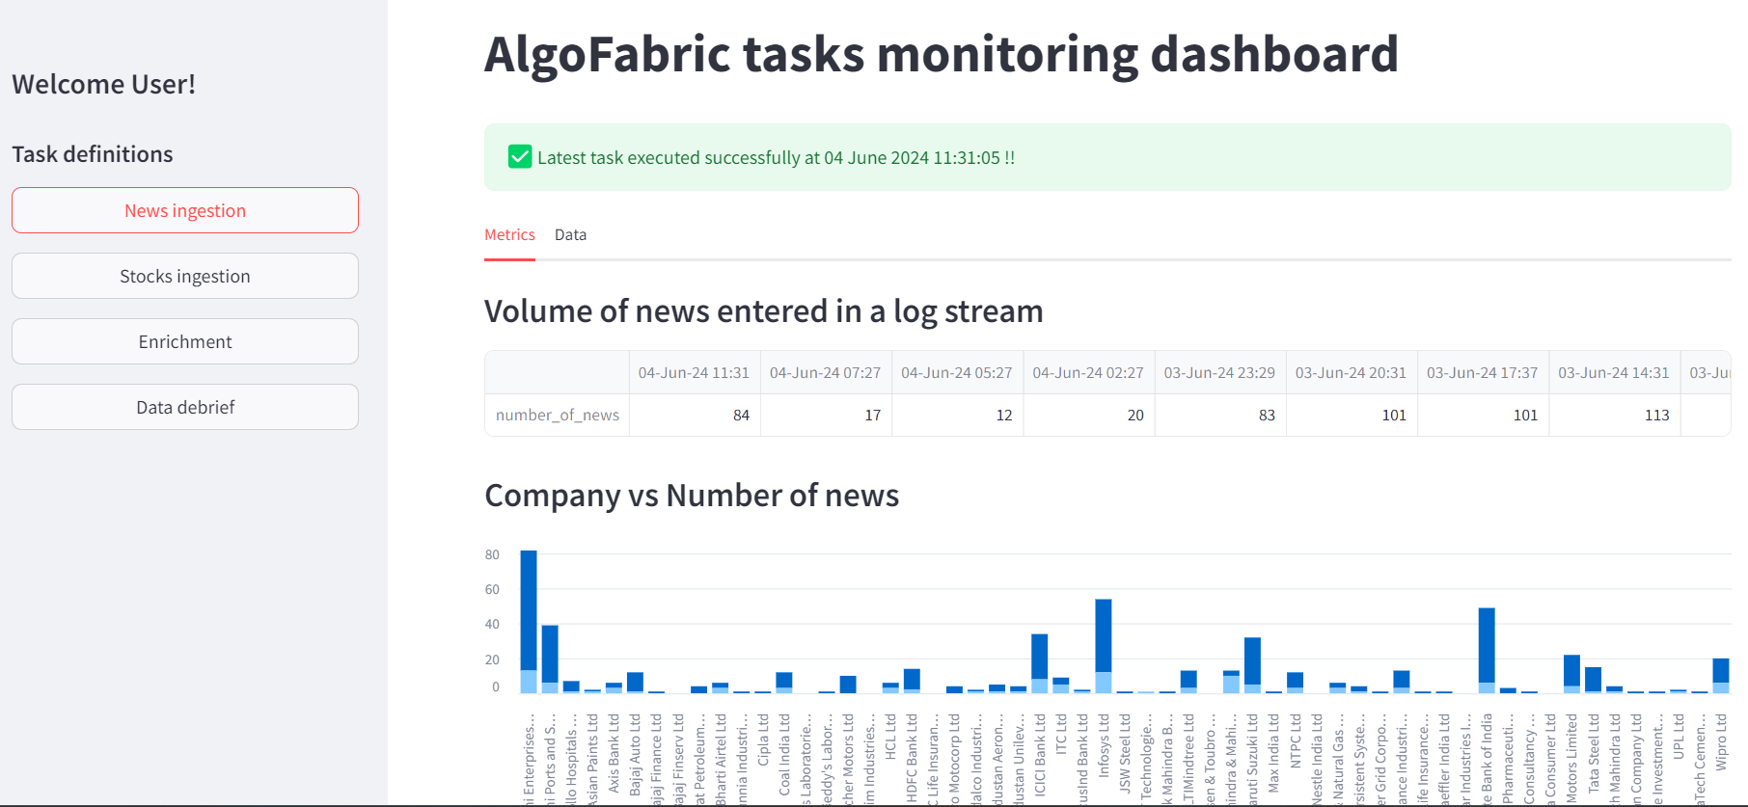
Overview of Algofabric
• • AI-powered financial insights platform designed for traders and investors.
• • Combines contextual and numerical data analysis for informed decision-making.
• • Real-time access to diverse data types including news, social media, and market trends.

Slide 3
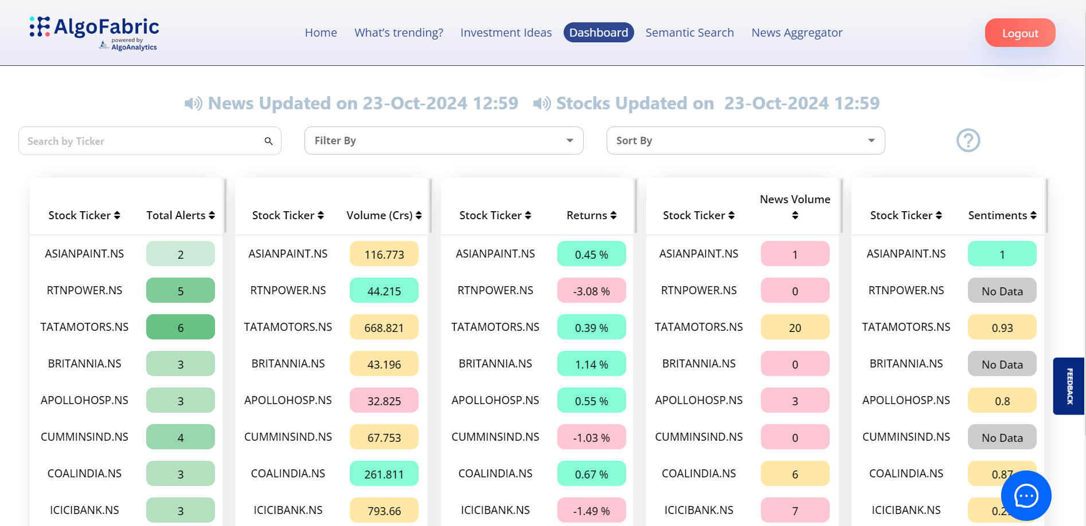
Key Features of Algofabric
• • Intelligent stock insights powered by advanced NLP models.
• • Dashboard for monitoring backend tasks, enhancing debugging efficiency.
• • Mutual fund investment composition display for comprehensive asset management.

Slide 4
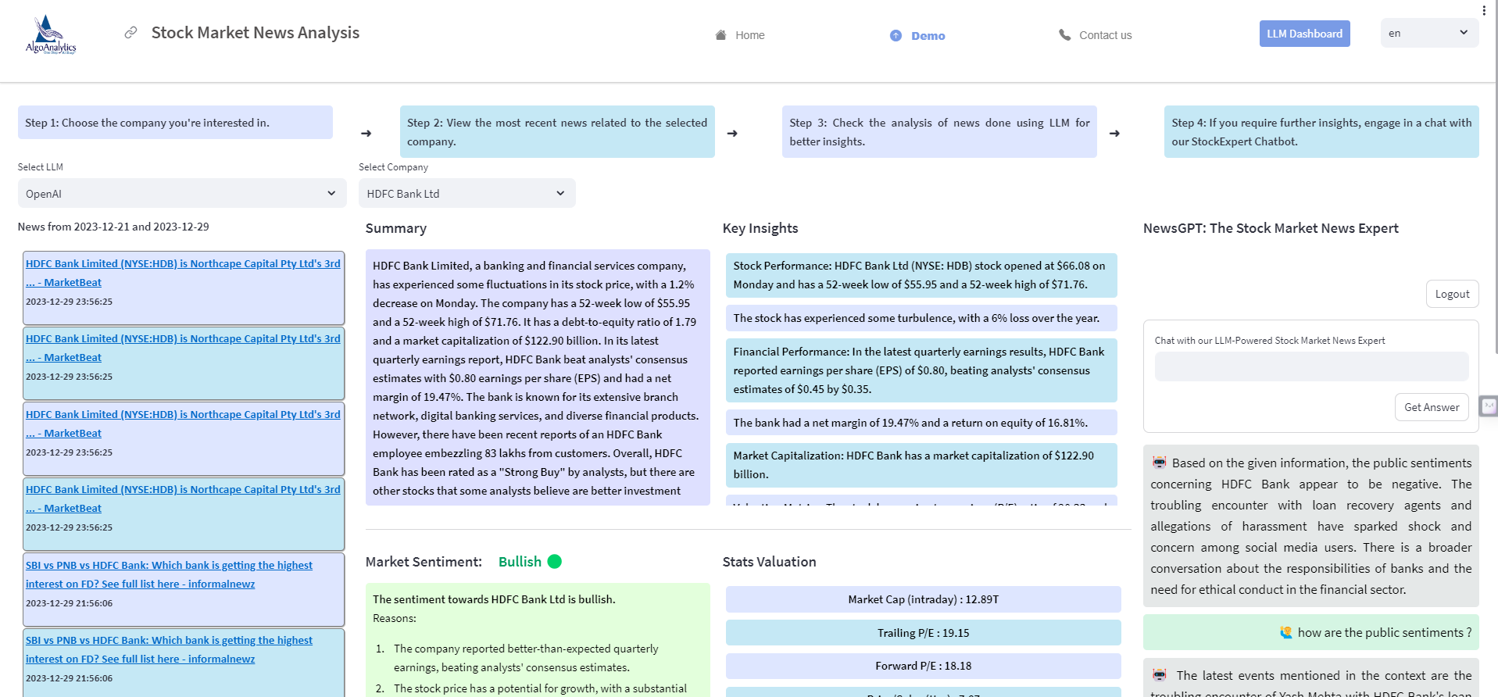
Practical Applications
• • Facilitates stock picking and recommendation strategies based on real-time data.
• • Generates insights from news articles, enabling quick adaptation to market changes.
• • Tracks daily price movements and identifies top gainers and losers for strategic investment.

Slide 5
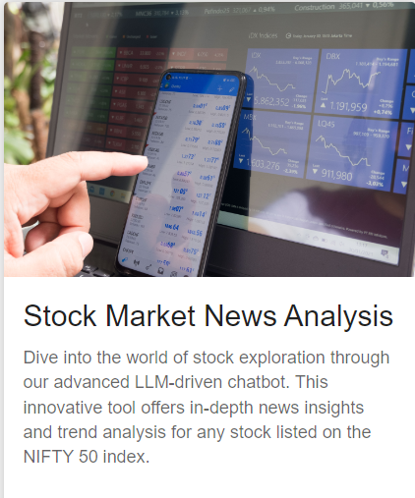
Business Value Proposition
• • Empowers users with a 360-degree view of stock performance and market dynamics.
• • Enhances competitive edge through data-driven insights and personalized recommendations.
• • Supports risk analysis and sentiment trends to inform investment strategies.

Slide 6
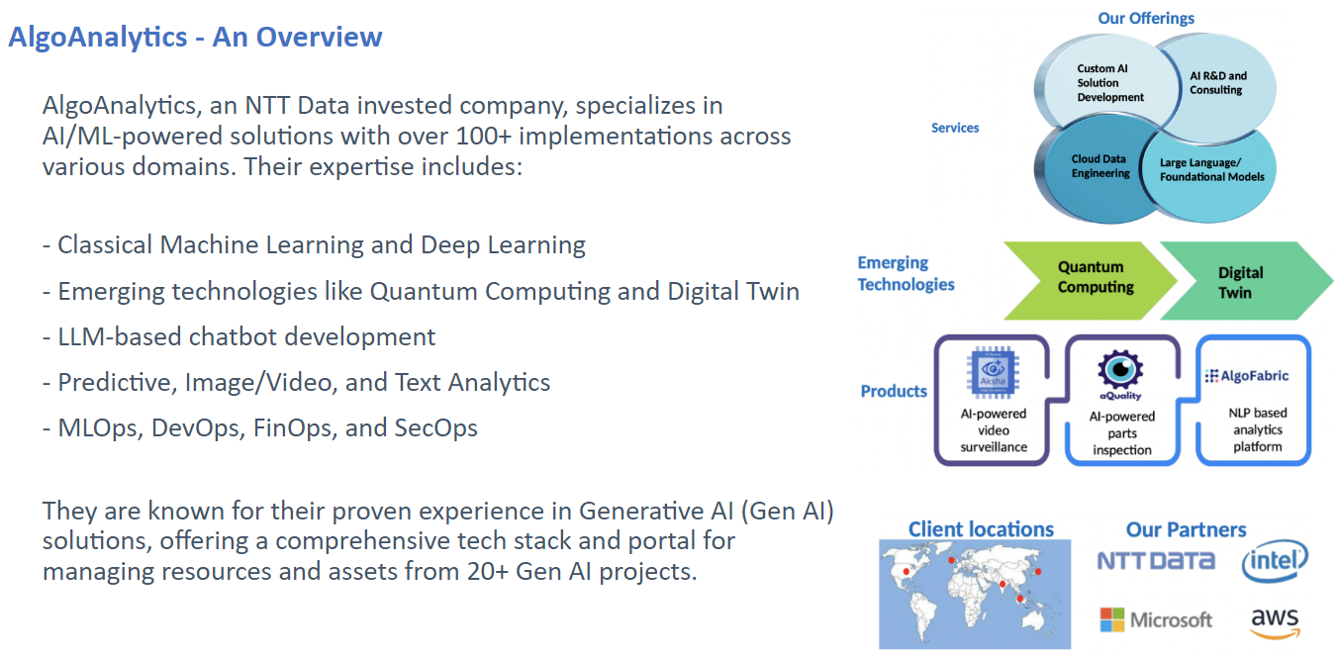
Future Developments and Enhancements
• • Ongoing expansion of the Algofabric portfolio to include more companies.
• • Integration of advanced features for enhanced user experience and functionality.
• • Commitment to continuous improvement and adaptation to evolving market needs.

