Slide 1
Unlocking Business Potential with LLM and Generative AI

Slide 2
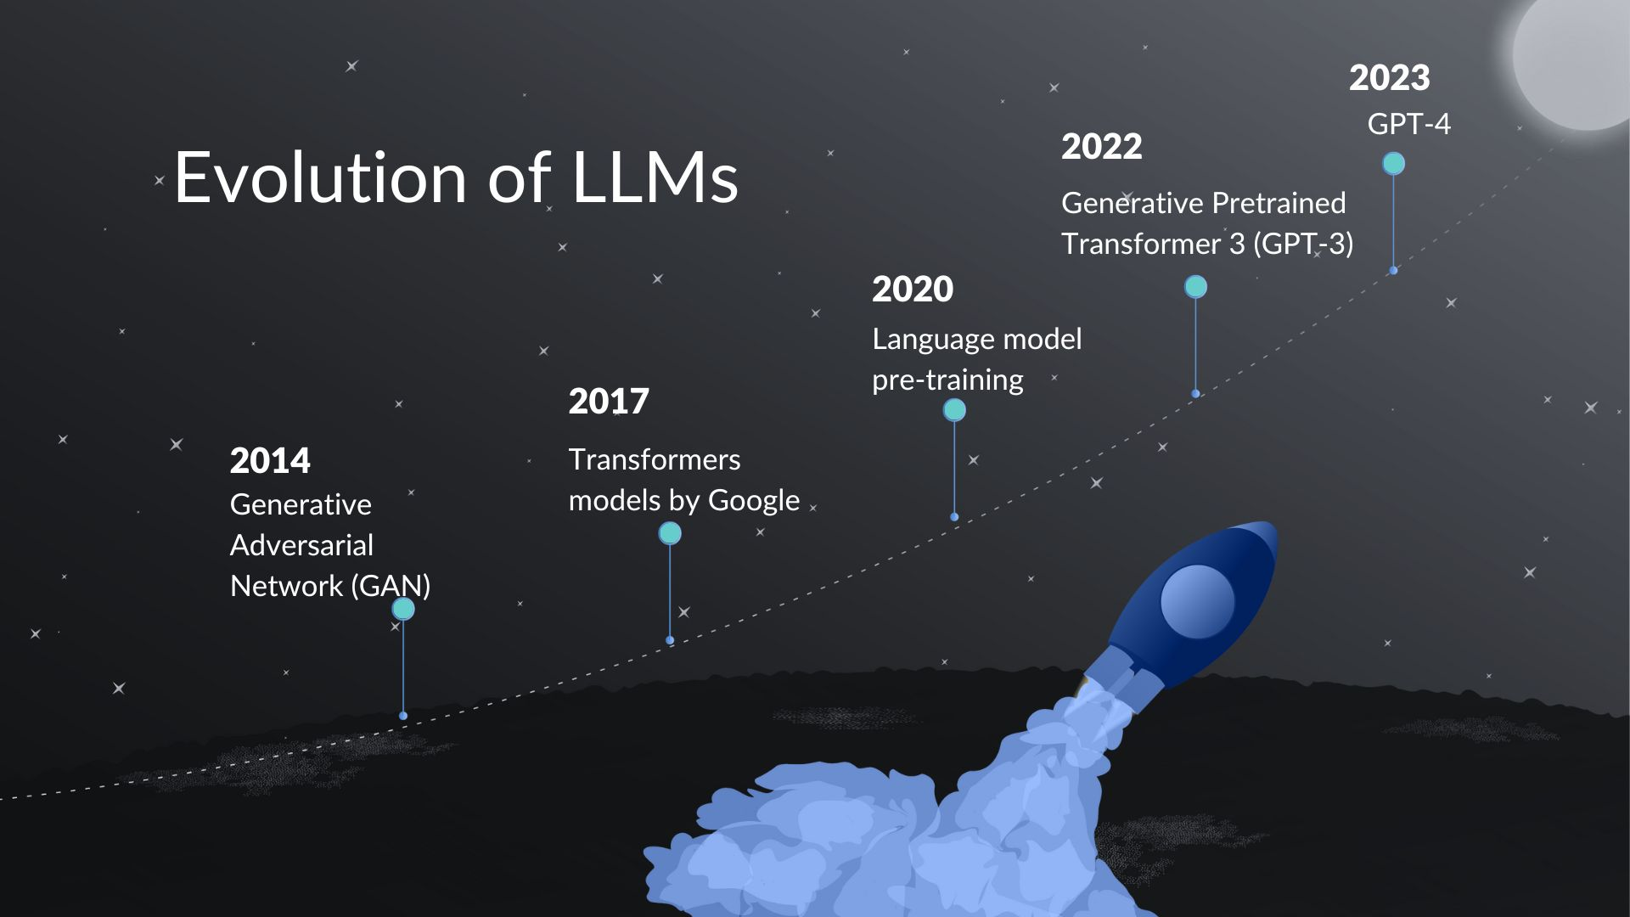
Understanding LLMs and Generative AI
• LLMs are advanced algorithms designed to learn and replicate human-like text generation.
• They analyze statistical patterns in large text corpuses to produce coherent and contextually relevant content.
• Generative AI leverages LLMs to create new content, enhancing creativity and efficiency in various business applications.

Slide 3
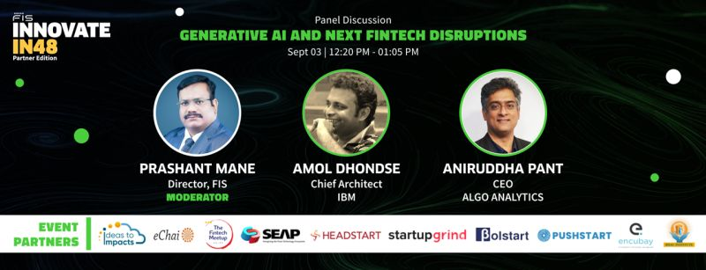
Core Offerings in Generative AI
• Development of innovative solutions across both private and public LLM frameworks.
• Utilization of cutting-edge technologies like Amazon Bedrock for enhanced performance.
• Expertise in multi-modal Generative AI models, enabling diverse applications across industries.

Slide 4
Specialization and Efficiency of LLMs
• Domain-specific LLMs enhance performance for targeted tasks, providing scalable integration.
• Specialized models reduce computational power requirements and training costs.
• Balancing specificity and versatility is crucial for effective model management and updates.

Slide 5
Practical Applications of LLMs
• Applications include chatbots, customer feedback analysis, and legal advisory tools.
• LLMs can streamline processes such as employee onboarding and financial advising.
• Innovative solutions like travel consultation apps and stock market analysis tools showcase versatility.

Slide 6
Future Trends in Generative AI
• LLMs will evolve with enhanced reasoning and contextual understanding capabilities.
• Integration with classical ML models will remain essential for comprehensive solutions.
• Ethical considerations and data privacy will shape the development and deployment of LLMs.

Slide 7
Challenges and Considerations
• Challenges include managing model complexity, latency, and computational demands.
• Addressing ethical concerns and data misuse is critical for maintaining trust.
• Continuous improvement and adaptation of LLMs are necessary to meet evolving business needs.

Slide 8
Conclusion and Next Steps
• LLMs and Generative AI present significant opportunities for business innovation.
• Investing in specialized LLM solutions can enhance operational efficiency and customer engagement.
• Organizations should prioritize ethical practices and continuous learning to leverage the full potential of Generative AI.

