Slide 1
Introduction to Aksha
Advanced AI Solutions for Manufacturing Excellence

Slide 2

Overview of Aksha
▸ Aksha is an intelligent surveillance system designed for automated monitoring with minimal human intervention.
▸ Utilizes advanced technologies including Computer Vision, Artificial Intelligence, and Generative AI for enhanced functionality.
▸ Capable of detecting objects and unusual situations, enabling proactive responses and analysis.
2/7

Slide 3
Architectural Approaches
▸ Offers multiple architectural configurations: Aksha on Edge (On Premise), Aksha UI & Backend on Edge, and hybrid models combining Edge & Cloud.
▸ Supports seamless integration with existing infrastructure to enhance operational efficiency.
▸ Designed for scalability and flexibility to adapt to various business needs.
3/7

Slide 4
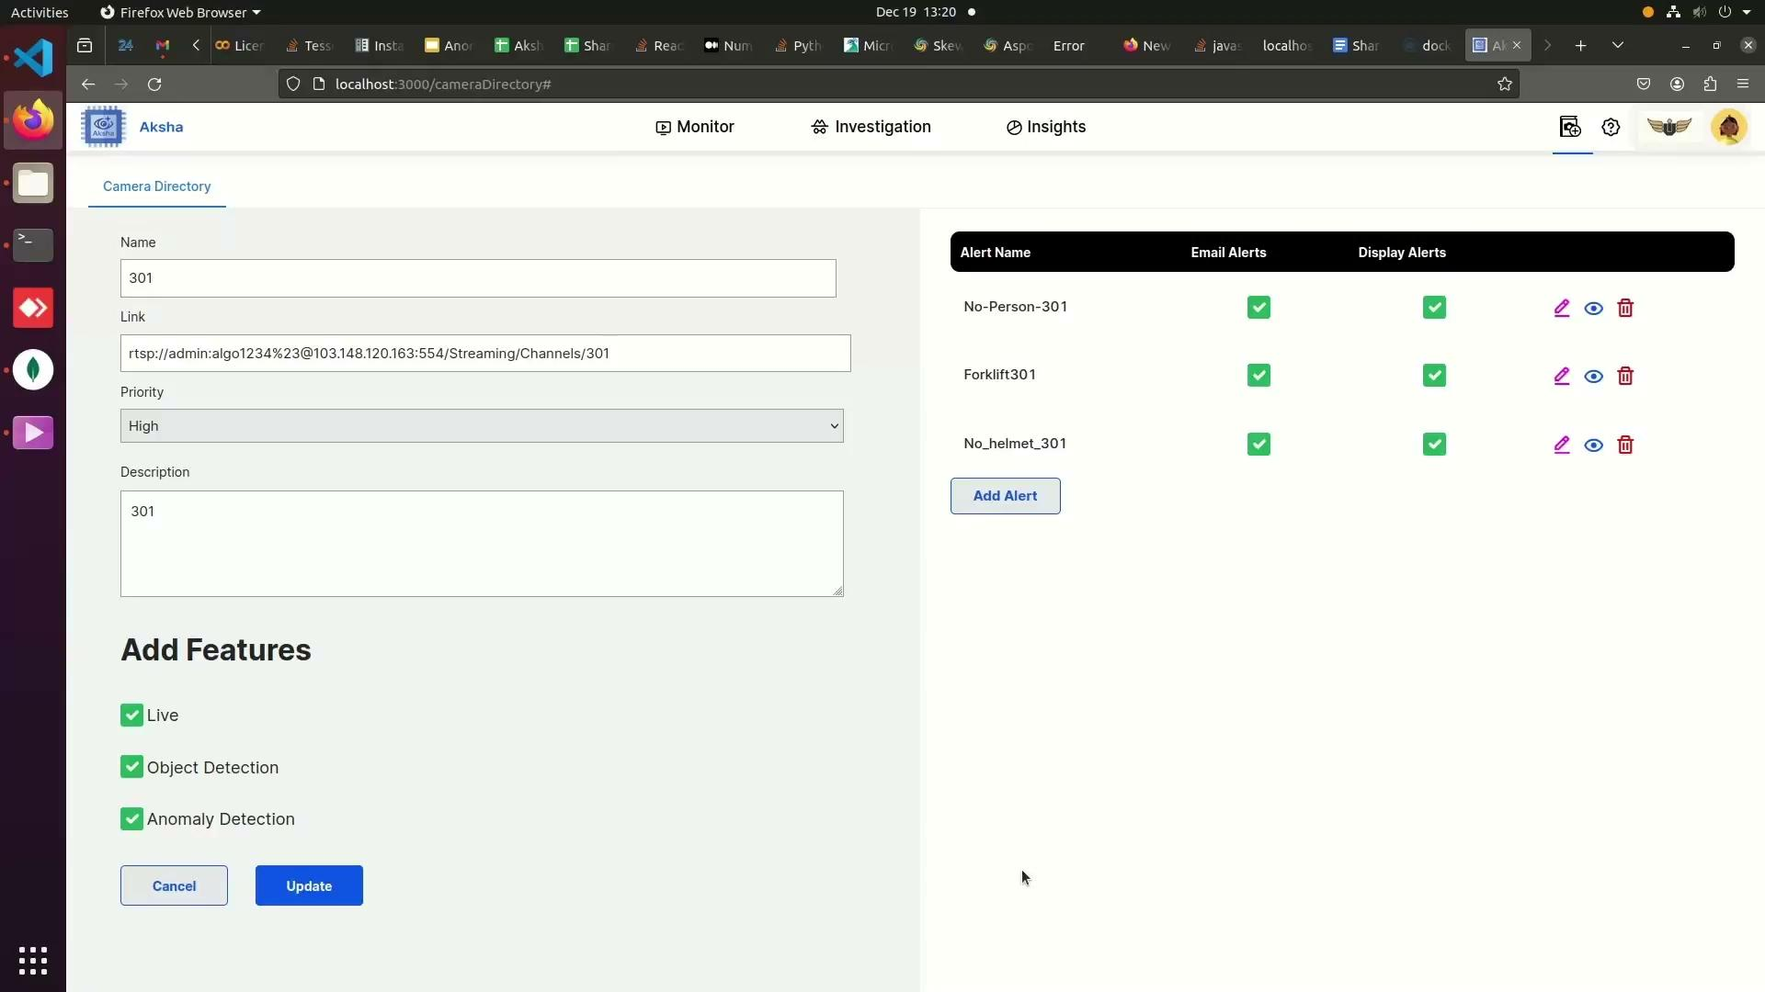
Key Features of Aksha
▸ Real-time live recording and processing of video data for immediate insights.
▸ Advanced object detection capabilities including identification of personnel, vehicles, and safety gear compliance.
▸ Customizable alerts allow users to set specific notifications for critical events, enhancing responsiveness.
4/7

Slide 5
Collaboration and Customization
▸ In collaboration with NDIL, Aksha has been customized for worker safety, integrating Edge + Cloud solutions.
▸ Phased development approach: Phase I focused on foundational capabilities, Phase II enhanced features with Generative AI, and Phase III optimized performance.
▸ Successful implementation on Raspberry Pi 4B demonstrates versatility and cost-effectiveness.
5/7

Slide 6
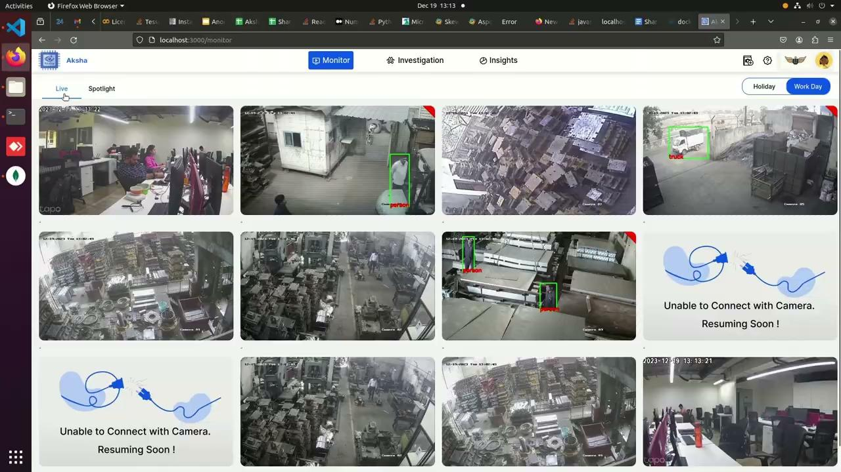
Customer Testimonials
▸ Clients report significant reductions in human monitoring efforts and enhanced detection of abnormal events.
▸ Feedback highlights the value of Aksha in transforming traditional CCTV setups into proactive safety systems.
▸ Continued interest in future updates indicates strong customer satisfaction and trust in Aksha's capabilities.
6/7

Slide 7
Scalability and Future Potential
▸ Effortless scalability through microservices architecture using Kubernetes and Kafka for high message volumes.
▸ Decoupled architecture enhances fault tolerance and maintainability, allowing for independent service updates.
▸ Real-time data processing capabilities ensure timely insights, positioning Aksha as a leader in intelligent surveillance solutions.
7/7

