Slide 1
Algoanalytics AI Products: Transforming Business with Intelligent Solutions
Advanced AI Solutions for Manufacturing Excellence

Slide 2
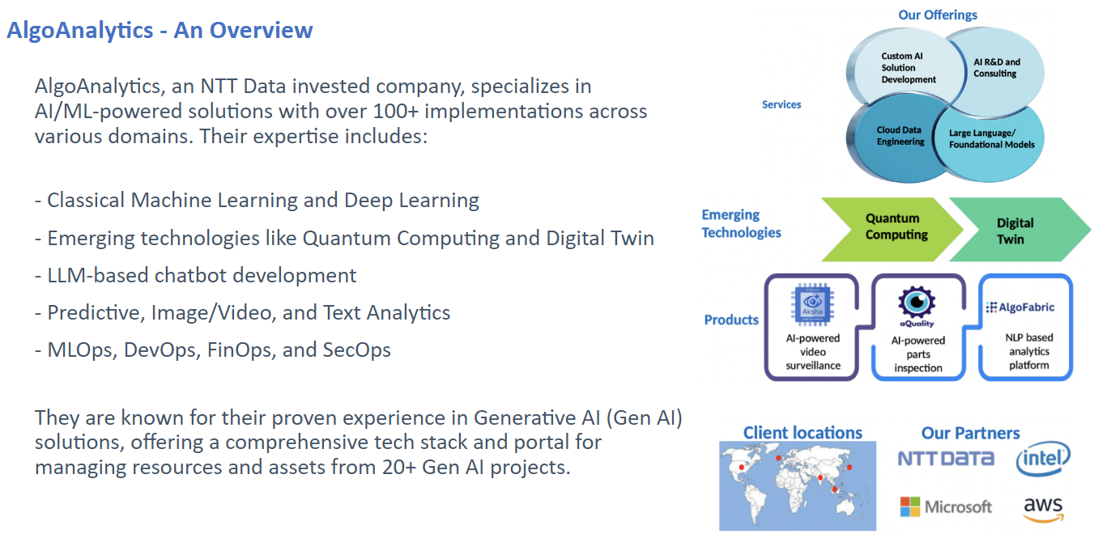
Introduction to Algoanalytics
• Specialist data analytics company focused on AI/ML-powered solutions.
• Over 100 successful AI solution implementations across various domains.
• Expertise in Classical ML, Deep Learning, and emerging technologies like Quantum Computing.
2/10

Slide 3
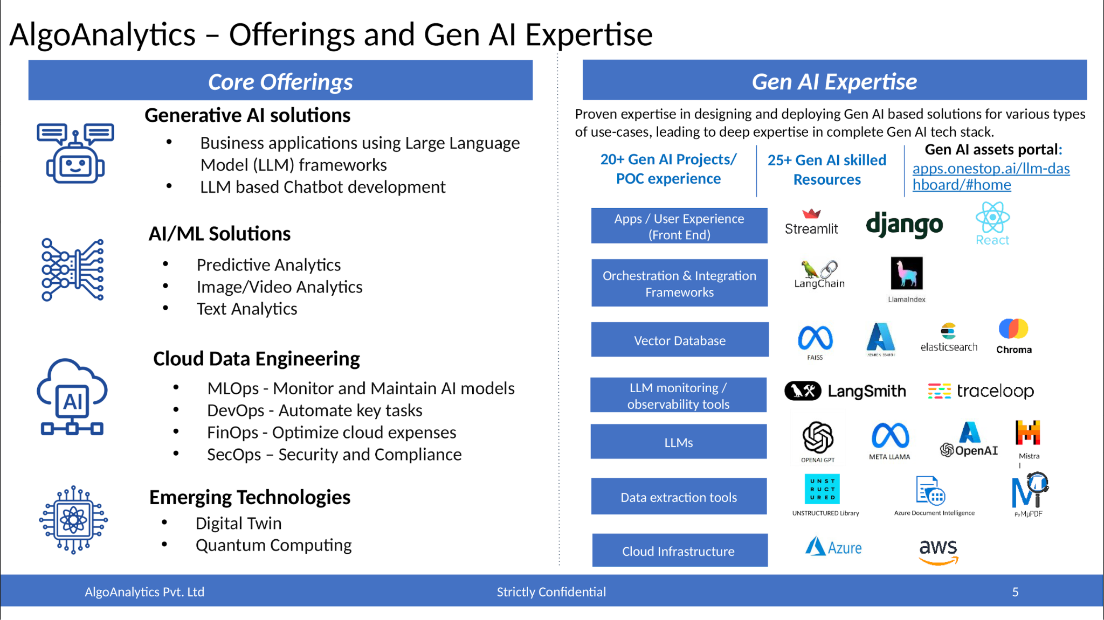
Core AI Product Offerings
• AI-powered Video Surveillance: Enhancing security through intelligent monitoring.
• AI-powered Parts Inspection: Streamlining quality control processes.
• NLP-based Analytics Platform: Transforming unstructured data into actionable insights.
3/10

Slide 4
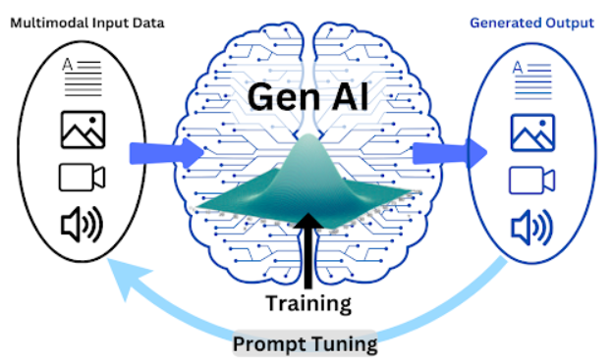
Gen AI Tech Stack Overview
• Comprehensive tech stack including user experience, orchestration, and integration frameworks.
• Focus on data readiness and vectorization for optimal model performance.
• Utilization of third-party tools for data extraction and model fine-tuning.
4/10

Slide 5
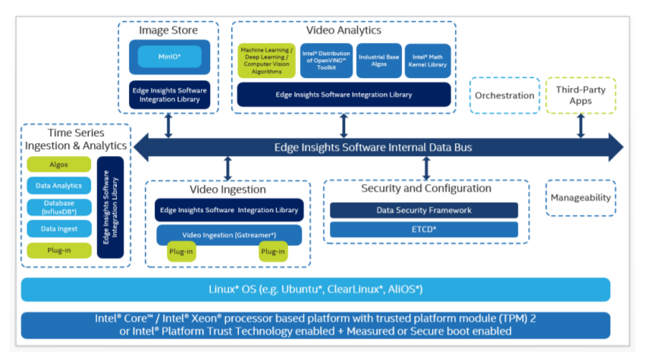
Infrastructure and Tools
• Robust cloud infrastructure for scalable AI solutions.
• Integration of advanced tools like Azure Document Intelligence and Mistral LLM.
• Monitoring and observability tools for enhanced model performance tracking.
5/10

Slide 6
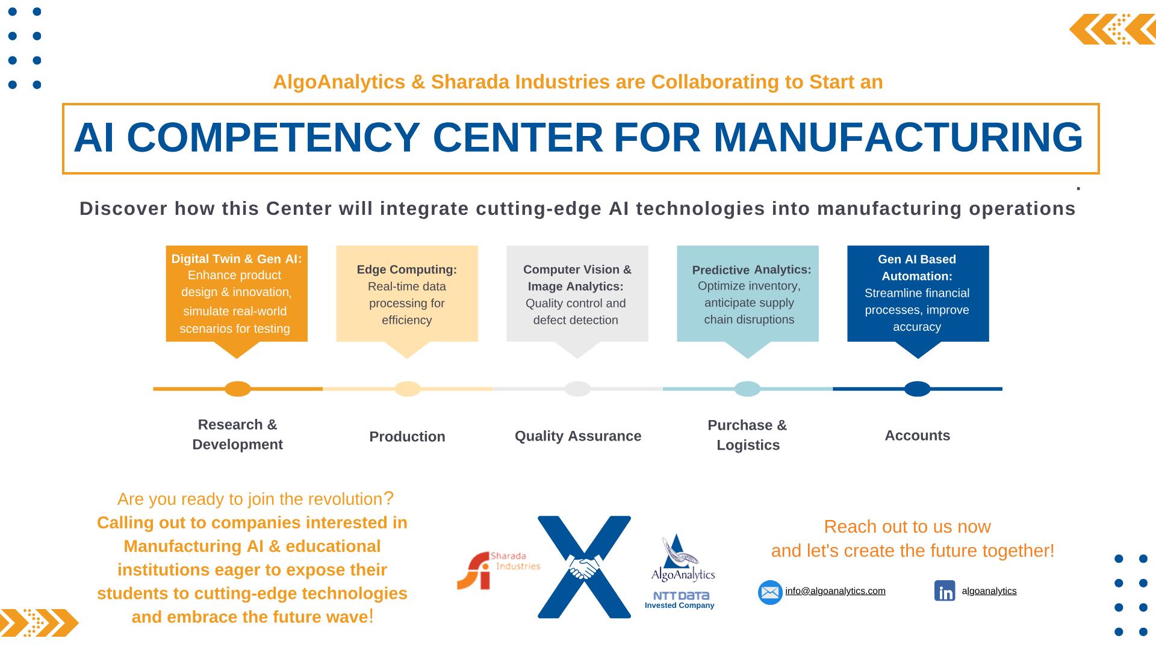
Business Value of AI Products
• Drive operational efficiency and reduce costs through automation.
• Enhance decision-making capabilities with data-driven insights.
• Improve customer experiences by leveraging AI for personalized services.
6/10

Slide 7
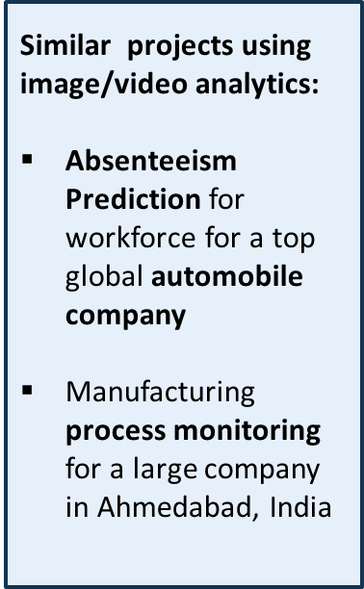
Practical Applications in Various Industries
• Telecom: Optimizing network performance and customer service.
• Insurance: Risk assessment and fraud detection using predictive modeling.
• Manufacturing: Quality assurance and predictive maintenance.
7/10

Slide 8
Custom AI Solutions and Consulting
• Tailored AI solution development to meet specific business needs.
• Expert consulting services in AI R&D to guide implementation.
• Collaboration with clients to ensure alignment with business objectives.
8/10

Slide 9
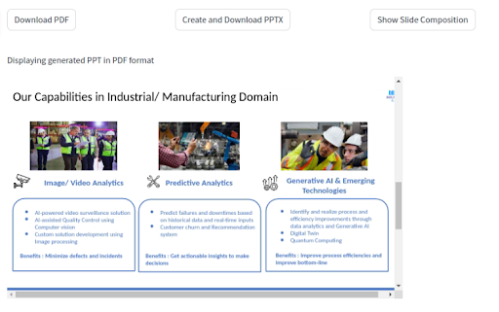
Future Directions and Innovations
• Exploring advancements in Quantum Computing for enhanced processing power.
• Continuous development of Digital Twin technologies for real-time simulations.
• Commitment to evolving AI capabilities to address emerging business challenges.
9/10

Slide 10
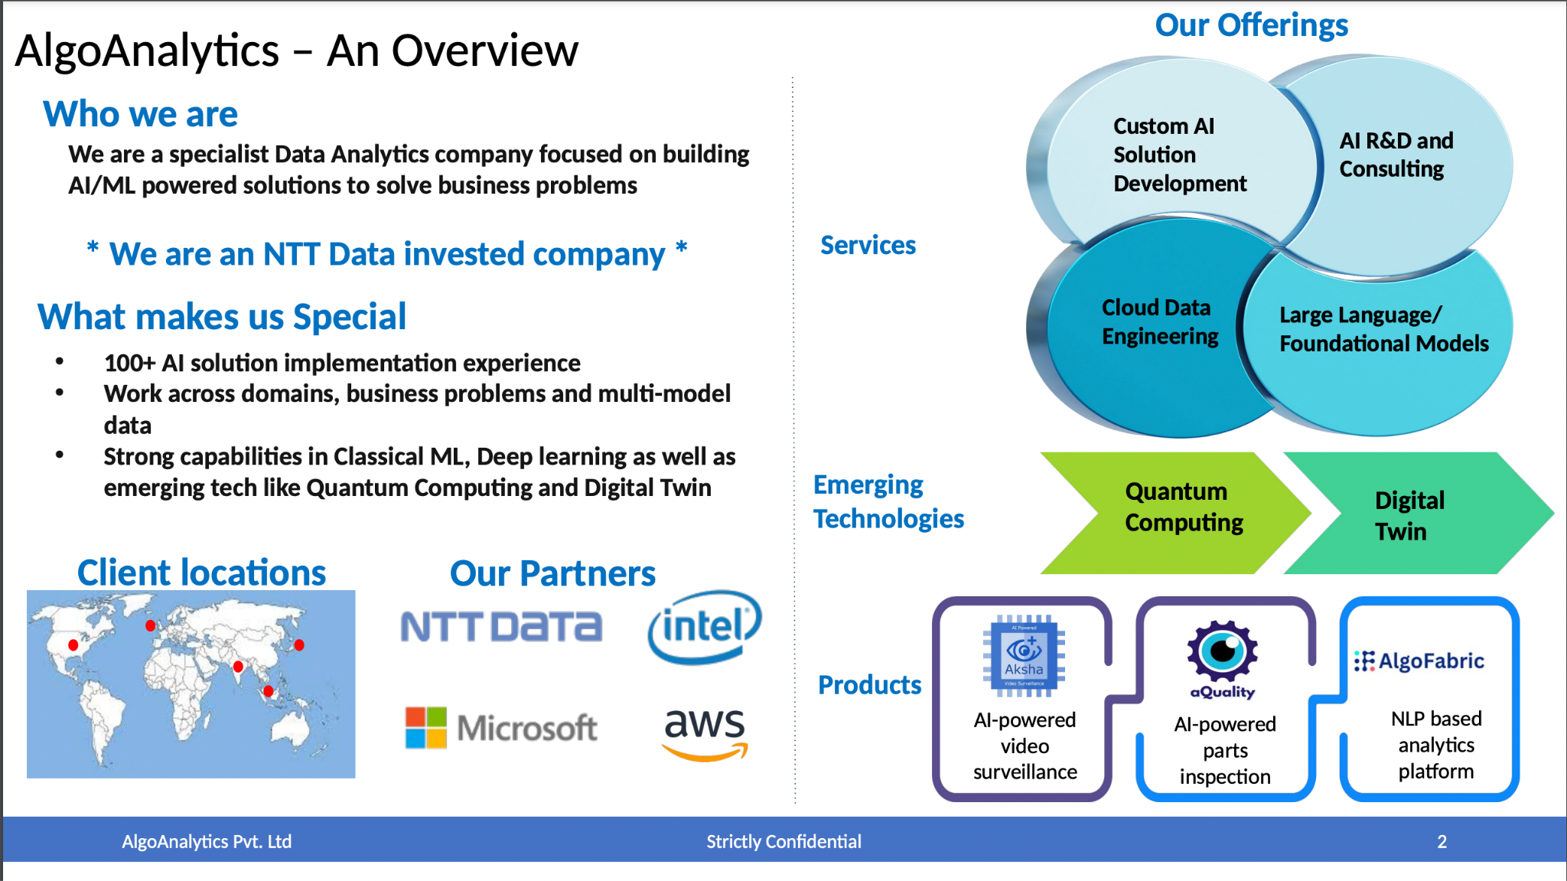
Conclusion and Call to Action
• Invest in AI solutions to stay competitive in a rapidly evolving market.
• Leverage Algoanalytics' expertise to unlock the full potential of AI.
• Engage with us for a consultation to explore tailored AI strategies.
10/10

