Slide 1
Unlocking Investment Potential with Algofabric
Advanced AI Solutions for Manufacturing Excellence

Slide 2
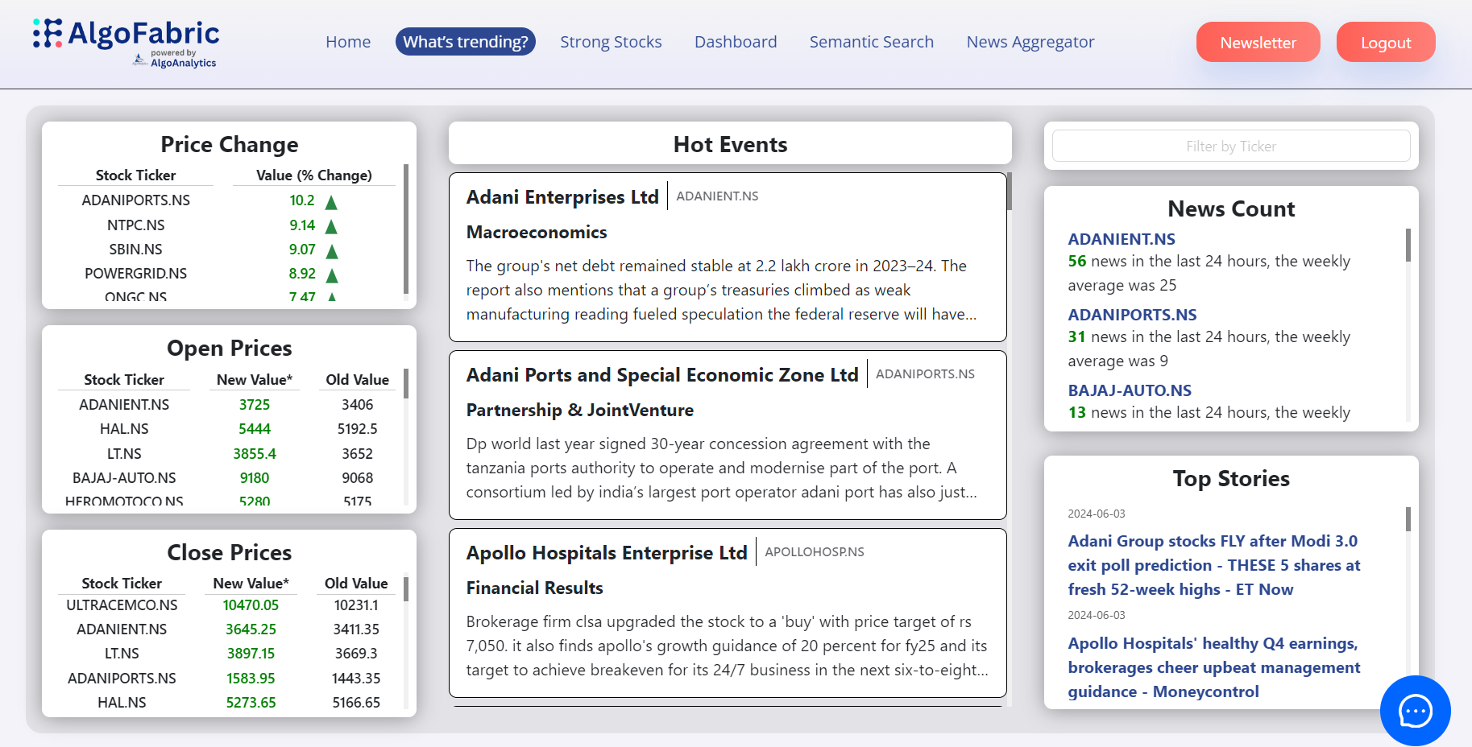
Overview of Algofabric
▸ • AI-powered fintech solution designed for stock market investors.
▸ • Generates actionable recommendations based on comprehensive data analysis.
▸ • Utilizes advanced algorithms to enhance stock selection and portfolio management.
This is a digital dashboard interface for AlgoFabric, showcasing stock market data. It includes sections for price changes, open and close prices of various stocks, and trending news articles. Key elements include stock tickers, percentage changes, and news summaries related to
2/6

Slide 3
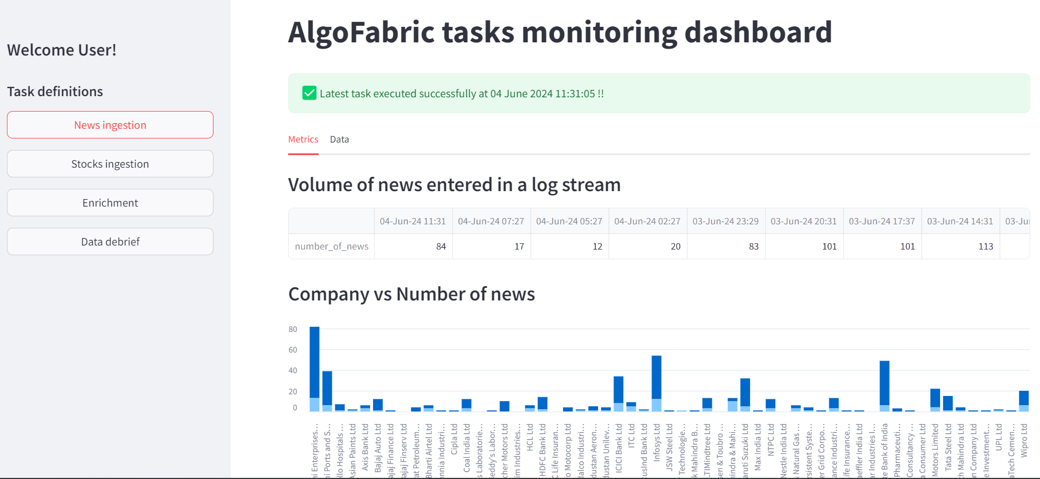
Key Features of Algofabric
▸ • Real-time performance monitoring dashboard for backend tasks.
▸ • Insight generation from news articles using small language models (SLMs).
▸ • Portfolio expansion capabilities aligned with stock picking strategies.
This is a screenshot of a dashboard interface for monitoring tasks in the AlgoFabric application. It features a user greeting, task definitions, and metrics displayed in tabular and graphical formats. Key elements include a log of news entries, a bar chart comparing news
3/6

Slide 4
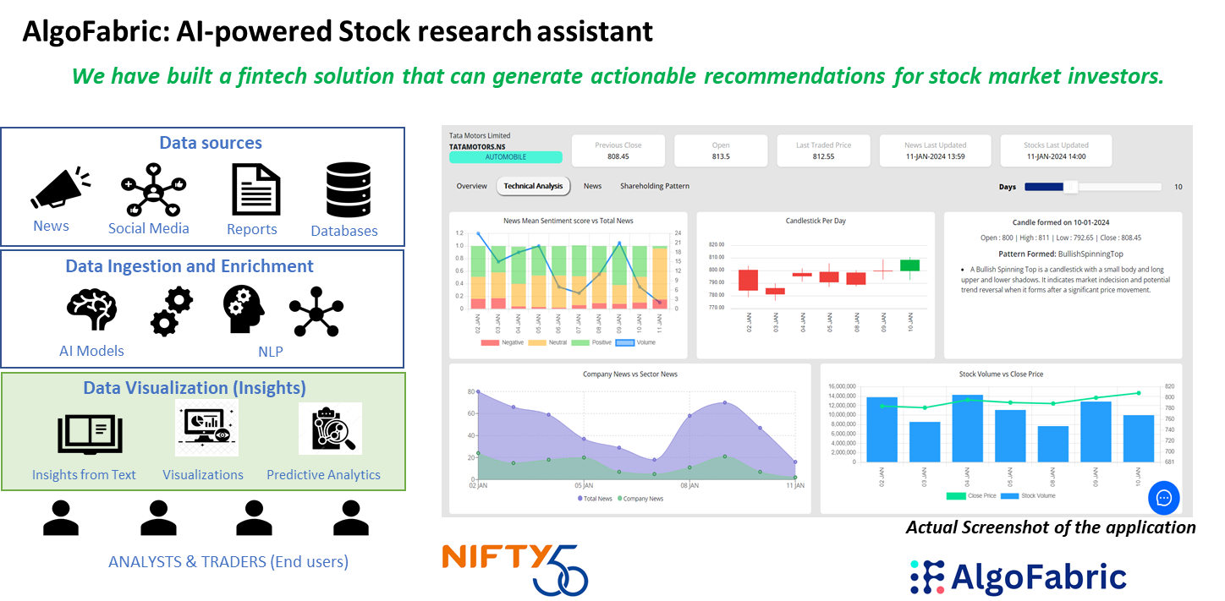
Investment Insights and Analytics
▸ • Mutual fund investment composition display for asset allocation analysis.
▸ • Historical performance review and backtesting for informed decision-making.
▸ • Insights derived from company reports, including shareholding patterns and cash flow.
This is a diagram showcasing a fintech solution designed for stock market investors. It features sections on data sources, data ingestion, and visualization insights. Key elements include charts for sentiment analysis, candlestick patterns, and stock volume comparisons. Visible branding includes "N
4/6

Slide 5
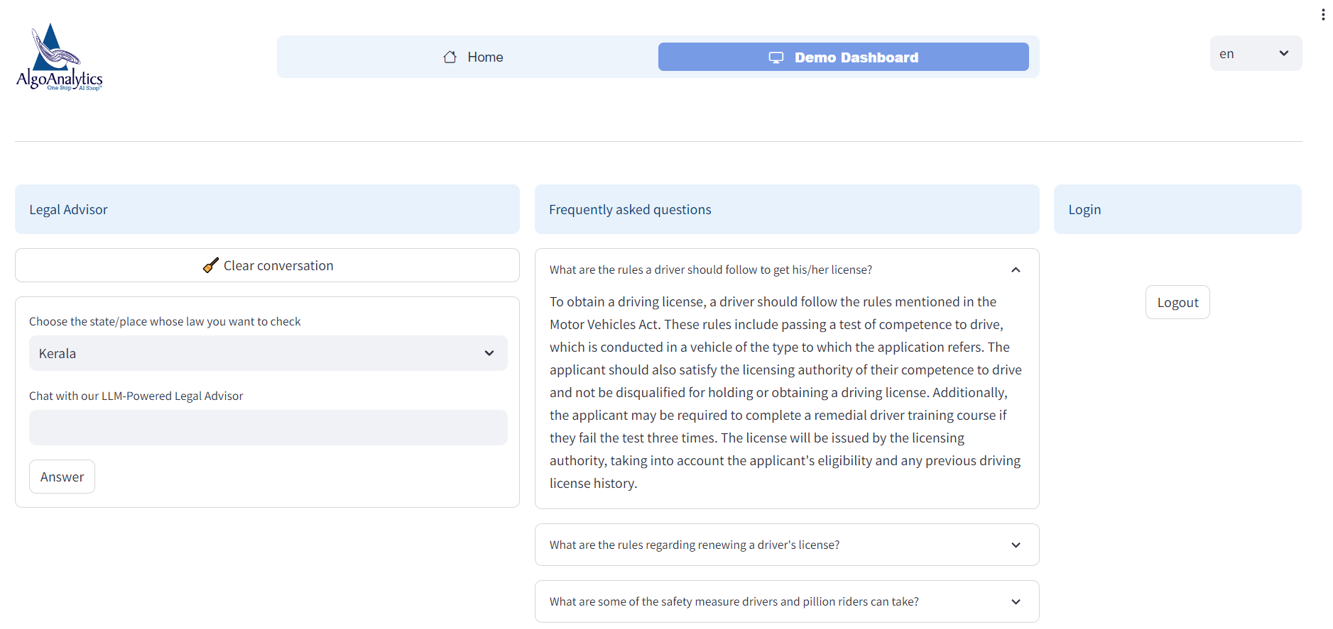
Practical Applications of Algofabric
▸ • Identify top gainers and losers with the 'What's Trending' feature.
▸ • Track daily price movements and significant corporate actions.
▸ • Diversify portfolios with superior returns while minimizing risk.
This is a screenshot of a web application interface for "AlgoAnalytics," featuring a logo at the top left. The interface includes sections for a legal advisor, frequently asked questions, and options to select a state (Kerala). Text fields prompt user interaction
5/6

Slide 6
Future Developments and Enhancements
▸ • Continuous integration of new companies into the Algofabric ecosystem.
▸ • Performance comparison and optimization of SLMs versus LLMs.
▸ • Expansion of business use cases to address real-life investment challenges.
6/6

