Slide 1
Info about the Autonomous Cars and the Aksha Project

Slide 2
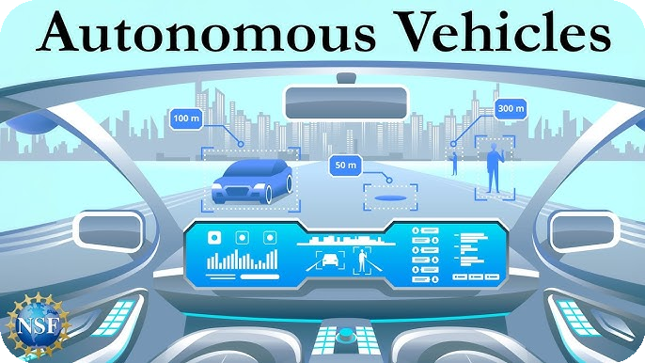
Introduction to Autonomous Vehicles
• Autonomous vehicles (AVs) are designed to operate without human intervention, utilizing advanced technologies.
• Key benefits include reduced traffic congestion, optimized fuel efficiency, and significant decreases in accident rates due to human error.
• The development of AVs faces technical, legal, and ethical challenges that must be addressed to achieve Level 5 autonomy.

Slide 3
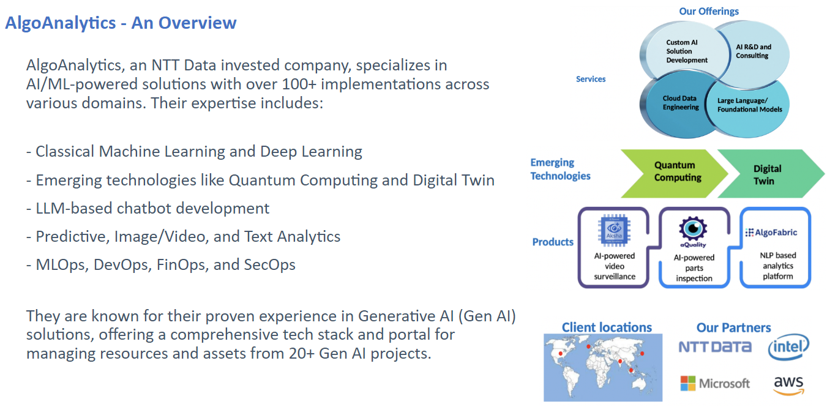
Technical Challenges in AV Development
• Sensor fusion is critical, requiring integration of LiDAR, radar, and high-resolution cameras for accurate environment perception.
• Navigating complex real-world scenarios involves understanding social cues and ambiguous situations.
• Robust algorithms are necessary for real-time decision-making and ensuring passenger safety.

Slide 4
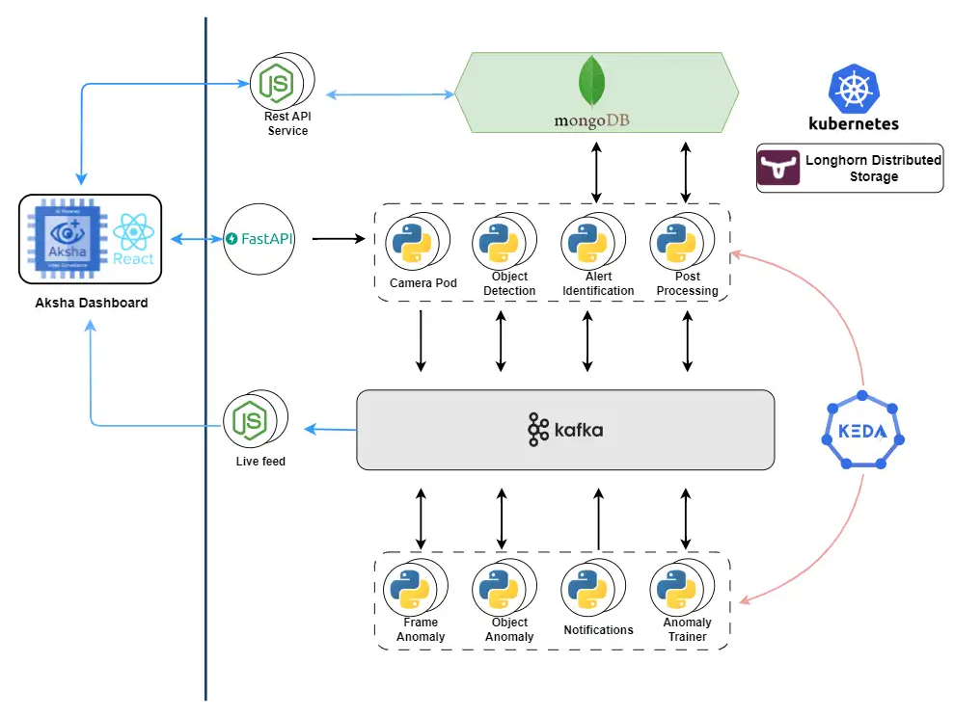
Overview of the Aksha Project
• Aksha is an intelligent surveillance system aimed at enhancing workplace safety through automated monitoring.
• Utilizes computer vision, artificial intelligence, and generative AI for real-time object detection and anomaly analysis.
• Designed to operate with minimal human intervention, providing continuous oversight of premises.

Slide 5

Aksha Customization and Development Phases
• Collaboration between AlgoAnalytics and NDIL led to the customization of Aksha for worker safety, running on Edge + Cloud architecture.
• Three development phases completed, with Phase III incorporating generative AI to enhance functionality.
• Successful proof of concept demonstrated on Raspberry Pi 4B with wireless camera integration.

Slide 6

Key Features of Aksha
• Live recording and processing capabilities ensure real-time monitoring and data analysis.
• Advanced object detection includes recognition of persons, vehicles, and safety compliance (e.g., helmet detection).
• Generative AI enables unsupervised learning for anomaly detection and customized alert creation.

Slide 7
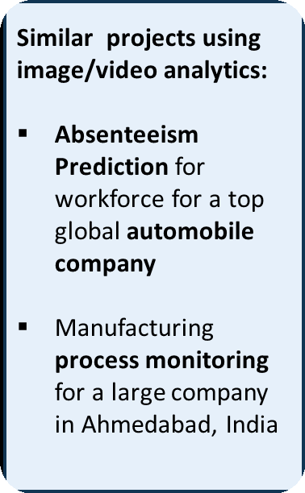
Business Value of Aksha
• Enhances employee safety by providing immediate alerts for unsafe conditions or behaviors.
• Reduces operational costs associated with manual surveillance and incident response.
• Facilitates compliance with safety regulations through automated reporting and analysis.

Slide 8
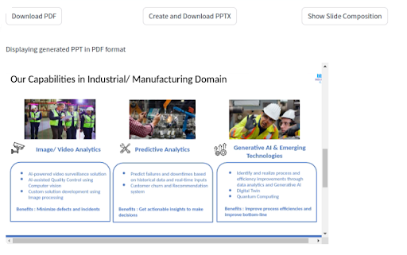
Practical Applications of Aksha
• Applicable in various sectors including manufacturing, construction, and logistics for enhanced site safety.
• Can be integrated into existing security systems to augment monitoring capabilities.
• Supports data-driven decision-making through comprehensive insight report generation.

Slide 9
Future Directions for Aksha and AVs
• Continued development of AI capabilities to improve accuracy and responsiveness of surveillance systems.
• Potential integration of Aksha technology into autonomous vehicles for enhanced safety and monitoring.
• Exploration of ethical implications and regulatory frameworks to support the deployment of AVs and intelligent surveillance.

Slide 10

Contact Information and Further Resources
• For more information on Aksha, visit: https://aksha.algoanalytics.com/
• Contact us at: aksha@algoanalytics.com for inquiries and collaboration opportunities.
• Visit our office at Alacrity India Innovation Centre, Pune for direct engagement and demonstrations.

