Slide 1
GenAI and LLM: Transforming Business Processes
Advanced AI Solutions for Manufacturing Excellence

Slide 2
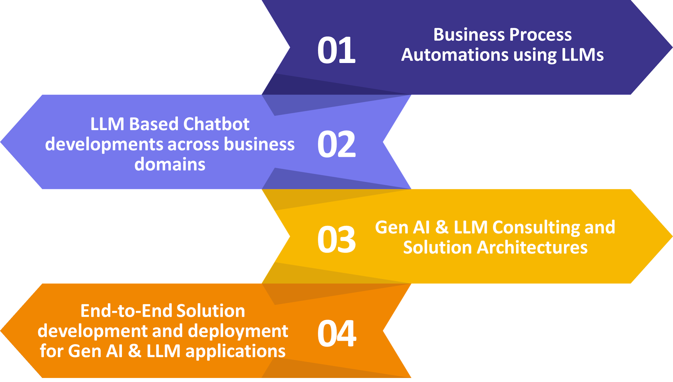
Introduction to GenAI and LLM
▸ Overview of Generative AI (GenAI) and its significance in modern business.
▸ Introduction to Large Language Models (LLMs) and their capabilities.
▸ Importance of LLMs in automating and enhancing business processes.
2/8

Slide 3
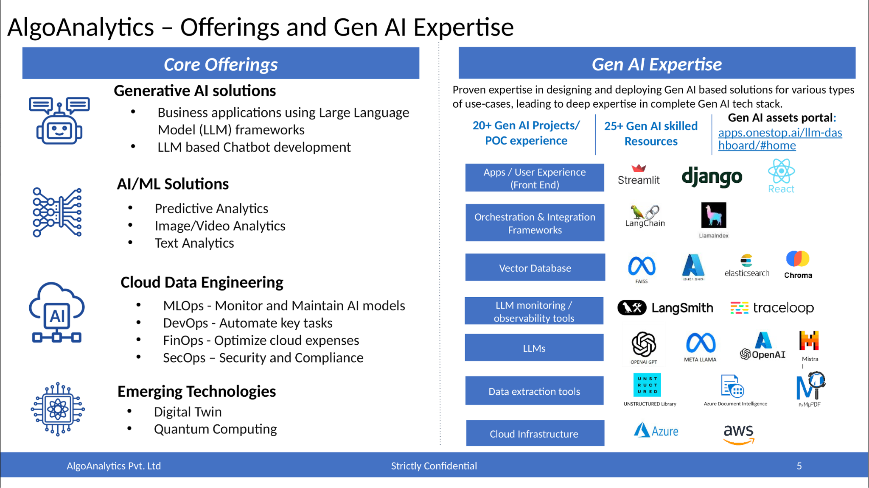
Core Offerings of GenAI and LLM
▸ Development of personalized assistants and copilots for enhanced productivity.
▸ Enterprise document Q&A and summarization to streamline information retrieval.
▸ Dynamic RFP response generation to improve proposal efficiency.
3/8

Slide 4

Industry Applications of LLMs
▸ Use cases in customer service, including chatbots and virtual employee services.
▸ Application in financial decision-making through AI Mirror integration.
▸ Translation model evaluation for multilingual e-learning content.
4/8

Slide 5
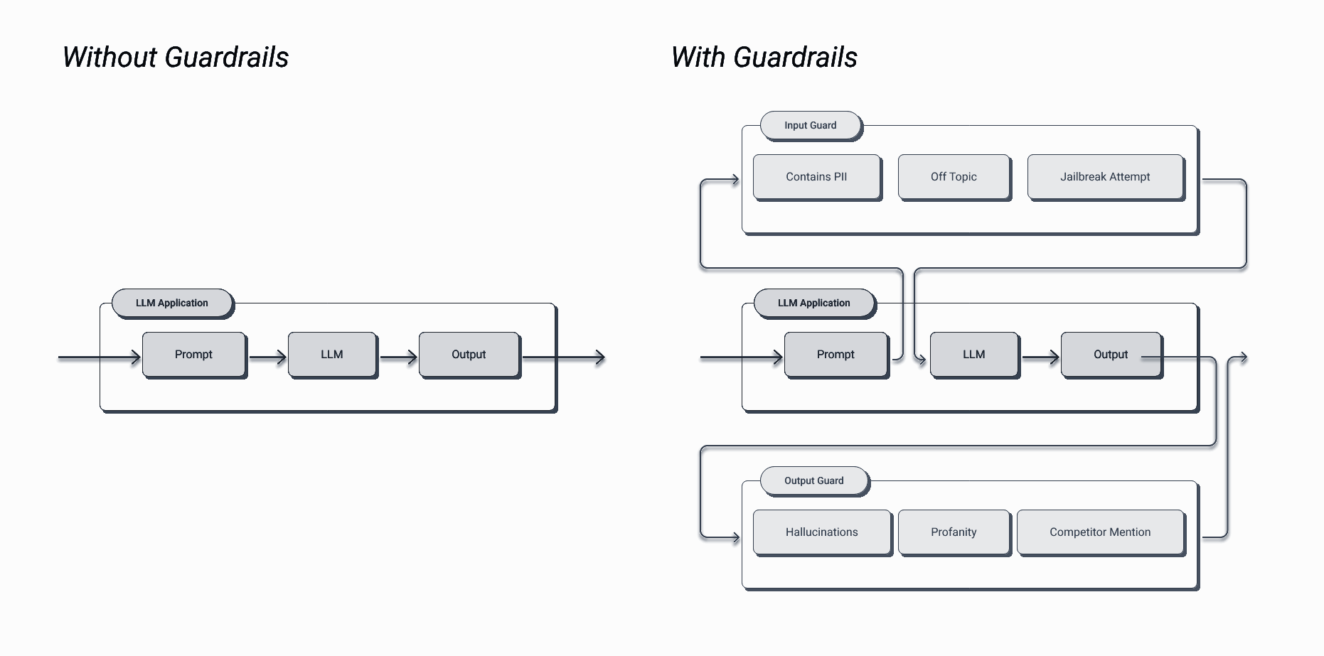
Benefits of Specialized LLMs
▸ Domain-specific LLMs enhance performance by tailoring to specific tasks.
▸ Efficiency gains through smaller, specialized models requiring less computational power.
▸ Challenges include complexity in model management and maintaining versatility.
5/8

Slide 6
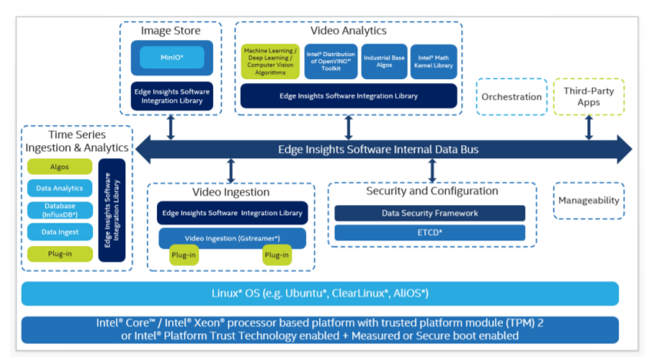
Technological Innovations and Frameworks
▸ Utilization of Meta's Llama 2 framework for robust LLM solutions.
▸ Integration of cutting-edge technologies for enhanced data security and privacy.
▸ Exploration of open-source models for greater control and flexibility.
6/8

Slide 7
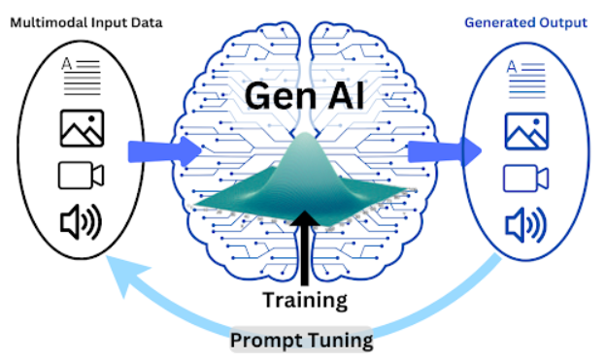
Future Trends in Generative AI
▸ Emergence of specialized models tailored for specific industries.
▸ Integration of LLMs with classical machine learning models for comprehensive solutions.
▸ Addressing ethical concerns and data privacy issues in LLM deployment.
7/8

Slide 8
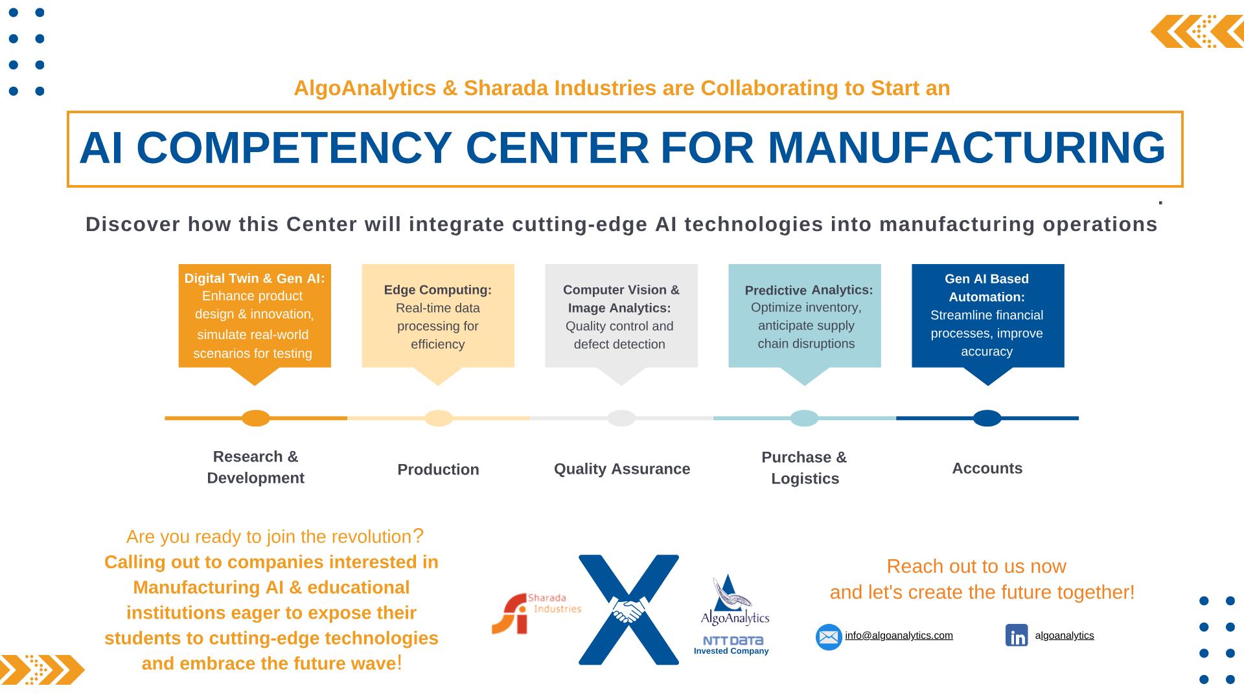
Conclusion and Next Steps
▸ Recap of the transformative potential of GenAI and LLM in business.
▸ Call to action for exploring LLM solutions tailored to organizational needs.
▸ Encouragement to stay informed on advancements and ethical considerations in AI.
8/8

