Slide 1
Leveraging FastAPI and GPU for High-Performance Applications
Advanced AI Solutions for Manufacturing Excellence

Slide 2
Introduction to FastAPI
▸ Built on Starlette and Uvicorn, FastAPI achieves performance comparable to compiled languages.
▸ Utilizes asynchronous programming to handle concurrent requests efficiently, enhancing throughput.
▸ Ideal for microservices and real-time applications requiring low latency and high concurrency.
2/7

Slide 3
Business Value of FastAPI
▸ Transforms Python's data-centric strengths into robust, scalable APIs for modern web infrastructure.
▸ Improves developer experience with standard type hints and automatic documentation generation.
▸ Reduces time-to-market for API development, enabling faster iteration and deployment cycles.
3/7

Slide 4
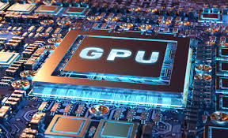
Understanding GPU Architecture
▸ GPUs excel in parallel processing, making them essential for deep learning and high-performance computing.
▸ Their architecture allows for simultaneous execution of thousands of threads, optimizing computational efficiency.
▸ Specialized hardware, like Tensor Cores, enhances performance for deep learning tasks, accelerating model training.
4/7

Slide 5
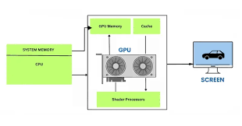
Business Applications of GPUs
▸ Enable rapid processing of large datasets, crucial for AI and machine learning applications.
▸ Facilitate complex simulations in fields like finance, weather forecasting, and scientific research.
▸ Support real-time data processing needs, enhancing decision-making capabilities across industries.
5/7

Slide 6
Integrating FastAPI with GPU Capabilities
▸ FastAPI's asynchronous capabilities complement GPU processing, maximizing resource utilization.
▸ Ideal for applications requiring high-speed data access and processing, such as AI-driven services.
▸ Streamlines the development of scalable applications that leverage both FastAPI and GPU strengths.
6/7

Slide 7
Conclusion and Future Directions
▸ FastAPI and GPUs represent a powerful combination for building high-performance applications.
▸ Organizations can achieve significant competitive advantages by adopting these technologies.
▸ Future developments in both FastAPI and GPU architectures will further enhance capabilities and business value.
7/7

