Slide 1
Unlocking Financial Insights with AlgoFabric
Advanced AI Solutions for Manufacturing Excellence

Slide 2
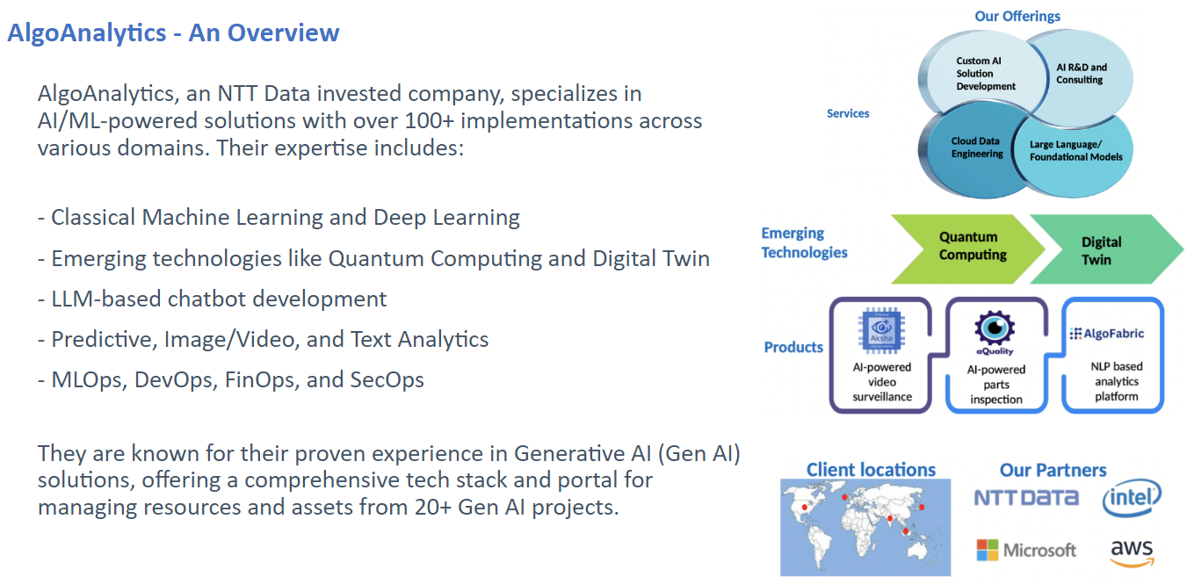
Overview of AlgoFabric
▸ AI-powered SaaS platform designed to provide comprehensive financial insights.
▸ Utilizes advanced Natural Language Processing (NLP) and numerical data analysis.
▸ Focuses on delivering actionable recommendations for stock trading and investment.
2/6

Slide 3
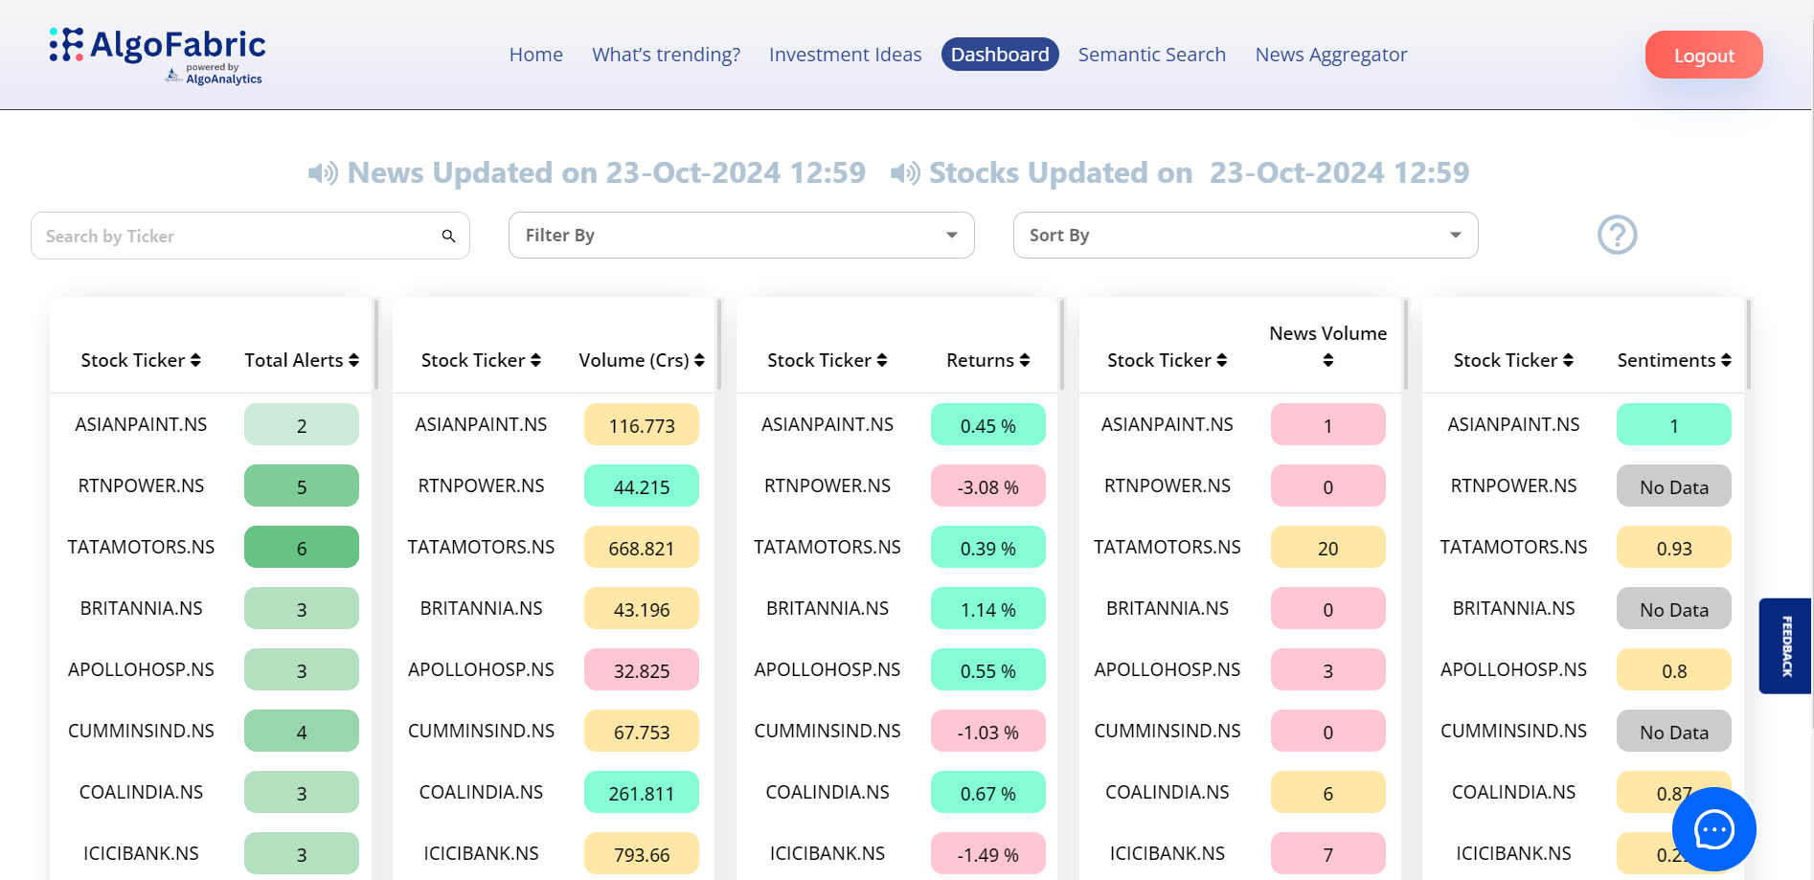
Key Features of AlgoFabric
▸ Real-time news aggregation and sentiment analysis to inform trading decisions.
▸ Dashboard for monitoring backend performance, facilitating quick issue resolution.
▸ Stock picking and recommendation strategies based on historical performance and market trends.
3/6

Slide 4
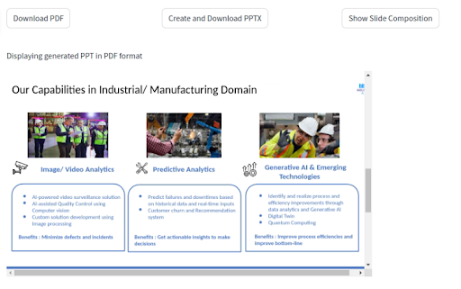
Generalization and Adaptability
▸ Designed to be adaptable across various domains including sports, politics, and education.
▸ Feature extraction techniques applicable to diverse datasets for broader insights.
▸ User interface components can be customized for different applications, enhancing usability.
4/6

Slide 5
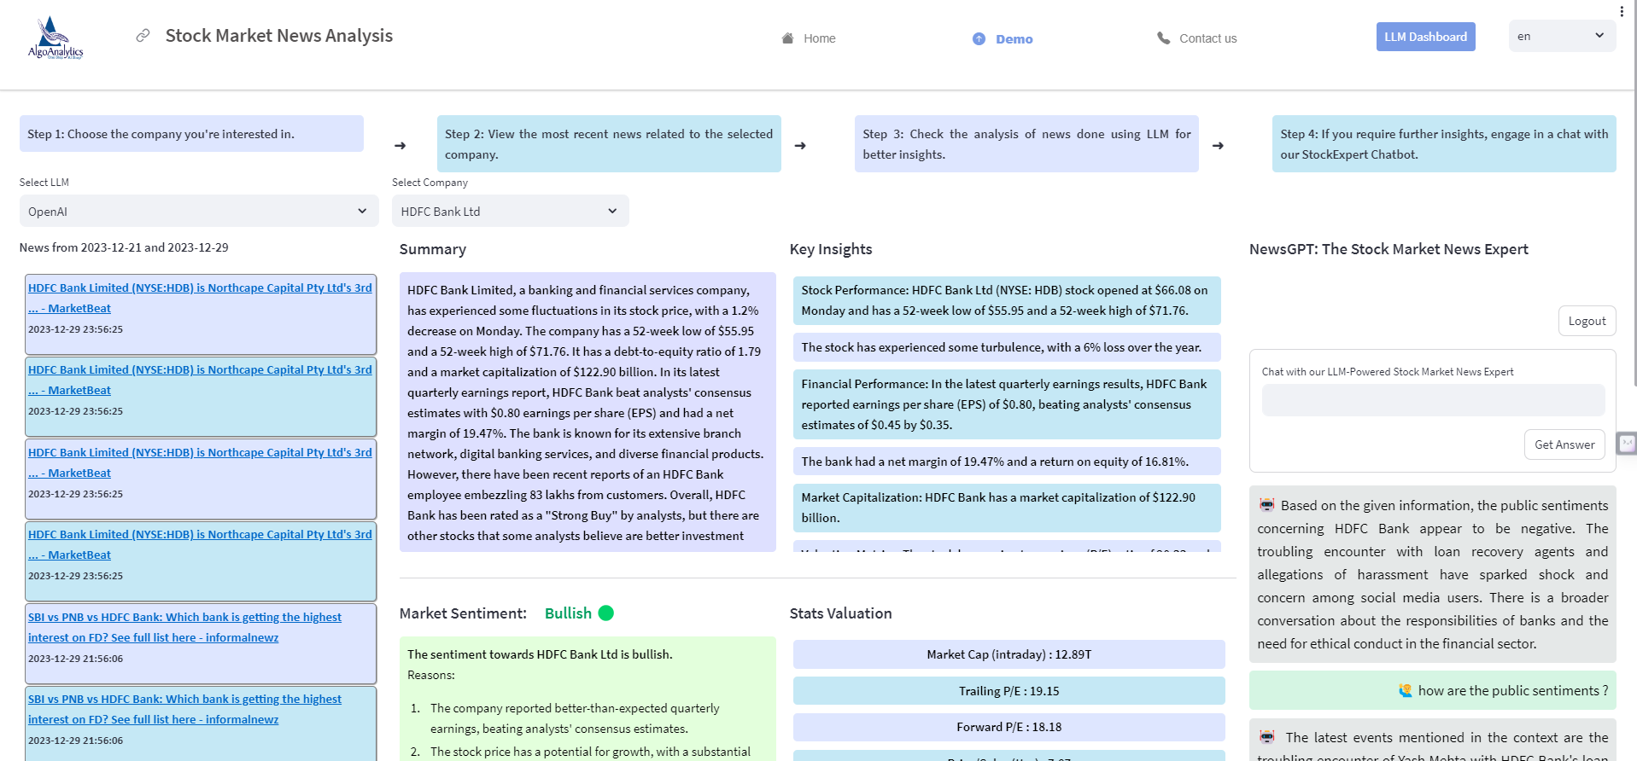
Upcoming Features and Enhancements
▸ Integration of mutual fund investment composition display for better asset management.
▸ Expansion of company portfolio in alignment with stock picking strategies.
▸ Deployment of small language models for faster, real-time insights generation.
5/6

Slide 6
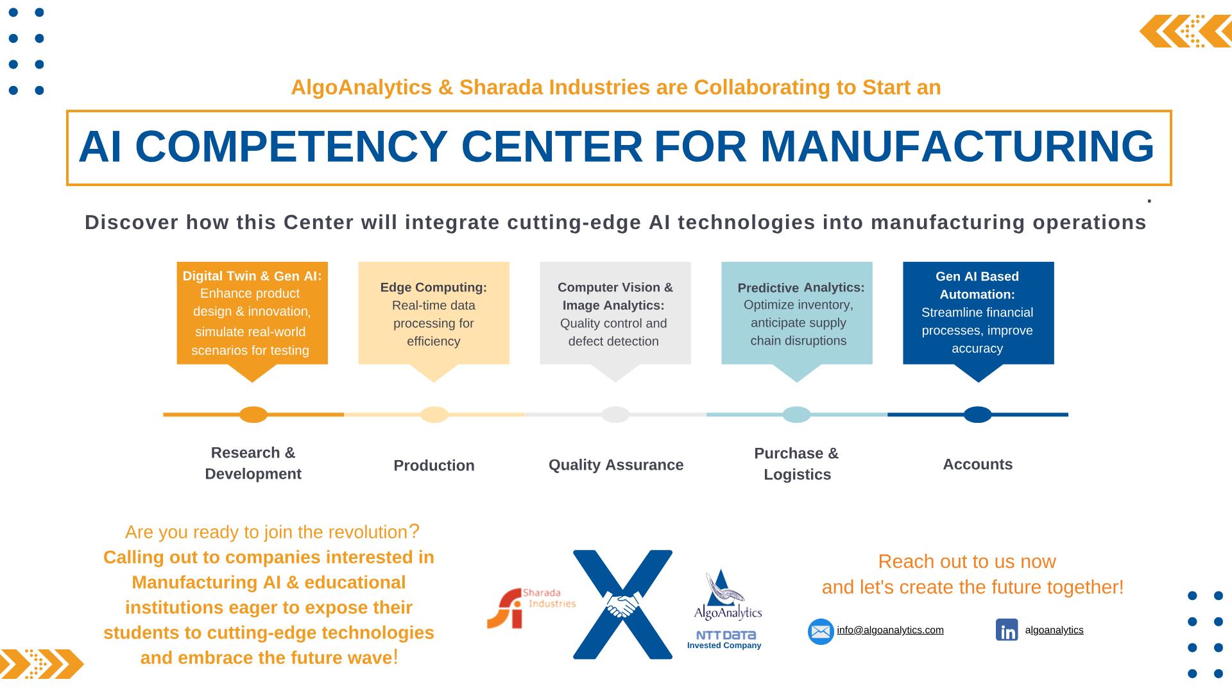
Business Value and Competitive Edge
▸ Provides a 360-degree view of investment opportunities with timely updates.
▸ Enhances decision-making through data-driven insights and AI-based recommendations.
▸ Empowers users to track market trends and corporate actions effectively.
6/6

