Slide 1
Our Work in Welding
Advanced AI Solutions for Manufacturing Excellence

Slide 2
AI-Driven Welding Solutions
KEY POINTS
▸ • Implementation of AI technology to enhance welding quality and efficiency.
▸ • Real-time monitoring of welding processes through advanced data analytics.
▸ • Utilization of sound analysis models to detect and classify welding defects.
🖼️
Visual Content
2/7

Slide 3
Data Collection for Quality Assurance
KEY POINTS
▸ • Systematic collection of welding data to log accurate sensor parameters.
▸ • Integration of multiple modalities: audio, video, and time-series data.
▸ • Automated data recording to ensure synchronization across various sensors.
🖼️
Visual Content
3/7

Slide 4
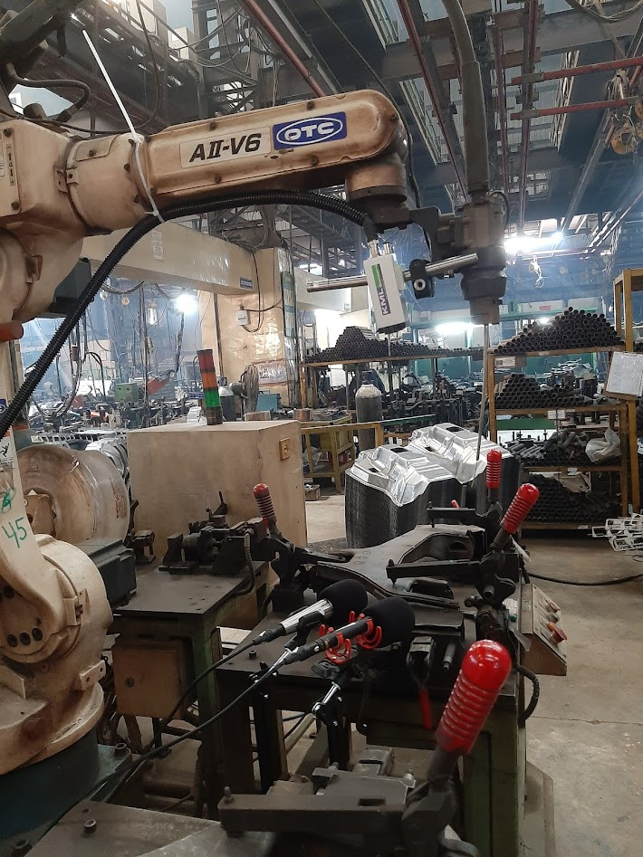
Experimental Setup and Configuration
KEY POINTS
▸ • Camera mounted on the welding robot for visual monitoring.
▸ • Microphones strategically placed to capture sound during the welding process.
▸ • Detailed setup ensures comprehensive data collection for analysis.
4/7

Slide 5
Dataset Requirements for Analysis
KEY POINTS
▸ • Dataset includes data from 4 modalities: audio, video, welding parameters, and photographs.
▸ • Minimum of 20 samples per defect type across 14 combinations of welding parameters.
▸ • Data must be time-synchronized for effective cross-analysis of welding activities.
🖼️
Visual Content
5/7

Slide 6
Classification and Documentation of Defects
KEY POINTS
▸ • Classification of welds into 'Good' and 'Defective' categories.
▸ • Natural language descriptions provided for each weld, detailing the creation process.
▸ • Supporting testing data included to confirm the presence of defects.
🖼️
Visual Content
6/7

Slide 7
Business Value and Future Directions
KEY POINTS
▸ • Enhanced quality control leads to reduced rework and increased customer satisfaction.
▸ • Data-driven insights facilitate continuous improvement in welding processes.
▸ • Future projects will expand on AI capabilities to further automate and optimize welding operations.
🖼️
Visual Content
7/7

